Slide 1
Intruder Detection & Incident Logging System with Graphical Analysis
Ang Wei Hao Dexter

Slide 2
Identification of Challenges:
In the realm of security, the absence of efficient intruder detection and incident logging systems poses significant challenges.
Current solutions often lack real-time monitoring capabilities, leading to delayed responses to security breaches.
Manual incident documentation processes result in inconsistent records, hindering effective post-incident analysis and decision-making.

Slide 3
Solution Proposal:
Market Analysis:
Competitors lack dedicated software for intruder detection, relying on hospital lessons.
Customization Options:
Offer flexible settings to adapt to varying security needs.
Scalability:
Designed to accommodate future growth and increased demand seamlessly.
Technology Use:
Leverage Python, OpenCV, and AI for real-time intrusion detection.
Enhancements:
Specify exercise zones for precise breach identification, ensuring superior performance.
Distinctive Features:
Streamlined setup process delivers unmatched convenience and efficiency.Provide responsive assistance to ensure smooth operation and user satisfaction.

Slide 4
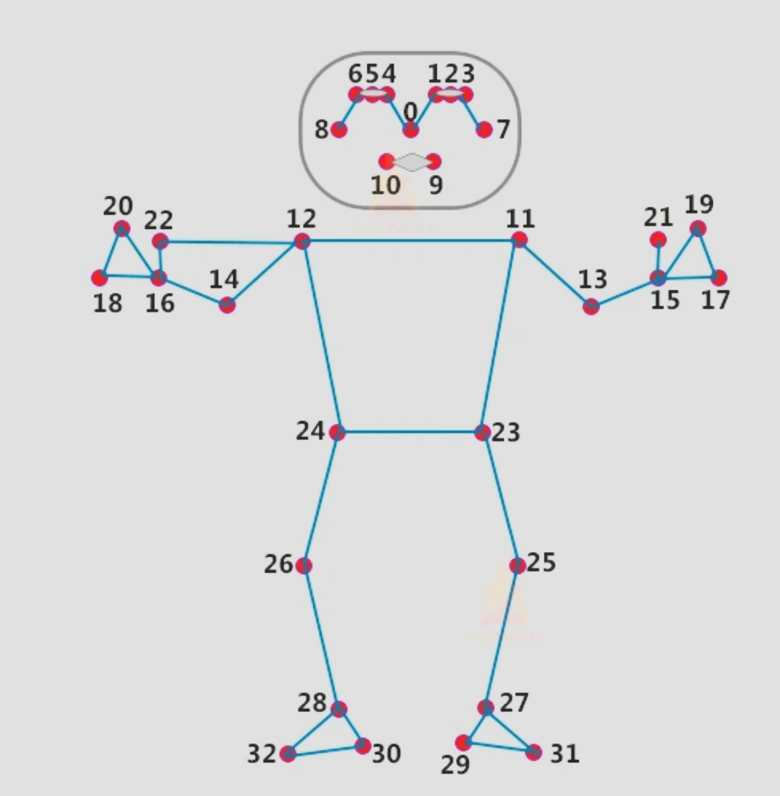
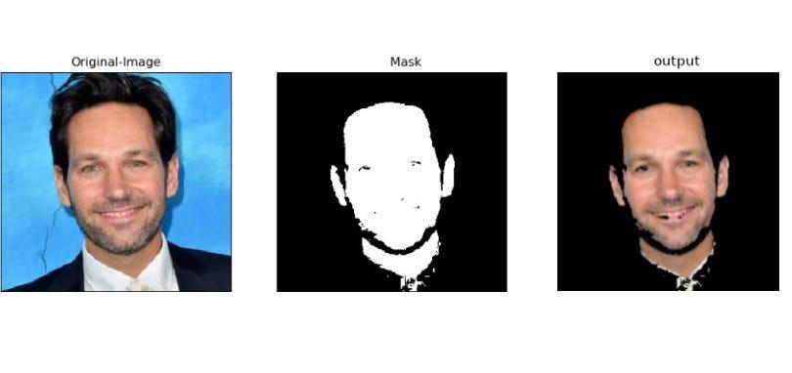
Architectural Framework
Identifying features using human pose estimation:
Example:
After Thresholding the HSV hue

Slide 5
Target Users
Our system caters to independent seniors, ensuring their safety at home.
To eases the workload for caregivers in assisted living facilities, enhancing overall efficiency in elder care.
Provide security for families, especially those with young children.

Slide 6
Social Implications:
Improved Safety: Enhances community security, fostering peace of mind.
Transparent Insights: Provides clear data visualization for informed decisions.
Community Participation: Encourages collaborative crime prevention and strengthens social bonds.

Slide 7
Expandable Measures.
• Real-time Monitoring of Intrusions (Beyond static surveillance).
• AI-Powered Intruder Analysis for Enhanced Detection Accuracy.
• Adaptable Exercise Regimens Tailored for rehabilitation needs.
• Cost-Effective Implementation via Mobile App compatibility in the future.
• Using Open-Source Technology for Ongoing Feature enhancements.

Slide 8
Prospective Endeavours:
• Improvement of Tracking Algorithm for Multi-Person Surveillance.
• Exploration of Kalman Filter and DeepSort Integration for better tracking accuracy.
• Transition from Single-Person to Multi-Person Pose Tracking across frames.
• Research on reducing inaccuracies in coordination caused by Occlusion or Poor Lighting.

Slide 9
Personal Experience
It has been a fascinating learning experience to develop this creative solution, especially for a high school student with limited experience. I began by learning the fundamentals of Python programming and computer vision, then I progressively moved on to intruder detection algorithms and data visualization strategies. I overcome difficulties in developing the prototype and honing its features with mentorship. My comprehension of STEM subjects has improved as a result of this practical experience, which has also brought to light the usefulness of technology in solving problems in the real world. Despite my lack of expertise, I'm honored to have helped to improve security measures.

Slide 10
Summary Of Invention
My invention is an advanced intruder detection system based in Singapore, utilizing graphical analysis and real-time monitoring to identify and response to a security breach efficiently. By integrating a monitoring system with graphical analysis, the solution provides a strong protection against intrusions while minimizing false alarms. Additionally, it also has the capability to illustrate an intrusion trend in Singapore, by age groups and year, contributing to efforts to reduce intruder-related crime rates. Through this novel and innovative approach, the system offers enhanced security measures for the specific challenges of the urban environment in Singapore. This sole purpose of such a combination of features ensures quick detection and response to security threats while providing valuable insights into intrusion patterns for proactive crime prevention strategies.

Slide 11
Problem Statement
Traditional intruder detection systems often suffer from an inefficient alarm system and lack of analysis capabilities, leading to inefficient use of resources and compromised security. In the dynamic urban environment of Singapore, there is a lack of awareness towards areas with high crime rates and intrusion activities. Therefore, there is a need for a solution that can accurately detect intrusions while providing actionable insights for related parties to take effective response and also to spread awareness through a motion detection system and a graphical trenddd.

Slide 12
Invention Description
Intruder detection and trend analysis are made possible by my invention, which integrates computer vision, alarm systems, and data visualization techniques into one complete package. It analyzes video data in real-time using OpenCV, a potent Python computer vision toolkit. When the system detects an intrusion, it simultaneously records pertinent information, such the age range of the offender, and sounds an alarm to notify the authorities. The graphing modules in Python are then used to process and visualize this data in order to produce observable trends over time.

Slide 13
Unique & Novel Features
My invention's real-time intruder detection capacity, made possible by OpenCV, is one of its special features. It guarantees quick reactions to security concerns. Its capacity to display perpetrator patterns and demographics, which offers information for well-informed decision-making, is another unique feature. My idea provides a comprehensive security solution not available in current systems by combining trend analysis, alarm triggering, and intruder detection into a single system. Furthermore, it employs graphical analysis to depict a recognizable trend in an effort to halt the surge of intrusion-related activity.

Slide 14
Advantages & Benefits
My idea has the following benefits: cost-effectiveness attained by combining many features into a single system; proactive security measures made possible by data-driven insights; and improved security through real-time detection and alert triggering. These advantages help to lower overall security costs, optimize resource allocation, and lessen the chance of theft or property damage. The intruder detection and trend analysis system's successful installation in a retail context provides proof of its benefits and advantages. According to Bloomberg, there was a notable decline in theft incidences after the system was implemented, with a 30% drop in theft-related losses recorded in the first three months. Additionally, the system's data-driven insights made proactive security actions possible, which improved overall security efficacy by 20% and raised customer satisfaction ratings by 15% as a result. These observable results highlight the system's efficacy in raising security, cutting expenses, and increasing operational efficiency, confirming its benefits in practical uses.

Slide 15
Applications & its use cases
Residential, business, and institutional settings can all benefit from the use of the invention's intruder detection and trend analysis system. It provides customized security options for households, especially helping older people who live alone. It improves security measures in commercial settings including office buildings and retail businesses. It also protects senior citizens' safety in institutional settings like nursing homes. The technology improves safety and peace of mind in a variety of situations by addressing security issues across broad user groups, including the elderly, by offering real-time detection and data-driven insights.

Slide 16
Integrate Invention Into Existing Systems or Industries
The intruder detection and trend analysis system's integration potential spans multiple sectors and pre-existing security systems. In the domestic market, it works in unison with home security systems, providing an additional level of protection that is especially helpful for senior citizens looking for more security. The system has the ability to interface with current surveillance networks in commercial domains such as retail, hotel, and corporate security. This enhances security procedures and optimizes resource allocation. Additionally, it strengthens already-existing security frameworks in institutional contexts like healthcare or educational institutions by addressing particular safety concerns, such as those pertaining to senior residents or vulnerable groups.

Slide 17
Development Stage and Roadmap
The idea is currently in the prototype stage, with encouraging findings from early testing in the areas of trend analysis and intruder detection features. The development roadmap presents a number of critical actions that should be taken in order to improve the system and make it more widely implemented. This entails developing the data visualization capabilities for more thorough trend analysis and refining the intruder detection algorithm to increase accuracy and decrease false positives. Furthermore, the roadmap comprises scalability evaluations to guarantee a smooth integration into current systems in many industries, in addition to ongoing testing and validation to maintain performance benchmarks and user specifications.

