Slide 1
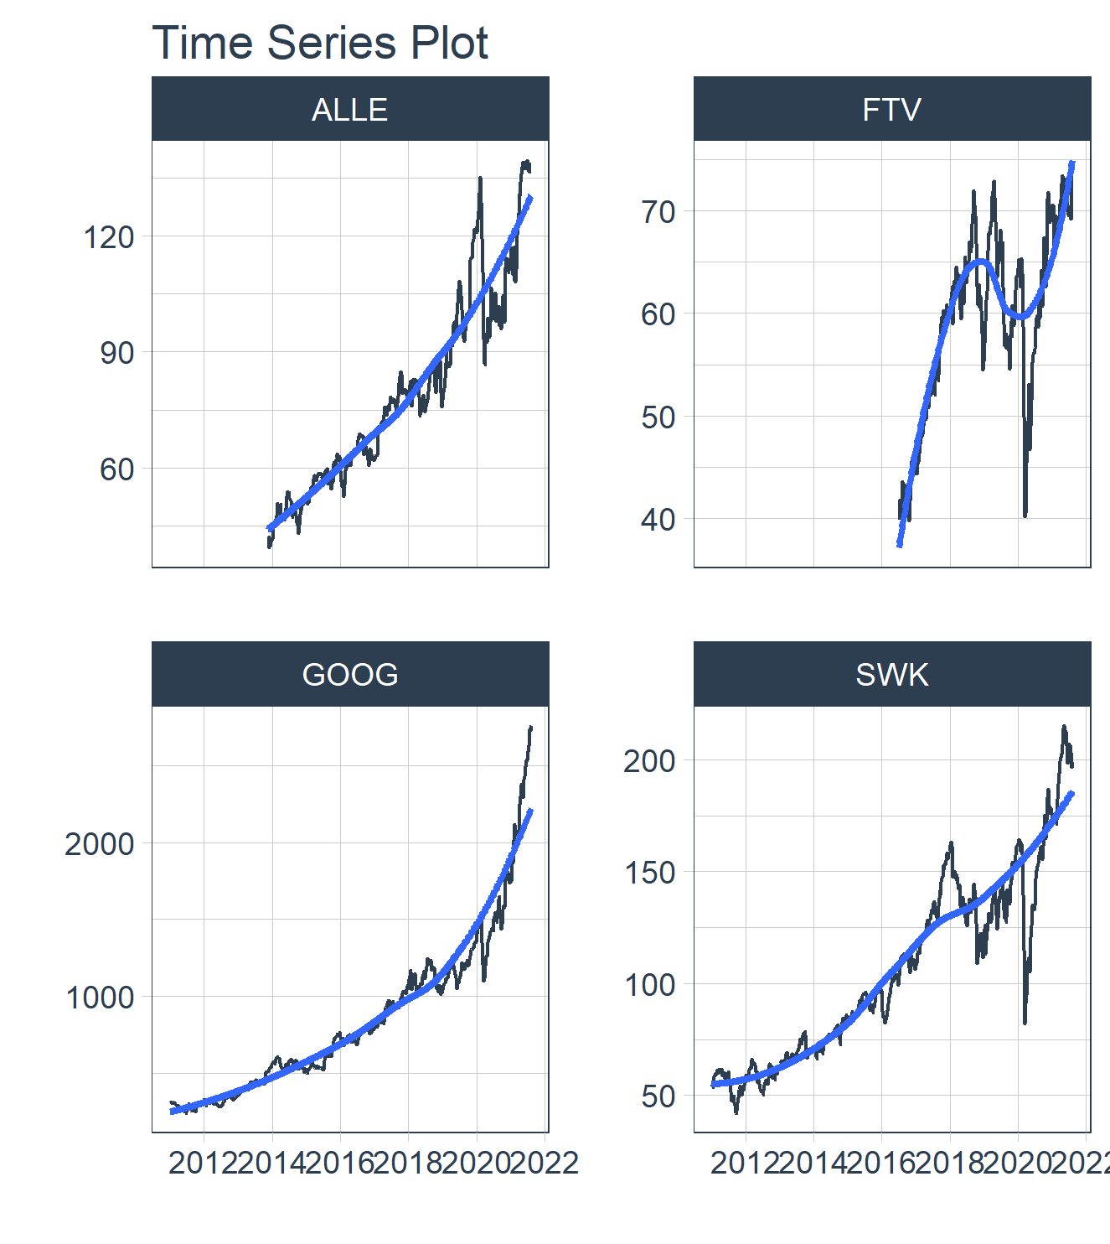
stock report
Symbol | Week | Month | Quarter | Year | All
ALLE | 1.20% | -2.22% | 4.6% | 202% | 202%
FTV | 2.73% | 7.11% | 6.0% | 90% | 90%
GOOG | 1.74% | 9.51% | 23.0% | 819% | 819%
SWK | 2.96% | -2.74% | 0.6% | 267% | 267%

