Slide 1
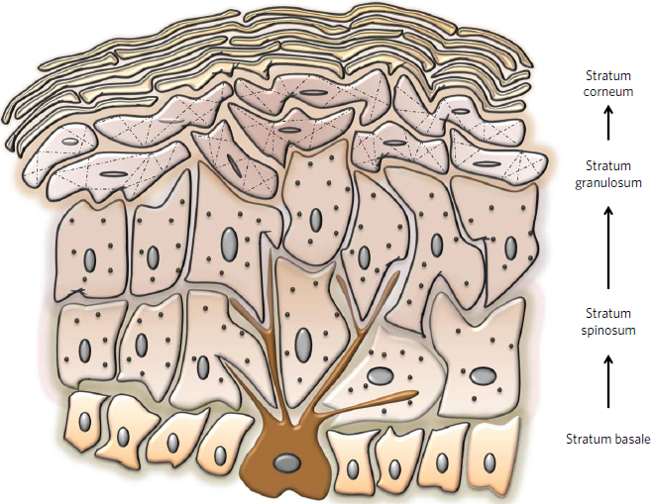
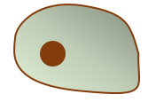
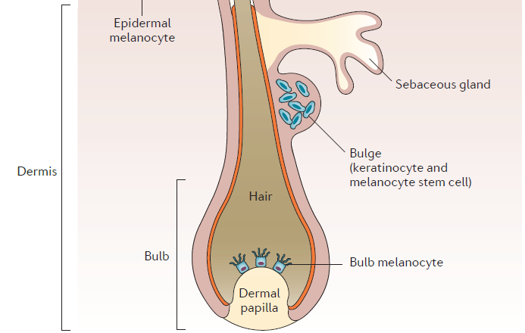
Development
Function
Neural Crest is a transient multipotent population which splinch off from the neural tube during development
Multipotent Neural Crest Cells
Mature Melanocyte
Immature Melanocyte
Committed Melanocyte Stem Cell

