Slide 1
Hive: Data Organization for Performance
Gopal Vijayaraghavan

Slide 2
In this episode
Data navigation?
All BigData problems are primarily lookup problems
All Lookup problems are really Storage problems
All Storage problems turn into ETL problems
Data organization?
Data ingestion?
ETL problems are all about the Data
It’s Big?

Slide 3
Good idea: Do things that scale!
There are many problems like this, but this one is mine

Slide 4
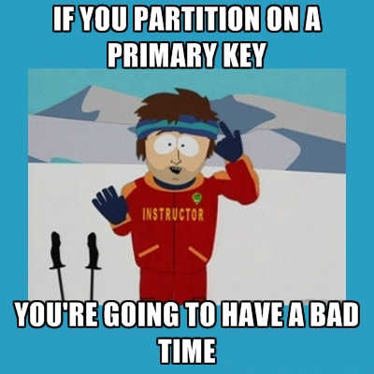
Partitions
If you have a database on cars and you partition on VIN#
If you have a database on sales and you partition on customer_id
Rule of thumb: Average partition is >=1Gb and total # of partitions per query <1000

Slide 5

Buckets
If you have more files than rows, you’ve definitely got bucketing wrong
“clustered by” != “cluster by”
Bucketing on a skewed column slows down ETL a *lot* (for no win)
If you have partitions, sort-merge bucket-mapjoin can be slower than a shuffle!!

Slide 6


Buckets - II
Histograms!
select explode(histogram_numeric(
hash(<col>)% <n-bucket>, <n-bucket>
)) as h from table;
The Curse of 31 & the last byte
If you have buckets & partitions, always remember to ETL with
set hive.optimize.sort.dynamic.partition=true;

Slide 7

Denormalization
Denormalization can turn a compute problem into an IO/lookup problem.
But if you then optimize that with compression, you get a compute problem again.
If you think JOINs are bad, you probably haven’t moved out of MapReduce.
Broadcast joins are good & dynamically partitioned broadcast joins can scale that ~1000x

Slide 8

Indexes?
Indexes in hive barely help in a columnar world – incremental rebuild isn’t really there
ORC maintains internal bloom filter indexes (PARQUET-41 too)
You can store your indexes as ORC files, if you want, so that you can have an index in your index, to speedup indexes

Slide 9

Schema & Predicate Push Down
Never store a Number as a string, because guess what “11” < “9” and “11.0” != “11” – transform, then load
Predicate push-down cannot fight the type system (♫ … breaking blocks in the hot sun ♫)
UDFs applied on the data column is always a bad idea for fast filtering.
If you need case-insensitive lookups, always store as UPPER/lower.
If you need LIKE “%.twimg.com”, store like DNS does “.com.twimg…”

Slide 10

Temporary tables
In-memory temp-tables
set hive.exec.temporary.table.storage=memory;
Easiest way to reorganize data temporarily or to produce a “distinct slice”
“create temporary table if not exists stored as orc as select …”
Can be used for pagination queries to good effect, for display tools

Slide 11

Complex types & Nesting
There’s pretty much no advantage to using structs – they’re nearly columns, without any of the good stuff
Maps – not so bad, but handle with care
Maps are way better than 4000 columns, most of them null
Arrays – ignore mostly
(JDBC!!)

Slide 12

Schema Evolution
Add columns, never remove them
Schemas are per-partition
Remember, the partitions don’t change their schema after they’re created
All new inserts have new schema
After schema update, inserting data into old partitions is a recipe for disaster
Type changes for a column also complicate things (except for simple stuff like Int -> BigInt or Float -> Double)

Slide 13

Questions?
?

