Slide 1
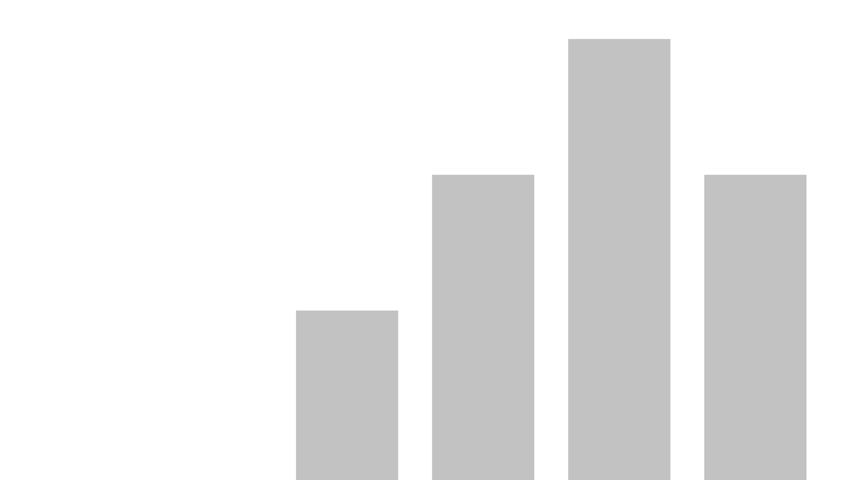


OPS Crime Insights
View in Power BI
Last data refresh:
11/20/2025 2:11:06 PM UTC
Downloaded at:
11/20/2025 2:19:11 PM UTC

Slide 2
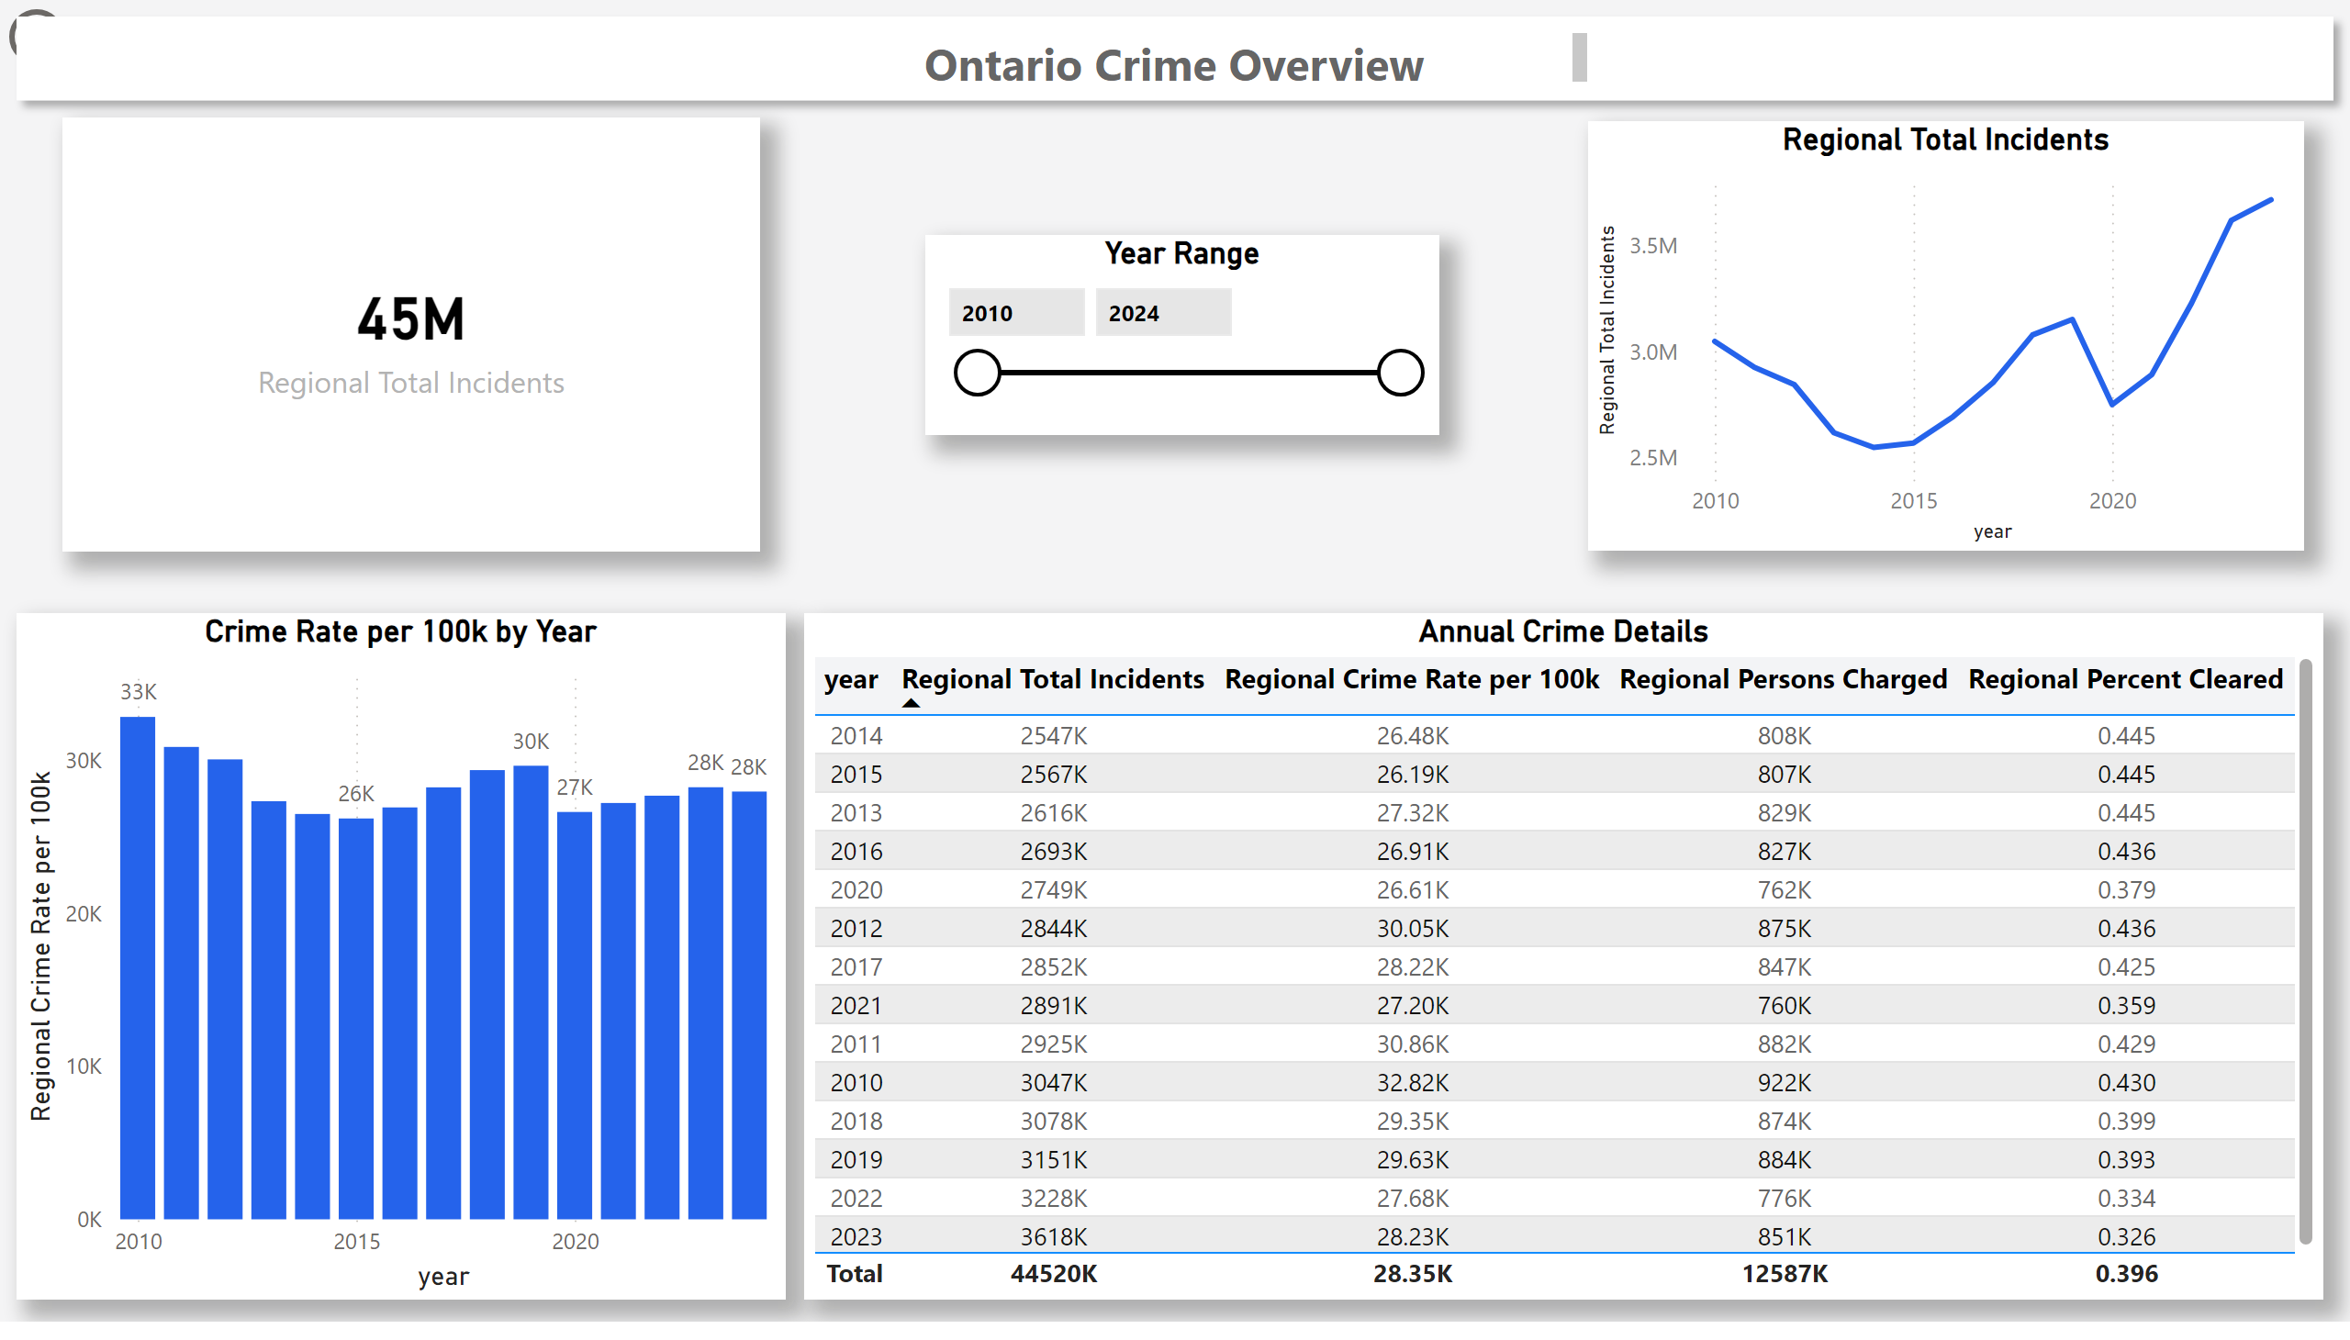
Dashboard
Notes:
card
No alt text provided
Regional Total Incidents
No alt text provided
Crime Rate per 100k by Year
No alt text provided
Annual Crime Details
No alt text provided
actionButton
No alt text provided
Year Range
No alt text provided
textbox
No alt text provided
shape
No alt text provided

Slide 3
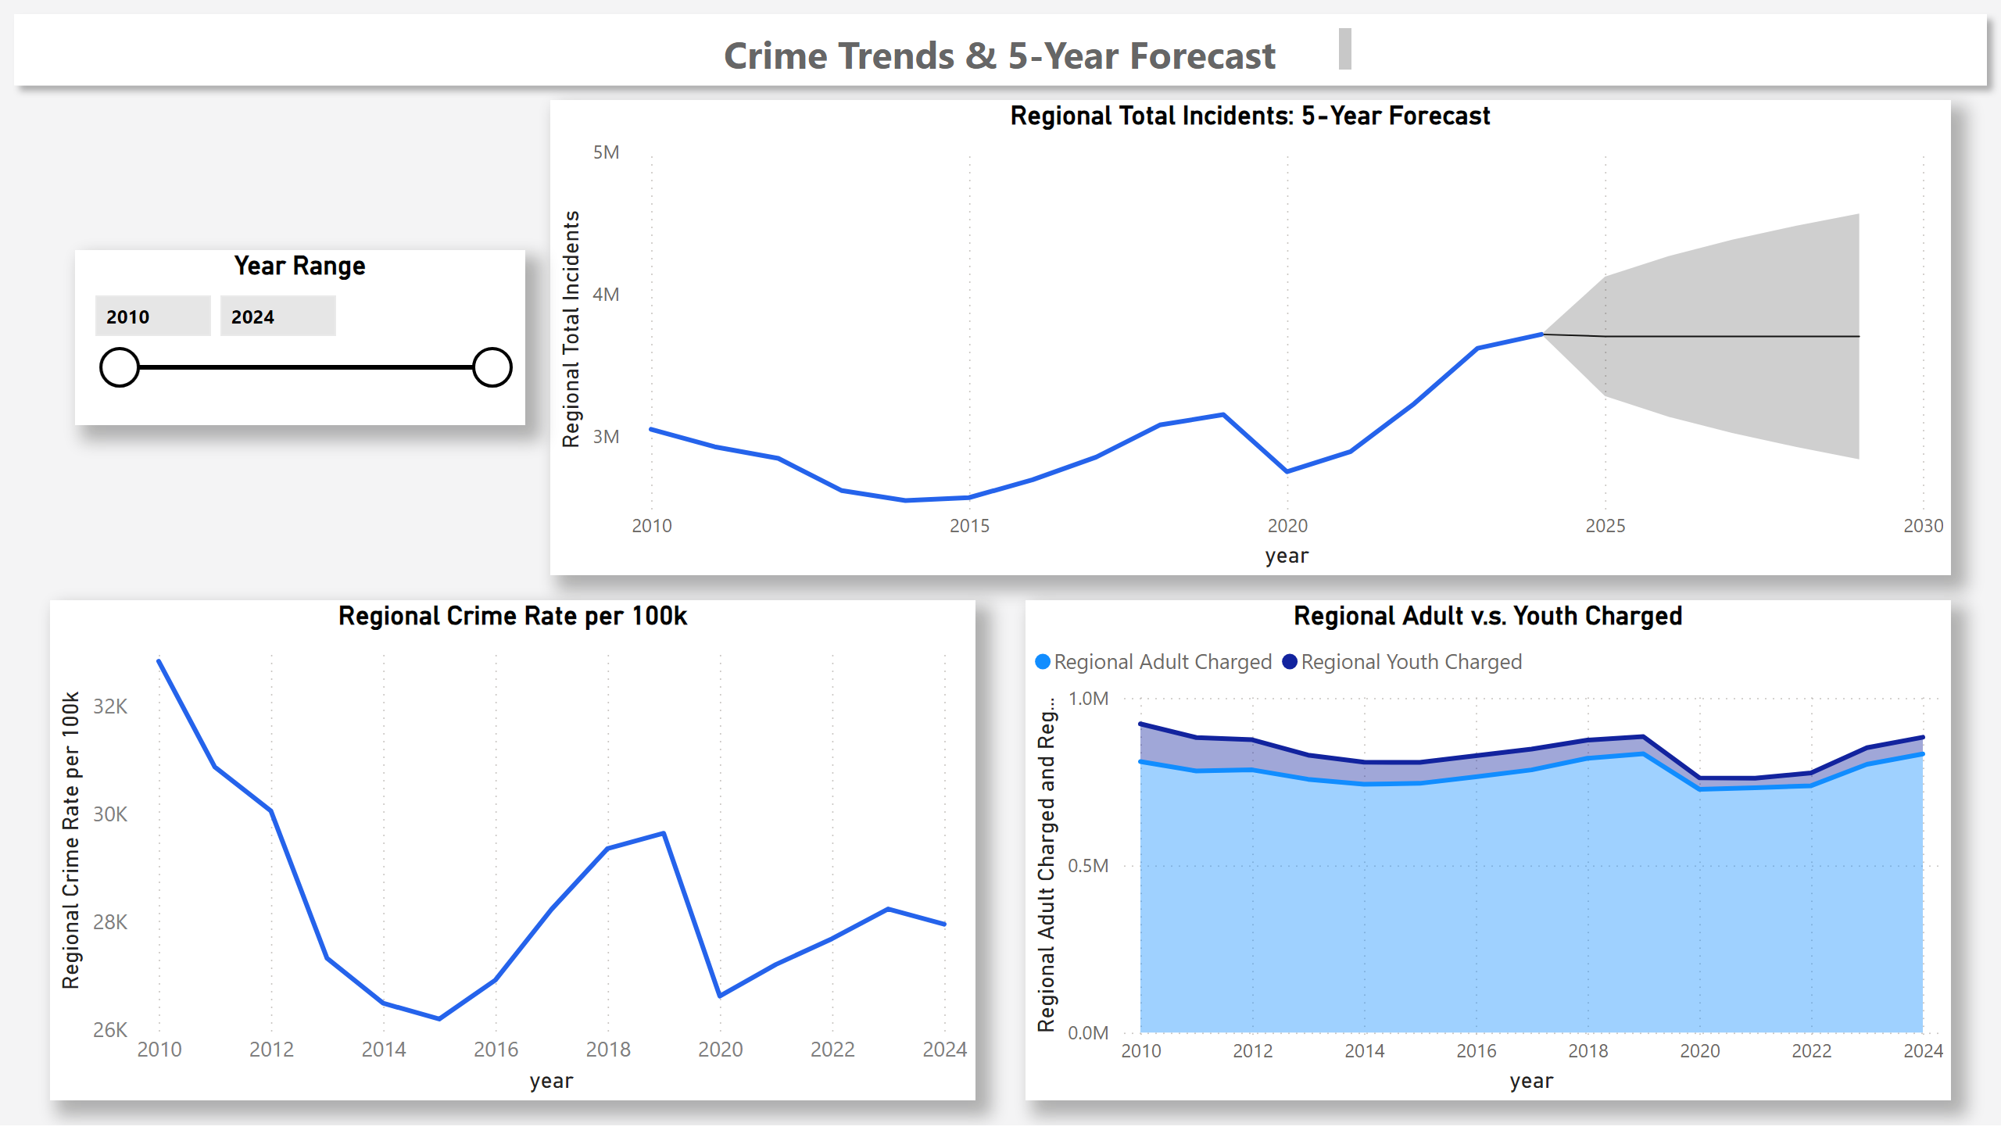
Trends + Forecast
Notes:
Regional Total Incidents: 5-Year Forecast
No alt text provided
Regional Adult v.s. Youth Charged
No alt text provided
Year Range
No alt text provided
Regional Crime Rate per 100k
No alt text provided
shape
No alt text provided
textbox
No alt text provided

Slide 4
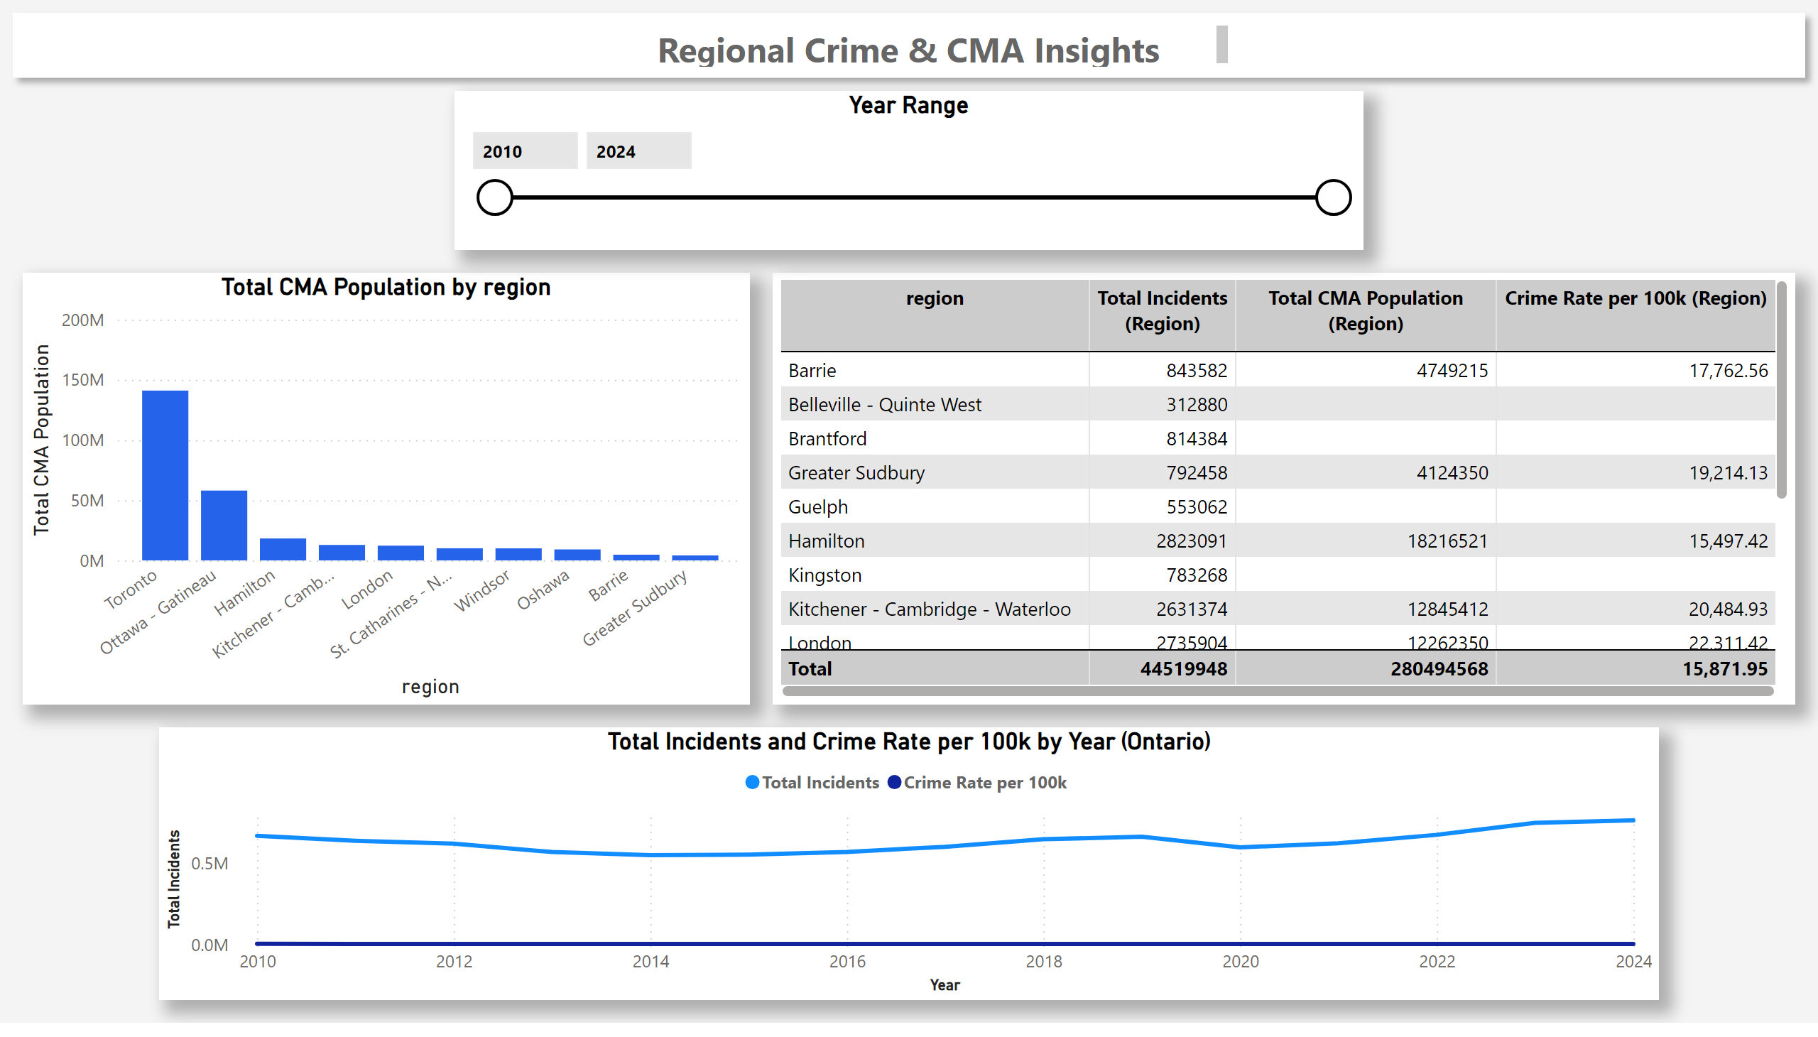
Regions & CMA
Notes:
Total Incidents and Crime Rate per 100k by Year (Ontario)
No alt text provided
tableEx
No alt text provided
clusteredColumnChart
No alt text provided
shape
No alt text provided
textbox
No alt text provided
Year Range
No alt text provided

Slide 5
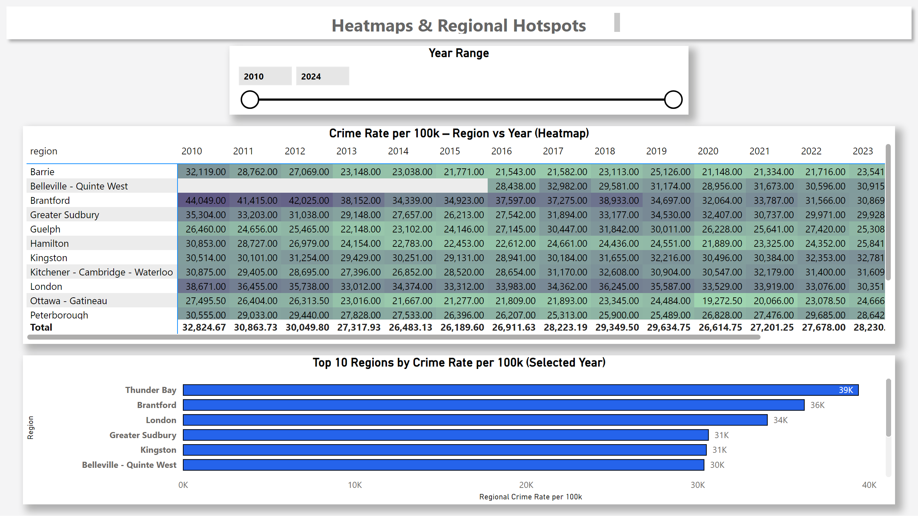
Heatmaps & Regions
Notes:
Year Range
No alt text provided
textbox
No alt text provided
shape
No alt text provided
Crime Rate per 100k – Region vs Year (Heatmap)
No alt text provided
Top 10 Regions by Crime Rate per 100k (Selected Year)
No alt text provided

Slide 6
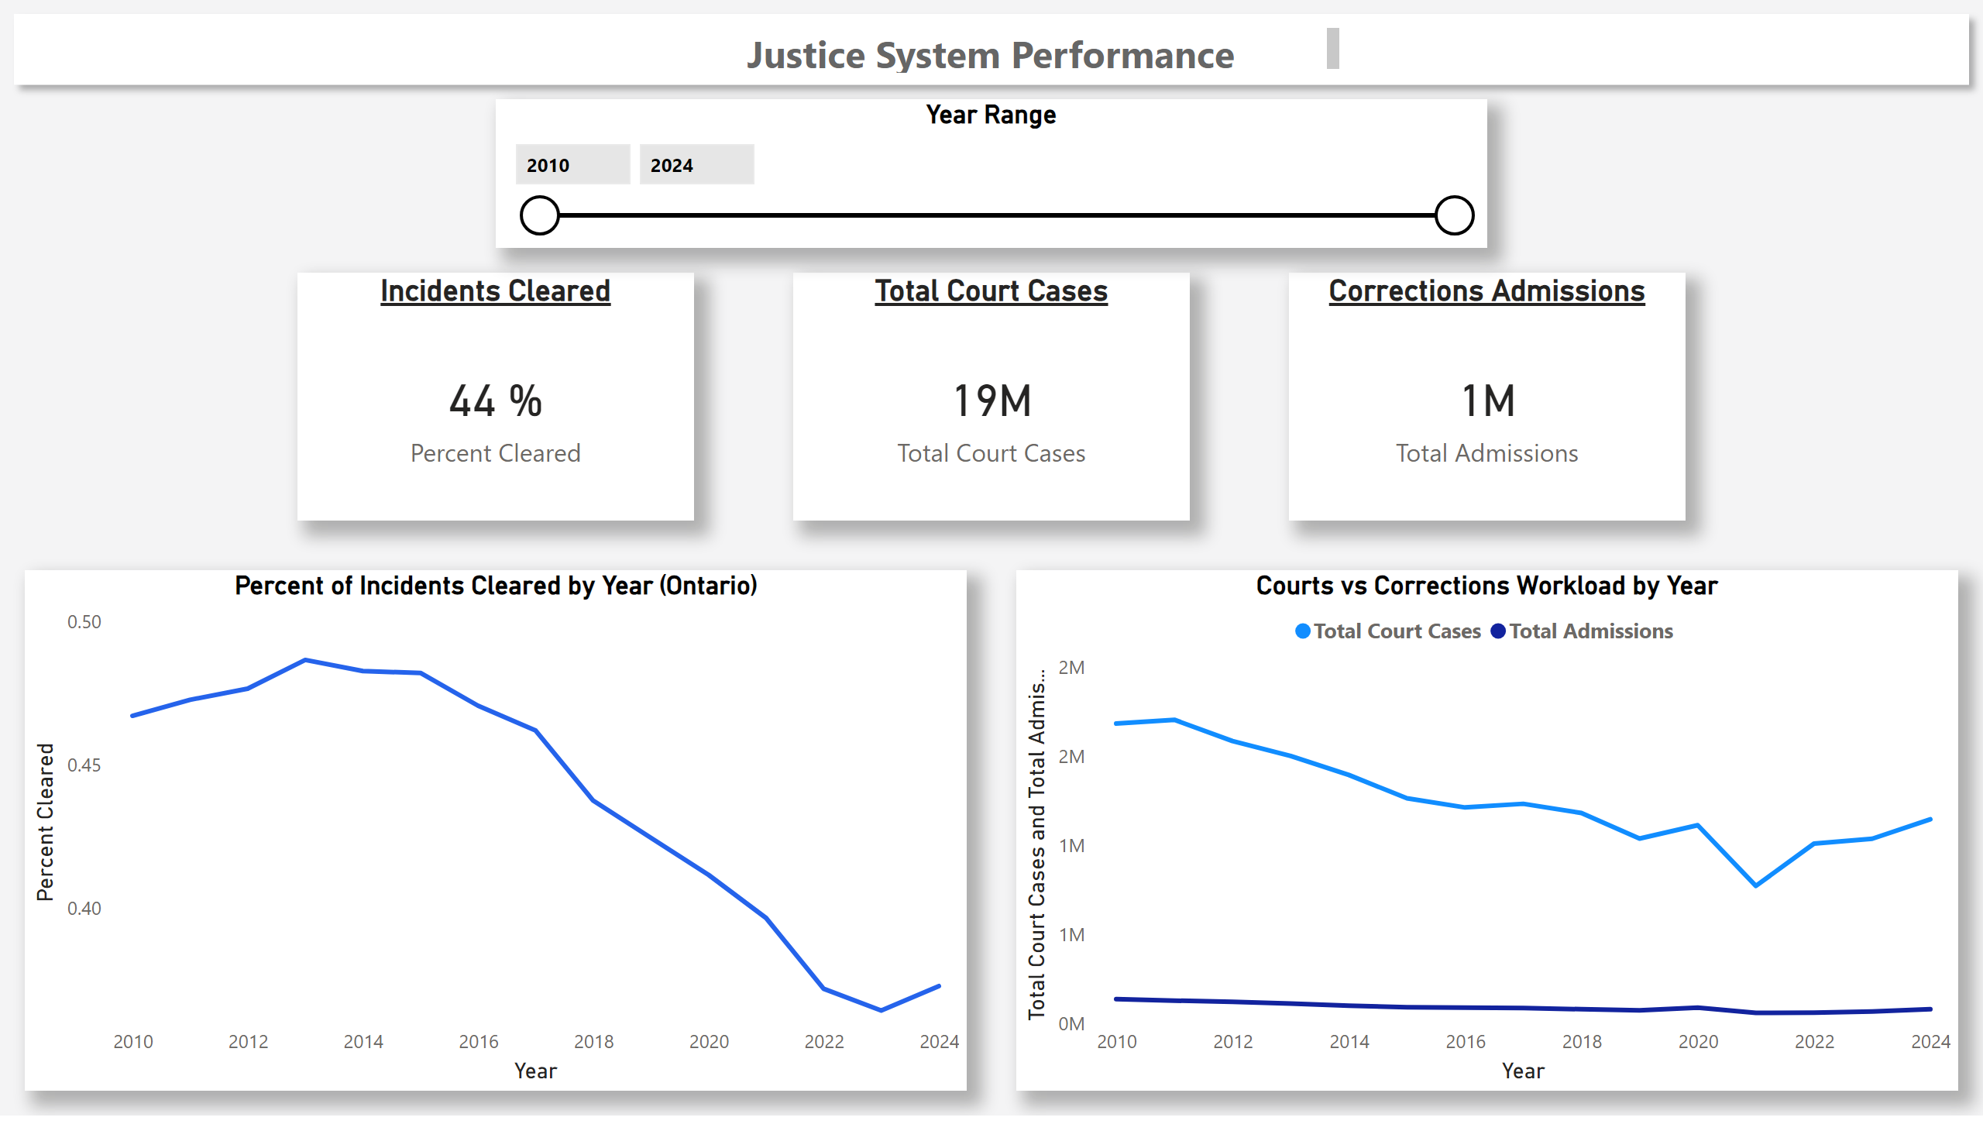
Justice System Performance
Notes:
Year Range
No alt text provided
Corrections Admissions
No alt text provided
Total Court Cases
No alt text provided
Incidents Cleared
No alt text provided
shape
No alt text provided
textbox
No alt text provided
Courts vs Corrections Workload by Year
No alt text provided
Percent of Incidents Cleared by Year (Ontario)
No alt text provided

Slide 7
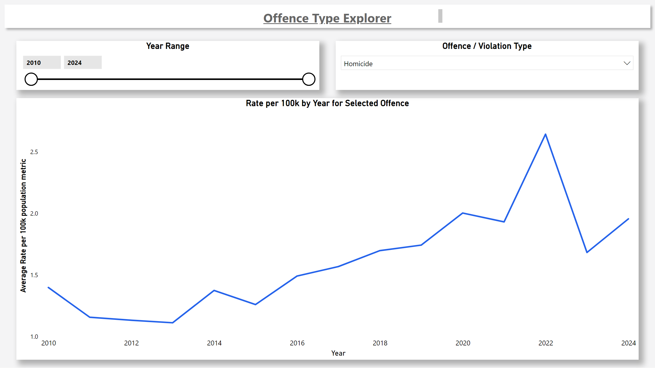
Offence Type Explorer
Notes:
Rate per 100k by Year for Selected Offence
No alt text provided
textbox
No alt text provided
shape
No alt text provided
Year Range
No alt text provided
Offence / Violation Type
No alt text provided

