Slide 1

Usage of artificial neural networks on skin cancer detection MACHINE LEARNING AND CONTENT ANALYTICS MSC IN BUSINESS ANALYTICS ATHENS UNIVERSITY OF ECONOMICS AND BUSINESS

Slide 2
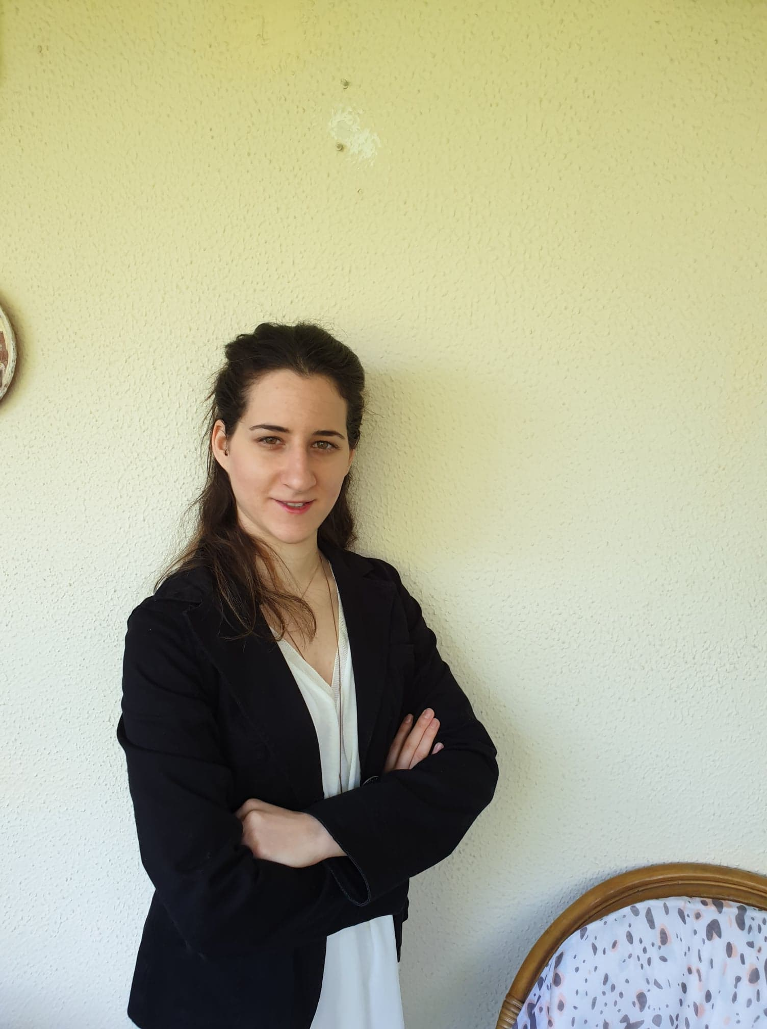

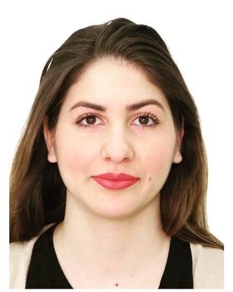

About us
Vasiliki Karamesiou
Business Analyst BSc in Economics
Evangelos Kontaratos Data Engineer / DevOps BSc in Computer Science
Erasmia Kornelatou Data Engineer / DevOps BSc in Computer Science
Christos Schismenos Business Analyst BSc in Economics and Regional
Development

Slide 3
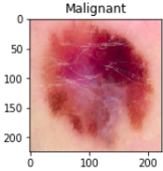
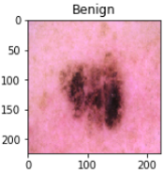
Mission
We are interested in classifying images containing tumors into benign (non-concerning ones)
and malignant (concerning ones) by using artificial neural network models.

Slide 4
Data
Dataset included
3297 images, showing 1800 images of benign and 1497 images of malignant cutaneous tumors
 | Train set | Validation set | Test set
Images | 9233 | 1283 | 2671
Division of training, validating & evaluating
train set, which consists the 70% of the data set
validation set, which consists of 10% of the data set (used to rectify the model’s parameters - such as weights- during its training)
test set, which consists of 20% of the data set (used without its ground truth labels, letting the model decide how to classify the image)

Slide 5
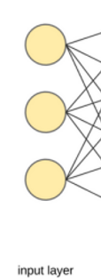
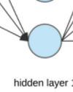
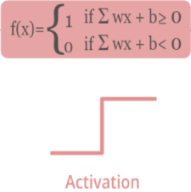

Multilayer Perceptron (MLP)
Input
neurons
Layers
2 dense neurons (sub-) layers
in the hidden layer each of them
consisting of 512 neurons
Activations Functions
18 epochs with ReLU
Output
softmax function

Slide 6


Convolutional Neural Network (CNN)
Layers
3 convolutional layers each of them consisting of 32 filters of 5x5 dimensionality.
1 dense (i.e. fully connected) layer consisting of 512 neurons.
Activation Function
40 epochs with ReLU
Output
softmax function
Image
A view of the convolutional neural network

Slide 7
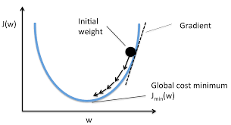
Stochastic Gradient Descent (SGD)
Scope: Given a minimization problem the algorithm tries to locate a (local) minimum by following the descent course of objective function’s gradient.
Algorithm stops when the gradient’s slope becomes positive (min passed).
Why called stochastic? Because it uses (randomly chosen) batches.

Slide 8
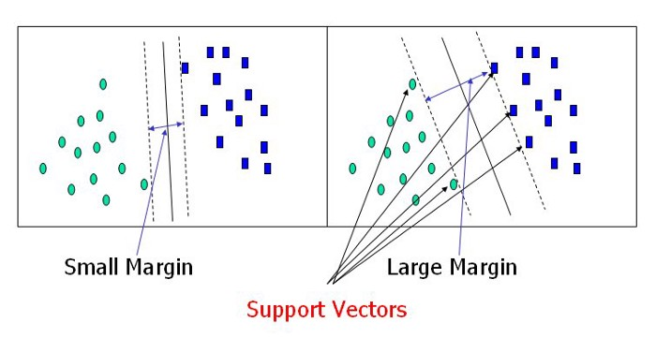
Support Vector Machine (SVM)
In SVM algorithm, there is not any correction by the validation set as it is performed in neural networks. The validation set was used for inspecting model’s accuracy during its training epochs. We created a Support Vector Machine model with an rbf kernel.

Slide 9
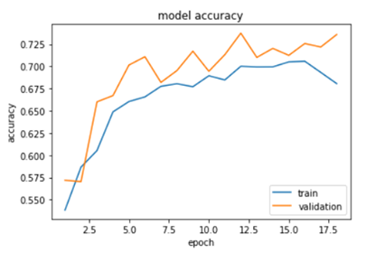
Results MLP
It is deduced that the 86% of (totally 1492) benign images and the 67% of (totally 1179) malignant images were classified correctly by the MLP model. Moreover, the model’s accuracy on test set was 75%.
 |  | true
 |  | benign | malignant
predicted as | benign | 987 | 157
 | malignant | 505 | 1022

Slide 10
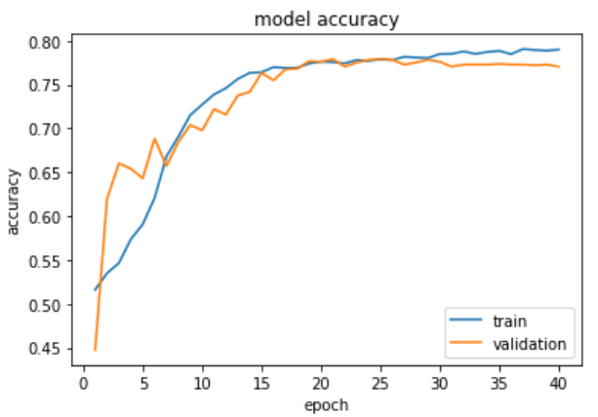
Results CNN
It is deduced that the 94% of benign images and the 69% of malignant images were classified correctly. Moreover, the model’s accuracy on test set was 79%.
 |  | true
 |  | benign | malignant
predicted as | benign | 987 | 66
 | malignant | 505 | 1113

Slide 11
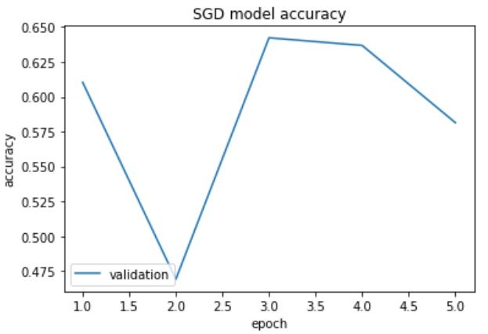
Results SGD
It is deduced that the 57% of benign images and the 65% of malignant images were classified correctly. Moreover, the model’s accuracy on test set was 57.73%.
 |  | true
 |  | benign | malignant
predicted as | benign | 1432 | 1069
 | malignant | 60 | 110

Slide 12
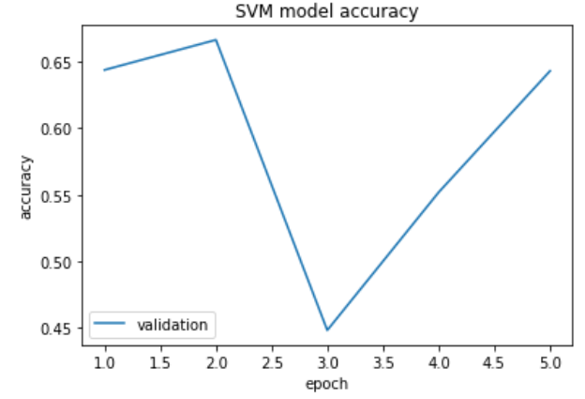
Results SVM
It is deduced that the 84% of benign images and the 56% of malignant images were classified correctly. Moreover, the model’s accuracy on test set was 64% (the highest recorded among the models that we tried).
 |  | true
 |  | benign | malignant
predicted as | benign | 663 | 122
 | malignant | 829 | 1057

Slide 13
Conclusion
 | MLP | CNN | SGD | SVM
Neurons (MLP); filter size (CNN) | (512, 512) | (32,32,32) | N/A | N/A
# Layers | 3 (3 neuronics) | 3 (2 conv + 1 neur) | N/A | N/A
# Epochs | 18 | 40 | 5 | 5
Mean Epoch duration (s) | 218 | 862 | 243 | 609
Accuracy (%) | 75 | 79 | 58 | 64
Convolutional NN needed a lot of time to be trained.
This was due to the convolutional layers that were applying filters to the image. On the other hand, the Perceptron model needed the least mean time per epoch to be trained.
% | MLP | CNN | SGD | SVM
valid accuracy | 74 | 78 | 64 | 66
test accuracy | 75 | 79 | 58 | 64
The models MLP, CNN achieved around 77% accuracy whereas the SGD and SVM achieved around 61 % accuracy.
As a concluding remark, we used the method “Early Stopping” on our neural networks in order to decide the number of epochs and prevent from overfitting.

Slide 14
THANK YOU
FOR YOUR ATTENTION!

