Slide 1

Usage of artificial neural networks on skin cancer detection
Machine Learning and Content Analytics
MSc in business analytics
Athens university of economics and business

Slide 2
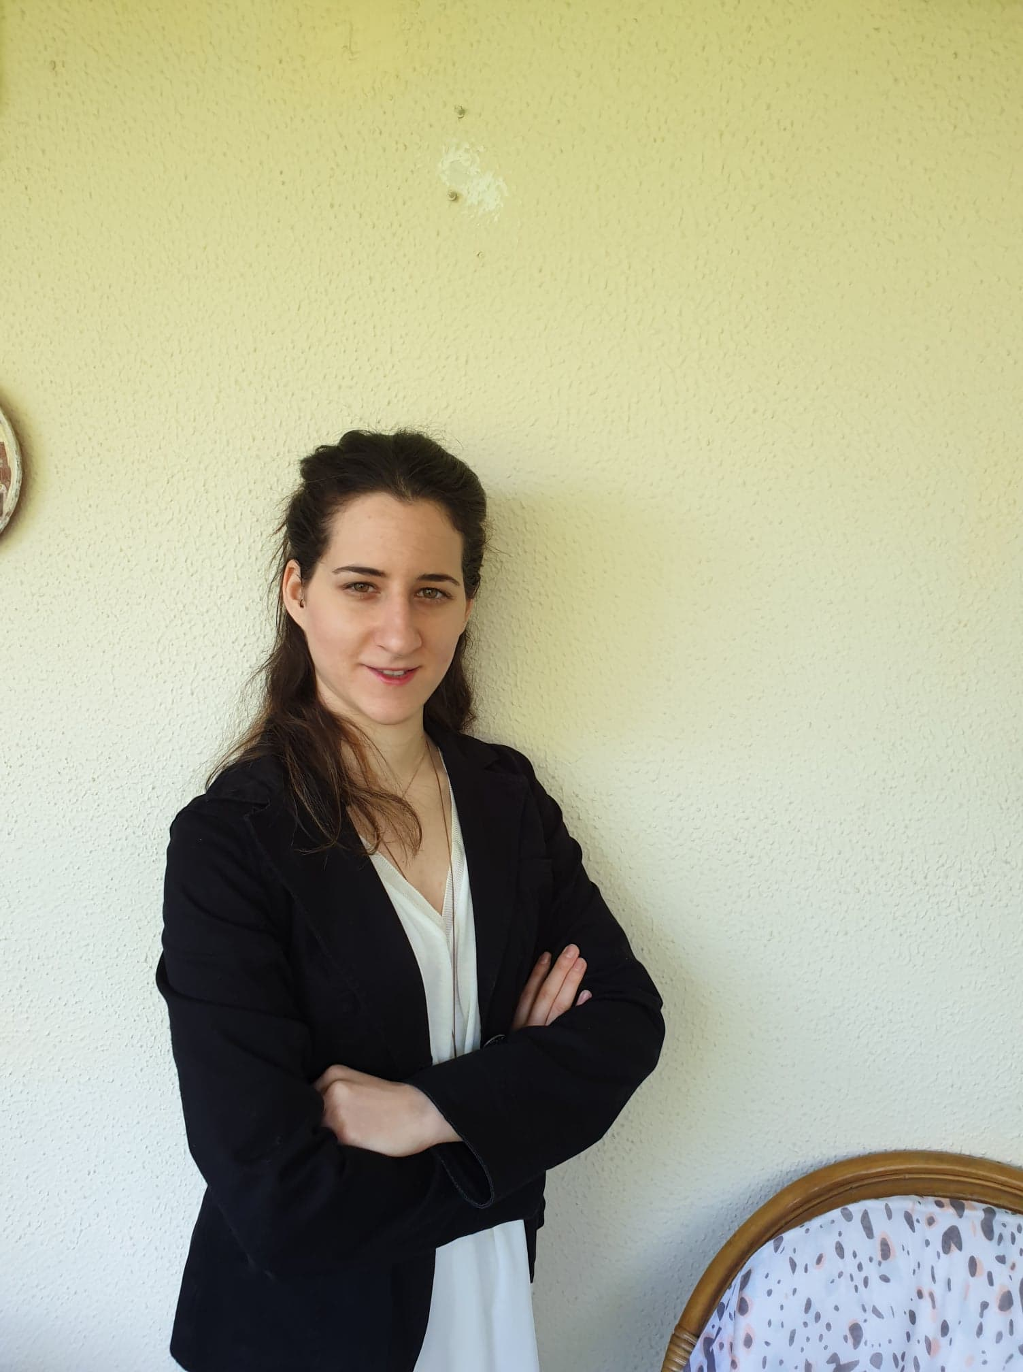

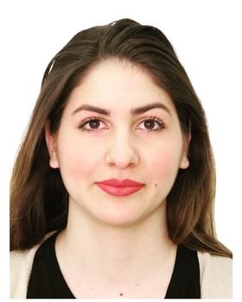

About us
Vasiliki Karamesiou
Business Analyst BSc in Economics
Evangelos Kontaratos Data Engineer / DevOps BSc in Computer Science
Erasmia Kornelatou Data Engineer / DevOps BSc in Computer Science
Christos Schismenos Business Analyst BSc in Economics and Regional
Development

Slide 3
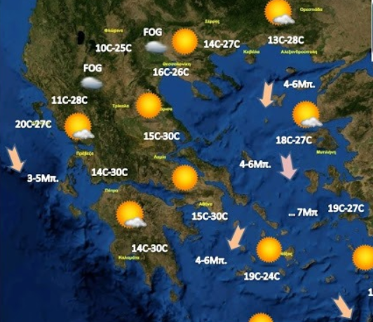

Mission

Slide 4
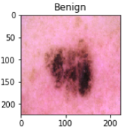
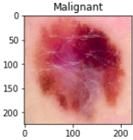
Mission
We are interested in classifying images containing tumors into benign (non-concerning ones)
and malignant (concerning ones) using artificial neural network models.

Slide 5
Data
Dataset includes
3297 images, showing 1800 images of benign and 1497 images of malignant cutaneous tumors.
 | Train set | Validation set | Test set
Images after augmentation | 9233 | 1283 | 2671
Purposes of training, validating & evaluating
train set, which consists of 70% of the data set,
validation set, which consists of 10% of the data set (used to rectify the model’s parameters -such as weights- during its training) and
test set, which consists of 20% of the data set (used without its ground truth labels, letting the model decide how to classify the image).

Slide 6

Models
MultiLayer Perceptron (MLP)
Convolutional Neural Network (CNN)
Stochastic Gradient Descent (SDG)
Support Vector Machines (SVM)

Slide 7
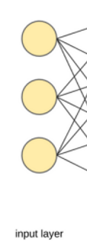
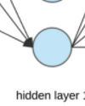

MultiLayer Perceptron (MLP)
Input Layer
(256*256*3)
196608 neurons
Flatten
Hidden Layer
2 dense neurons (sub-) layers
in the hidden layer each of them
consisting of 512 neurons
ReLU Activation Function
Dropout 0.5
Output Layer
2 classes
softmax activation function
18 epochs (early stopping)
Optimizer with Learning Rate 1e-5
Binary Cross Entropy for Loss Estimation

Slide 8




Convolutional Neural Network (CNN)
Input
(256*256*3)
196.608 neurons
Layer
3 Convolutional Layers 2D
32 Filters
Maxpooling 2D 5x5
Dropout 0.25
1 Dense Layer consisting of 512 neurons (MLP)
Flatten
Activation Function
ReLU Activation Function
Softmax Activation Function
Optimizer
Optimizer with Learning Rate 1e-5
Binary Cross Entropy for Loss Estimation
40 epochs (early stopping)
ModelCheckpoint for saving the weights of the model

Slide 9
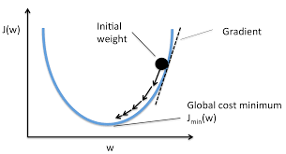
Stochastic Gradient Descent (SGD)
Scope: Given a minimization problem the algorithm tries to locate a (local) minimum by following the descent course of objective function’s gradient.
Algorithm stops when the gradient’s slope becomes positive (min passed).
Why called stochastic? Because it uses (randomly chosen) batches.

Slide 10
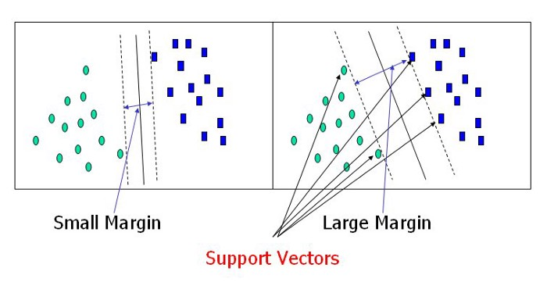
Support Vector Machine (SVM)
We implemented the Support Vector Machine with rbf kernel. The goal of SVM, since we are talking about two-dimensional space, is to define a line capable of sorting a sample with n characteristics. The dimension of the line is smaller than that of the surrounding area. Once we sort our data, there can be an infinite number of rows that achieve the same (desired) sort. The SVM algorithm selects the line with the largest Euclidean distance between classes. Finally, to avoid overfitting, we trained the SVM model for 5 epochs.

Slide 11
RESULTS

Slide 12
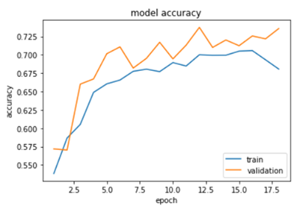
Results MLP
It is deduced that the 86% of (totally 1492) benign images and the 67% of (totally 1179) malignant images were classified correctly by the MLP model. Moreover, the model’s accuracy on test set was 75%.
 |  | true
 |  | benign | malignant
predicted as | benign | 987 | 157
 | malignant | 505 | 1022

Slide 13
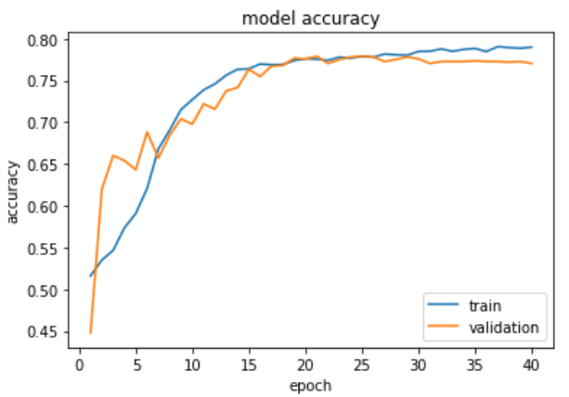
Results CNN
It is deduced that the 94% of benign images and the 69% of malignant images were classified correctly. Moreover, the model’s accuracy on test set was 79%.
 |  | true
 |  | benign | malignant
predicted as | benign | 987 | 66
 | malignant | 505 | 1113

Slide 14
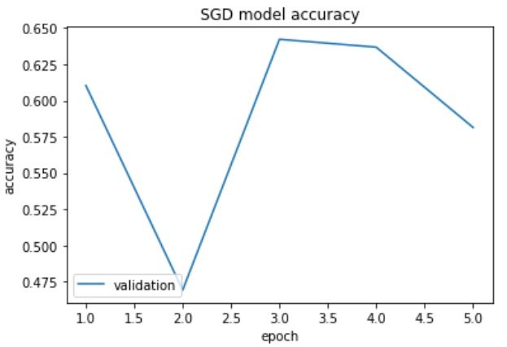
Results SGD
It is deduced that the 57% of benign images and the 65% of malignant images were classified correctly. Moreover, the model’s accuracy on test set was 57.73%.
 |  | true
 |  | benign | malignant
predicted as | benign | 1432 | 1069
 | malignant | 60 | 110

Slide 15
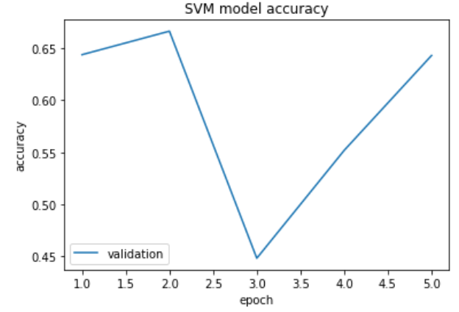
Results SVM
It is deduced that the 84% of benign images and the 56 % of malignant images were classified correctly. Moreover, the model’s accuracy on test set was 64%.
 |  | true
 |  | benign | malignant
predicted as | benign | 663 | 122
 | malignant | 829 | 1057

Slide 16
Conclusion
Convolutional NN needed a lot of time to be trained.
This was due to the convolutional layers that were applying filters to the image. On the other hand, the MultiLayer Perceptron model needed the least mean time per epoch to be trained.
The models MLP, CNN achieved around 77% accuracy whereas the SGD and SVM achieved around 61 % accuracy.
 | MLP | CNN | SGD | SVM
Neurons (MLP); filter size (CNN) | (512, 512) | (32,32,32) | N/A | N/A
# Layers | 3 (3 neuronics) | 3 (2 conv + 1 neur) | N/A | N/A
# Epochs | 18 | 40 | 5 | 5
Mean Epoch duration (s) | 218 | 862 | 243 | 609
Accuracy (%) | 75 | 79 | 58 | 64
% | MLP | CNN | SGD | SVM
valid accuracy | 74 | 78 | 64 | 66
test accuracy | 75 | 79 | 58 | 64

Slide 17
THANK YOU
FOR YOUR ATTENTION!

