Slide 1
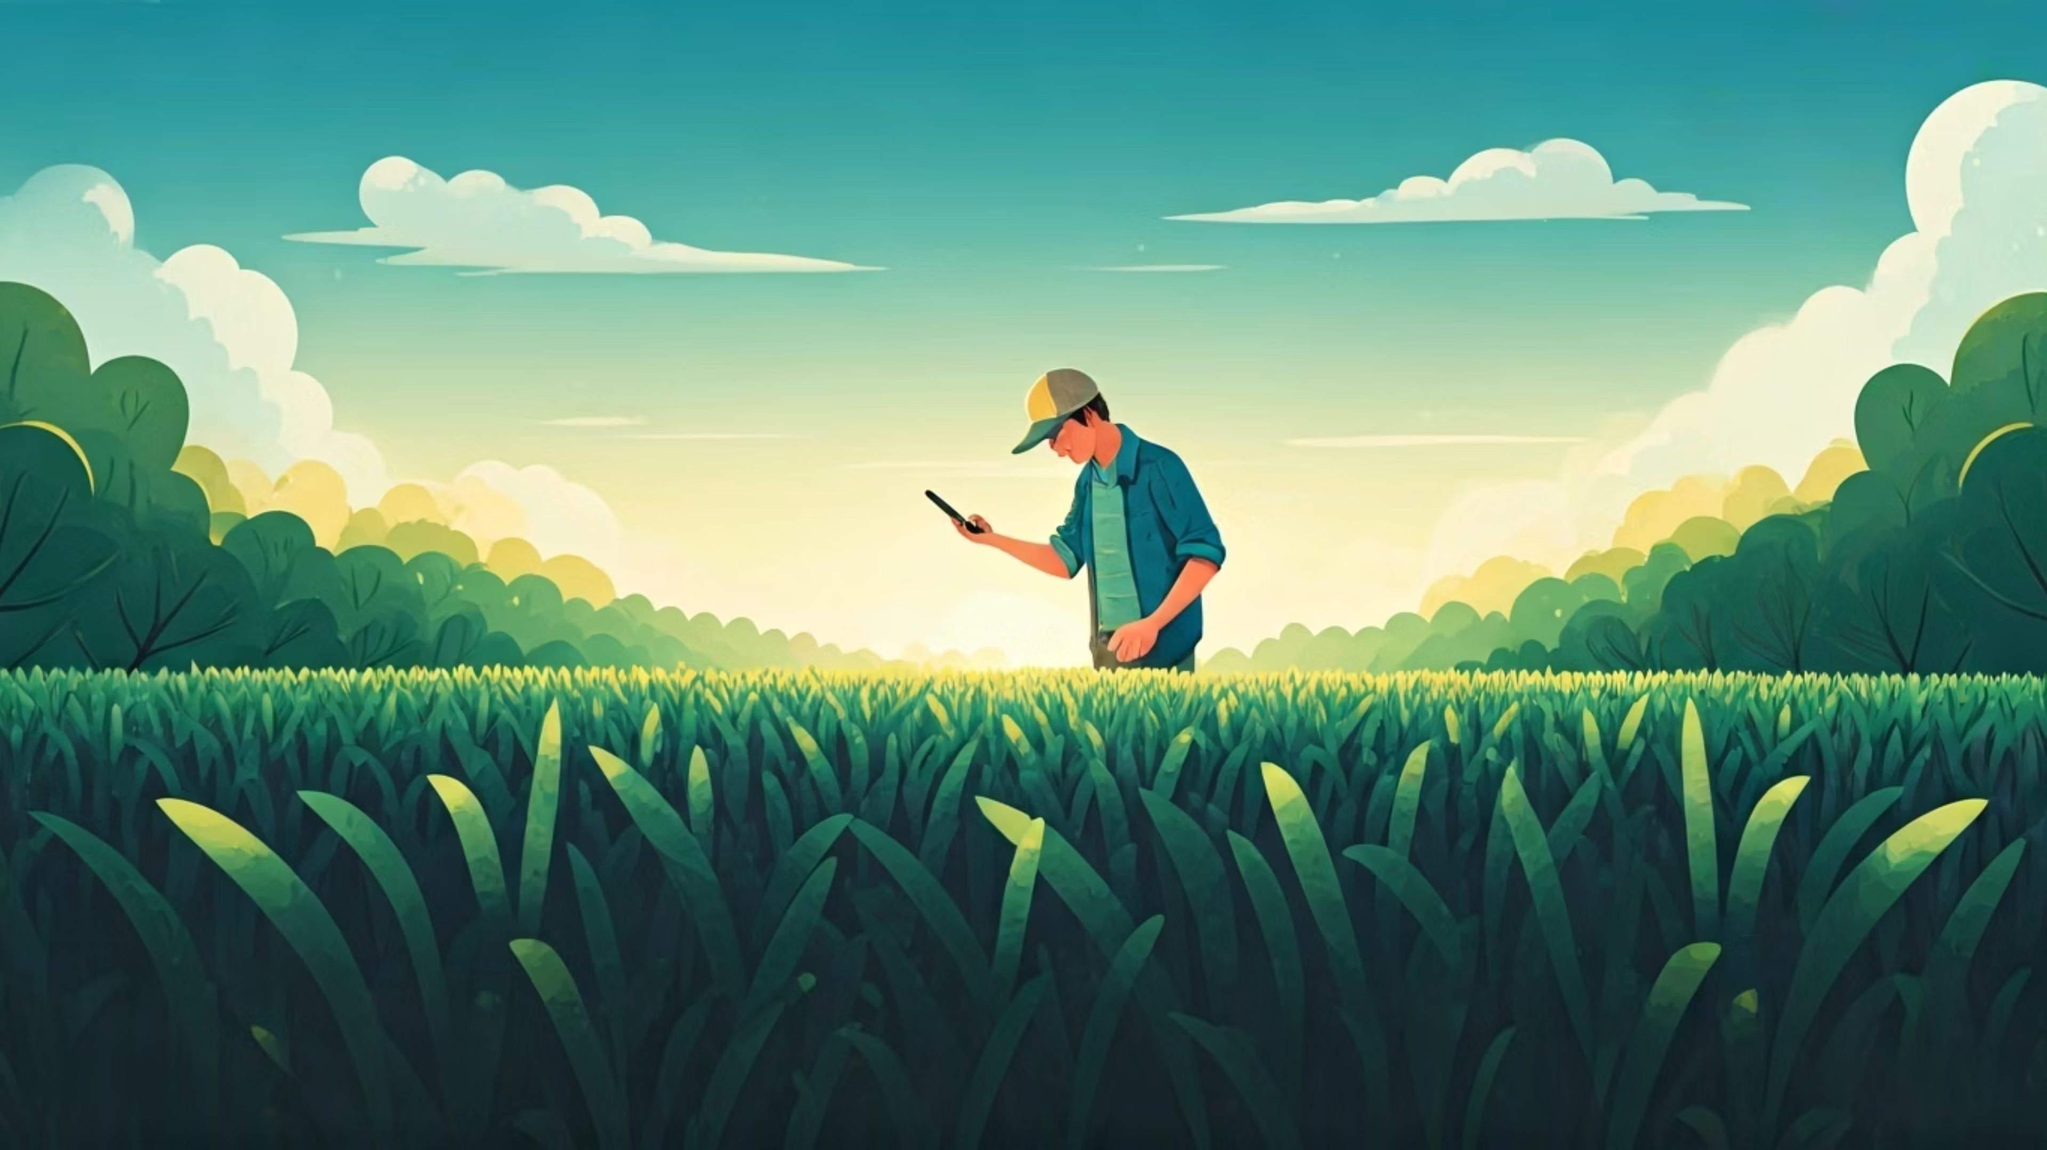
Agrigate: AR & AI-Driven Decision Support for Smallholder Farmers
Team Ghost
Aditya Kumar Panigrahy, 05/11/25

Slide 2
Outline
01
02
03
Software Requirements Specification (SRS)
Software Design Specification (SDS)
System Overview
04
05
06
Implementation & Demo (Video)
Testing
CASE Tool
Manual Reports
07
08
09
Glossary
Conclusions
References

Slide 3
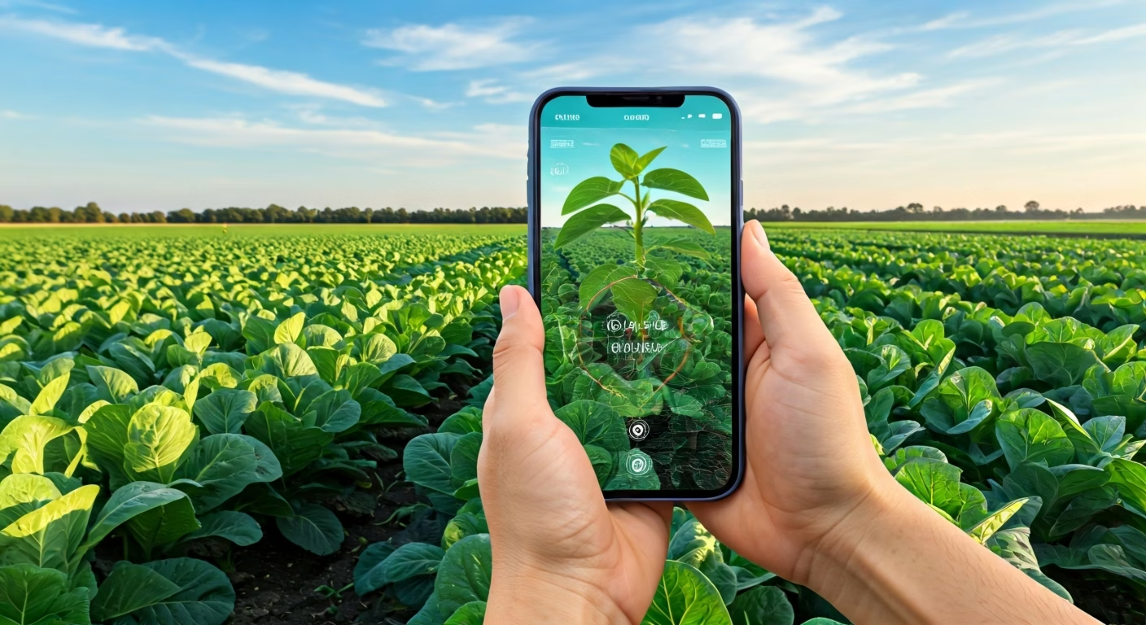
SRS
Agrigate is a mobile first decision support application for farmers and field agents that combines on device AR visualization with AI and ML services delivered by a lightweight Flask backend. The app lets users scan plants in AR to capture images and receive disease classifications, view crop recommendations based on soil and environmental parameters, monitor live or simulated IoT sensor readings such as NPK and humidity, browse a plant and animal directory, and check market listings and agricultural news while consolidating essential field workflows into a single interface. The primary objective is to reduce time to diagnosis and improve the quality of crop decisions while remaining usable in low connectivity contexts.
In scope for this release are AR assisted plant disease detection with image capture and server-side inference, crop recommendation through parameter input and ranked results, a live sensor dashboard that polls a sensor endpoint, and curated content modules that include market listings, news, and searchable directories. Key benefits include faster and more confident field decisions, improved yield outcomes through timely guidance, reduced dependence on fragmented tools, and a clearer feedback loop between observed field conditions and recommended actions. The goals are to deliver a reliable and easy to use mobile experience with responsive AR interactions and predictable backend performance that can be validated against measurable acceptance criteria in later sections of the SRS.

Slide 4
Functional Requirements
1
2
3
AR Plant Disease Detection
Crop Recommendation System
Market and Resource Listings
The app detects horizontal planes in AR mode, captures plant images, sends them for disease classification, and displays diagnosis with confidence or retry hints.
Users input soil and environment data to get ranked crop suggestions with suitability scores and brief explanations.
The app shows market cards for seeds, vendors, and equipment, along with short agricultural news updates.
4
5
Searchable Catalog and Details
Profile, Settings, and Support
A searchable catalog displays plants and animals with filters; selecting an item shows details like soil type, season, and prices.
Users can view app info, adjust settings, and access a support/about section with necessary disclaimers.

Slide 5
Non-Functional Requirements
Performance Metrics
System Responsiveness
AR Frame Rate: The AR view should maintain at least 24 FPS on mid-range Android devices under normal indoor lighting.
Sensor Dashboard Performance: The dashboard polls every second (adjustable to 5s) and UI updates must not cause frame stalls over 16 ms.
Plant Disease Detection Speed: The disease check round-trip should be ≤2s on Wi-Fi (for ≤1.5 MB image) and ≤5s on 4G.
App Launch Time: Cold start to first interactive screen should be under 3 seconds on mid-range Android devices.
Crop Recommendation Response: The backend should respond within ≤1.5s on Wi-Fi for a typical crop recommendation request.
AR Plane Detection Time: Plane detection should complete within 10 seconds indoors; otherwise, the app prompts a retry.

Slide 6
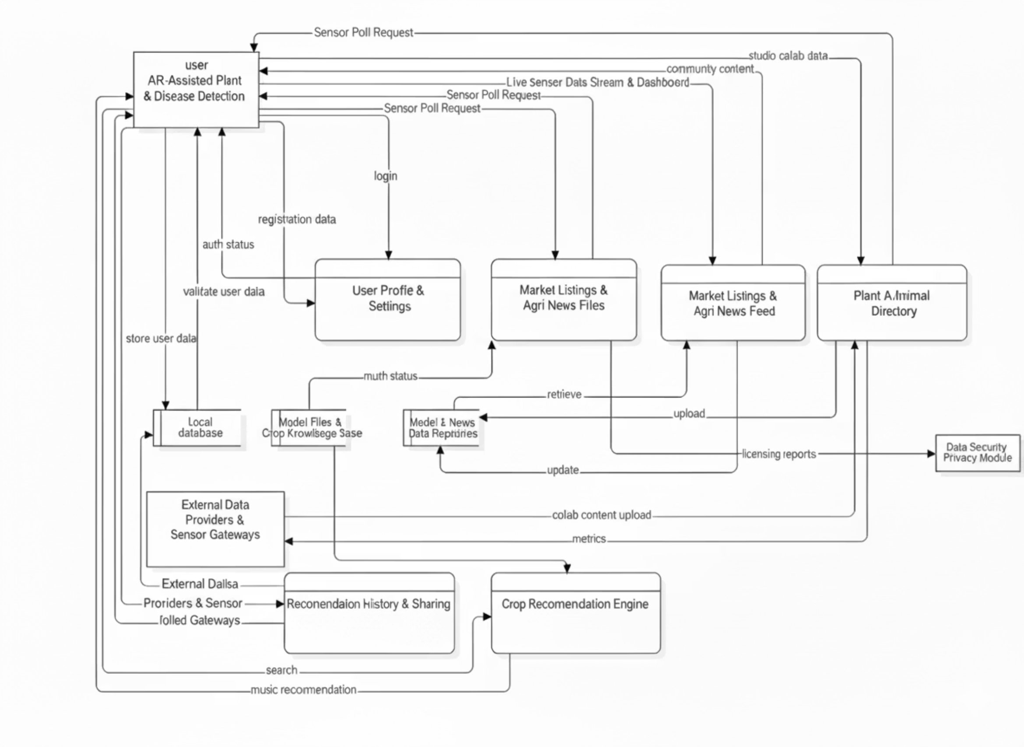
SDS

Slide 7
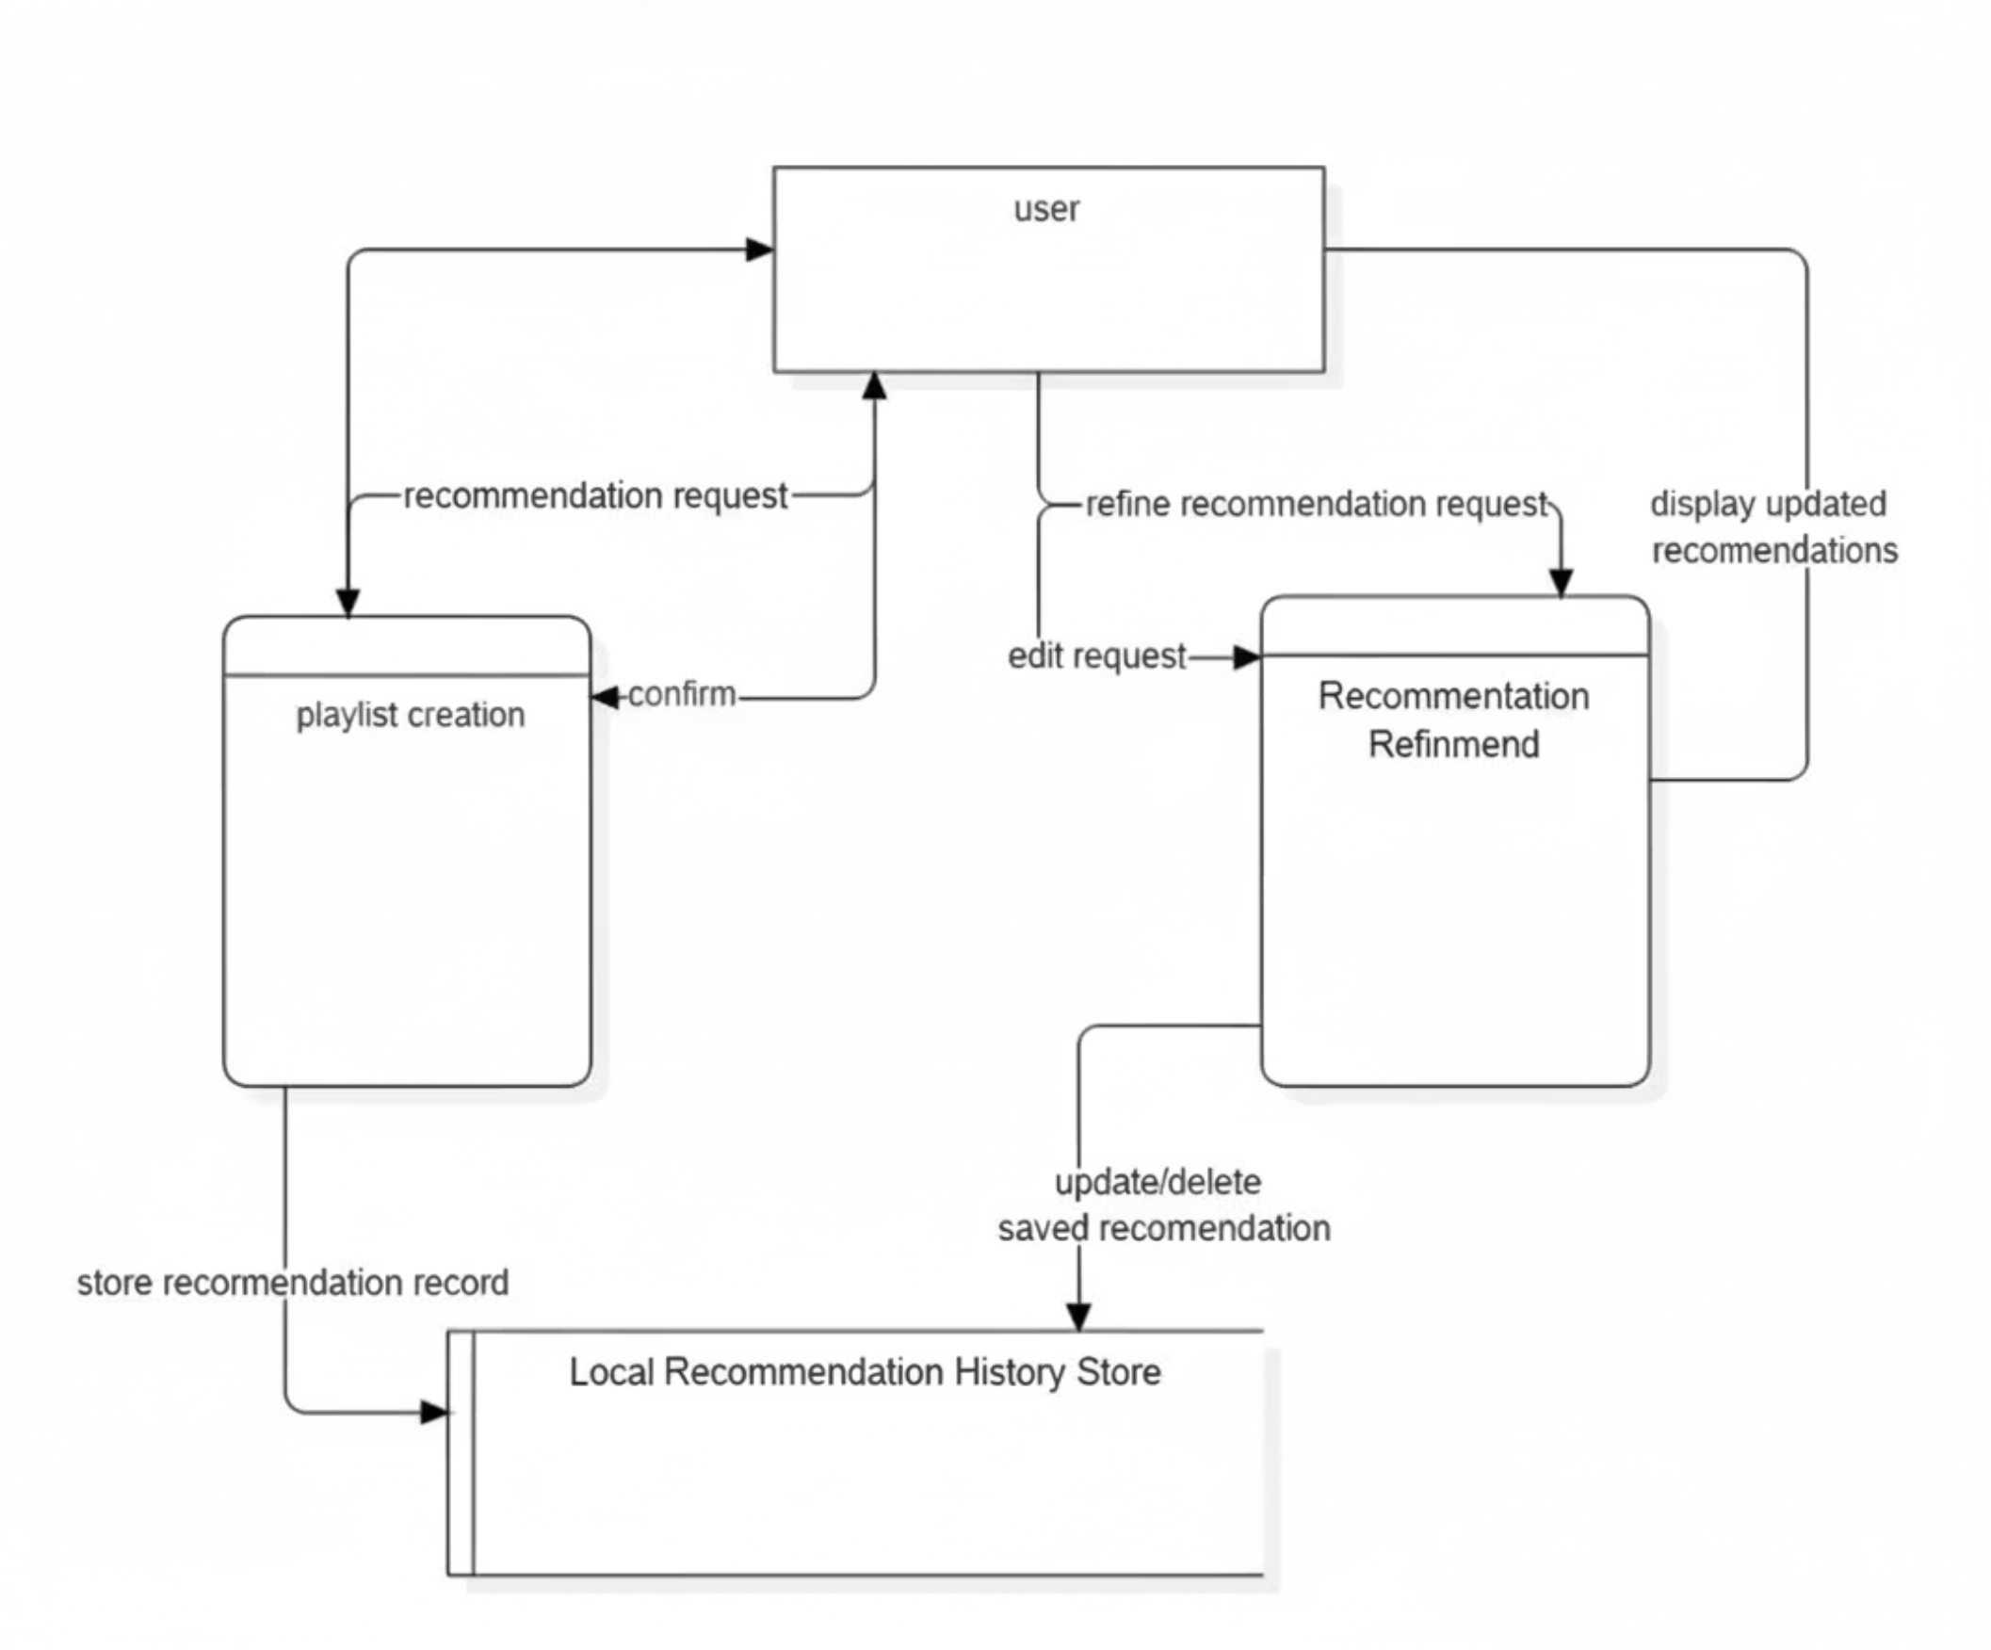
Crop Recommendation

Slide 8
System Overview
Flutter Mobile App
Flask Backend
Domain Services
A Flutter-based mobile app that uses ARCore/ARKit to detect planes, capture leaf images, and overlay live disease labels and confidence scores.
A lightweight Flask/Python backend exposing three REST endpoints—/plantdisease, /croprecommendation, and /sensor—that power server-side PyTorch inference, AI crop ranking, and IoT-style sensor simulation.
Domain services in the client (PlantDiseaseService, CropRecService, SensorService) orchestrate user flows, invoke HTTP calls, parse JSON results, and cache data locally for offline resilience.
IoT Dashboard
Integrated Features
An IoT-inspired dashboard polls NPK and humidity readings at configurable intervals, displays gauges and sparklines, and issues alerts when thresholds are crossed.
Integrated market listings and agri-news feeds fetched from external APIs, combined with a searchable plant/animal directory, give farmers a one-stop decision-support tool—built end-to-end in a 48-hour hackathon.

Slide 9

Design Consideration
Real-Time Performance
Platform & Device
Optimized for speed and immediate response.
Cross-platform compatibility for all user devices.
Offline Resilience
Core App Features
Modularity &
Maintenance
Ensuring functionality without an internet connection.
Security & Privacy
Ensuring functionality without an internet connection.
Secure & Transitivity

Slide 10
Architecture Strategies
On-Device Processing
1
The AI model is stored within the app and runs directly on the phone, eliminating the need for an internet connection for analysis.
Advantage: Instant results and offline capability.
Disadvantage: Increased app size, variable performance based on device hardware.
Web-Based App (PWA)
2
Agrigate operates entirely in a web browser, accessed through a link, without requiring a dedicated app installation.
Advantage: Lightweight, automatic updates, and cross-platform compatibility.
Disadvantage: Limited access to advanced features like AR, sensors, or robust offline storage.
Client-Server Model(Chosen Approach)
The Flutter app manages the user interface, camera, AR view, and local storage, while a Flask backend handles demanding AI tasks like disease detection and crop suggestions.
3
Advantage: Small app footprint, rapid updates, and support for powerful features.
Disadvantage: A minor delay (2–5 seconds) for server communication.

Slide 11
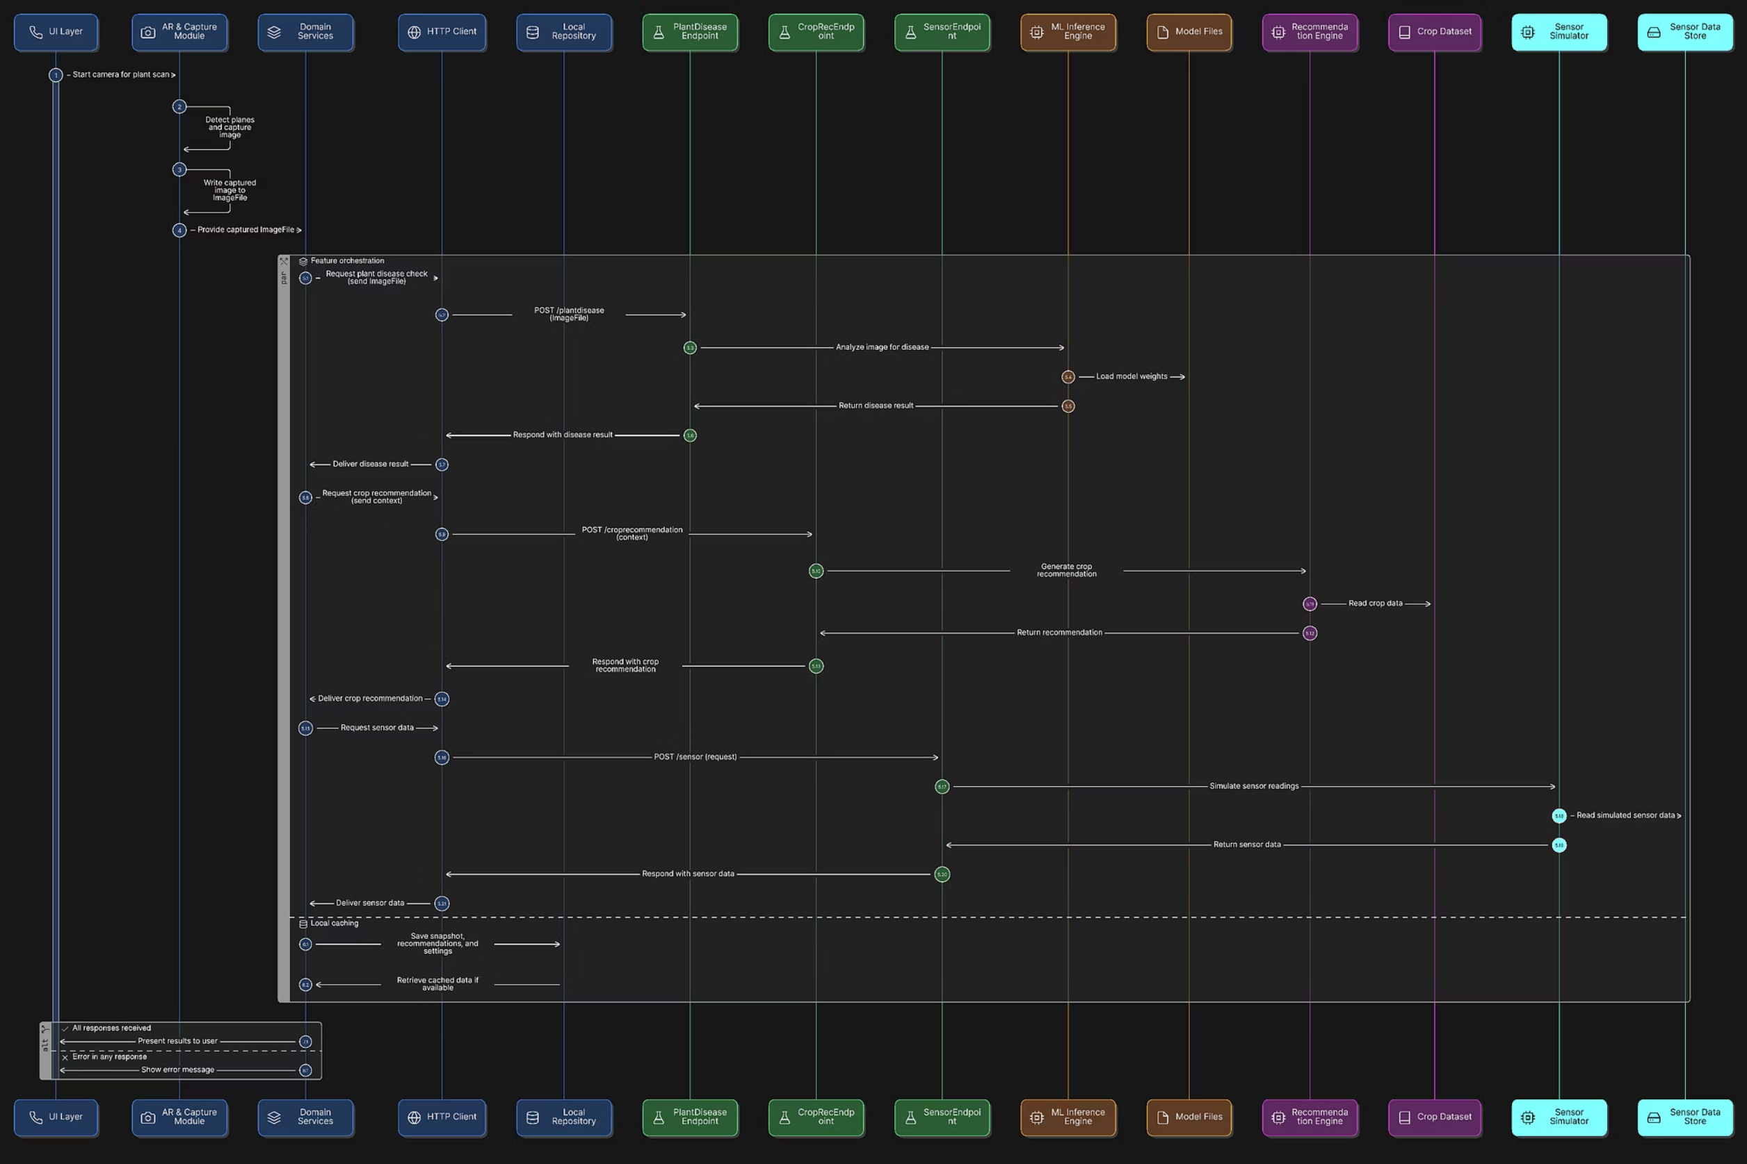
System Architecture

Slide 12
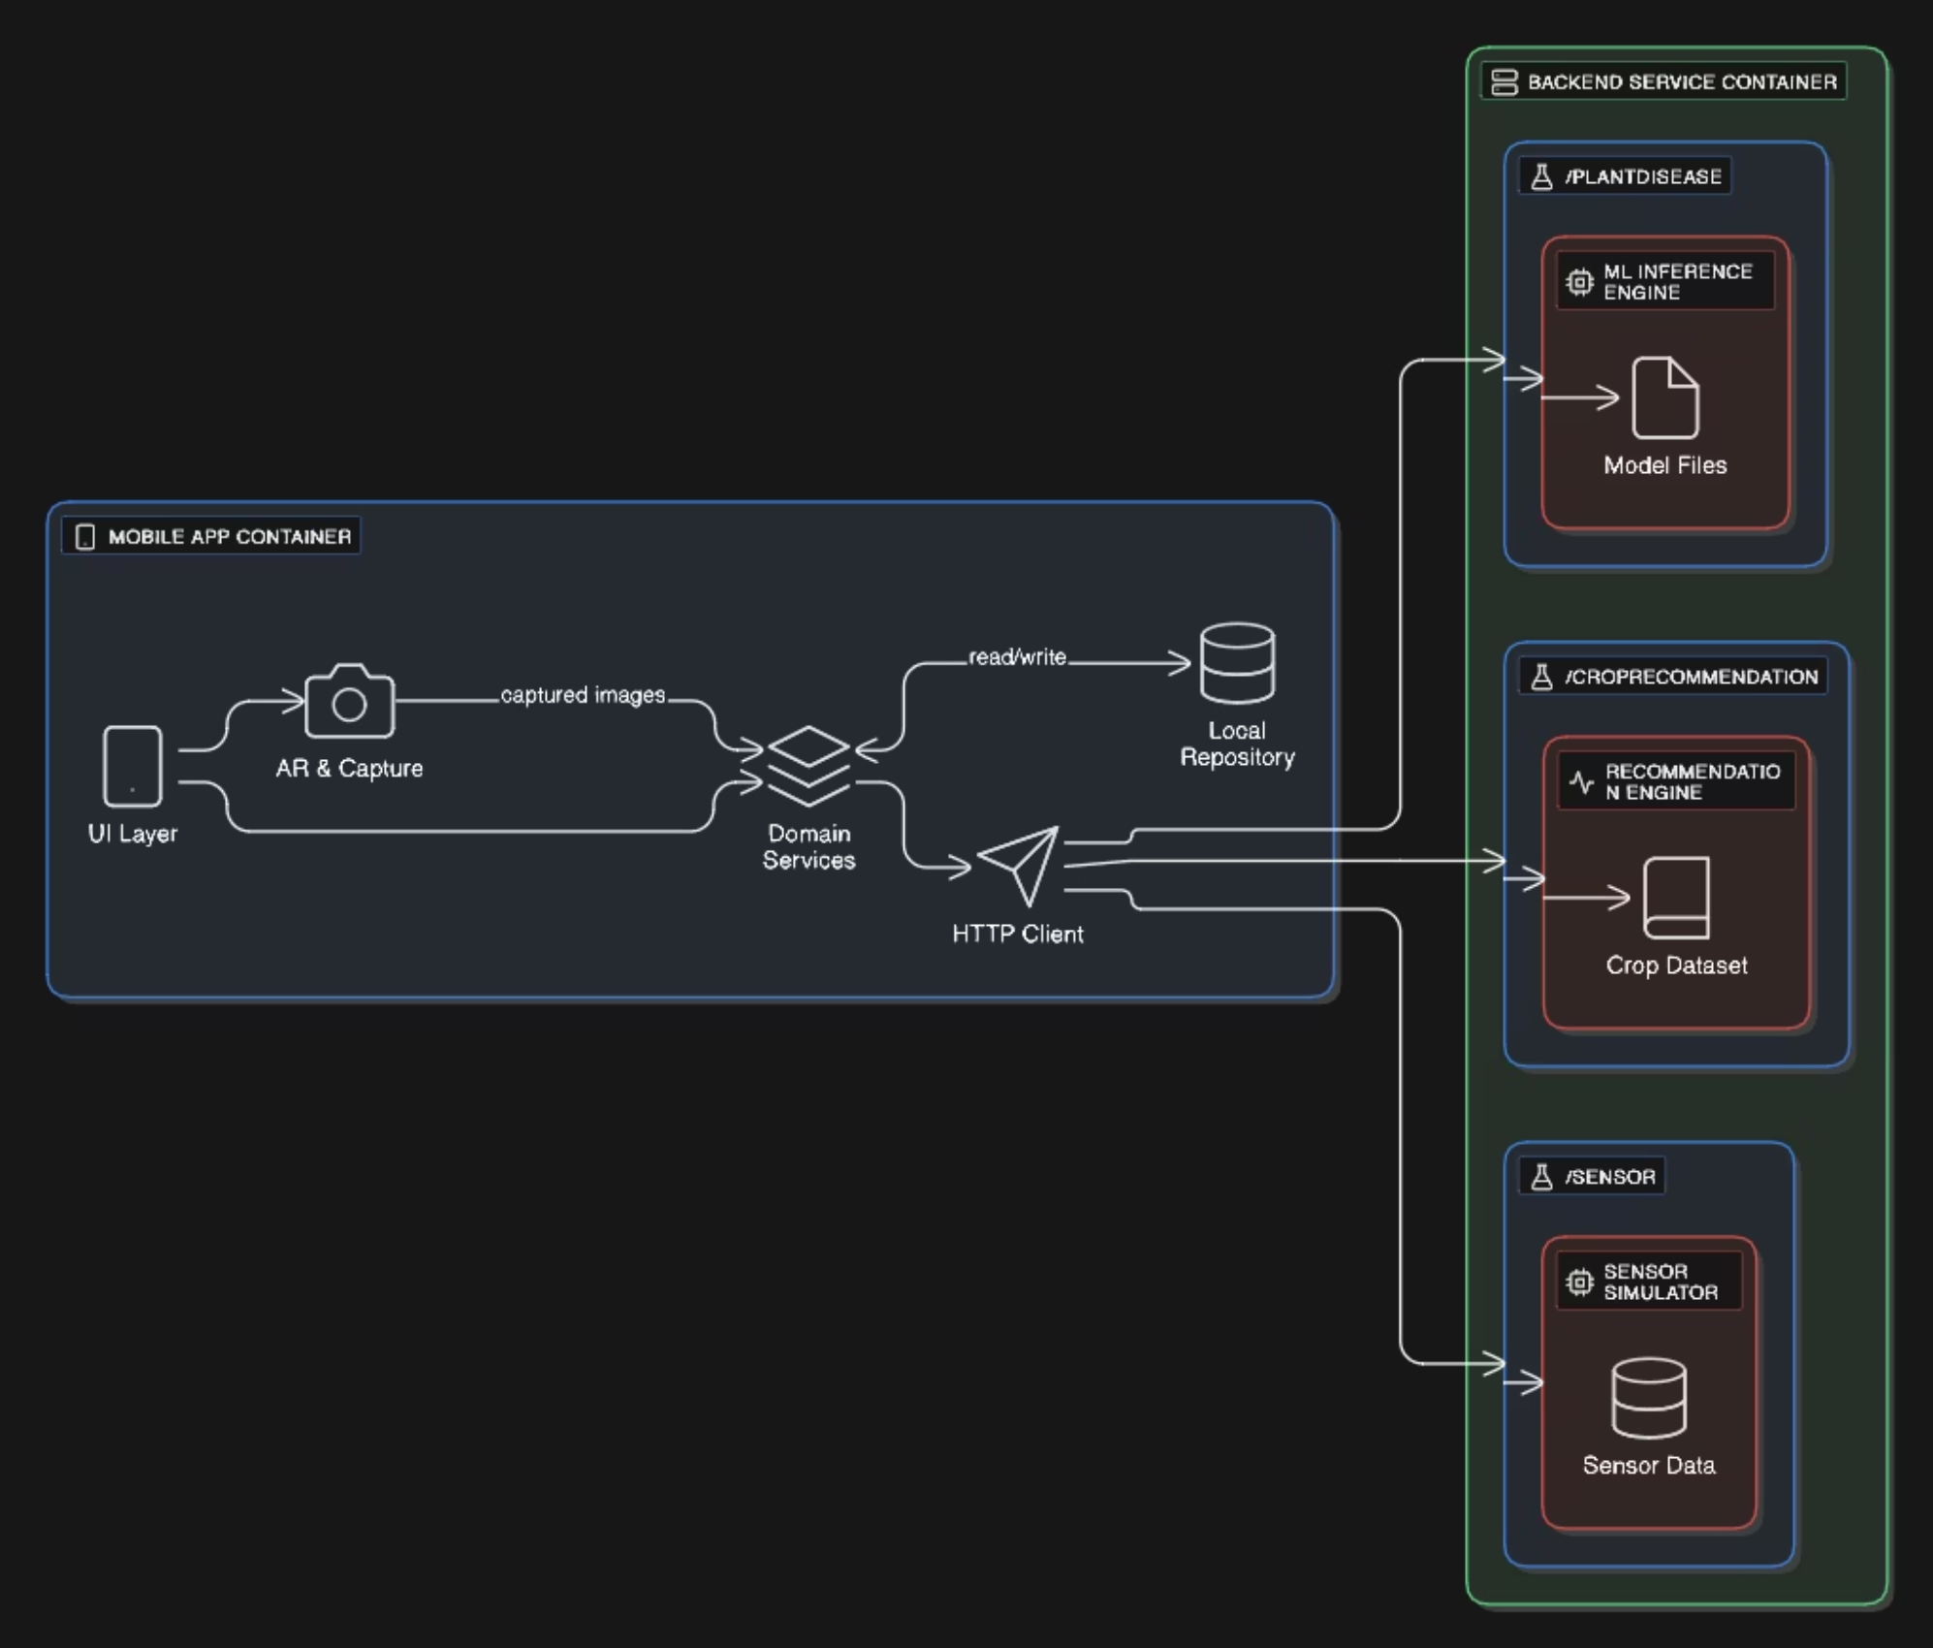
Detailed System Design
In Agrigate, the farmer taps “Start AR Disease Detection” to open the camera, which detects a flat surface. Once positioned over a suspect leaf, the farmer taps “Capture”, and the image is sent to the /plantdisease endpoint. The server’s AI analyzes it and returns the disease name and confidence, displayed instantly on the AR view. Next, the farmer selects “Get Crop Recommendations”, entering or importing NPK, humidity, and temperature data from the sensor dashboard. These are sent to /croprecommendation, which returns ranked crop suggestions with short explanations. The Sensor Dashboard continuously polls /sensor for live readings, updating gauges and alerting if thresholds are crossed. The farmer can also browse market listings and news from external APIs, which are cached for offline use. Throughout the process, Agrigate saves images, results, and preferences locally so the farmer can access them even without internet.

Slide 13
Implementation & Demo
Github Link: https://github.com/Aggerio/Agrigate_App
Video Link: https://drive.google.com/file/d/1hN_OOvydTjxzEwXqXJWj9-0rRlXFcIhT/view?usp=sharing
PPT Explanation Video Link: https://drive.google.com/file/d/1eNuhgSenOGuOekjBdZ35rhQoMlpHg7Id/view?usp=sharing

Slide 14
Manual Testing
Unit Testing
Regression Testing
Integration Testing
Dart unit tests covered core functions (e.g., ImageFile.compress(), DiseaseResult.fromJson(), HTTPClient methods) with 95% line coverage, revealing a compression logic bug.
Automated smoke tests for six primary user flows (AR detection, sensor dashboard, etc.) were run on every merge to main; no regressions detected over three weeks.
End-to-end integration tests confirmed interactions between services (PlantDiseaseService, HTTPClient) and the Flask server, uncovering and patching missing null checks.
Black Box Testing
Scenario Testing
Input validation (N, P, K, humidity, temperature) was tested using black box methods across invalid (negative, >100) and valid (0-100) partitions, ensuring correct error handling.
Real-world user flows were scripted, leading to fixes for a missing share button on the snapshot detail screen and an unclear poll interval dialog in the Sensor Dashboard.

Slide 15
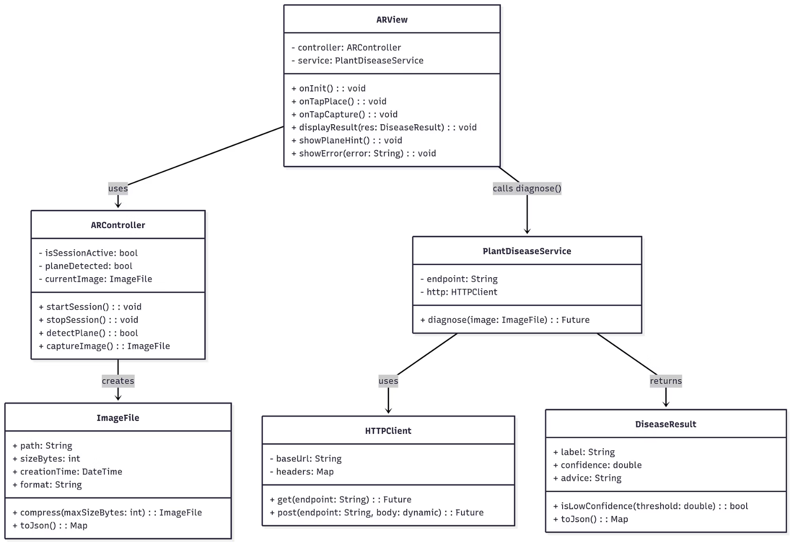
CASE TOOL
Class Diagram
Context Model

Slide 16
Glossary
API
HTTP / HTTPS
Application Programming Interface
Hypertext Transfer Protocol (Secure)
JSON
UI
JavaScript Object Notation
User Interface
UX
SDK
User Experience
Software Development Kit
CI/CD
POC
Continuous Integration / Continuous Deployment
Proof of Concept
MVP
UML
Minimum Viable Product
Unified Modeling Language
ERD
DFD
Entity–Relationship Diagram
Data Flow Diagram
CRUD
IoT
Create, Read, Update, Delete
Internet of Things
APK
IPA
Android Application Package
iOS App Store Package
TFLite
MVC / MVVM
TensorFlow Lite (on-device inference framework)
Model–View–Controller / Model–View–ViewModel (architectural patterns)

Slide 17
Conclusion
Agrigate represents a proof-of-concept that a comprehensive, AR-enabled crop-decision-support system can be developed in just 48 hours. By unifying AR capture, ML inference, AI ranking, IoT monitoring, and market/news integration within one mobile client, we address vital research gaps and streamline farmers’ workflows. Rigorous unit, integration, regression, E2E, and usability testing confirm system stability and UX quality. While prototype limitations remain, Agrigate lays a robust foundation for future precision-agriculture tools that seamlessly blend on-device interactivity with cloud-based intelligence.

Slide 18
References
[1] A. Smith, B. Patel, and C. Liu, “Augmented Reality-Powered Plant Disease Detection for Smart Farming,” Int. J. Creative Res. Thoughts, vol. 13, no. 7, pp. 123–130, Jul. 2025.
[2] D. Johnson and E. Chen, “Deep Learning Based Mobile Application for Automated Plant Disease Detection,” IEEE Access, vol. 9, pp. 15000–15008, Jun. 2025.
[3] F. Martinez and G. Singh, “PlantCareNet: An Advanced System to Recognize Plant Diseases with Dual-Mode Recommendations,” Plant Methods, vol. 21, no. 1, pp. 45–52, Apr. 2025.
[4] H. Zhao and I. Kumar, “Augmented-Reality Enabled Crop Monitoring with Robot Assistance,” arXiv preprint arXiv:2411.01234, Nov. 2024.
[5] J. Lopez and K. Yamamoto, “Future Agriculture Farm Management Using Augmented Reality: A Study,” IEEE Trans. Agric. Informatics, vol. 2, no. 3, pp. 25–33, May 2025.
[6] L. Nguyen and M. Sharma, “AI-Based Agriculture Application for Crop Recommendation and Guidance System for Farmers,” IEEE Sens. J., vol. 23, no. 4, pp. 678–685, Apr. 2025.
[7] N. Patel, O. Diaz, and P. R. Srinivasan, “Integration of Smart Sensors and IoT in Precision Agriculture: Trends, Challenges and Future Prospectives,” Front. Plant Sci., vol. 16, no. 5, pp. 1000–1012, May 2025.
[8] Q. Ahmed and R. Kumar, “IoT Based Multifunctional Agriculture Monitoring and Smart Irrigation System,” in Smart Agriculture: IoT and Big Data Analytics, Springer, Cham, 2025, pp. 123–140, Feb. 2025.
[9] S. Chen, T. Wang, and U. Garcia, “Internet-of-Things-Based Multiple-Sensor Monitoring System for Soil Information Diagnosis Using a Smartphone,” Micromachines, vol. 14, no. 7, Art. no. 1310, Jul. 2023.
[10] V. R. Iyer and W. Thompson, “AI-Based Smart Crop Recommendation System for Sustainable Agricultural Production,” Madras Agric. J., vol. 112, no. 8, pp. 88–96, Aug. 2025.

