Slide 1

UNIBULK

Slide 2
What is It?
It works on the principal of the seller giving huge discounts on bulk orders or also known as volume discount.
Producers or sellers can reduce inventories and take advantage of economies of scale by allowing discounts to bulk buyers.
The discount increases as for tiers that include larger and larger numbers of units. For instance, a discount could be applied to 50 to 100 units sold, with a greater discount for 101 to 200 units sold, and an even larger discount could apply to 201 to 300 units sold, and so on.

Slide 3
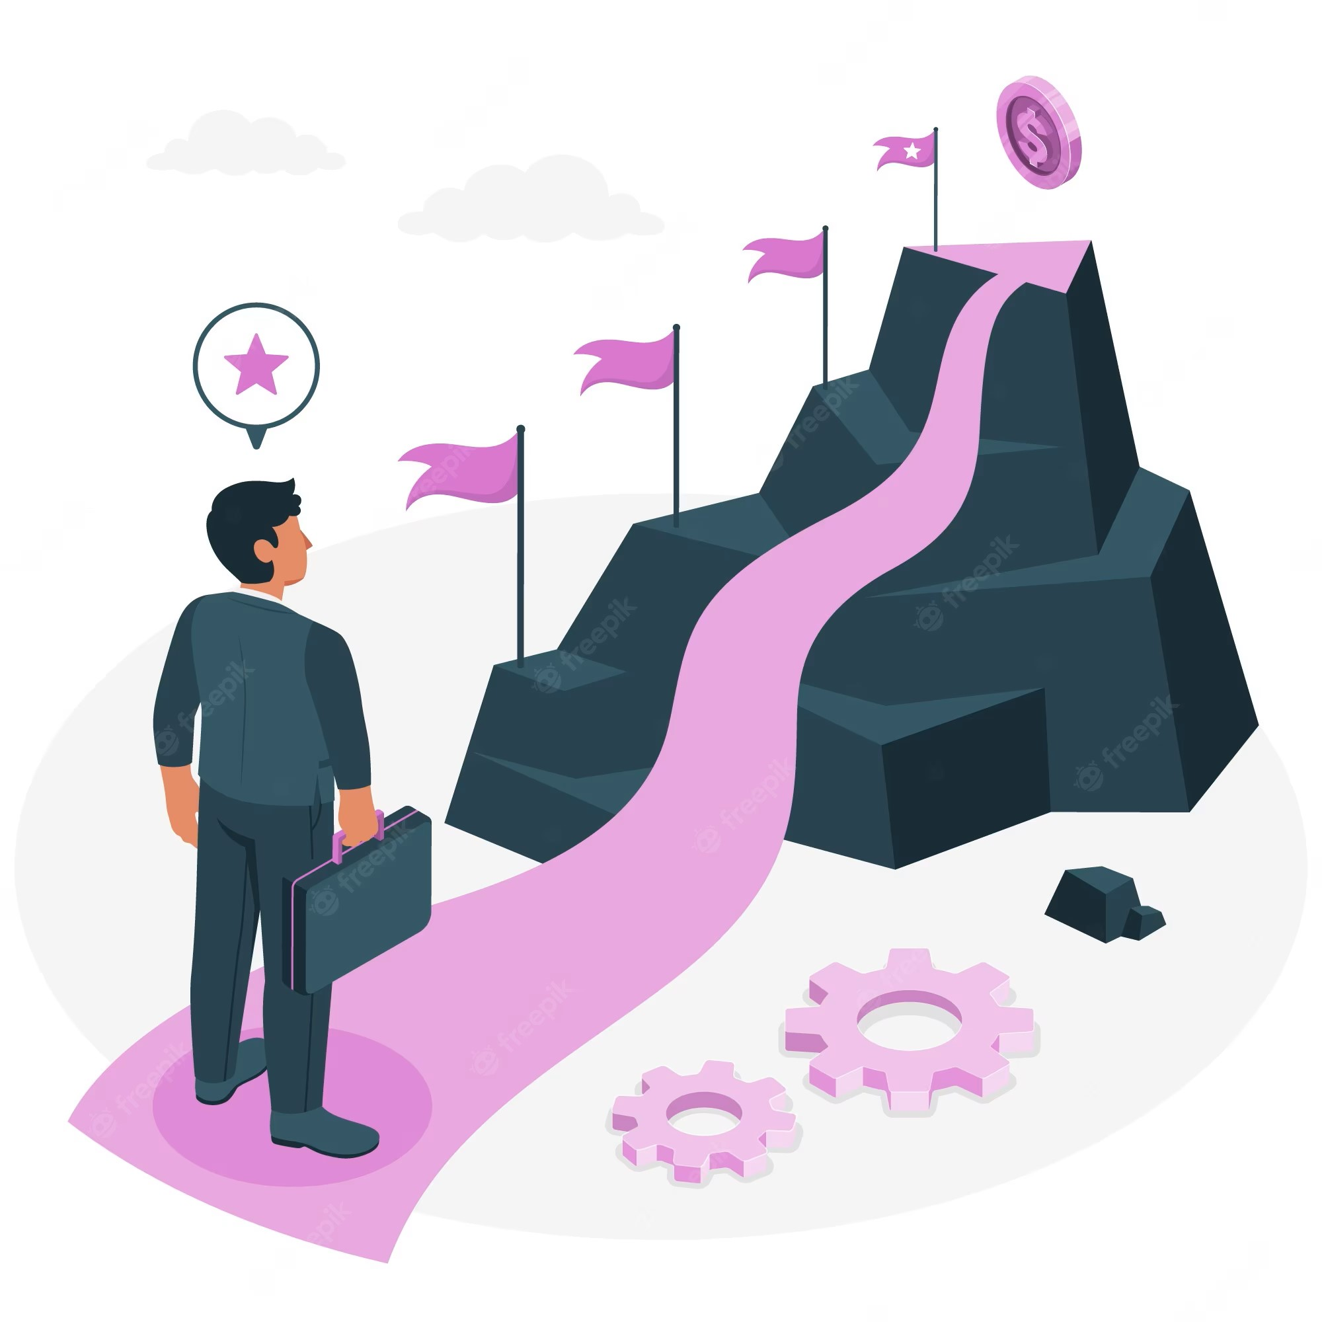
How we plan to implement it
We plan to proceed with a kickstarter like milestone system which showcases the upcoming discounts, the no. of people registered and the end date of the discount.

Slide 4
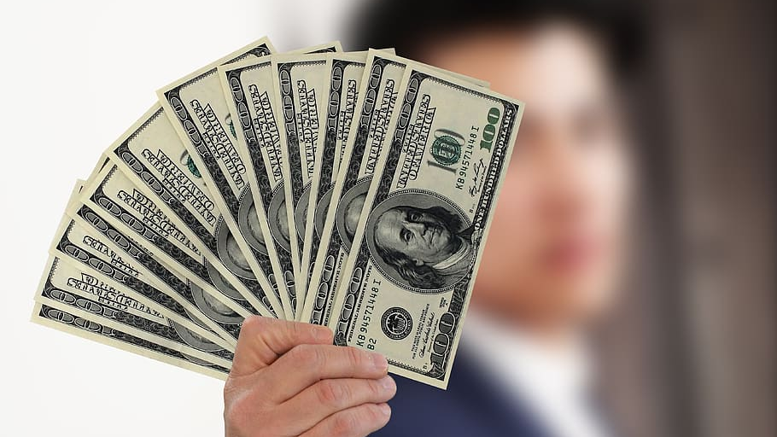
How we plan to Make money
Since every business needs to make money, we derive our profits from the wholesale seller instead of the buyer.
Imagine you have a huge no. of pre orders from a lot of customers.
And now we proceed to play the game of free market.
The wholesaler which will give the cheapest price for each unit will get our offer, now since our only cost of doing business is to maintain the delivery service

Slide 5
Why would someone trust an unknown company with a lot of pre orders , won’t you suffer from a lack of trust from the public and the buyers initially?
Yes, it is true that we are a nobody with no public trust, but that’s not a trust problem it’s an image problem. Public image of a company is malleable and very changeable with good marketing. Cred started advertising way before it actually launched because the founder knew it is a pretty novel system. A credit card management app , what bullshit for the very orthodox Indian in matters concerning financial matters. But it overcame that stigma, this idea is like a train, very hard to get upto operating speeds, but once the necessary speeds are achieved good luck stopping it externally.

Slide 6

But your business depends on large volumes of orders from the consumer to operate in the first place, you would succumb very quickly to the trend of individualism. How would you overcome that?
Our business specifically targets products that our considered to be special by the masses and general status symbols. A prime example of these kind of items is the iphone. How many times have your friends raced to buy the latest and greatest offering of apple even though they have no need of it . It’s simple its showoff, it’s keeping up with the trends, its loyalty towards the brand. Its simple some products stand above the rest, some are extraordinary and that’s where opportunity lies.
We will not target the latest and greatest, but the second latest and greatest, the older version that has a lot of stock.

Slide 7
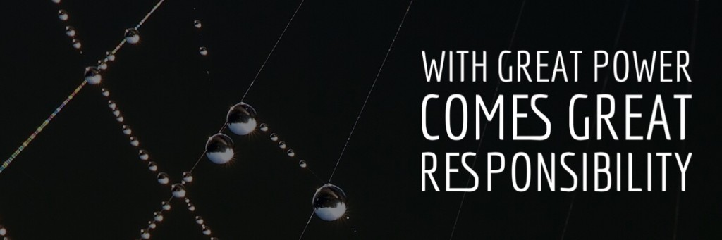
This Photo by Unknown Author is licensed under CC BY-NC-ND
With extra ordinary demand comes extra ordinary opportunity

Slide 8


