Slide 1



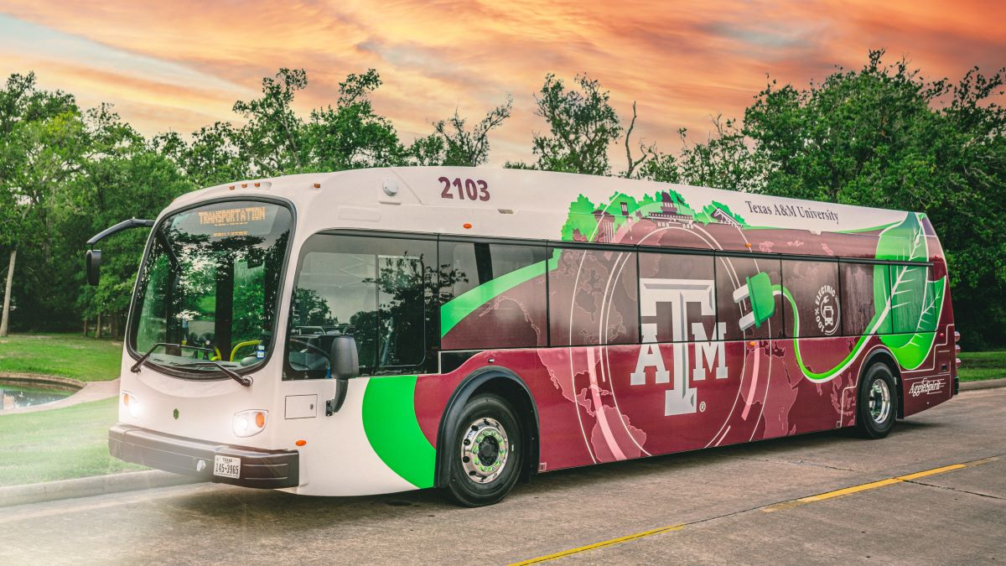


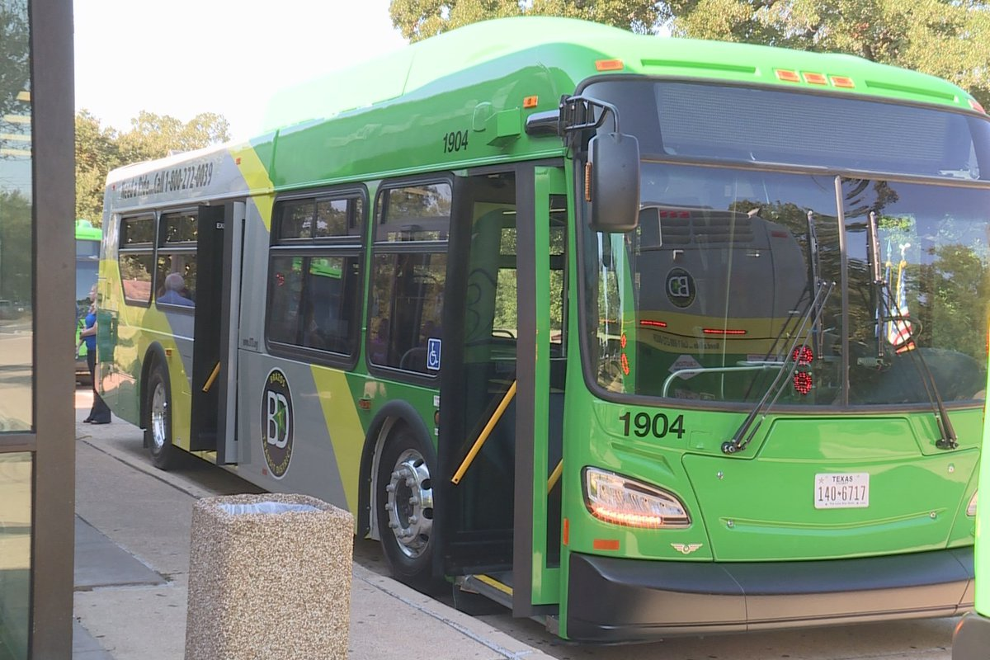

Aggie Commute
👍
📱
Plan commutes between arbitrary points in Bryan/CStat using public transportation (AggieSpirit and Brazos Transit)
Why?
Real commutes require route/bus switching
BTHO driving stress - relax during your commute
Make an impact on campus by decongesting traffic
Relevant Technologies
OpenStreetMap
TypeScript, Python
LeafletJS, Svelte/React
OpenStreetMap
Project Managers
Skills Preferred
• Shivanand P shivanandvp#4200
• Co-PM needed!
Web Scraping
Web App development
Version Control with git
GIS (Optional)

