Slide 1
Populations, Samples, and Stats
Matthew J. Martinez, PhD
Notes:
https://www.youtube.com/watch?v=lnc0FNvUZ7o

Slide 2
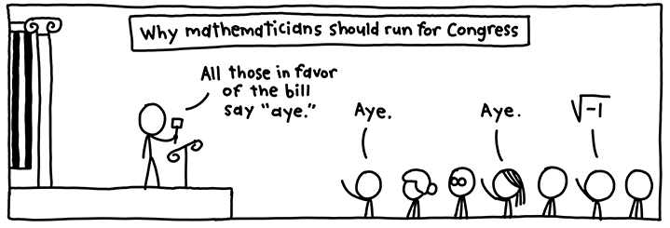
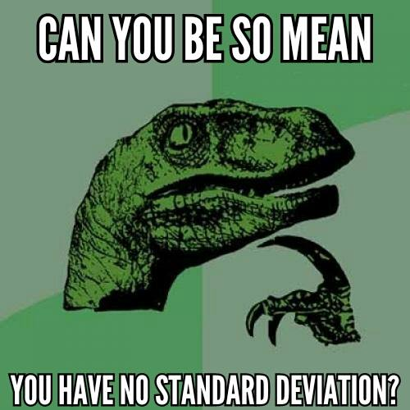

Slide 3
Population and Samples
Population
Complete Count
United States Census
Samples
Random
Stratified Random
Probability

Slide 4
Questions to Consider
Can we ever know the true population?
When would a sample be better?

Slide 5
Demonstration

Slide 6
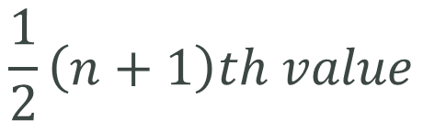
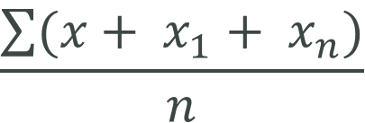
Describing Populations & Samples: Central Tendency
Mean
Median
Mode
$$\frac{\sum{(x+ x_{1}+ x_{n})}}{n}$$
$$\frac{1}{2}\left(n+1\right)th value$$

Slide 7
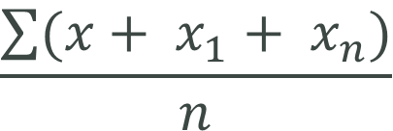
Mean
Arithmetic mean (or average):
Properties of the mean
Quantitative data only
Highly susceptible to outliers
$$\frac{\sum{(x+ x_{1}+ x_{n})}}{n}$$

Slide 8
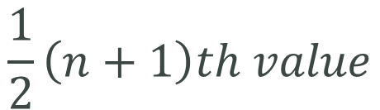
Median
The Median – the observation that divides an ordered data set in half; 50th percentile
Properties of the median
Quantitative or ordinal data required
In symmetric distributions, median=mean
In skewed distributions, the mean resides between the median and the tail of the distribution
The median is unaffected by outliers or by distances between measurements
$$\frac{1}{2}\left(n+1\right)th value$$

Slide 9
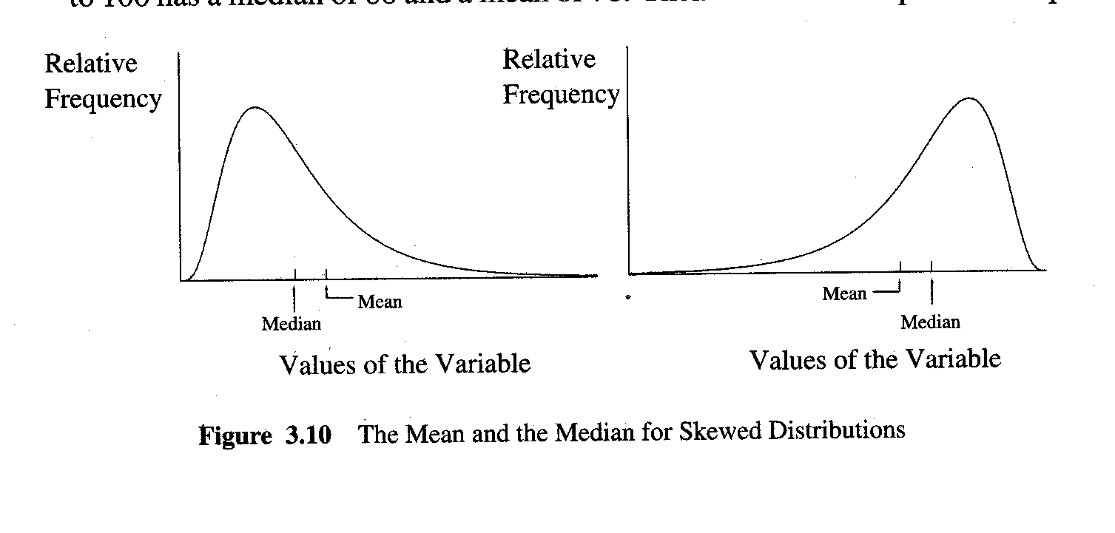
Mean and Median

Slide 10
Mode
Defined: the most frequent value in a data set
Properties
Works will all types of variables
Uni-, bi- and trimodality
In a unimodal, symmetric distribution,
Mean = median = mode

Slide 11
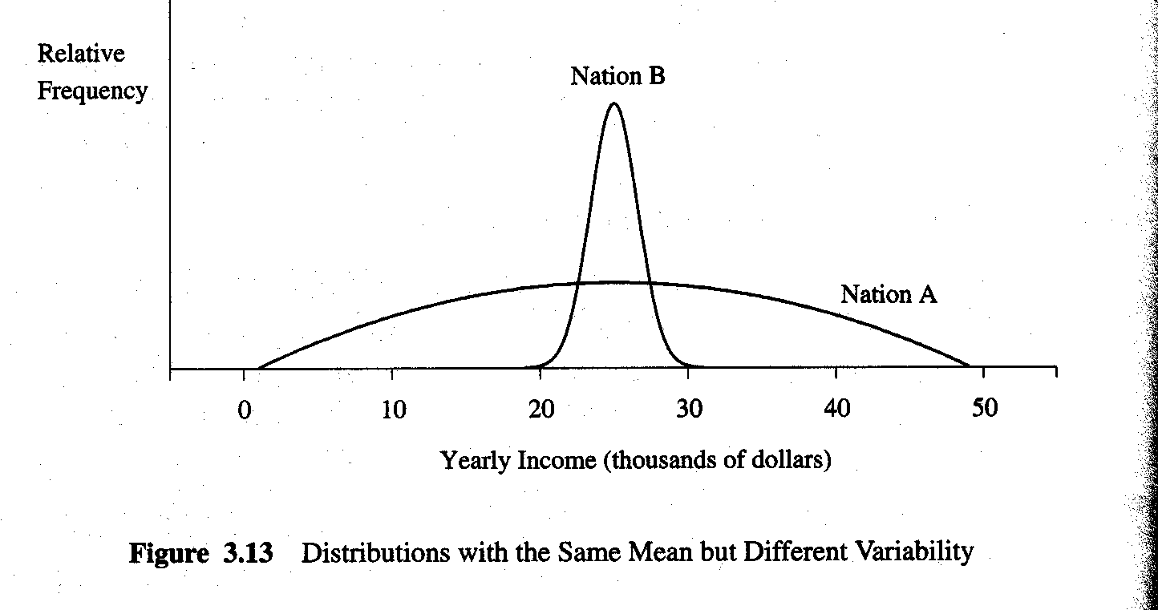
Why Variation Matters

Slide 12
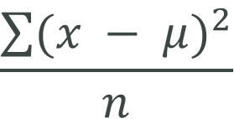
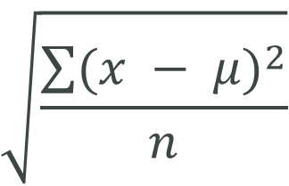

Describing Populations & Samples: Variation
Range
Variance
Standard Deviation
$$Upper Limit −Lower Limit$$
$$\frac{\sum{{(x − μ)}^{2}}}{n}$$
$$\sqrt{\frac{\sum{{(x − μ)}^{2}}}{n}}$$

Slide 13
Variation
The Range – difference between the largest and smallest observations
Deviation – difference between any observation and its mean:
Sum of deviations = zero

Slide 14
Variation
Sum of squares –
Variance –

Slide 15
Variation
Standard Deviation –

Slide 16
More Examples
Sampling and Normal Distribution
http://www.hhmi.org/biointeractive/sampling-and-normal-distribution
http://media.hhmi.org/biointeractive/click/sample-distribution/?_ga=1.229734676.983006972.1480921538

Slide 17
Further Study
“Mr. Willis of Ohio” from The West Wing
“Two Cheers for the 2000 Census”. http://www.prb.org/Publications/Articles/2000/TwoCheersforthe2000Census.aspx
“Better Data, Better Decisions: How the U.S. Census Bureau's American Community Survey Benefits Business and Government”. http://www.prb.org/Multimedia/Video/2011/acs-benefits-business-government.aspx
“Understanding and Using 5-Year Estimates From the ACS”. http://www.prb.org/Multimedia/Video/2010/acs-webinar.aspx

