Slide 1
CodeJudge
Aravind Badavath
Chetan Nagavathi Chendrayudu
Gokul Sai Doppalapudi
Jeya Krishna Chandu Akula
Rajendra Thottempudi
Shyam Prasad Nagulavancha

Slide 2
Table of contents
Introduction to CodeJudge
Requirements
Database and Schema changes
Features & their implementations
Final product

Slide 3
Introduction to CodeJudge
CodeJudge is a site for Texas A&M instructors to assign automatically judged programming problems to their students.
While it provides some of the core functionalities, we are asked to implement some new features to enhance the usability of the CodeJudge application

Slide 4
Requirements
User profiling
Student grouping
Map questions to a student group
Add student to a class.
Score of a student
Access code for joining a student group (Class)
Question tagging
Solution to a question
Search questions by tags
Questions and Student count metric

Slide 5
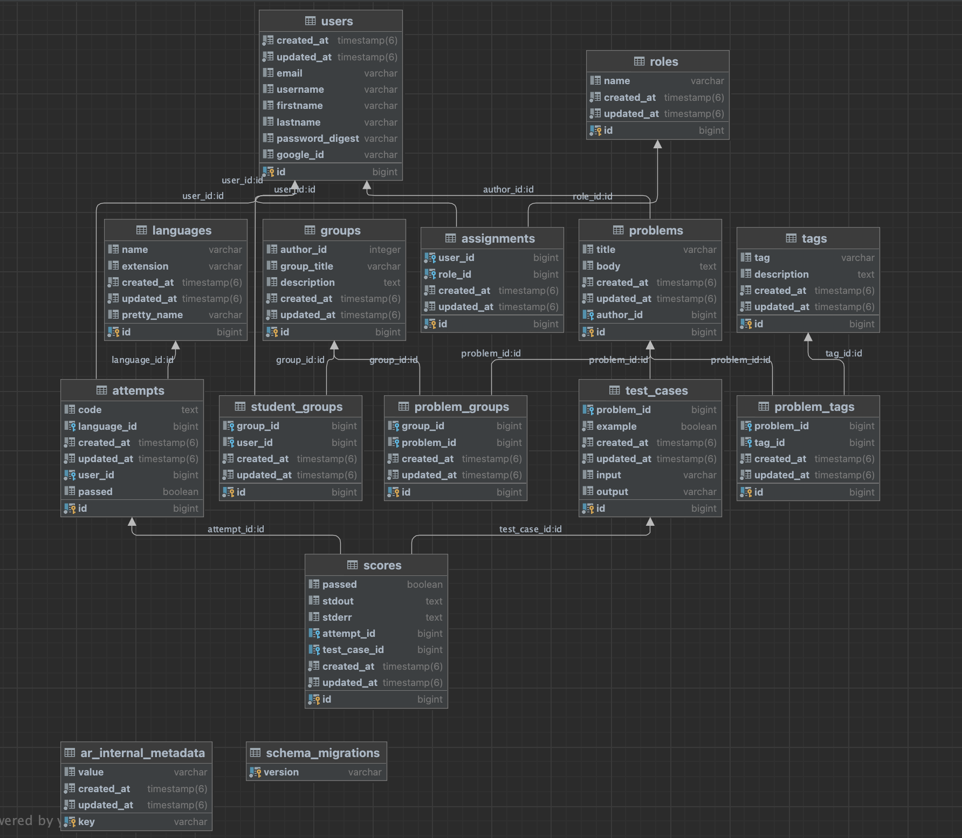
Database & schema changes

Slide 6

Feature : User profiling
Posting problems
Setting test cases
Creating classes
Uploading solution
Post a problem to a class
Add student to a class
Tag a problem
Search problems with a tag
Instructor
Answering problems
Join a class
Attempts
Score of a attempt
Search problems with a tag
Student

Slide 7
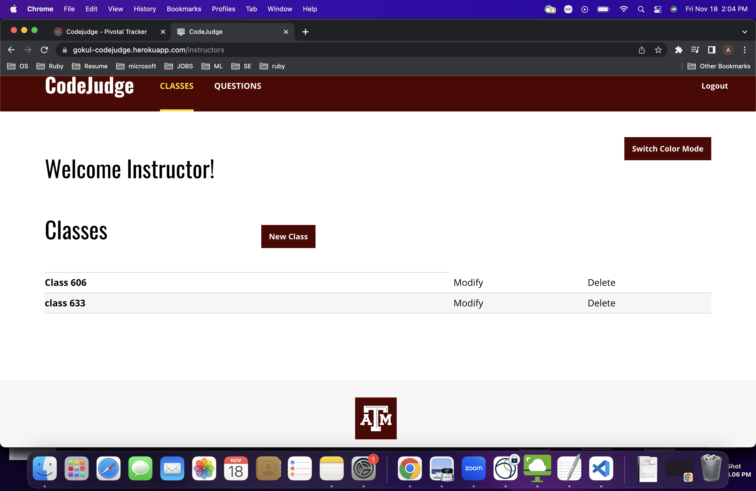
Feature : Student grouping
Instructor should be able to group students(Class). Instructor is also able to add a student to a class he created.

Slide 8
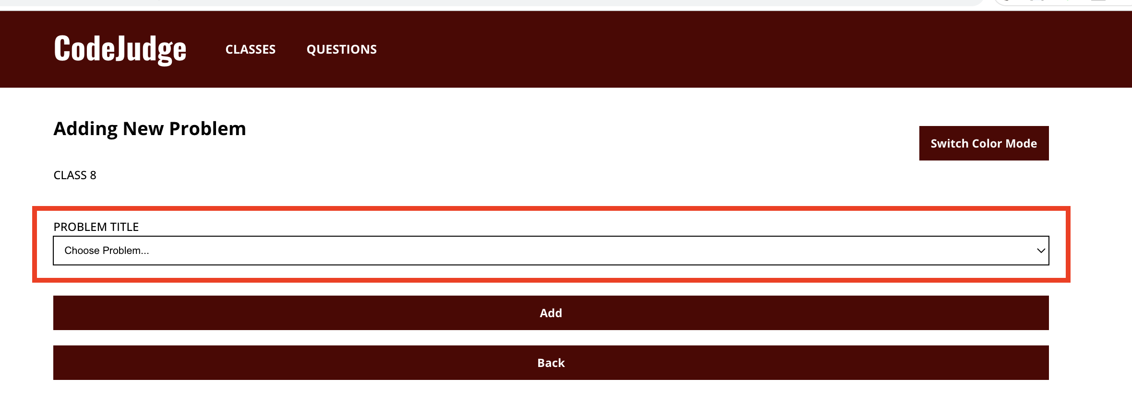
Feature : Mapping Question to a Student group
Instructor should be able to post question to a class. All the students in that class should be able to attempt it.

Slide 9
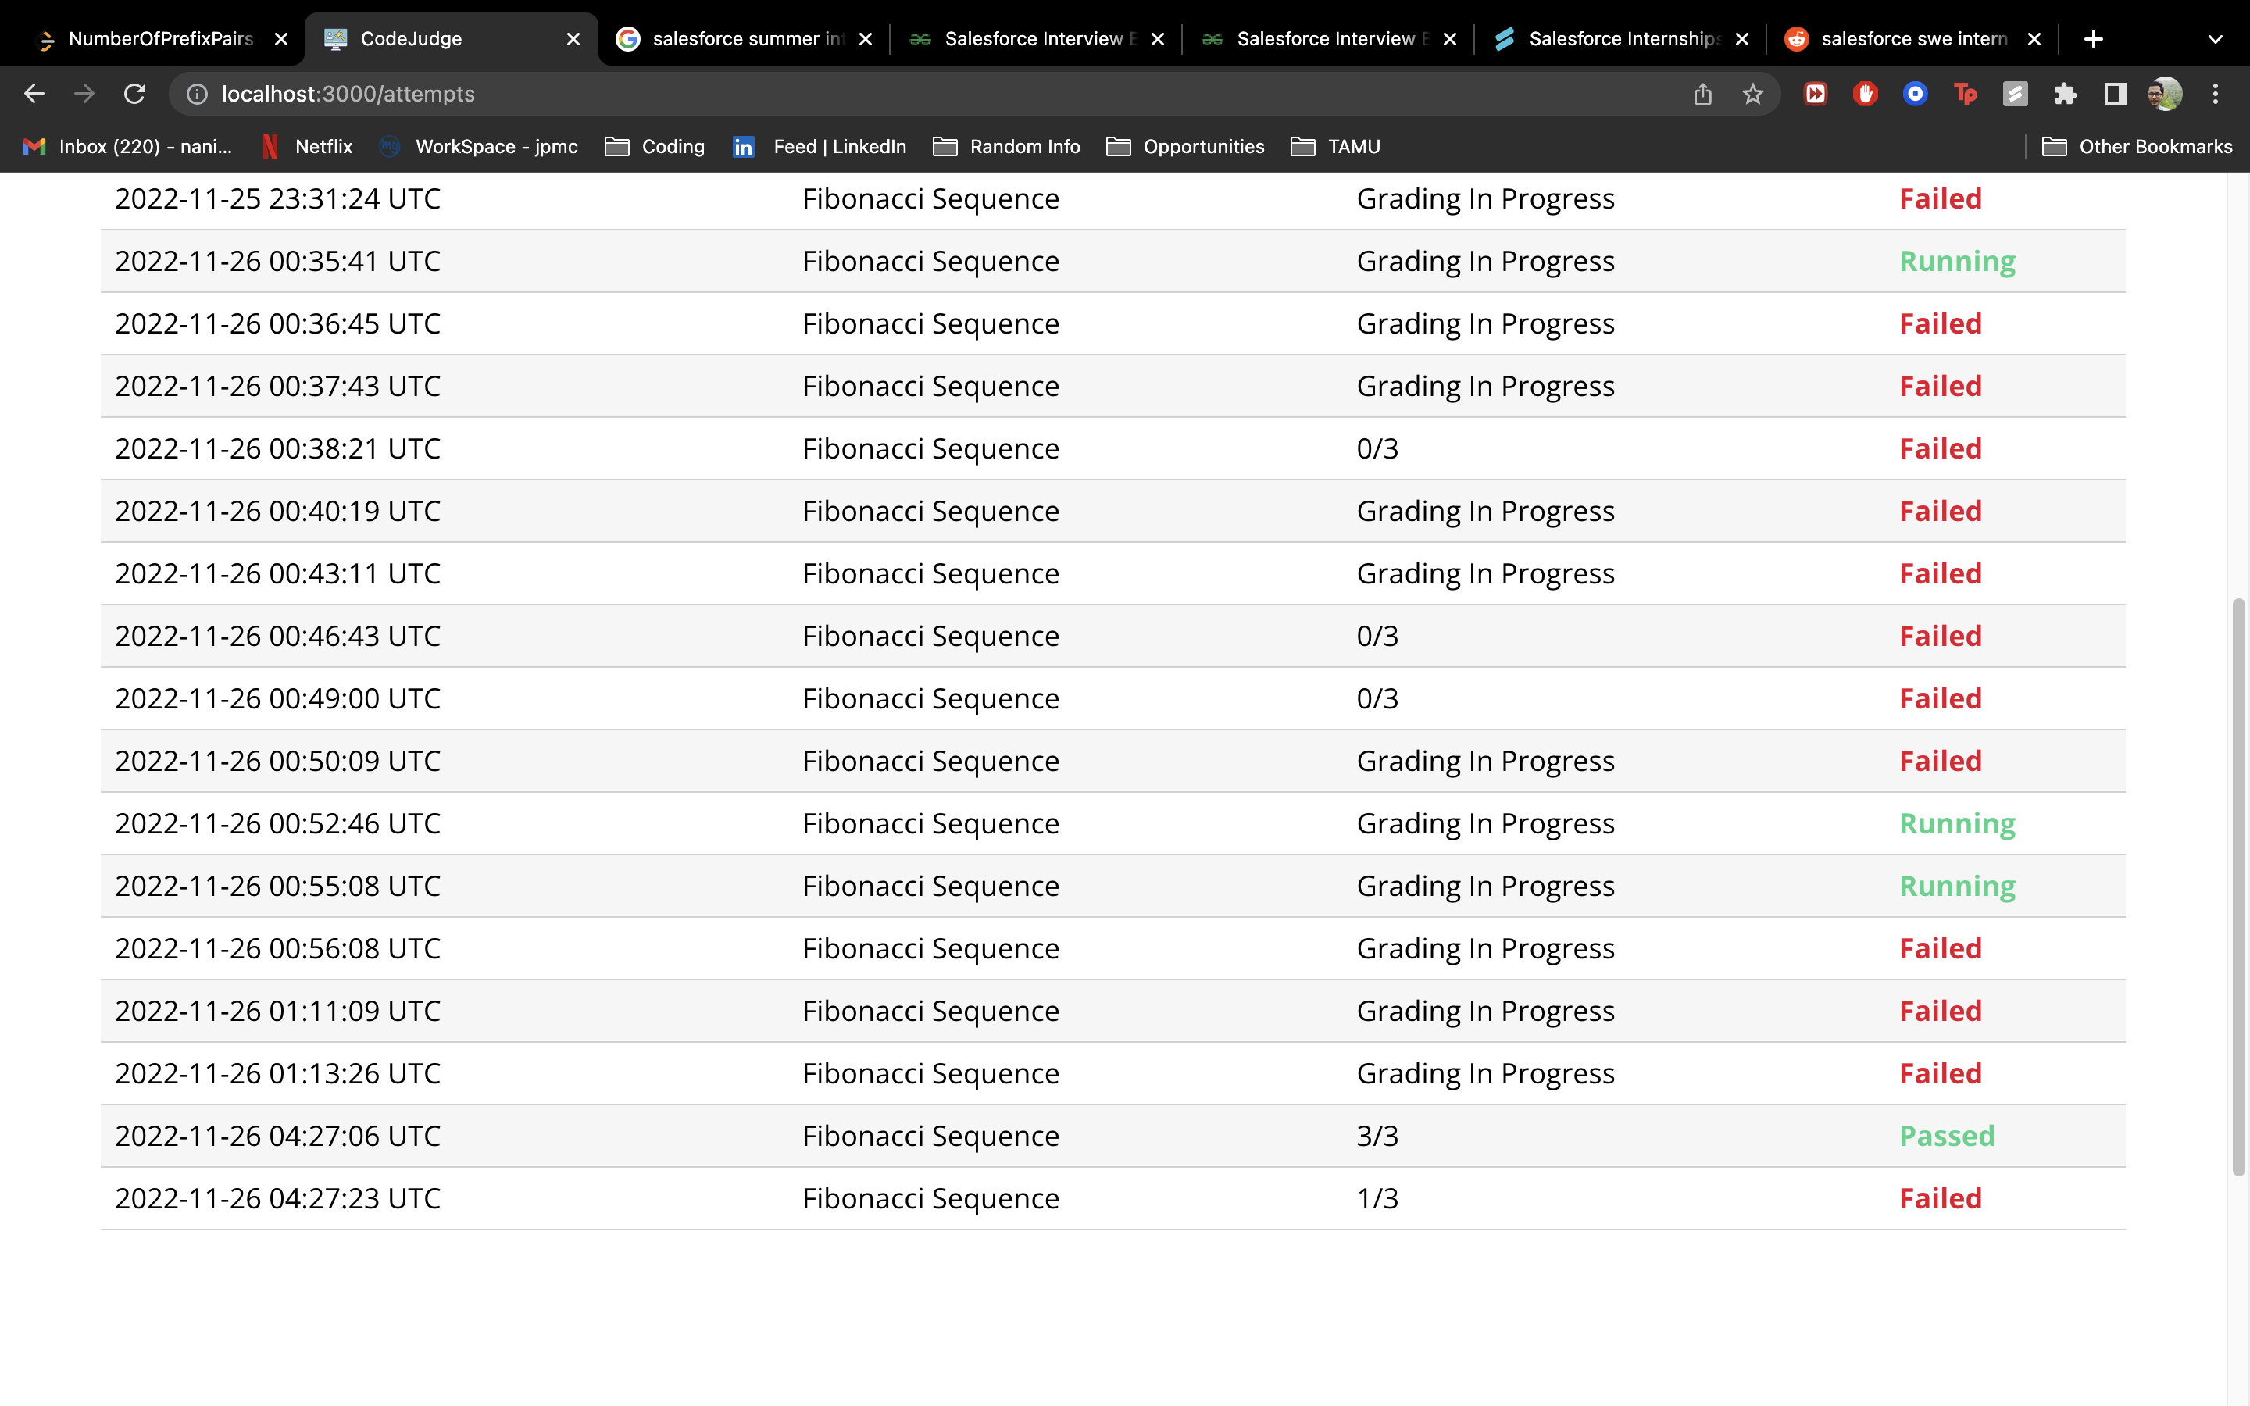
Feature : Student score
After attempting a question, student should be able to see the score.

Slide 10
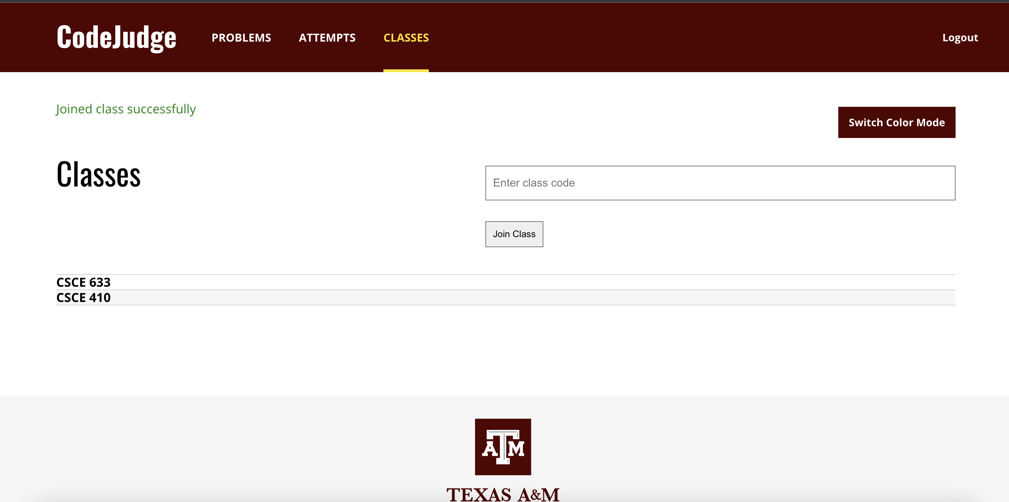
Feature : Class access code
Student should be able to join a class with access code.

Slide 11
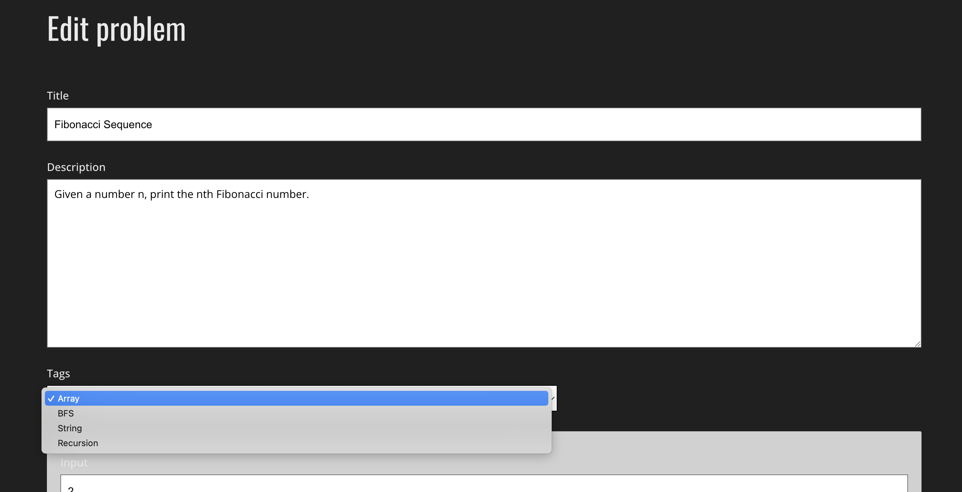
Feature : Question tagging
Instructor should be able to tag questions.

Slide 12
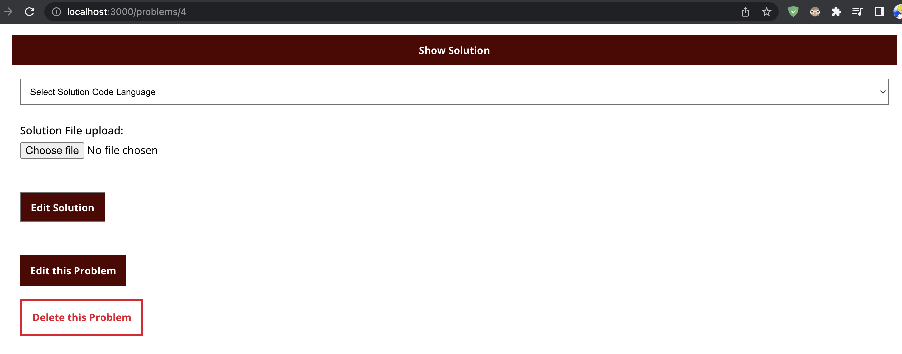
Feature : Upload solution
Instructor should be upload solution for a question to validate the test cases.

Slide 13
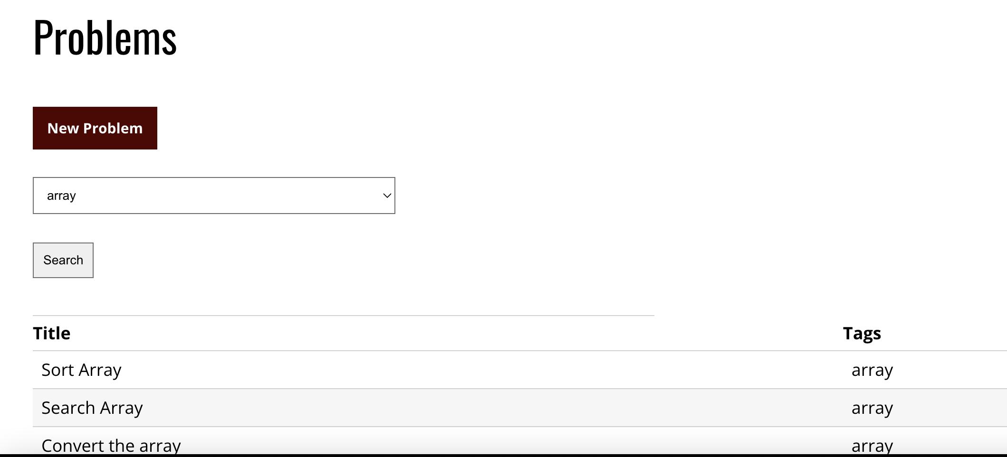
Feature : Search questions by tags
User should be able to search all questions with a specific tag.

Slide 14
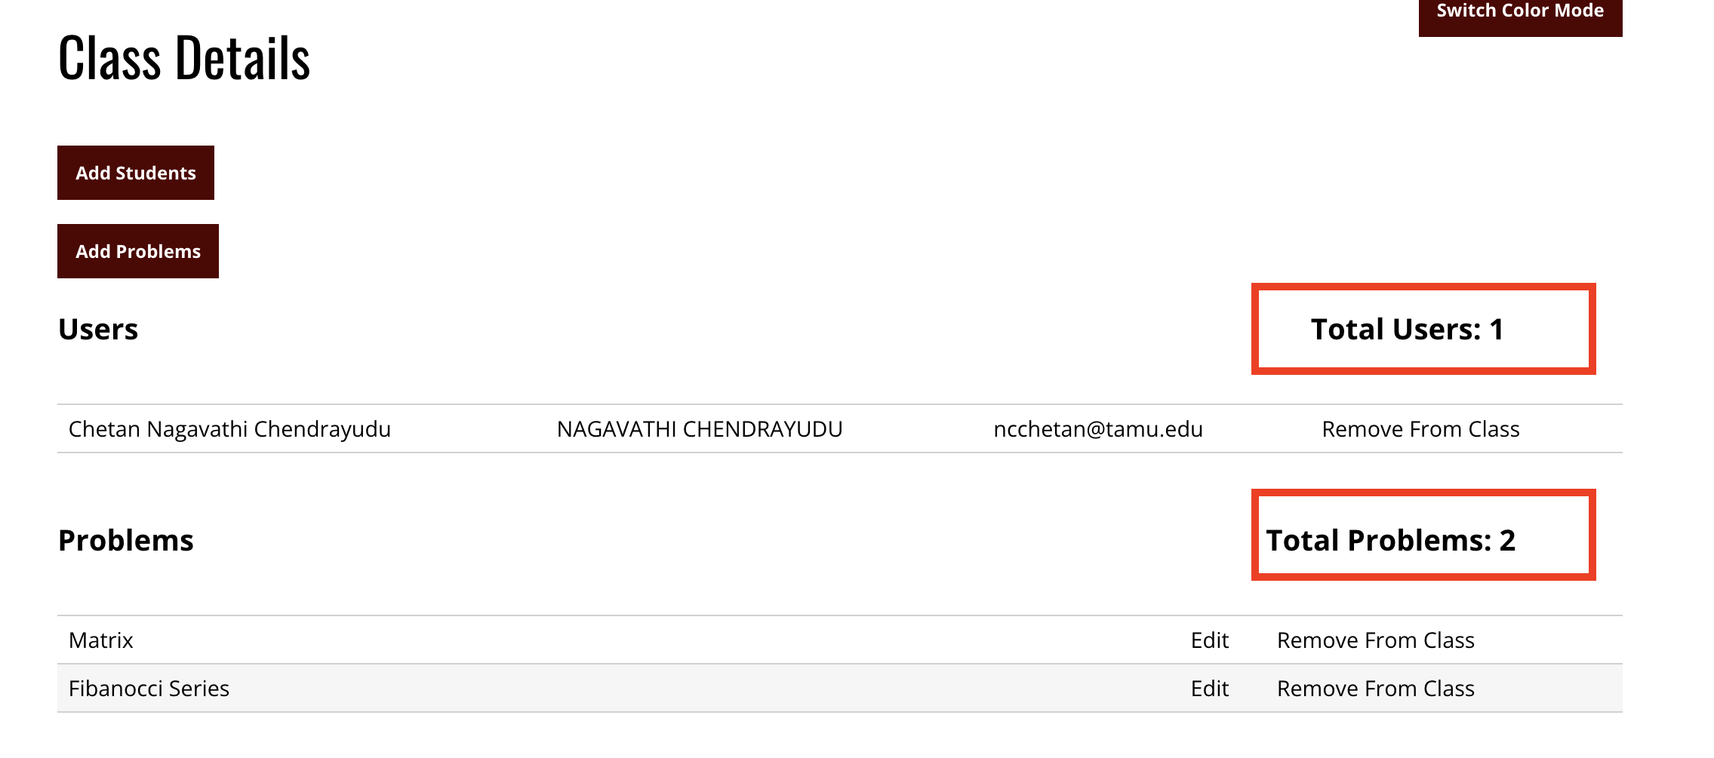
Feature : Questions and Students count
Instructor should be able to see the total count of number of students and questions in a particular class.

Slide 15
Challenges & Lessons
Challenges:
Rectifying existing migration history.
Scaling the existing database
Starting Sidekiq on Heroku as a daemon
Configuring the local infrastructure of the project.
Learnings:
Learning about Docker and containers (Heroku)
Behavior driver development
Using migrations for DDL
Learning MVC architecture

Slide 16
Thank you!

