Slide 1

Humber Bridge Review Results from the HUMBER ESTUARY TRANSPORT MODEL
Notes:
2
2
2

Slide 2
This presentation
The model
Results of option tests
Traffic impacts
Economic appraisal

Slide 3
Purpose of the model
To allow the assessment of the impact of different tolling scenarios for the Humber Bridge on both:
traffic flows
the Humber area economy
Designed to be consistent with the DfT’s Transport Analysis Guidance (WebTAG)
Designed to forecast the demand response to changes in the tolls in terms of the number & destination of trips made, as well as route choice

Slide 4
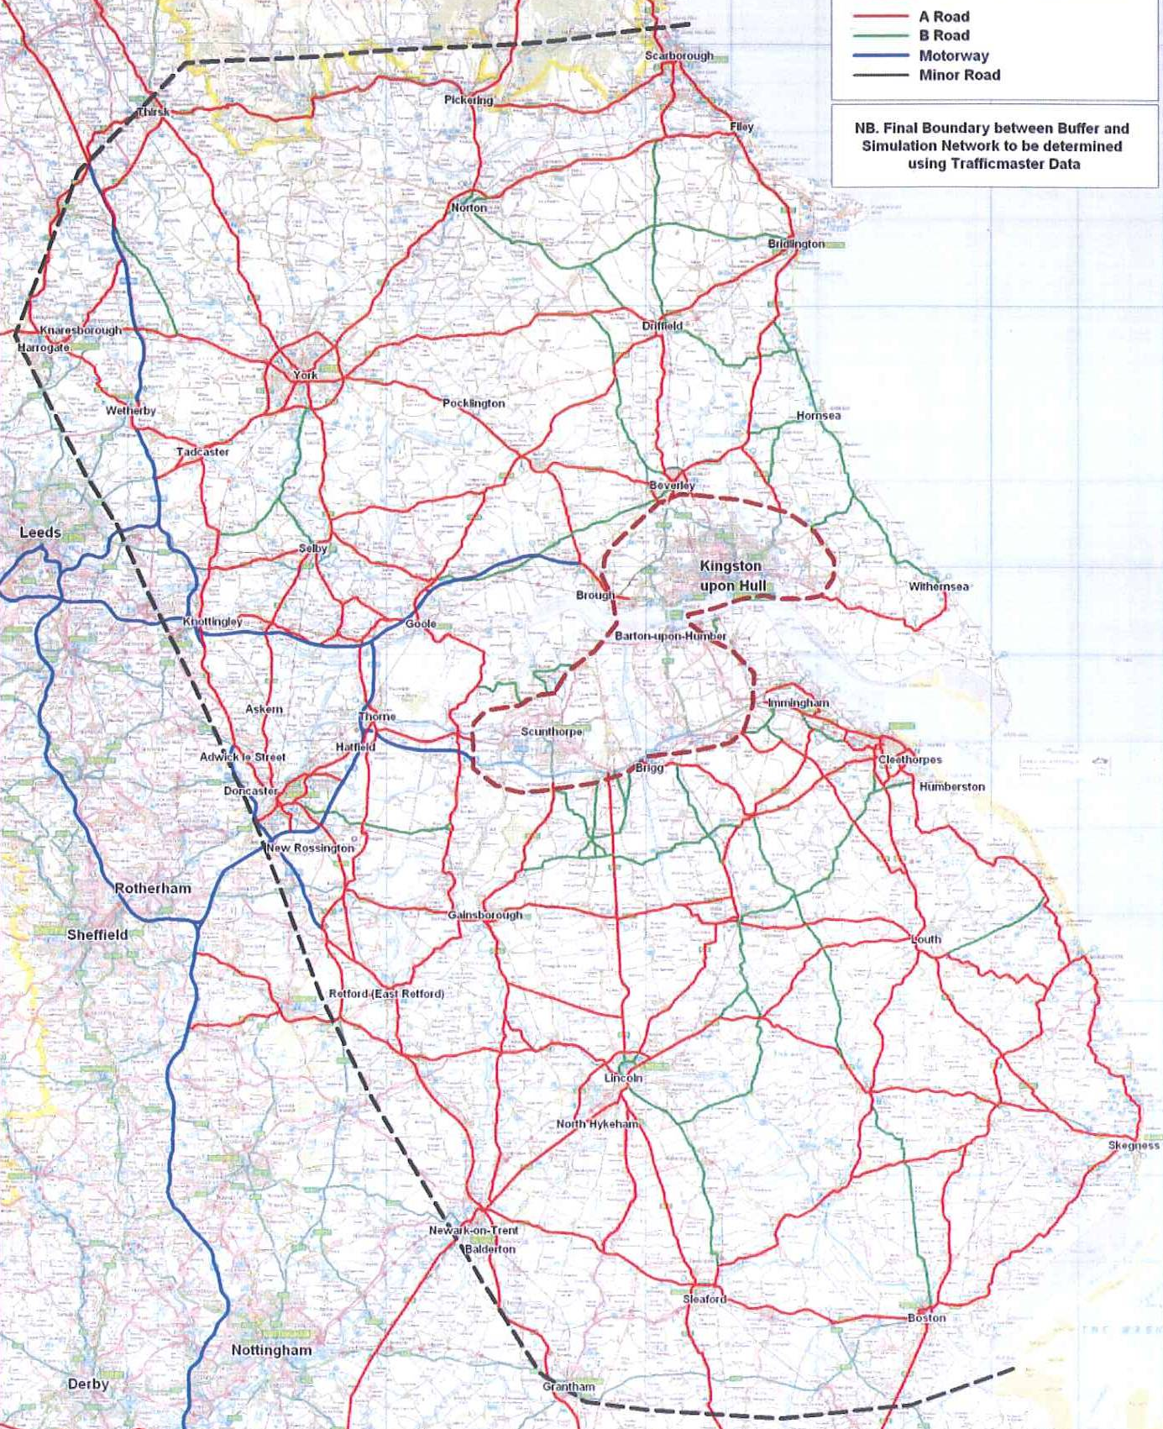
Model area
Full extent: area bounded by Thirsk, Scarborough, Grantham, Boston.
Western boundary: A1
>200 traffic origin/ destination zones plus externals

Slide 5
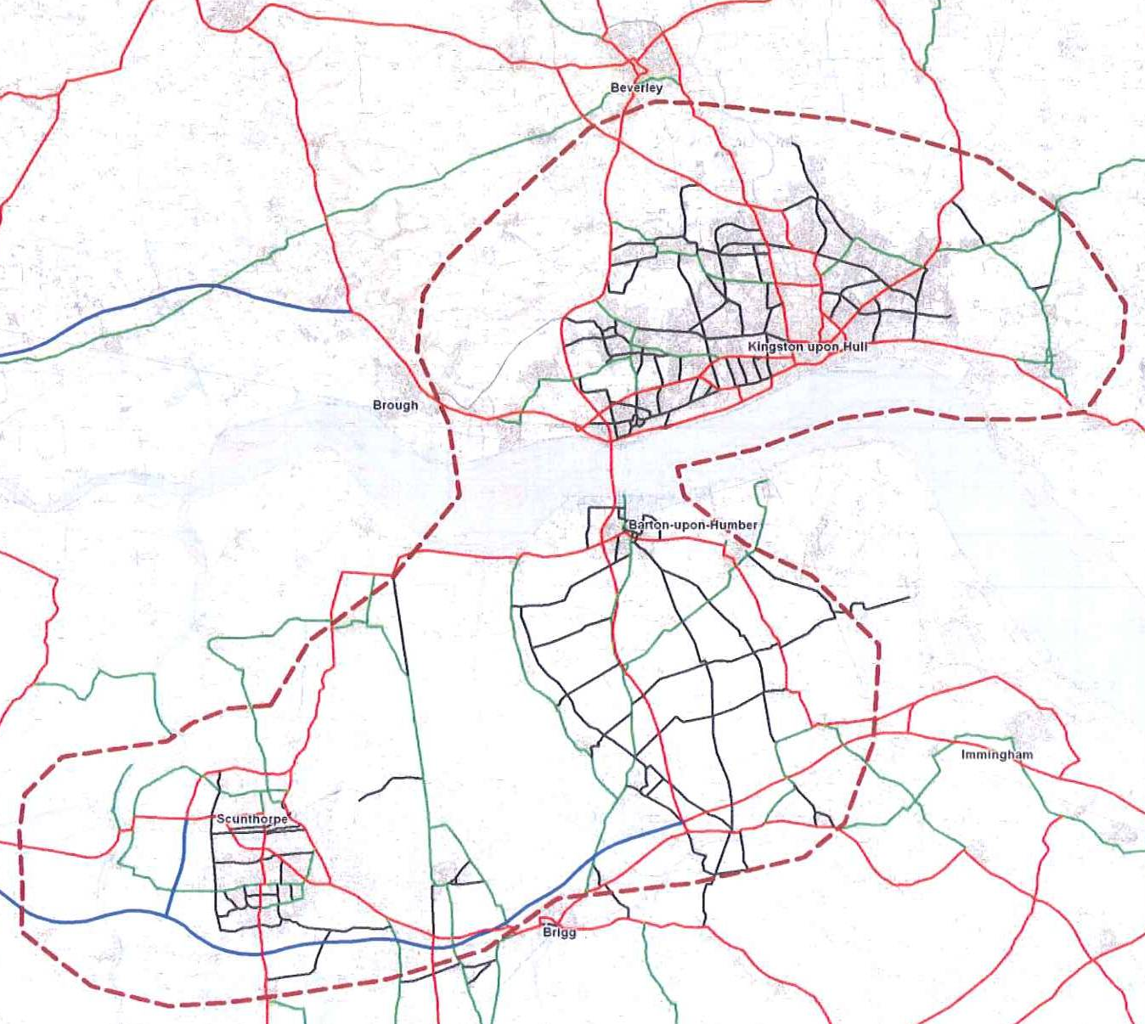
Model area
Network where all traffic movement actively simulated (links and junctions shown):
west of Scunthorpe to east of Hull
150 traffic O/D zones

Slide 6
Model capability
3 time periods: am peak, interpeak, pm peak
5 vehicle types: private car, 4x goods vehicle classes
5 passenger journey purposes:
home-based: journey to work, employer’s business, other
non home-based: employer’s business, other
3 income classes (low, medium, high) for commuting & other
each has its own demand elasticity w/ respect to trip cost
3 model years: 2010, 2021, 2033
Does not model public transport

Slide 7
Model source data
Update & extension of pre-existing north bank model
41,000 roadside interviews on trip origin/destination, journey purpose at 38 sites (5,000 interviews at 5 sites bespoke for this study);
>100 traffic count sites
Growth in trips 2010-2033 from DfT National Trip End Model (NTEM) forecast, version 6.2 incorporating the effects of the 2008/09 recession

Slide 8
Toll option tests
Base case (Do Nothing) = existing toll level in real terms (£2.70 per car in 2010 prices)
Toll levels tested:
No toll
Maintenance-only level toll, £1 per car (63% reduction, other vehicle classes pro rata)
£2 per car toll (26% reduction)
£2.43 per car toll (10% reduction)

Slide 9
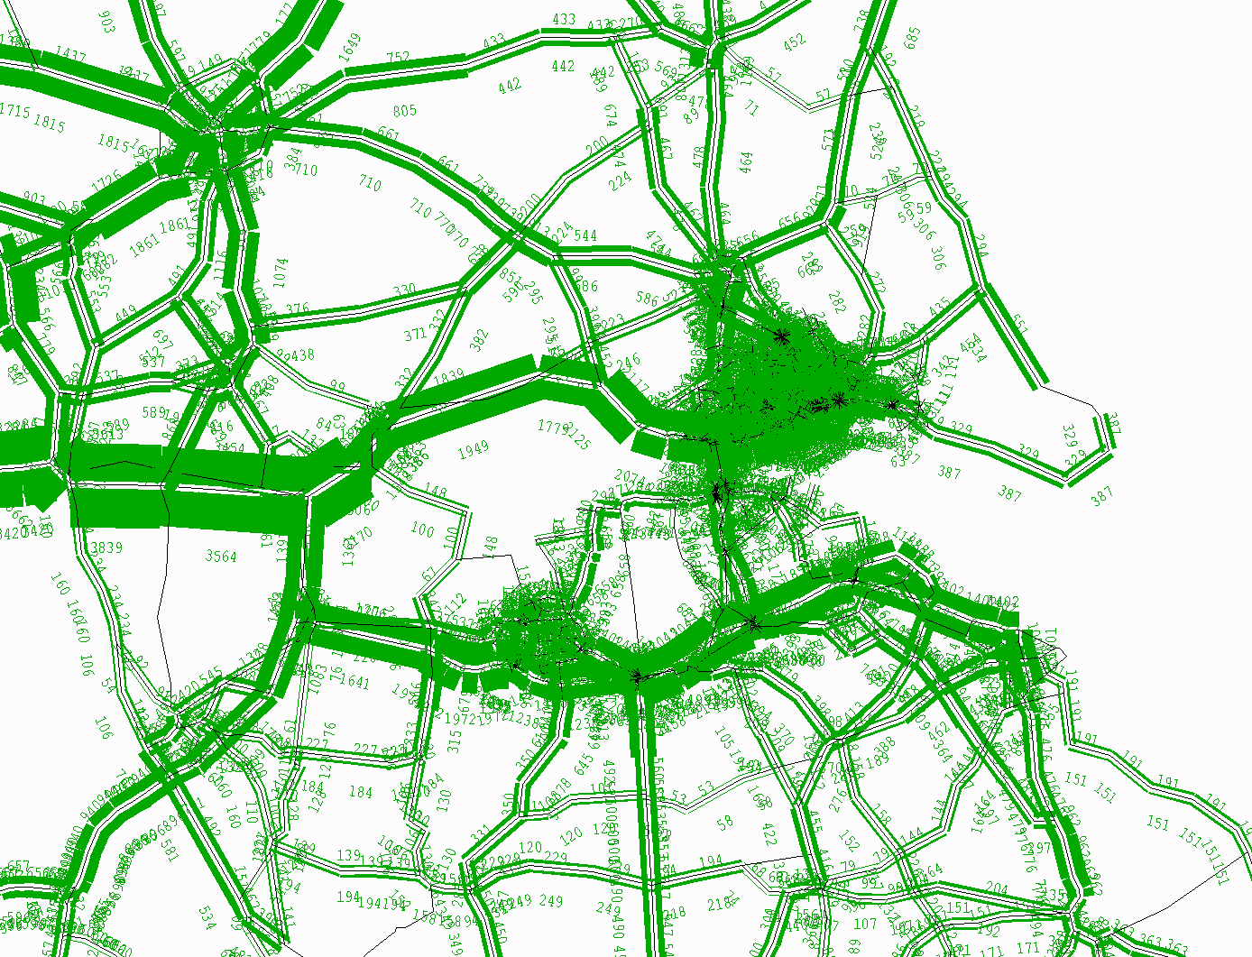
Traffic in the base model (2010)

Slide 10
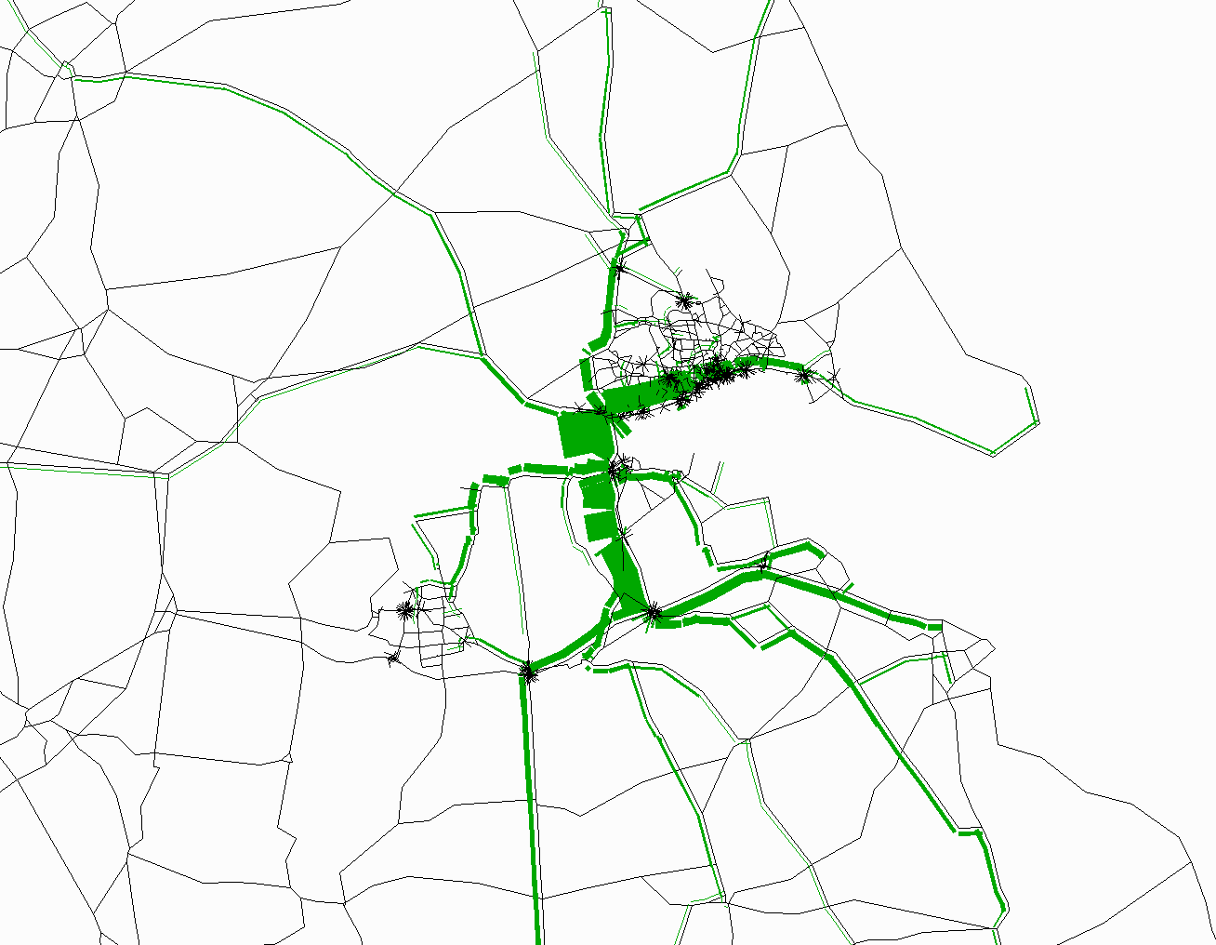
Bridge traffic northbound, am peak

Slide 11
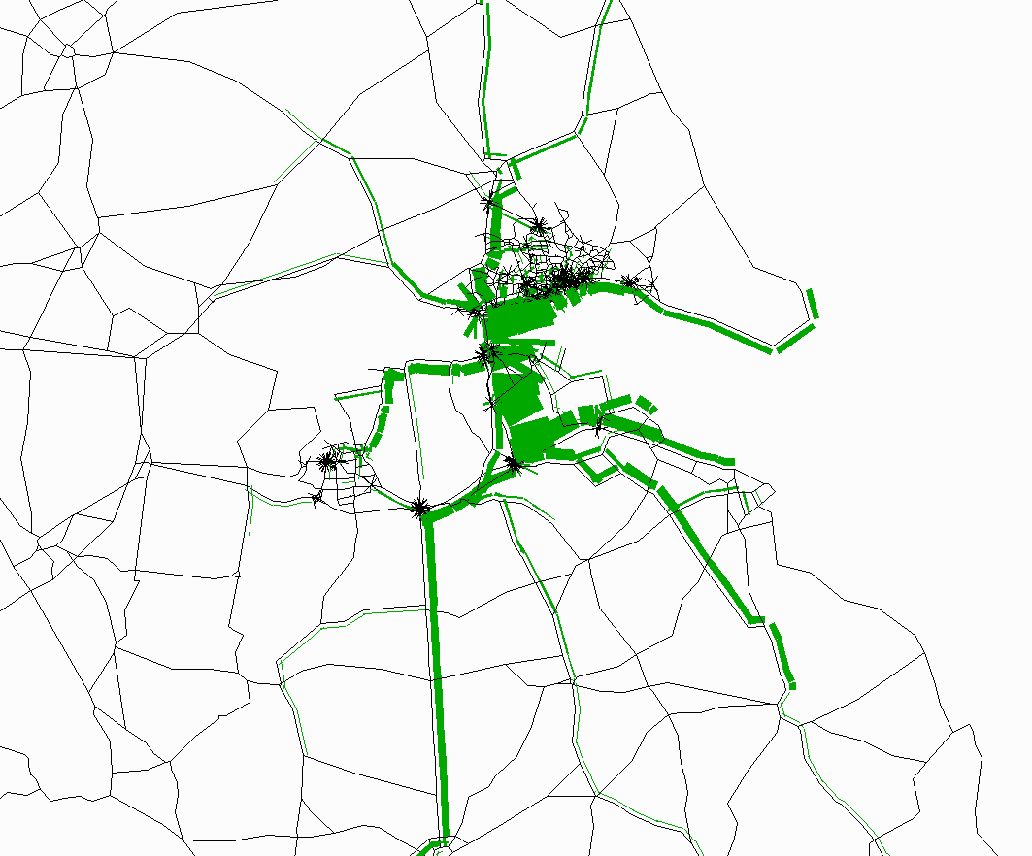
Bridge traffic southbound, am peak

Slide 12
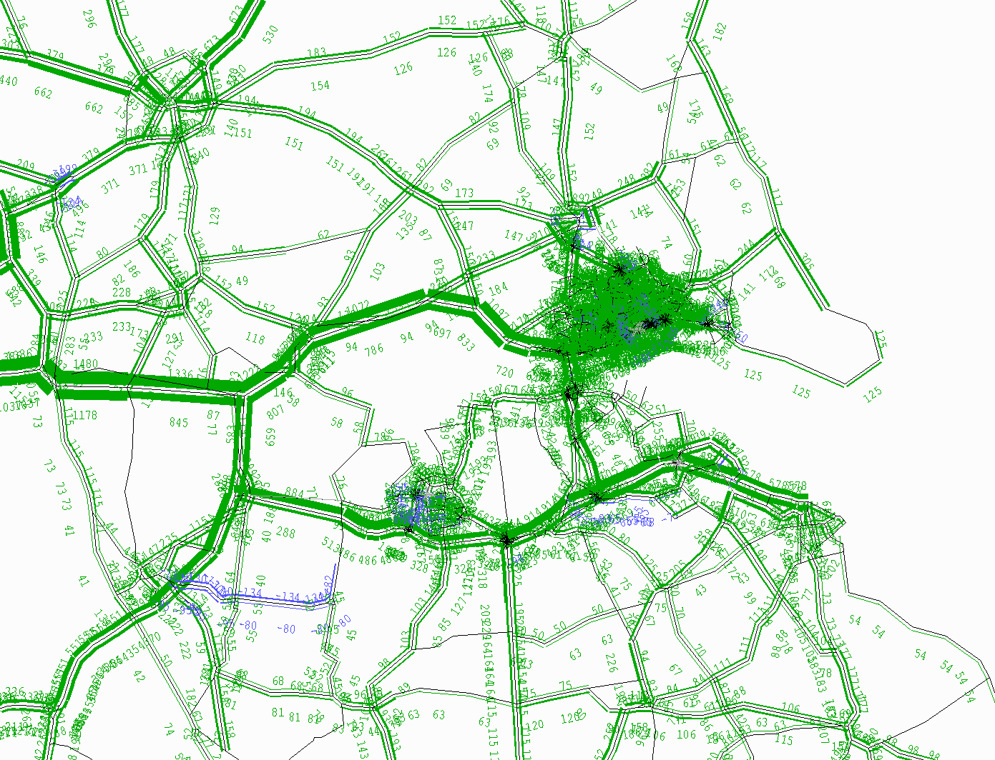
Base case, growth in traffic 2010-2033

Slide 13
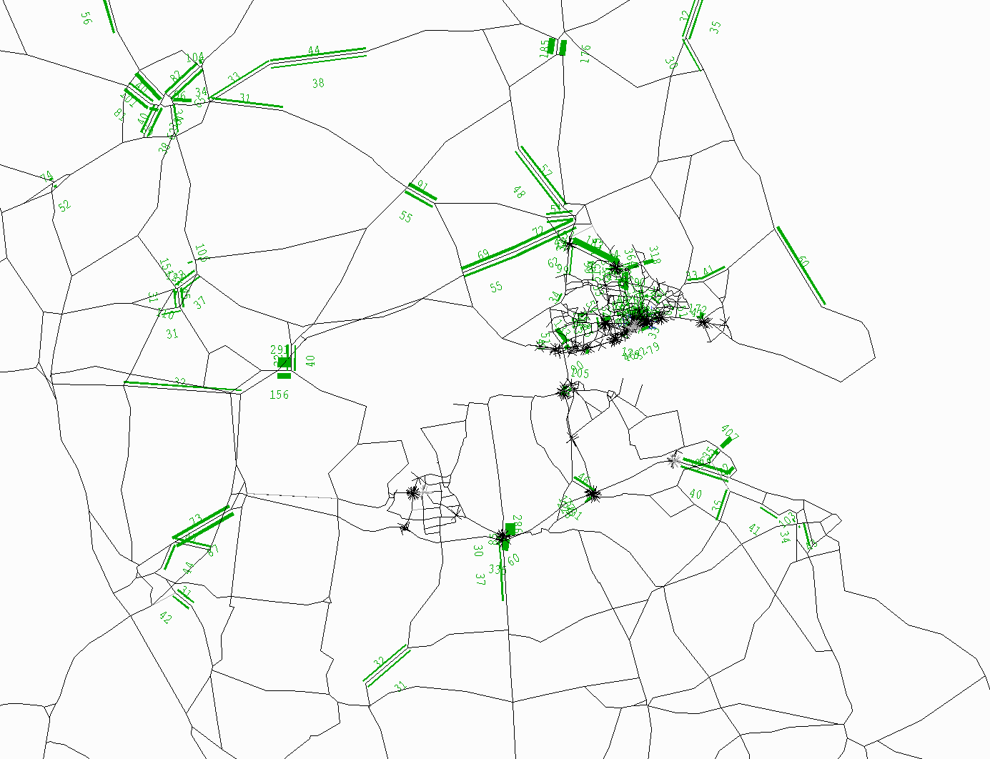
Base case, growth in congestion delays 2010-2033

Slide 14
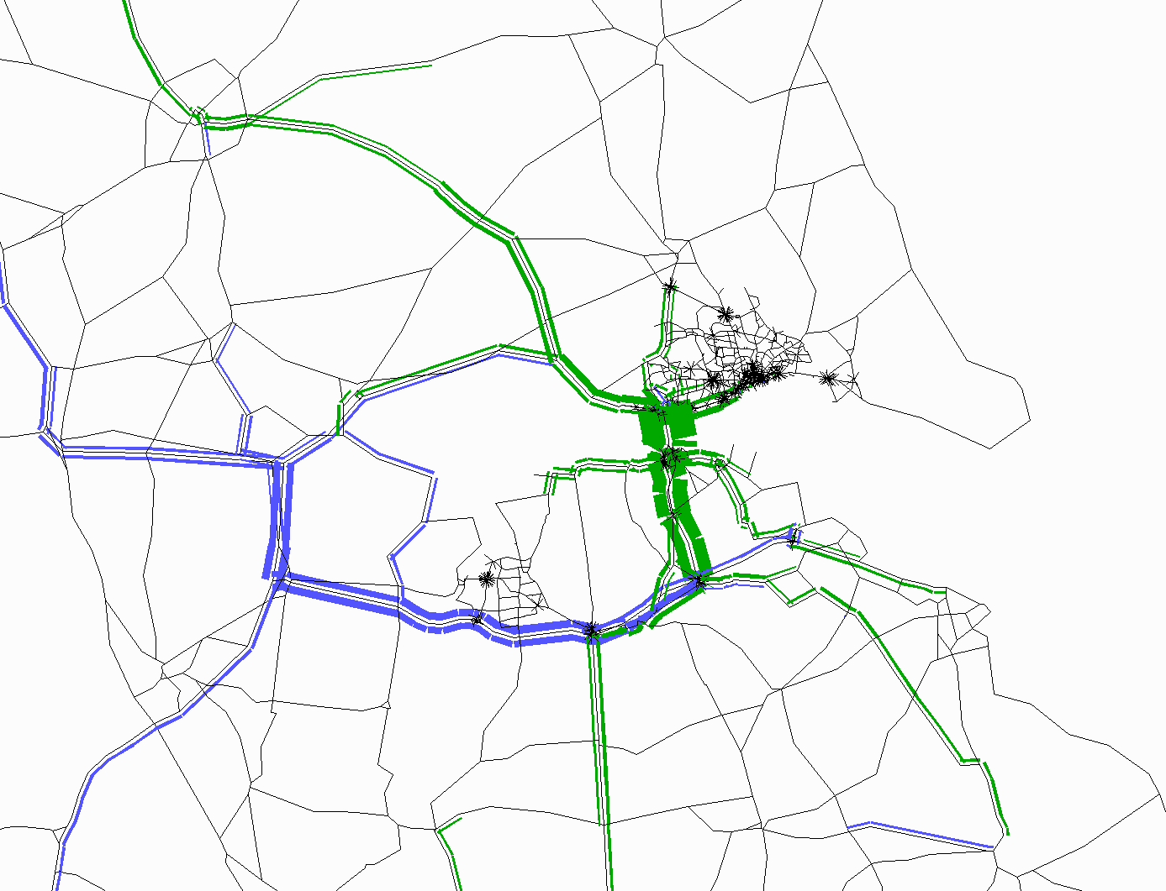
Traffic impact of removing tolls (2010)

Slide 15
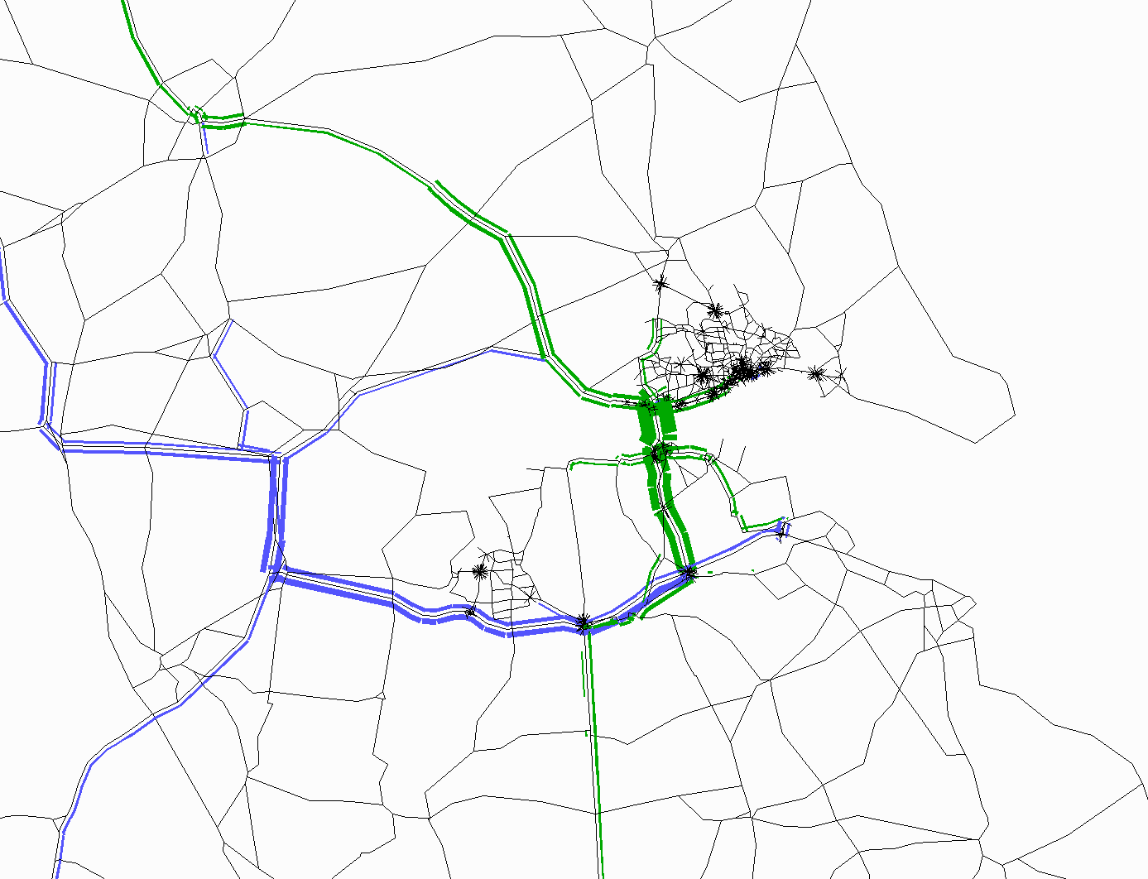
Impact of reducing tolls by 63%

Slide 16
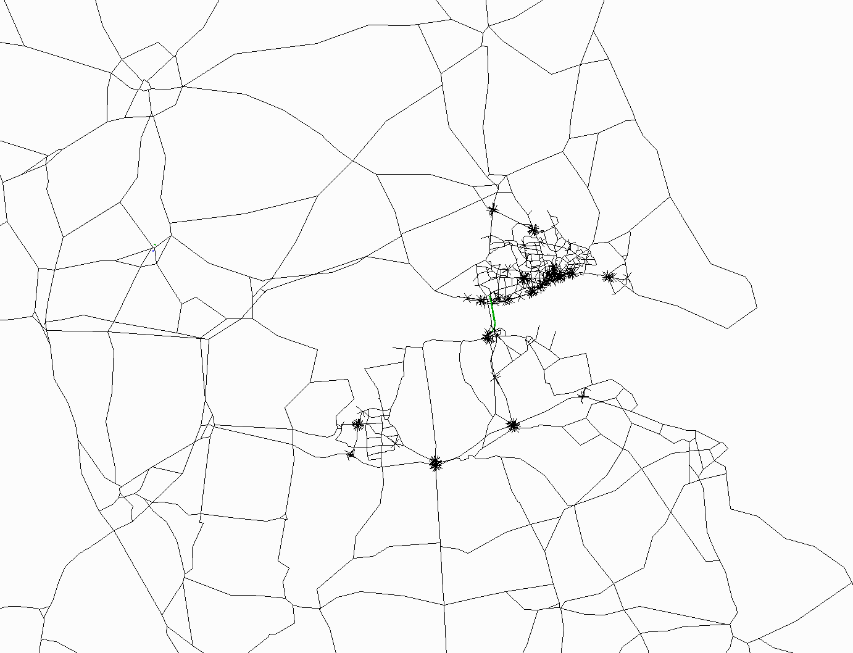
Impact of reducing tolls by 10%

Slide 17
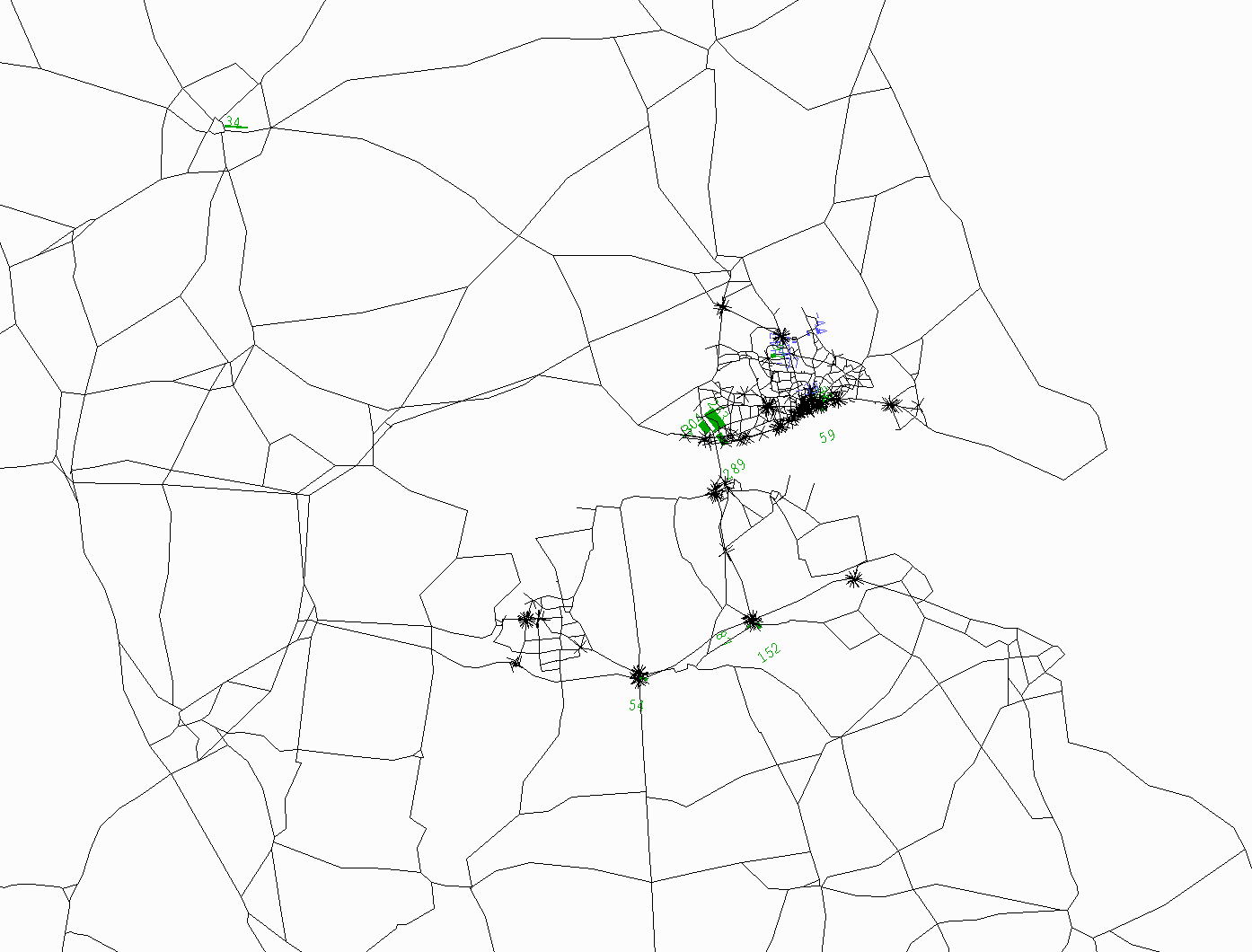
Change in congestion delays in zero tolls option (2033 am peak)

Slide 18
Modelled effect of toll level on traffic

Slide 19
Modelled effect of toll level on traffic

Slide 20
Effect of toll level on traffic, base year (with full demand response)
Toll at 2010 prices | Change in toll | Change in traffic am peak |  | Change in traffic interpeak
2.70 |  | Humber Bg | M62 Goole | Humber Bg | M62 Goole
2.43 | -10% | 3% | 0% | 3% | 0%
2.00 | -26% | 10% | -1% | 10% | -1%
1.35 | -50% | 25% | -1% | 26% | -1%
1.00 | -63% | 32% | -2% | 35% | -1%
0.00 | -100% | 54% | -2% | 67% | -5%

Slide 21
Economic appraisal
Economic efficiency of the transport system analysis:
For commuters, other consumers, businesses (passenger and road freight), impact on:
travel time
vehicle operating cost
user charges
For the public sector, direct revenues and indirect tax revenues

Slide 22
Economic appraisal
Wider impacts analysis:
Agglomeration benefits
Welfare benefits
Broadly speaking, the benefits to employers and employees of a broader, deeper labour pool in a sub-regional labour market

Slide 23
Economic appraisal – transport economic efficiency

Slide 24
Economic appraisal – transport economic efficiency

Slide 25
Economic appraisal – transport economic efficiency

Slide 26
Present value of benefits and costs before wider impacts

Slide 27
Present value of benefits and costs before wider impacts

Slide 28
Present value of benefits and costs with wider impacts

Slide 29
BCR by toll level

