Slide 1
TEAM NUMBER 13
AVENGERS
- INFINITY2K19_HACKATHON_13

Slide 2
PROBLEM STATEMENT
Gated Community
An App/Website for a Gated Community. Wherein people can register and post meetings and issues.
Functional Requirements:
People joining the community should be able to register in the portal.
The registration request should be accepted by the security admin of the community.
People can post a meeting into the portal.
The details of the meeting should be visible to all the families of the community.
People can raise a concern in the portal.
The concern should go the respective department based on the tags selected.
The respective department should also be able to respond to the raised concern.

Slide 3
PROPOSED SOUTION
Develop an App for the Gated Community , where people can register using their Google account or Phone number.
The users are accepted by the Admin / Secretary.
The App helps the community to post meetings and their issues.
A website is developed for the easy access of Admin.
The Admin can accept or decline user accounts.

Slide 4
PROPOSED SOUTION
The App has 4 sections :
Meetings
Concerns
Notice Board
Emergency Phone Numbers
The Website has two sections
Admin portal
Department Portal

Slide 5
PROPOSED SOUTION
App Description
In the meetings portal, Everyone has the access to post the meeting. The posted meetings are visible to everyone else in the community.
The issues portal has two sections, The issues posted by the Secretary regarding the Community are visible to all. The issues posted by people are only visible to them.
The issues are forwarded to departments based on the tags given.
The notice board is a collection of current events, upcoming meetings and recent issues opened. It is a user specific page.
The emergency section has the Phone numbers of POLICE , FIRE STATIONS , AMBULANCE etc.

Slide 6
PROPOSED SOUTION
Website Description
In the Web portal the admin has access to all the requests sent by the users.
The admin can accept or decline the requests.
The admin can also delete or update the status of the requests.
The admin has control over all the user accounts, issues and meetings.
The issues are forwarded to respective department based on the tags.
The issue status could be changed by the department as the issue is resolved.

Slide 7


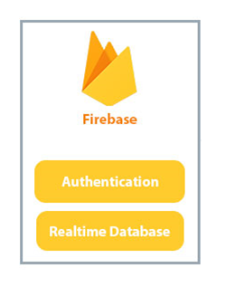

PROPOSED SOLUTION
+

Slide 8
PROJECT DEMO (APP)
Link to Video:
https://drive.google.com/open?id=1InO3GLdDifYU3z_uFDq-km4LxeCHBTOA

Slide 9
PROJECT
DEMO (WEB)
Link to Video:
https://drive.google.com/open?id=1Dttf5VIT4ZsXEAPhSw32aCJt1xtAgCg2

Slide 10
THANK YOU

