Slide 1
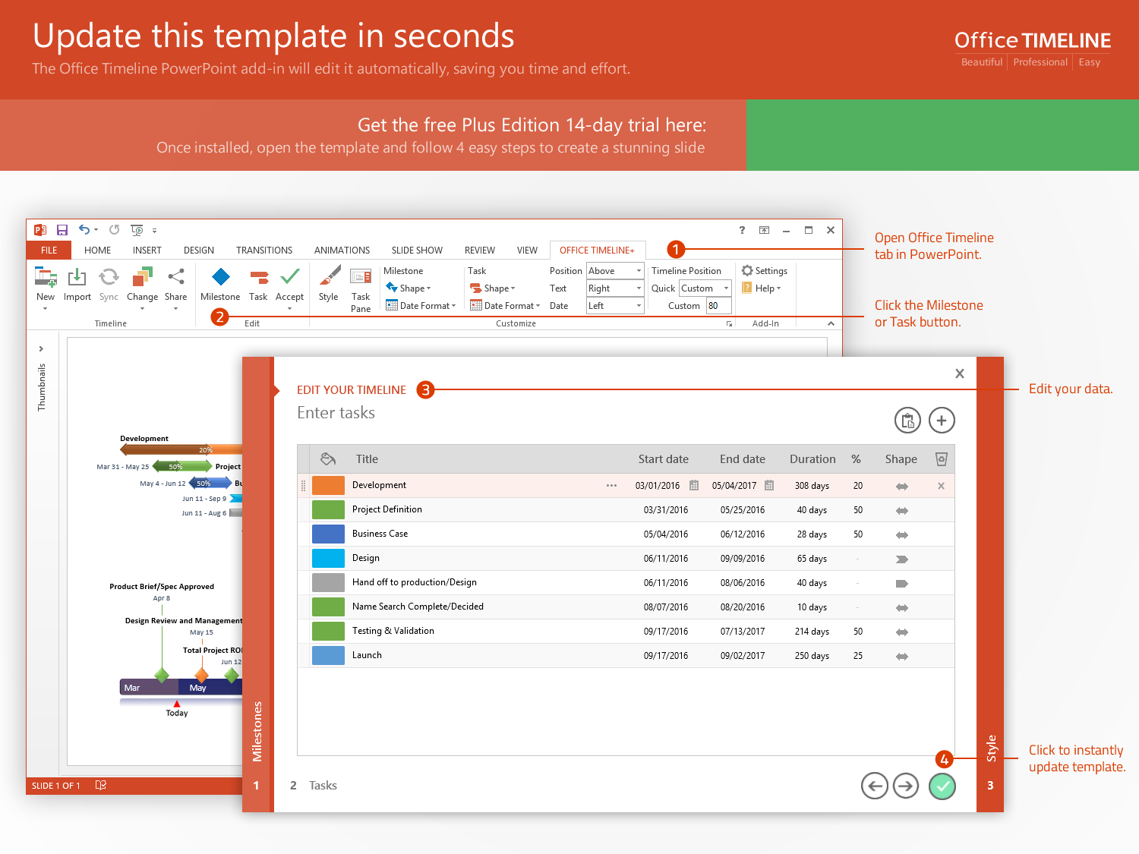
https://www.officetimeline.com/14-days-trial

Slide 2
Minimal Prototype
Release Web Prototype
9/30/17
3/1/18
Kick-Off
Submission
Online Testing
Release
11/25/17
5/20/18
3/15/19
2017
December
Jul
Oct
2018
Apr
Jul
Oct
2019
Apr
2019
Today
10/30/17
7/22/18
1/1/19
Integration
Validation
Exec Review
143 days
5/17 - 11/17
System Design
80%
74 days
11/17 - 3/18
Coding
73%
129 days
3/18 - 8/18
Code Improvements
56%
42 days
8/18 - 10/18
Stabilization
20%
77 days
8/18 - 11/18
Integration with Website
15%
99 days
10/18 - 2/19
User Acceptance
104 days
1/19 - 5/19
Documentation

