Slide 1
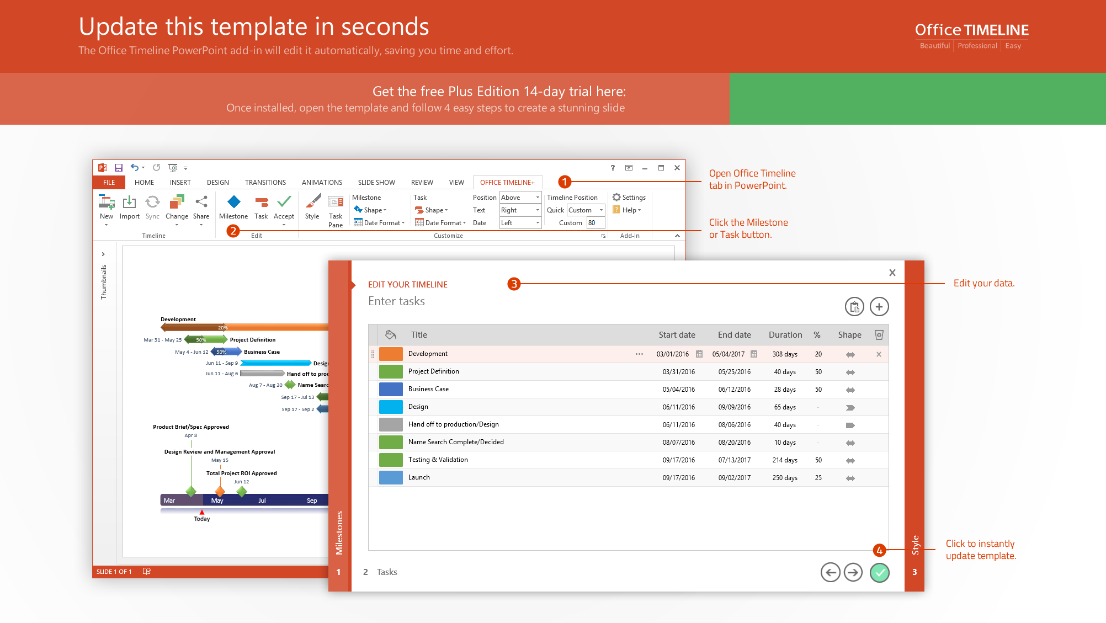
https://www.officetimeline.com/14-days-trial

Slide 2
Release Web Prototype
Minimal Prototype
9/30/17
3/1/18
Kick-Off
Submission
Online Testing
Release
5/1/17
11/25/17
5/20/18
3/15/19
2017
Apr
Jul
Oct
2018
Apr
Jul
Oct
2019
Apr
2019
Today
10/30/17
7/22/18
1/1/19
Integration
Validation
Exec Review
143 days
System Design
80%
5/17 - 11/17
74 days
Coding
73%
11/17 - 3/18
129 days
Code Improvements
56%
3/18 - 8/18
42 days
Stabilization
20%
8/18 - 10/18
77 days
Integration with Website
15%
8/18 - 11/18
99 days
User Acceptance
10/18 - 2/19
104 days
Documentation
1/19 - 5/19

