Slide 1
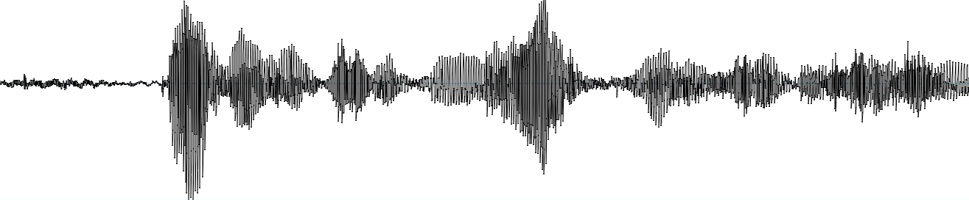
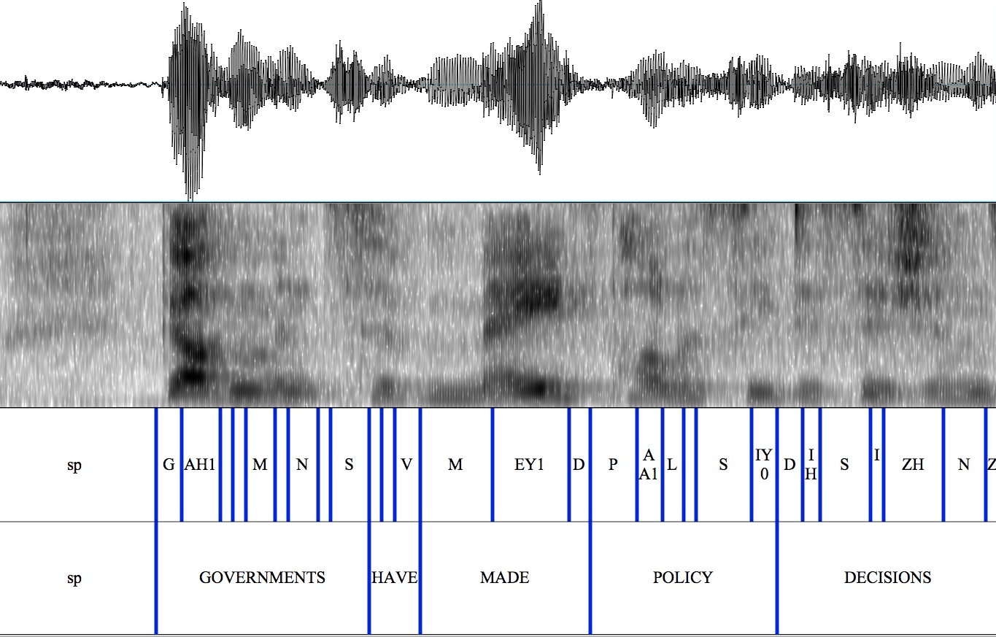
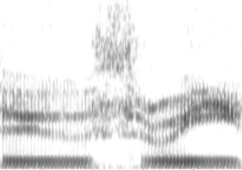
Words phonemes
ADVERSITY AE0 D V ER1 S AH0 T IY0
BLUEST B L UW1 IH0 S T
BLUESTEIN B L UH1 S T AY0 N
Acoustic
models in
memory
Lexicon &
Transcription
Property
Extraction
Evaluation:
Likelihood
score

Slide 3
Dec 2016
Jan 2017
Feb 2017
Mar 2017
Apr 2017
May 2017
Jun 2017
Jul 2017
1st
ACII
GPU &
CPU
7th
8th
GPU &
CPU
SPECOM
14th
15th
INTERSPEECH
GPU &
CPU
21th
22th
31st
TSD

