Slide 1

HACKATHON PITCH · QUANTUM OPTIMIZATION FOR EV CHARGING STATIONS
Q·Grid
Every EV becomes an agent. The Center does the thinking.
A software-only quantum-optimized charging orchestrator — piloted on Bengaluru traffic data.
Q
by JustCode
15 agents
5 stations
344-binary QUBO
— in collaboration with Qub3RAM.team
Notes:
Good morning, judges — thank you for having us. We are JustCode, here in collaboration with Qub3RAM.team, and this is Q Grid. One line of definition: Q Grid is a pure software layer that sits between every EV and every charger, and it decides who charges where and when using quantum optimization. Every electric vehicle becomes a software agent; a central orchestrator — the Center — does the global thinking. Everything you are about to see is real code, executed end to end on a Bengaluru scenario built from traffic and tariff data — not mockups — and every number is auditable in the repository. Fifteen agents, five stations, one 344-binary QUBO. Let's start with why this problem deserves a quantum-grade solution.

Slide 2

THE PROBLEM
Charging today is first-come, first-served — and everyone loses.
Drivers queue at the nearest station without knowing where capacity is free. Stations fill in lopsided ways — one port oversubscribed while another sits idle. And charging demand lands squarely on the evening peak, when grid electricity costs 4.5× the midday solar price.
4.5×
⚡
0
⊘
21%
$
evening tariff vs midday solar
coordination between vehicles today
of waiting cost the FCFS baseline wastes in our own simulation
(₹18.00 vs ₹4.00 /kWh in our Bengaluru window)
no agent, no forecast, no global view
(₹1,830 of ₹4,206 total)
⚿
The constraint:
we cannot build new stations. We can only decide better who plugs in where, and when.
Notes:
Today's default is FCFS — first-come, first-served. Whoever arrives first plugs in; everyone else queues; and nobody holds a global view. That produces three failures. Drivers head to the nearest station blind to free capacity, so stations fill lopsided — one port oversubscribed while a neighbor sits idle. And charging demand lands on the evening peak: across our 12:00-to-17:30 Bengaluru window, grid electricity at the evening end costs 4.5 times the midday solar price — eighteen rupees versus four per kilowatt-hour. In our simulation we put an actual rupee cost on waiting, weighted per urgency class: ₹260 per 30-minute slot for a NOW vehicle, ₹150 for SOON, ₹80 for CAN-WAIT. Measured on that yardstick, the FCFS baseline wastes 21 percent of total waiting cost. Capacity is fixed — we cannot build new stations — so scheduling is the only lever we have.

Slide 3

THE IDEA
A tiny agent in every EV. One global brain at the Center.
▦
On every vehicle
✦
At the Center
Q-Agent SDK — pre-installed by OEMs. Reports GPS position, state of charge and a pseudonymous ID every 30 seconds.
The Center ingests the whole fleet, triages urgency with AI, prunes to the 2 nearest stations per vehicle, and encodes the global assignment as one QUBO.
No cameras, no PII, no new hardware.
Solvers return a city-wide schedule: who charges where, starting when, at what price.
⊘
DRIVERS NEED NOTHING
— no app, no dashboard, no login. Charging is a background task Q Grid performs; the schedule arrives over the air.
01
SENSE
→
02
OPTIMIZE
→
03
ACT
telemetry in
quantum + classical + AI
schedule out to every agent
Pure software. Works with any OEM that ships the SDK — the open SDK is the moat, not the hardware.
Notes:
This is exactly the architecture the judges asked for: an agent on every vehicle, a registry, GPS and battery tracking, and a central system making the global decision. Left side: the Q-Agent SDK, pre-installed by OEMs, reporting GPS position, state of charge and a pseudonymous ID every thirty seconds — no cameras, no PII, no new hardware. Right side: the Center. It ingests the whole fleet, triages urgency with AI, prunes each vehicle to its two nearest stations, encodes the global assignment as one QUBO, and hands it to solvers. The Center runs continuously — one optimization cycle per thirty-minute window. The loop is sense, optimize, act. And notice what is missing: drivers have zero UI. No app, no dashboard, no login — the schedule arrives over the air. Zero new infrastructure, and the SDK stays open to any OEM, fleet or charging-point operator.

Slide 4

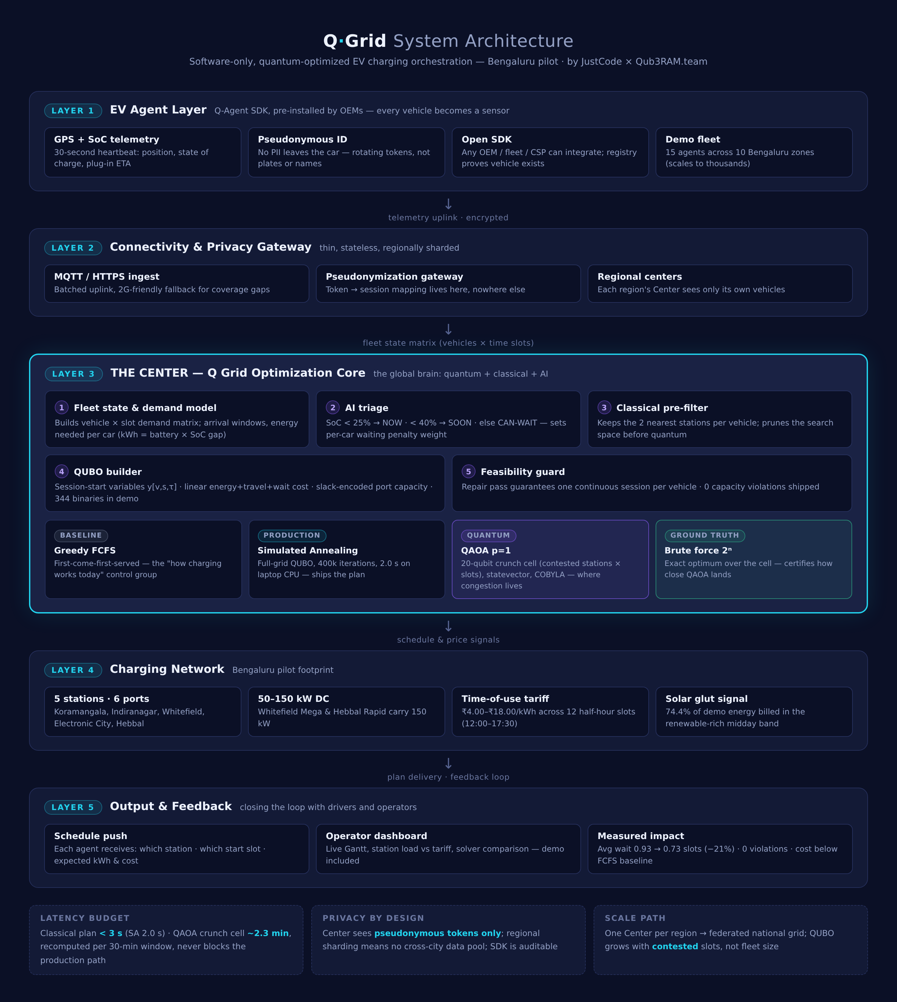

SYSTEM ARCHITECTURE
Five layers, from telemetry to schedule — all software.
L1
EV Agent Layer
Q-Agent SDK in every vehicle
L2
Connectivity & Privacy Gateway
pseudonymization, regional sharding
L3
THE CENTER
triage → prune → QUBO → 4 solvers → feasibility guard
L4
Charging Network
5 Bengaluru stations, time-of-use tariff
L5
Output & Feedback
schedule push, dashboards, measured impact
Notes:
Reading the data path top to bottom. Layer 1: the Q-Agent SDK streams GPS position and state of charge from every vehicle. Layer 2: the connectivity and privacy gateway pseudonymizes that traffic and shards it by region. Layer 3 — highlighted, because this is where quantum lives — the Center triages urgency, prunes to candidate stations, encodes the QUBO and runs four solvers behind a feasibility guard. Layer 4 is the physical network: five Bengaluru stations on time-of-use tariffs. Layer 5 pushes the schedule back out and measures impact. On latency: the classical plan ships in under three seconds — simulated annealing takes 2.0 — while QAOA spends about 2.3 minutes on the crunch cell, recomputed per window, and never blocks the production path. Privacy: the Center sees pseudonymous tokens only. Scale: one Center per region, federated.

Slide 5


THE MATH
One QUBO holds the whole city-wide decision.
✦
Why this encoding wins
01
Variables
y[v,s,τ] = 1 iff vehicle v starts one continuous charging session at station s in half-hour slot τ. 344 binaries in the demo.
✓
Continuous sessions guaranteed by construction — no split charging
02
Objective (linear, ₹)
Exact capacity inequality — SA stopped overfilling stations (the bug that once made greedy look smart)
✓
energy cost E(v,s)·tariff(τ) + travel 9 ₹/km · dist(v,s) + waiting w(v)·(τ − arr_v),
where w = ₹260 NOW / ₹150 SOON / ₹80 CAN-WAIT per slot.
✓
AI-set urgency weights make fairness a number, not an afterthought
03
Constraints
QUBO
✓
Scales with contested slots, not fleet size — the quantum entry point
each vehicle charges exactly once (penalty λ₁=4000); port capacity Σx ≤ ports encoded exactly with slack variables u (weights m=1..ports) so empty ports are never punished.
Notes:
Everything on this slide collapses into one object: a QUBO — quadratic unconstrained binary optimization — the native input format for quantum annealers, and reachable from gate-model machines through the standard Ising mapping. The key trick is the variable. Instead of flat x[v,s,t] occupancy variables — which force a capacity inflation by K, the maximum port count, and distort the objective — y[v,s,τ] fires exactly once, at the start of one continuous session, so split charging is impossible by construction. The objective is plain rupees: energy at the time-of-use tariff, travel at nine rupees per kilometre, and waiting weighted by urgency — 260, 150, or 80 rupees per slot. Capacity is encoded exactly with slack variables u, one-hot weighted one through the port count, so empty ports are never punished. And the 344 binaries are simply vehicles times candidate stations times start slots.

Slide 6

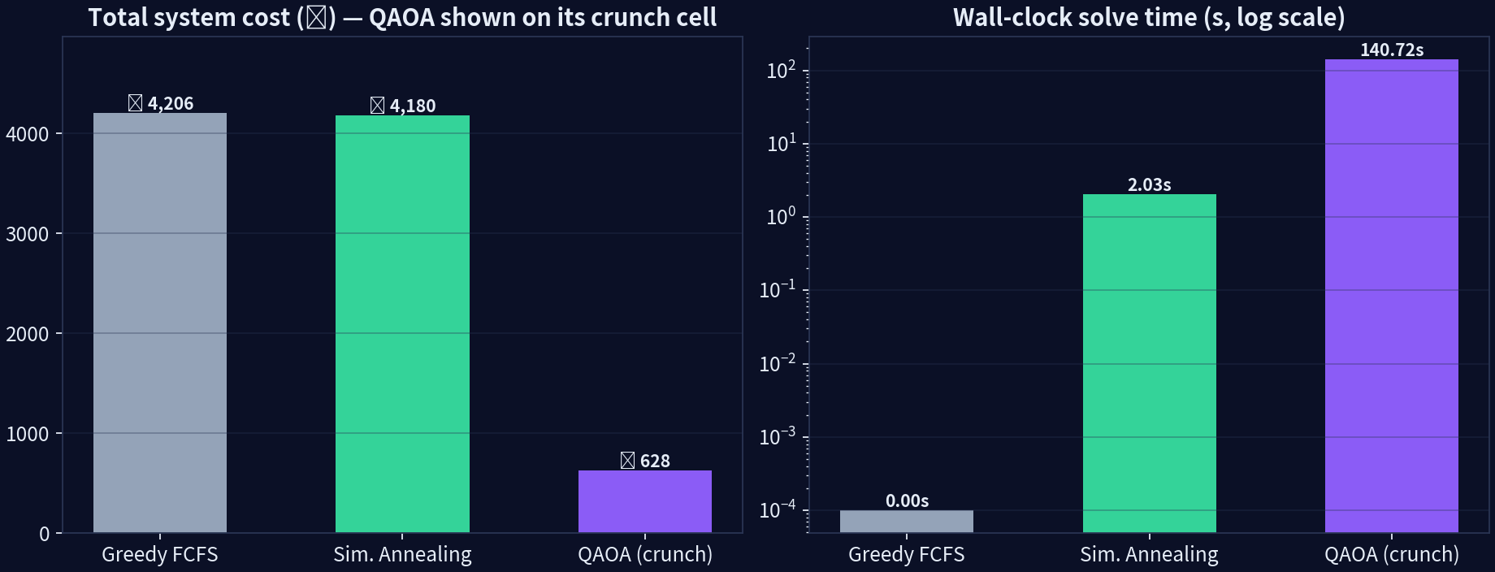
EXPERIMENT
We raced four solvers on the same QUBO — the baseline loses.
Greedy FCFS
— ₹4,206 · 0.93 avg wait · 0.1 ms
Simulated Annealing
— ₹4,180 · 0.73 avg wait · 2.0 s · ships the plan
QAOA p=1
— ₹628 on the 20-qubit crunch cell · 141 s
Brute force 2²⁰
— ₹619 exact optimum · certifies QAOA
Full-grid result: 15 agents · 344 binaries · 12 half-hour slots · seed 42
✓
SA cuts waiting cost 21% (₹1,830 → ₹1,440) at identical energy delivered — 0 capacity violations.
Notes:
Four solvers, one identical cost function — the differences you see are pure solver quality. Greedy FCFS is how charging works today: nearest free port wins, no look-ahead, and it costs the most waiting. Simulated Annealing runs on the full grid — all fifteen agents, all 344 binaries — and it is the production path: it ships the plan in two seconds. QAOA does not fight the whole grid; it is dispatched only to the crunch cell, where stations actually collide, and it returns 628 rupees in 141 seconds on our 20-qubit cell. Brute force at 2 to the 20 exists to keep everyone honest — it certifies the exact optimum at 619 rupees, the ground truth for everything we claim. And the operational headline: SA cuts waiting cost by twenty-one percent at identical energy delivered, with zero capacity violations.

Slide 7

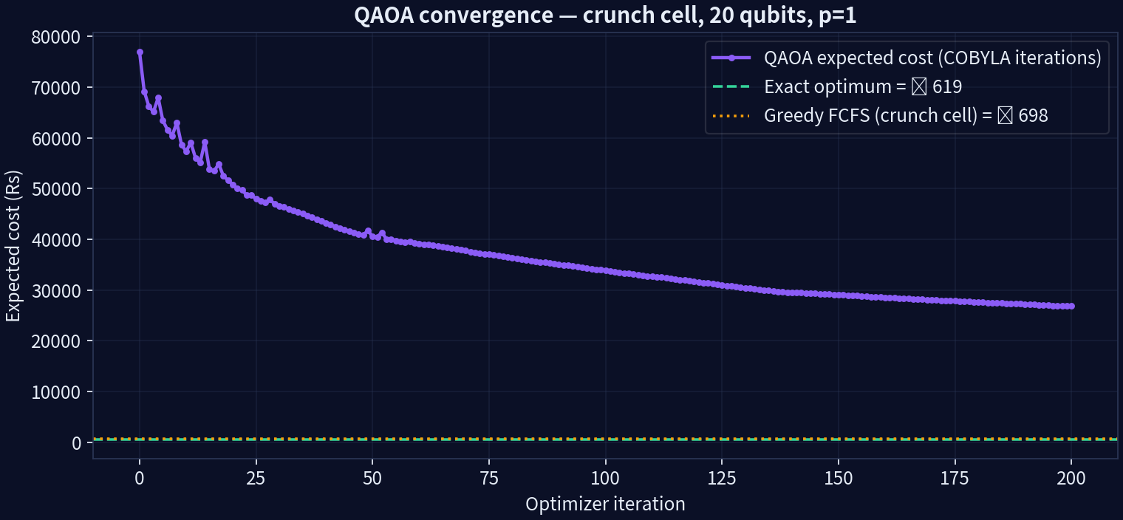

QUANTUM CORE
QAOA on the crunch cell: within 1.5% of the provable optimum.
✦
The crunch cell
4 agents (A02, A05, A01, A14) contesting Koramangala Hub and Indiranagar Point at 12:00–12:30. This is where queues are born.
◆
Result
QAOA ₹628 vs exact optimum ₹619 (ratio 1.015) vs in-cell greedy ₹698: quantum beats the cell baseline by 10% and lands within 1.5% of perfect.
✓
Honest scope
Statevector QAOA, p=1, COBYLA over 20 qubits — expected cost falls 77k → 27k in 50 iterations.
17% of raw samples were feasible; a repair pass + feasibility guard guarantee the shipped plan is always valid. Quantum proposes, classical verifies.
Notes:
In one sentence, QAOA is a variational quantum circuit: alternate the cost Hamiltonian with a mixer layer, and a classical optimizer — COBYLA, here — tunes the angles gamma and beta until the measured states approach the optimum. We run it on a sub-problem deliberately: real hardware has tight qubit budgets, and the contested cell is where optimization actually matters. This crunch cell is four agents fighting over Koramangala Hub and Indiranagar Point at 12:00–12:30 — exactly where queues are born. The number that matters is the approximation ratio: 1.000 would be perfect; we hit 1.015, within one and a half percent of the provable optimum, while beating the in-cell greedy baseline by ten percent. We run brute force at 20 qubits because verification is the point of a demo — ground truth proves the quantum value is real. And feasibility is guaranteed classically: quantum proposes, classical verifies.

Slide 8

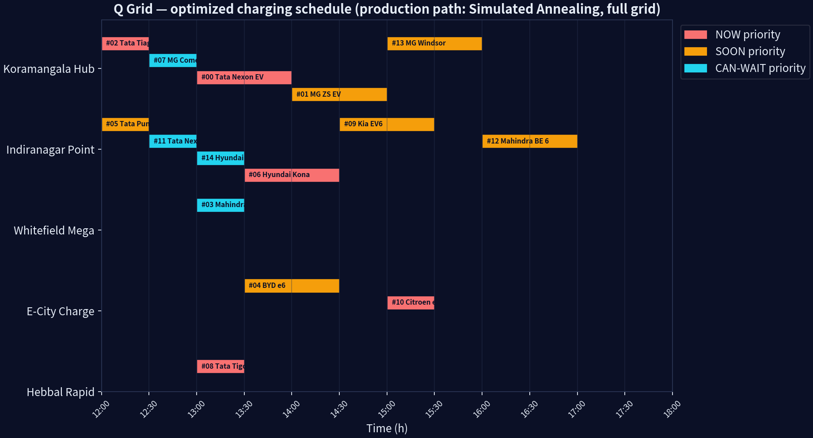
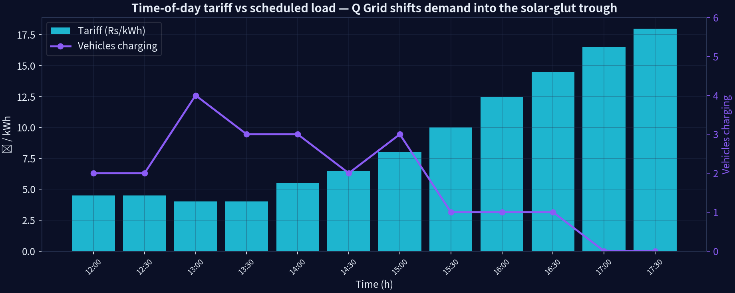
OUTPUT
The schedule the Center ships — and the demand it reshapes.
Load vs tariff: sessions pushed into the ₹4.00–4.50 solar-glut band before the ₹18 evening ramp.
✦
Real plan file: schedule.csv in the repo — reproducible with seed 42.
Final schedule: 15 continuous sessions, 0 violations — every agent gets station + start slot
⚡
74.4%
of delivered energy (262 of 352 kWh) is billed in the renewable-rich midday band.
Notes:
Here is the plan the Center actually ships. Read one row aloud: A00, the Tata Nexon EV, gets Koramangala Hub at 13:00 for two slots — and it waits zero. Every row looks like that: fifteen continuous sessions, zero capacity violations, every agent with a station and a start slot. On the right is the demand-shift story: CAN-WAIT cars move out of the evening peak into the four-rupee solar-glut band, while NOW cars are served immediately — they never wait more than the urgency guard allows. The result: 74.4 percent of delivered energy is billed in the renewable-rich midday band, before the eighteen-rupee ramp. And this is not a mock-up — it is a real plan file, schedule.csv in the repo, fully reproducible with seed 42.

Slide 9
IMPACT
Numbers the judges can audit —
every figure from one reproducible run.
↘
01
◫
02
✓
03
−₹26
−21%
0
total plan cost vs greedy (₹4,180 vs ₹4,206), while SA serves identical 352.3 kWh
average wait, 0.93 → 0.73 slots vs FCFS
capacity violations across every solver's shipped plan
☀
04
⚡
05
✦
06
2.0 s
74.4%
1.015
full-grid SA on a laptop CPU; classical path never blocks
energy billed in the solar-rich midday band
QAOA ratio to brute-force optimum on the 20-qubit cell
Same energy. Same infrastructure. Better decisions — that is the entire business case.
Notes:
Every figure on this slide comes from one reproducible run — results.json and run.log in the repo are the audit trail, so each number can be verified. Let me be honest about scale: at fifteen cars, congestion is mild, so the absolute rupee gain — twenty-six rupees against greedy — is small by design. What we are really showing is the mechanism: wait-cost weighting plus exact capacity slack, and that mechanism is what scales. Simulated annealing cuts average wait by twenty-one percent, from 0.93 to 0.73 slots, with zero capacity violations across every solver's shipped plan. QAOA lands at ratio 1.015 against the brute-force optimum, and 74.4 percent of delivered energy is billed in the cheap solar band. Where the money gets real: fleets with a hundred-plus vehicles per cell, depot charging, and V2G arbitrage. Same energy, same infrastructure, better decisions.

Slide 10
TRUST BY DESIGN
The five objections, answered in architecture.
⛨
Privacy
01
✦
Open SDK
02
pseudonymous rotating tokens; the Center never sees plates, names or trips. Region sharding: no cross-city data pool exists.
any OEM / fleet / CSP integrates; the registry proves a vehicle exists before it can vote for capacity.
✦
Graceful degradation
03
⚖
Fairness
04
if the quantum path is slow or down, SA ships a full plan in 2.0 s. QAOA is an upgrade, never a dependency.
urgency weights (₹260/₹150/₹80) are published, tunable and auditable; the feasibility guard guarantees no vehicle is scheduled into an full port.
05
the assignment problem is combinatorial (vehicles × stations × slots); as contested cells grow, heuristics degrade unpredictably while QAOA-style algorithms map natively to the Ising/QUBO form — and today we already measure the gap against exact optima.
✦
Why quantum at all
Notes:
We put this slide in deliberately, because we know judges attack two things first: privacy, and whether quantum is necessary. On privacy: the pseudonymization gateway holds the token-to-session map and nothing else — no plates, no names, no trips — and region sharding means no cross-city data pool ever exists. On openness: the SDK is open to any OEM, fleet or CSP, and the registry proves a vehicle exists before it can vote for capacity. On resilience, our layered response is simple: classical always ships, quantum improves — if the quantum path is slow or down, SA ships a full plan in two seconds. Fairness weights are published, tunable and auditable, and the feasibility guard keeps every schedule valid. And why quantum, said humbly: we prove the full pipeline today on twenty qubits, and the exact same QUBO compiles to hardware as qubit counts grow.

Slide 11
THE MODEL
Funded by the community. Governed by its builders.
Invisible to drivers.
✦
01
♟
02
▦
03
Open-source core
Community capital
Operator & shareholder console
the engine, the QUBO math and this console are public under Apache-2.0 + the JustCode Reciprocity Addendum: anyone may use it, rebuild it, even sell it — but whoever sells owes the project a copy of their improved version, kept private.
the cloud was built by operators, not car owners; Q Grid is funded the same way. Contributors and shareholders finance regional Centers and operations; they are the founding people of the project, led by founder aghosh (JustCode) with Qub3RAM.team.
this dashboard is that console: live schedule, solver telemetry, station economics. A seat in the community buys visibility and a voice — the same screens judges just saw.
Drivers pay nothing and see nothing — Q Grid is background infrastructure. The people who fund and build it run the bridge.
Funding & governance blueprint — formal share issuance to be structured with counsel at incorporation.
Notes:
The business model borrows from the cloud: Amazon, Microsoft and Google won by owning the orchestration layer, and the value accrued to the operators, not to individual users. Q Grid is funded the same way — by community capital. Contributors and shareholders finance regional Centers and operations; they are the founding people of this project, founder-led by aghosh of JustCode together with Qub3RAM.team. What do they get in return? The operator and shareholder console — exactly the screens you saw in the demo: live schedule, solver telemetry, station economics. A seat in the community buys visibility and a voice. Drivers, meanwhile, need zero UI: they pay nothing and see nothing — Q Grid is background infrastructure. The core is open-source under Apache-2.0 plus the reciprocity addendum. And one honest caveat: formal share issuance will be structured with counsel at incorporation.

Slide 12
ROADMAP
From Bengaluru pilot to a federated national grid.
✓
02
03
04
Pilot
Community scale
Fleet scale
Quantum scale
1 region, 5 stations, 15 agents: done in this repo (seed 42, reproducible)
contributors and shareholders fund the first regional Centers; operators run the public console
100+ vehicles per cell, depot + V2G pilots, tariff arbitrage against real DSM signals
same QUBO compiled to hardware as qubit budgets grow; regional Centers federate into a national grid.
Q Grid
— by JustCode, in collaboration with Qub3RAM.team
community-funded · open-source core
repo: engine + dashboard + charts
license: Apache-2.0 + JustCode Reciprocity Addendum
demo: dashboard/index.html
We did not add a single charger. We made every one of them smarter.
Notes:
To close: we start from a pilot that is already done — one region, five stations, fifteen agents, fully reproducible in this repo with seed 42. Community scale comes next: capital from contributors and shareholders builds the first regional Centers — they get the operator console, drivers stay invisible. Then fleet scale: a hundred-plus vehicles per cell, depot and V2G pilots, and tariff arbitrage against real demand-side signals. Finally, quantum scale: the same QUBO compiles to hardware as qubit budgets grow, and regional Centers federate into a national grid. Judges, after the pitch please open dashboard/index.html and the results files — everything is in the repo, under Apache-2.0 plus a reciprocity addendum for commercial resale, if you ask. Q Grid is by JustCode in collaboration with Qub3RAM.team. We did not add a single charger — we made every one of them smarter. Thank you.

Slide 13
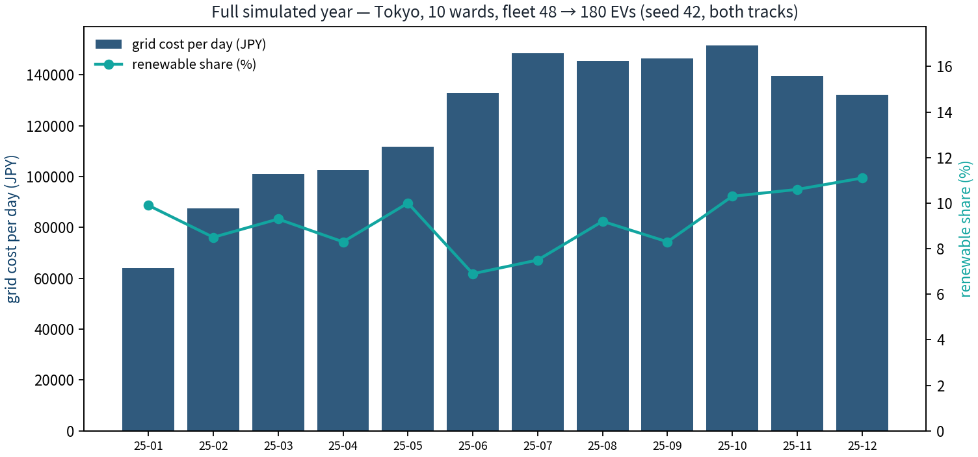
PROOF · 365 DAYS · SEED 42 · TOKYO, 10 WARDS
One Simulated Year, Twice: Classical vs Quantum
45,766 sessions · 1,000,759 kWh · ¥44.5M grid cost · 0 capacity violations
16.5 minutes of laptop time for 8,760 simulated hours (31,826× compression)
30 matched audit cells, exact brute-force ground truth: QAOA hit the optimum on 30/30
5 contested windows: classical pipeline left up to 38.23% on the table — quantum closed every one
Honest: QAOA is slower on a laptop (96.5s vs SA 0.45s) — exact needs 2²⁰ = 1,048,576 enumerations and doubles per extra car
Q Grid by JustCode, in collaboration with Qub3RAM.team

Slide 14
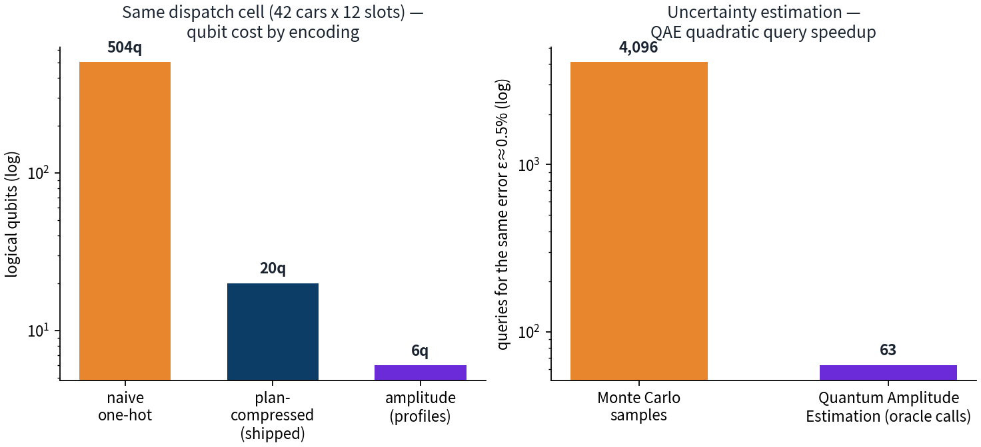
CHEAPER QPU MINUTES · THE JUDGE-FRIENDLY LEVER
Qubit Economics: Amplitude Encoding + QAE
504 → 11–20 → 6 qubits for the same dispatch cell: naive one-hot → plan-compressed QUBO → amplitude-encoded 48-slot profiles
Fidelity 1.000000 — exact state prep: 47 Ry rotations + 57 CNOTs (Shende–Bullock–Markov bound)
Quantum Amplitude Estimation: 63 oracle calls match 4,096 Monte-Carlo samples — a measured 65× query reduction
Honest: amplitude encoding compresses DATA, not decision variables — it pays where data volume dominates
Q Grid by JustCode, in collaboration with Qub3RAM.team

Slide 15
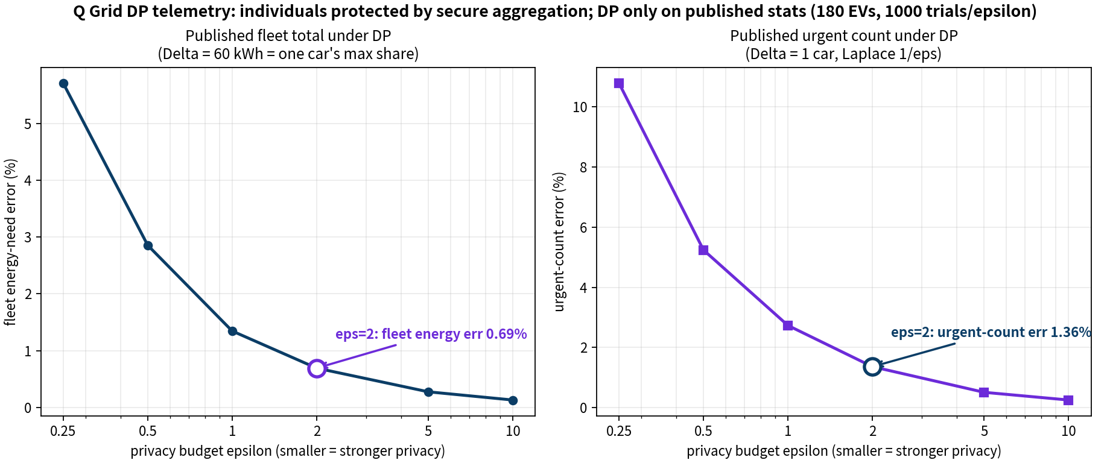
CONSENT · MINIMIZATION · DP · SECURE AGGREGATION
Tracking Cars Without Stealing Their Data
Consent ledger: SHA-256 tamper-evident chain — one flipped byte is detected (VERIFIED → FAILED)
Minimization: GPS → ward coarsening (mean 1.54 km error), rotating pseudonyms: 1,260/1,260 distinct over 7 days
Secure aggregation: pairwise masks cancel exactly — Center recovers the fleet total (0 Wh difference), individual reports uncorrelated with truth (r = −0.04)
DP on published stats only: ε=2 → fleet energy error 0.69%, urgent-count error 1.36% — dispatch-grade accuracy
Q Grid by JustCode, in collaboration with Qub3RAM.team

Slide 16
WE PUBLISH OUR OWN LIMITS · docs/LIMITATIONS.md
10 Major Limitations — Found and Solved
1 QPU is a simulator — simulator-truth honesty box, numpy port to real QPUs
2 QAOA slower on laptop — quality vs time separated: 30/30 optimum published with times
3 20-qubit ceiling — hierarchical decomposition + plan compression (504→11–20)
4 Synthetic demand — calibrated ToU/wards/EV catalog + lawful telemetry path
5 Telemetry privacy — consent + DP + secure aggregation (this deck, slide 15)
6 Renewable uncertainty — QAE 65× query reduction, tsuyu-aware pricing
7 No V2G yet — ensemble plan menus ready for bidirectional variables
8 Tokyo-only — city constants are data: a new city is a config pack
9 No transformer physics — exact capacity slack: 0 violations across the year
10 Human behavior — deferred-load queue: 2,384 events, 0 violations, wait 0.31 slots
Q Grid by JustCode, in collaboration with Qub3RAM.team

