Slide 1
Embedded Systems: Timers
Professor: M Campisi
TAs: Abhimanyu (Abhi) Ghosh
Sravani Bhuma Koppula

Slide 2
Overview
Admin
  Github, Wiki
  Office hours
  Announcements
  Brief intro to Git
  Coding “Best Practices” & use in industry
Wrap-up of C programming concepts
Embedded systems and time
  What is “Real-time” and when do we care?
The humble timer
  Applications, et. al.
Clocks
Embedded “Hello World” Revisited
  Can we do this differently? :)
PWM
  Hardware to the rescue!
PWM and relation to Analog
Measuring inputs using timers
  Applications?
Q&A

Slide 3
Github, Wiki
Links posted to NYU Classes
We have a GitHub page!
  https://github.com/Aghosh993/EmbeddedSystems/
  Code samples, snippets
  Recitation presentations (including this one!)
  Useful as a reference later on
There is a Wiki!
  https://github.com/Aghosh993/EmbeddedSystems/wiki
  Basic course info
  Office hours, availability, TA calendar links
  Shall be appended with further info, articles, et. al. as semester progresses, so check back frequently!

Slide 4
Office Hours
Abhi: (Almost) always at LC 029 in Dibner Building
  Technically accessible 24/7/365
  Take stairs down to basement, make left, right, right
    Or follow the left wall for a while...
  Should end up at a lab full of robots
  Highly prefer email or chat prior to meeting
    Contact info on Wiki
Sravani: Email to set up appointment and figure out location
  Contact info & calendar also on Wiki

Slide 5
Announcements

Slide 6
Brief Intro to Git
What is Git?
  Trivia: Similar systems?
  Trivia: Creator?
Rationale for use
  Software dev happens in teams
  Asynchronous process
  Need to keep different “branches” sep. and mark/tag versions
  Rapidly view changes between versions as diffs
  Merge codebase from different teams when ready to ship

Slide 7
Brief Intro to Git (Cont'd)
Usage
  Linux: git is typically in package repository
    Ubuntu: “sudo apt-get install git”
    Arch: “pacman -Syy && pacman -S git”
    Others: Read the man pages :)
  Windows:
    TortoiseGit is an excellent GUI front-end with Windows Explorer integration
    Plenty of online installation guides
    Git shell available for power users who want more “linux-y” experience
To “clone” repo:
  “git clone <repo>”
    “git clone https://github.com/Aghosh993/EmbeddedSystems.git”

Slide 8
  Coding “Best Practices”
70's and earlier
  Hardware WAS expensive, software was... unaccounted for
    Exhibit A: Software delays in Apollo almost cost the US the race to the Moon
Now...
  Hardware is cheap
  Software is the new “top expense” in projects
  SoftEng a whole new field
Think carefully before making extremely machine-dependent optimizations
  Machine time = <<<$ in extra electricity or cost of small HW upgrade
  Programmer time = >>>$$$ in misery, salary and gray hair spent debugging/porting
Macros, #defines important
Structuring of code into modules of source and header files very important in large projects
  Structure code into portions that are HW-dependent and those that are HW-independent
  HW-dependent code frequently called the HAL – Eases porting process to diff. platform
Pick the right toolchain, optimize b/w setup time and time saved in easier usage or some other metric
Don't listen to the bean-counters

Slide 9
Coding “Best Practices” (Cont'd)
“Everyone knows that debugging is twice as hard as writing a program in the first place. So if you're as clever you can be when you write it, how will you ever debug it?”
  Brian W. Kernighan (Co-author, The C Programming Language)
Most mere mortals aren't very clever...
Comments and “good code”
  Comments should COMPLEMENT, not REPLACE understandable code
  “int magic, tmp, temp, foo; //These variables hold values... “
    No...
    Surefire way to get poor performance reviews and eventually be fired
Unit-testing, HITL
More advanced: Doxygen
  Auto-generate HTML, PDF docs of software based on structured comments
Even More Advanced(TM): Coding standards
  MISRA, DO-178b, et. al.
  If you're coding to these standards, your mistakes will follow your clients to their graves :)

Slide 10
Wrap-up of C programming concepts
Bitwise math
  AND, OR, XOR
Two's complement, conversions of types
  Trivia: Why do we care?
Enums, unions re-visited
Q&A

Slide 11
Embedded systems and time
Time is important
  Especially so in Embedded Systems
  Frequently a variable that actions are based on
    Ex: Measure a sensor every X seconds and update some actuator value based on a set of calculations
Real-time:
  “Hard”-RT: Airliner controls, missile guidance system, car airbag deployment system
  “Soft”-RT: Infotainment system, average user desktop
  Everything is ultimately “hard”-RT in the sense that eventually the response characteristic will be deemed unacceptable by the user (i.e. people killed in a crash, user throwing out computer)

Slide 12
The Humble Timer
Variety of ways to create delays, keep track of time
  Why not just a busy loop?
  External time reference? Trivia!
Timers to the rescue!
  Processors already use some kind of timebase, known as crystal or oscillator
  Timer uses the transitions in the waveform of oscillator/other clock source to increment a counter
  Since timebase (crystal, oscillator, et. al.) has a well-defined period, the counter will also count up/down at a very well-defined rate
    We can use this in our app!
  Many HW methods to take various actions based on counter and a few other regs
    Toggle a pin
    Take some user-defined action
    Sample a pin and use it to trigger reset/stop of counter

Slide 13
Clocks
Commonly some kind of quartz crystal that oscillates at a VERY consistent frequency
  Consistency/accuracy often given by the manufacturer as PPM (parts per million) or max % deviation
  Often temperature-sensitive
    Is this an issue in some apps? Trivia!
  Might need to consider crystal drift in some apps...
    Trivia: Where might there be an immediate issue?
Clock source can also be some other logic circuit
  Free lunch/dinner for any ideas/circuit names that do this :)
    Cannot use crystal/anything besides transistor-based ICs, resistors, capacitors

Slide 14
Clocks (Cont'd)
Problem: We don't just want to count at 1/CLK
  Prescalers
  What else can be done? Trivia!

Slide 15
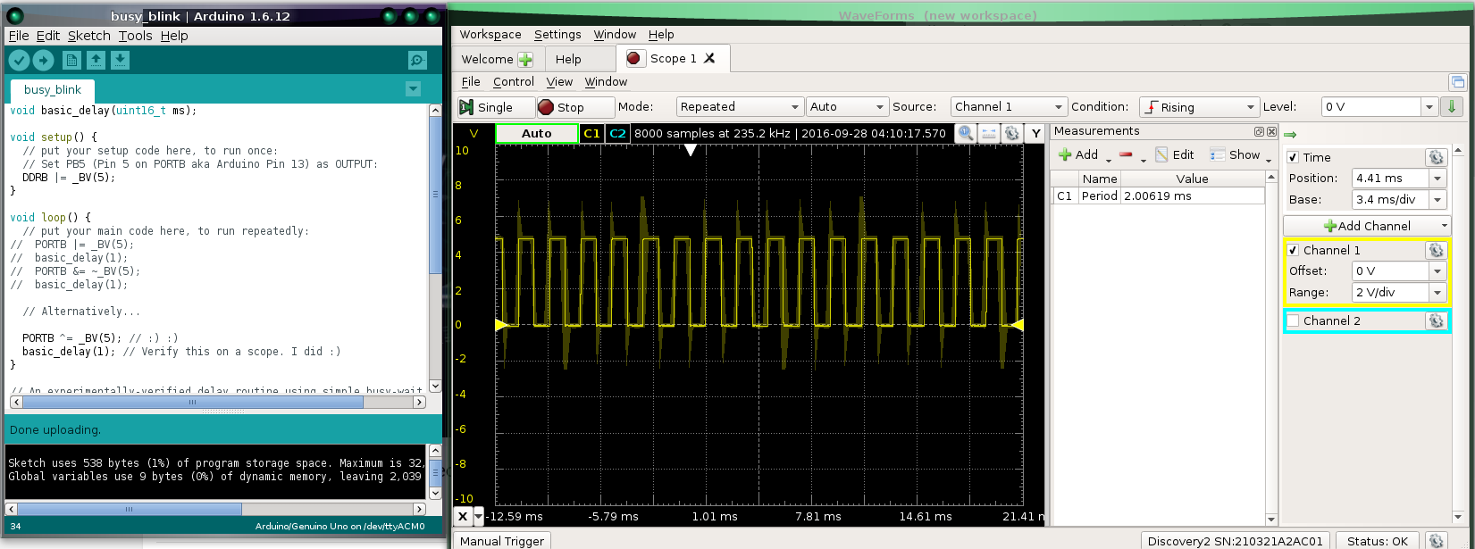
Embedded Hello World Revisited
Trivia: Any idea why the scope shot has artifacts?

Slide 16
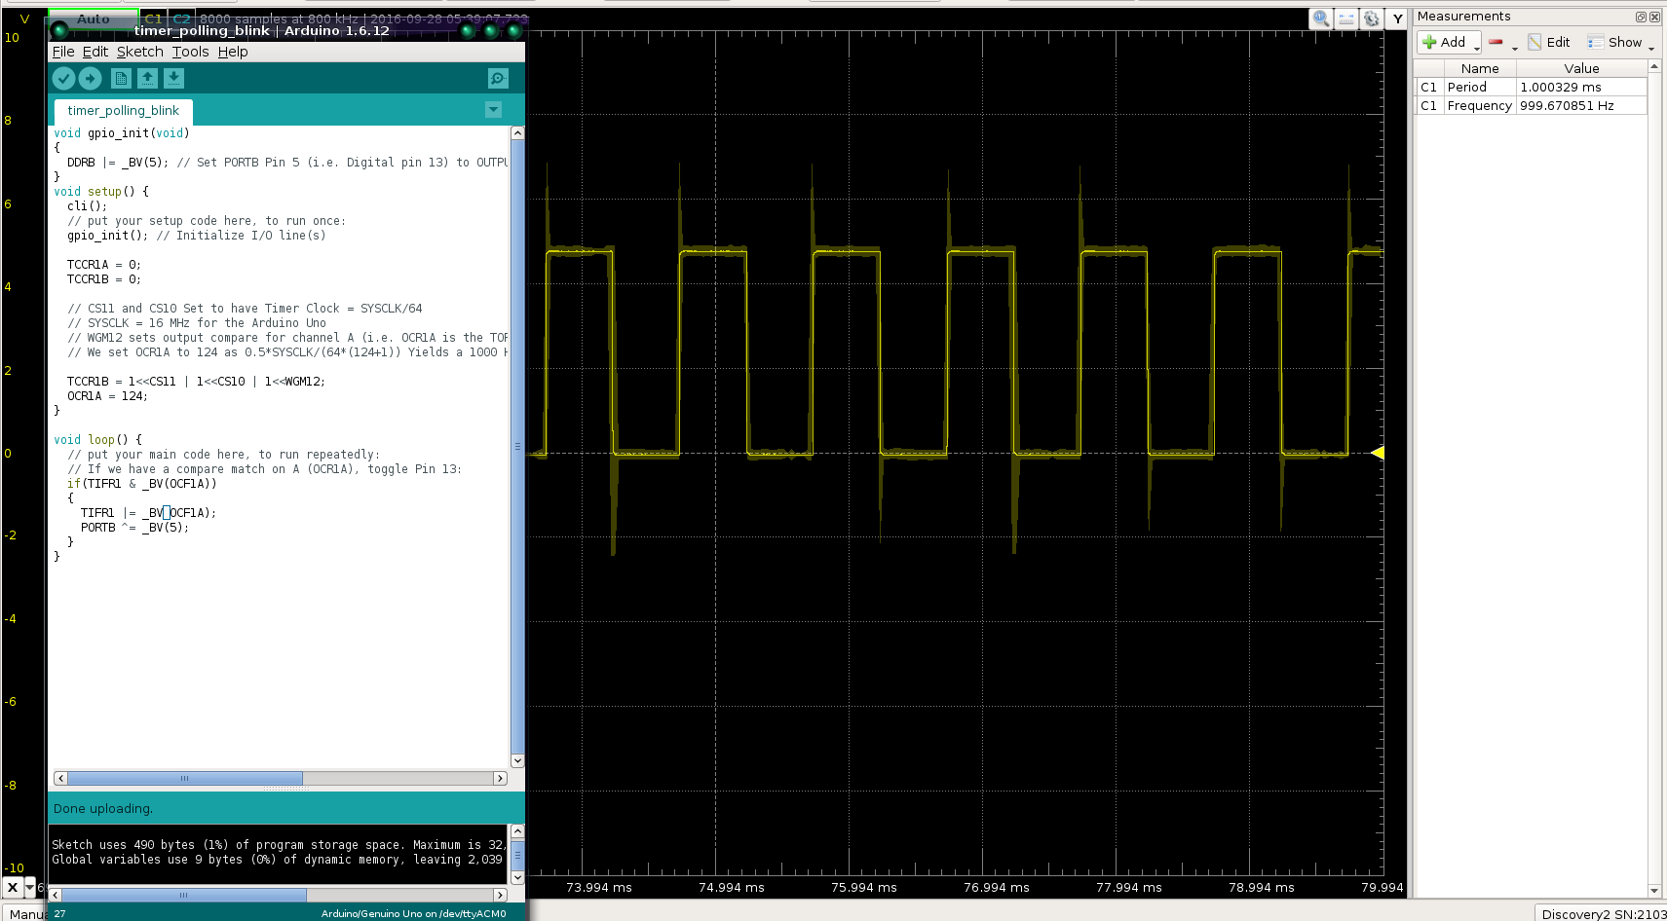
Can we do better?

