Slide 1
Transparent Background
Works in コイカツ！(Koikatu) (Maker, Studio, Free H, and Main Game)

Slide 2
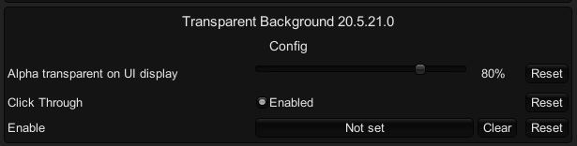
Config
Open configuration manager(F1) and search for “Transparent Background”
First of all, set the hotkey for the enable button.
Set UI transparent. (0% is transparent, 100% is opaque)
If you do not want to click the back, please disable clicking through.
It should be useful when placing reference pictures at the back when making a character.

Slide 3

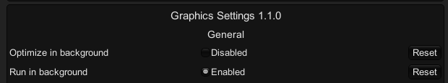
restriction
Disable MFAA and FXAA in the graphics card settings, which will result in a black background.
Do not Enable Depth of Field:
Set Graphics Settings in the game like this:
When the function is enabled, the camera will only display CharaLayer (10) That is, everything else will be hidden. Such as native maps and some furniture.

Slide 4
HINT
Notice the cursor type before clicking.
Click once in-game before hitting the keyboard.
Due to the high load of the game, it is not recommended to always start on the desktop.
If you encounter window problems, please restart the game.
Recommended to use with HideAllUI plugin.
Use out-of-game programs to take screenshots. Such as PrtScn or other ScreenRecorder. (F9 and F11 will give you a black background)
If it is used when creating something, please do more saving. I cannot be responsible for accidental game freezing ☹

Slide 5
Studio
Most screen effects can cause problems.
Some items in the 2D effect do not work.
Some items that are not in CharaLayer(10) will be hidden. (Most are furniture)

Slide 6
Maker
Outline is not displaying.
I cannot guarantee that all display effects will be presented as usual.

Slide 7
Free H Scene
Not Safe For Work

Slide 8
Main Game
I don't think it's easy to play.

Slide 9
Many Thanks
kirurobo @ Github: For the UniWinApi and CSharpWinApi These are the core technologies used in transparent windows. https://github.com/kirurobo/UniWinApiAsset https://github.com/kirurobo/CSharpWinApi
An anonymous person on 2ch: The person who brought this cool idea to Koikatu as the デスクトップマスコット GOL script.
サバカン: Modified the DesktopMascot script above and introduced it on Discord. I was inspired by him.

Slide 10
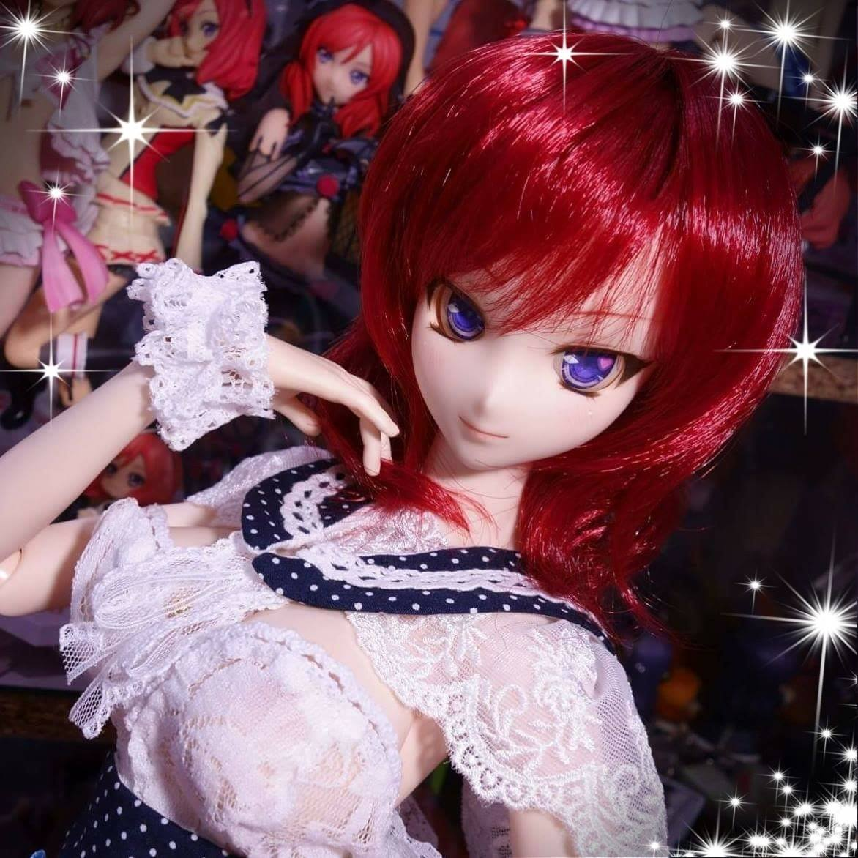
Have fun
琳 jim60105
Blogger: https://blog.maki0419.com/
Download: https://github.com/jim60105/KK

Slide 11
