Slide 1


Slide 2


Designing Mobile Applications with Xamarin
A best practices guide for optimum mobile cross platform development.

Slide 3
Who?
Jerel R Hass
@agies1
jhass@quicksolutions.com

Slide 4
Application Life Management
Application Life Cycle
Write
Build
Test
Analyze
Deploy
Release
Build
Test
Analyze
Release
Write
Deploy

Slide 5
What is Continuous Integration?
“Continuous Integration (CI) is a development practice that requires developers to integrate code into a shared repository several times a day. Each check-in is then verified by an automated build, allowing teams to detect problems early.
By integrating regularly, you can detect errors quickly, and locate them more easily.”
- Thought Works

Slide 6
What Makes Mobile More Challenging?
ASP.NEt Deployment Scenario
Mobile Deployment Scenario
Developer
Build Server
Development Server
QA Server
Development Tester
QA Testing
Pre-Production
Production
Developer
Build Server
QA Release
iOS
Android
WP8
Store Release
WP8
Android
iOS
Deployment Package
Provisioning Profiles
Signing Cert

Slide 7
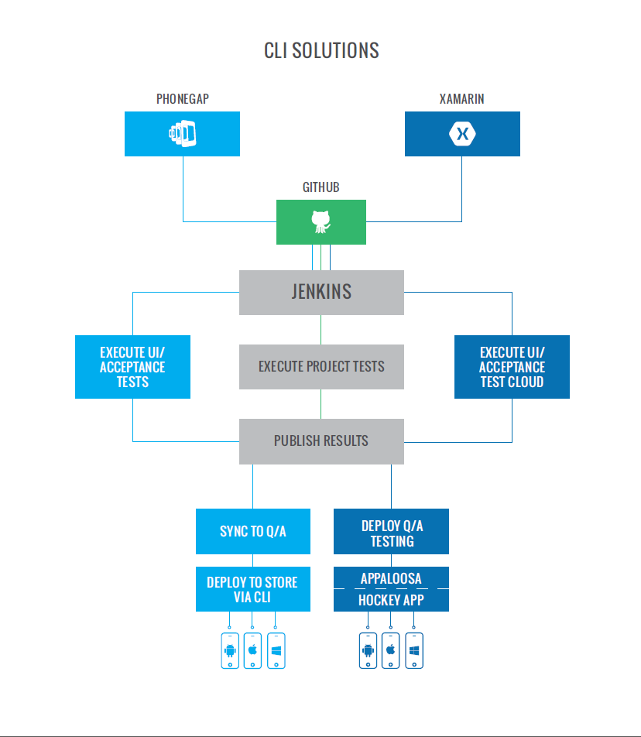
Applying CI To Mobile

Slide 8
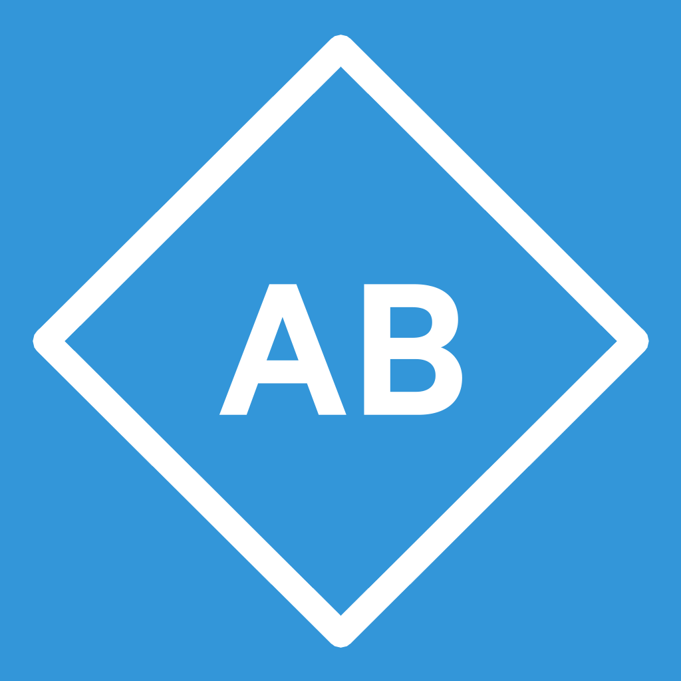
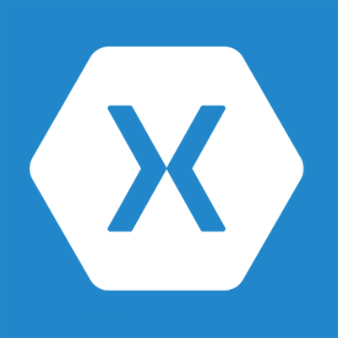
Development Stack
Telerik AppBuilder
Cordova with Cloud Build
Xamarin
Simplified code base across major phone platforms

Slide 9

Build Server
Jenkins
Jenkins is an award-winning application that monitors executions of repeated jobs, such as building a software project or jobs run by cron. Among those things, current Jenkins focuses on the following two jobs:
Building/testing software projects continuously, just like CruiseControl or DamageControl. In a nutshell, Jenkins provides an easy-to-use so-called continuous integration system, making it easier for developers to integrate changes to the project, and making it easier for users to obtain a fresh build. The automated, continuous build increases the productivity.
Monitoring executions of externally-run jobs, such as cron jobs and procmail jobs, even those that are run on a remote machine. For example, with cron, all you receive is regular e-mails that capture the output, and it is up to you to look at them diligently and notice when it broke. Jenkins keeps those outputs and makes it easy for you to notice when something is wrong.

Slide 10
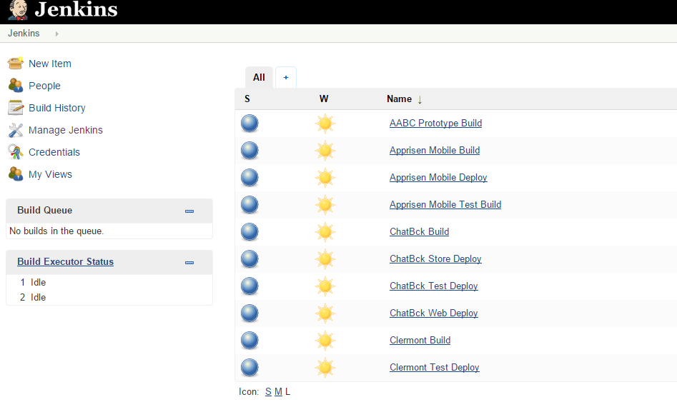
Jenkins Build Processes

Slide 11
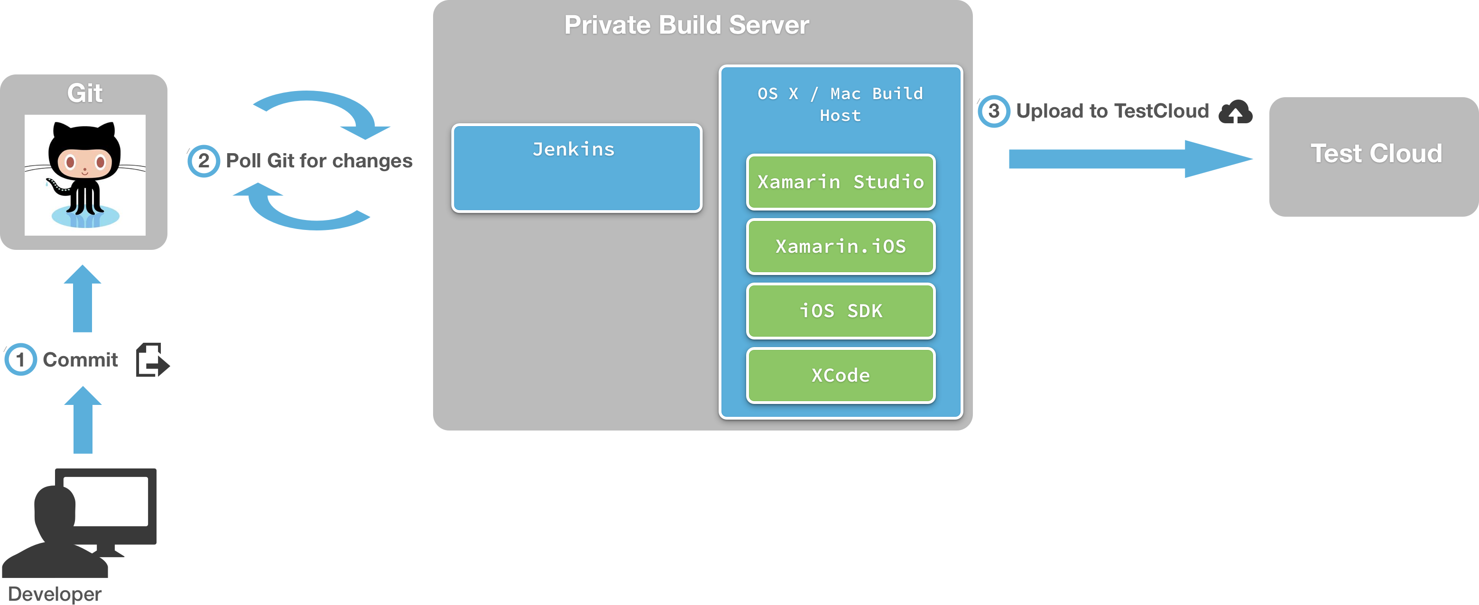
Xamarin And Jenkins
http://developer.xamarin.com/guides/cross-platform/ci/jenkins_walkthrough/
Grab the Github Plugin
Grab the MSBuild Plugin
iOS Project
Android Project

Slide 12


Unit Testing
Xamarin
NUnit: NUnit is a unit-testing framework for all .Net languages.
PhoneGap
JS Testing With Jasmine: Does DOM less JS Testing

Slide 13
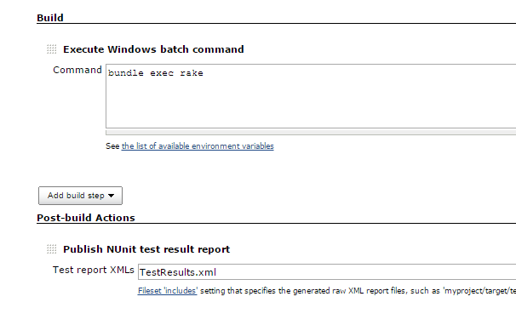
Unit Testing and Jenkins
http://www.codemag.com/Article/1006101
nunit :unit_tests do |nunit|
nunit.command = "Lib/NUnit 2.6/nunit-console.exe"
nunit.assemblies “ProjectLog/ProjectLog.Unit/bin/Debug/ProjectLog.Unit.dll"
nunit.options '/xml=TestResults.xml /framework:net-4.5'
end

Slide 14
Unit Testing and Jenkins
https://github.com/larrymyers/jasmine-reporters
NUnitXmlReporter - Report test results to a file in NUnit XML Report format.
http://johnbintz.github.io/jasmine-headless-webkit/
require 'jasmine-headless-webkit‘
Jasmine::Headless::Task.new('jasmine:headless') do |t|
t.colors = true
t.keep_on_error = true
t.jasmine_config = 'this/is/the/path.yml'
End
Post Build Add the Result TestResult.xml as during the Xamarin Tests

Slide 15
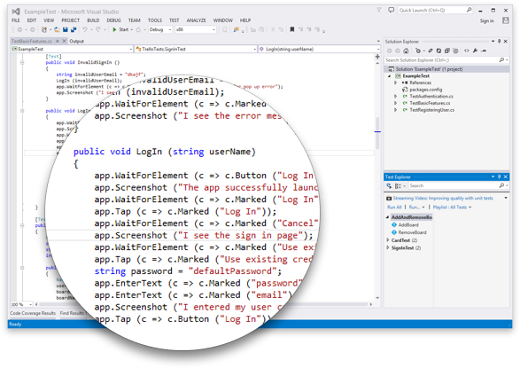
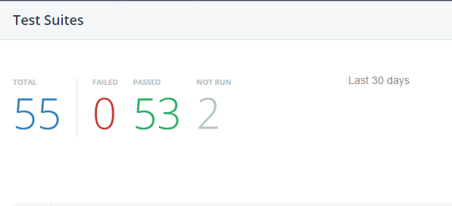
Acceptance Testing
Xamarin
Xamarin Test Cloud
Telerik AppBuilder
Telerik Platform Testing

Slide 16
Xamarin Test Cloud and Jenkins
Install the necessary command line tool test-cloud.exe - This is for tests written using Xamarin.UITest.
Add A Build Step to your iOS or Android Build
test-cloud.exe <path-to-apk-or-ipa-file> <test-cloud-api-key> --devices <device-selection-id> --assembly-dir <path-to-tests-containing-test-assemblies>

Slide 17
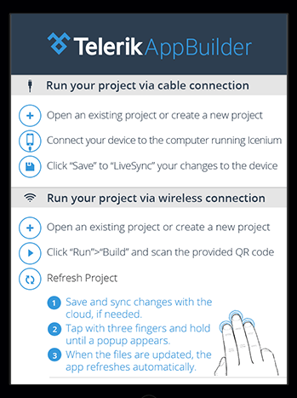
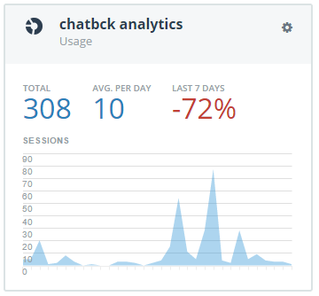
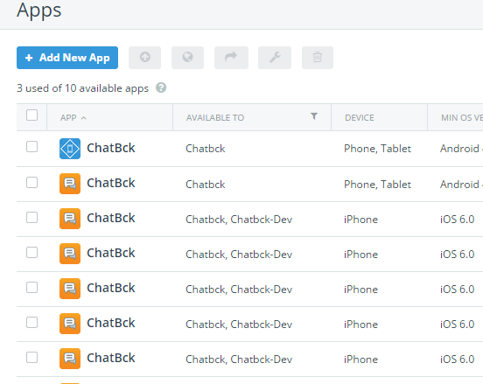
QA Deployment
appbuilder build android --no-livesync
appbuilder build ios --provision "My Provisioning Profile" --certificate "My Certificate" --no-livesync
Telerik AppBuilder
AppBuilder CLI
AppBuilder Companion
AppManager
Analytics
appbuilder build wp8 --no-livesync

Slide 18
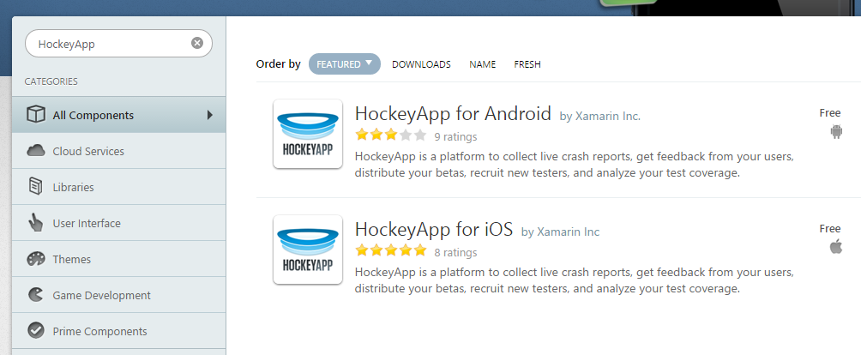
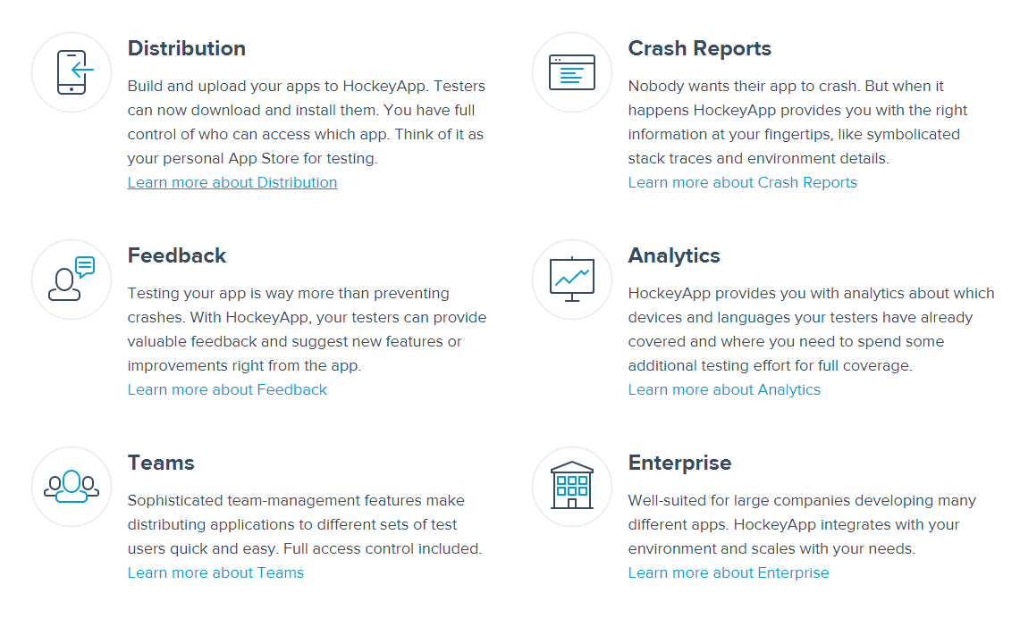
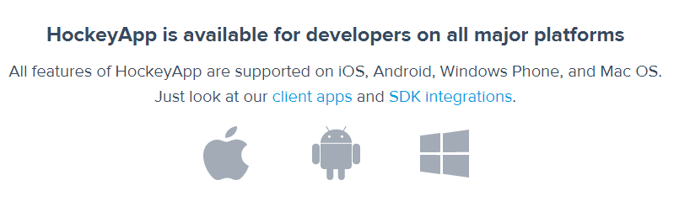
QA Deployment
Xamarin
Componet
Hockey App

Slide 19
Production Deployment
appbuilder build android --no-livesync --download
Telerik AppBuilder
AppBuilder CLI
- Copy To
DropBox/Fileshare
*Windows and Android both Require a Manual Deploy
appbuilder appstore upload <Application Name> <Apple ID> <Password> --certificate <Certificate ID> --provision <Provision ID>
appbuilder build wp8 --no-livesync --download

Slide 20
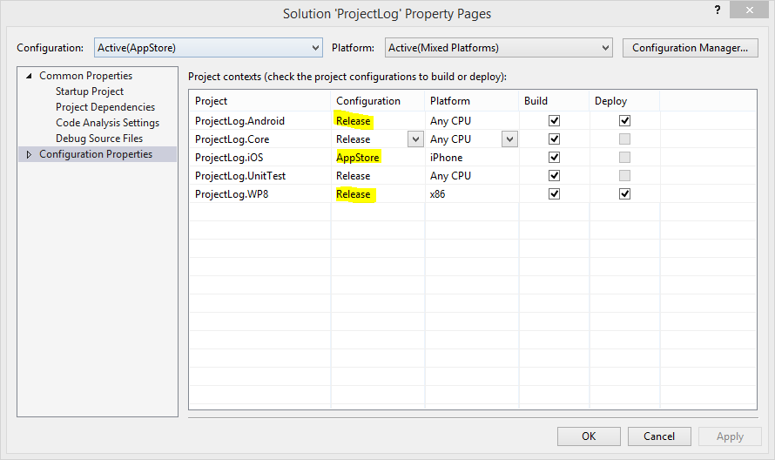
Production Deployment
<ItemGroup>
<BuildArtifactsDir Include="BuildArtifacts\" />
<SolutionFile Include=“ProjectLog.sln" />
</ItemGroup>
<PropertyGroup>
<Configuration Condition=" '$(Configuration)' == '' ">AppStore</Configuration>
<BuildPlatform Condition=" '$(BuildPlatform)' == '' ">Any CPU</BuildPlatform>
</PropertyGroup>
<Target Name="Compile" DependsOnTargets="Init">
<MSBuild Projects="@(SolutionFile)" Targets="Rebuild"
Properties="OutDir=%(BuildArtifactsDir.FullPath);Configuration=$(Configuration);Platform=$(BuildPlatform)" />
</Target>
Xamarin
Build in Deployment
- Copy To
DropBox/Fileshare

