Slide 1
Tumour WGS
Aligned to Human Ref
(N=11,735)
PySAM
Unaligned
Reads
Trimmomatic
Human
Depleted
BBDuK
Quality
Trimmed
Kraken
1,363
genera
Classified
Reads
Min Reads ≥10
Filtered
Classifications
Confidence
Threshold
0.2
N=8,103
Final
Classifications
Filtering

Slide 2

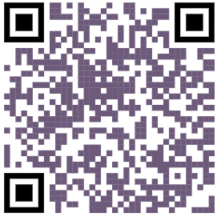
Reproduce Poster

Slide 3




Slide 4
N=41
N=935
N=987
N=213

