Slide 1
USER VALUE: 25 POINTS
Clarity: from recurring complaints
to a reviewed next step
SUPPORT + CX LEADS
Who owns
the next
step?
Digital-service companies
with engineering owners
Connect recordings, recurring complaints
and the next investigation.
Target-user hypothesis. Customer validation and time savings remain unmeasured.
01
Notes:
Time: 0:00-0:30
Rubric: User value: 25 points
SPOKEN SCRIPT
Clarity is for support and customer-experience leads at digital-service companies. When the same problem appears across recordings, they need to connect the evidence and agree what deserves investigation. Clarity brings related calls, a proposed next step and a recorded human decision into one workflow. That is the value we are testing. We have not yet validated customer demand or measured time savings.
PRESENTER NOTES
The initial target user is a support or CX lead who needs an engineering owner for recurring reported problems. Customer interviews, demand and measured savings remain pending. Use the pilot sheets to validate this hypothesis.
SOURCES
docs/JUDGE_EVALUATION.md
docs/EVIDENCE_PLAN.md

Slide 2
WORKING PROTOTYPE AND MEANINGFUL AI CONTRIBUTION: 30 POINTS
Automatic analysis,
with explicit human decisions
01
02
03
04
Receive
→
Analyze
→
Review
→
Compare
Connected source
submits audio
Transcribe, mask,
interpret and group
Check evidence,
owner and rationale
Count issue calls
before and after
Automatic intake
AI + validation
Human decision
Observational
Local by default. Configured compatible analysis providers and versioned company rules.
02
Notes:
Time: 0:30-1:00
Rubric: Working prototype and meaningful AI contribution: 30 points
SPOKEN SCRIPT
Once a recording source is connected, ingestion and analysis run automatically. Speech models transcribe; patterns and a local model mask sensitive text; language models propose findings and actions; embeddings help group related issues. Code validates references and calculates counts. People decide what to approve. Company rules and compatible analysis providers are configurable, while the review requirement remains. This is an implemented workflow, with compatibility boundaries.
PRESENTER NOTES
Automatic ingestion is an upload API plus a watched-folder connector, not a native connector for every call platform. External analysis needs a configured compatible endpoint and workspace opt-in. Speech, masking and embeddings remain local. Skill export contains prompts, schemas, workflow and read-only API contracts; it does not deploy an autonomous agent. Source wiring and operational intervention after failures can still be necessary.
SOURCES
docs/AUTOMATION_AI.md
worker/csi_worker/analysis.py
worker/csi_worker/agent_profile.py
worker/csi_worker/activities.py
server/src/main/java/az/csi/DecisionController.java

Slide 3
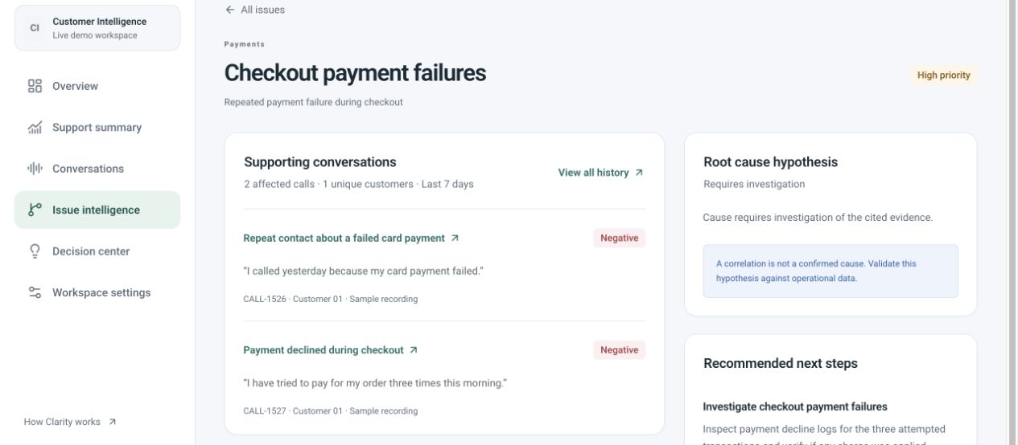
WORKING PROTOTYPE AND MEANINGFUL AI CONTRIBUTION: 30 POINTS
A recommendation the reviewer
can trace to the call
2 calls
1 fictional customer
Inspect decline logs.
Verify any charge.
Prepared AI output with editorial titles and masking corrections. Seeded decisions are illustrative.
03
Notes:
Time: 1:00-1:30
Rubric: Working prototype and meaningful AI contribution: 30 points
SPOKEN SCRIPT
Here is the prepared payment example: two calls from one fictional customer describe checkout failures. The recommendation is to inspect transaction logs and verify whether a charge occurred. The reviewer can return to the cited conversation before accepting that investigation. We do not claim the model found the root cause. These are synthetic recordings with stored model outputs, editorial titles and documented masking corrections. Seeded decisions are illustrative.
PRESENTER NOTES
Use the existing issue screenshot as a prepared prototype capture, not a new run. Catalog payment issue ddab40f9-e736-4fdf-bbf5-af0759145421 has two linked calls sharing demo-customer-01. Prepared call outputs record call-analysis-v2; current worker uses call-analysis-v6-reviewed. Demo state remaps IDs and dates. Proposed outcome text is an aspiration, not observed impact. Start a separate fresh job during the main demo; this screenshot remains prepared evidence.
SOURCES
server/src/main/resources/demo/catalog.json
demo/labels.json
demo/corrections.json
server/src/main/java/az/csi/DemoCatalog.java
docs/DEMO_SCRIPT.md

Slide 4
QUALITY TESTING, FAILURES AND COMPARISON WITH THE CURRENT APPROACH: 20 POINTS
Measured quality
and remaining failures
87.5% precision / 100% recall
8 synthetic cases · 7 labeled issues · Lexical measures
Keyword baseline
Failures retained
100% precision / 42.9% recall
3 matched issues; AI matched 7.
One extra issue; 3/8 rubric flags.
Human semantic review pending.
9 October 2026. Same-author synthetic labels. No measured reviewer time savings.
04
Notes:
Time: 1:30-2:00
Rubric: Quality testing, failures and comparison with the current approach: 20 points
SPOKEN SCRIPT
On eight new synthetic transcripts, AI matched all seven labeled issues with eight findings. A fixed keyword baseline matched three issues with three findings. That is better recall in this small test, with an extra paraphrased issue. Three AI findings triggered narrow rubric flags, including two action-wording checks. These are lexical measures, not human-confirmed accuracy. We retain the failures and have prepared an independent reviewer comparison.
PRESENTER NOTES
Source and baseline were frozen before this new set was authored. Same-agent synthetic labels are not independent ground truth. No tuning followed inspection of outputs. One extra paraphrased issue and two action-pattern mismatches account for 3/8 flags. This is not a hallucination rate. Version 5 used a different set, so do not claim a controlled accuracy gain. The keyword baseline has no masking or ASR and is deliberately simple. See SUBMISSION_EVIDENCE.md for current software checks.
SOURCES
evaluation/RESULTS_V6.md
evaluation/reports/text-heldout-v6.json
evaluation/reports/keyword-heldout-v6.json
docs/SUBMISSION_EVIDENCE.md

Slide 5
FEASIBILITY, DATA REQUIREMENTS, RUNNING COSTS AND NEXT STEPS: 15 POINTS
A pilot with measurable
quality and operating cost
Data
Permissioned recordings, stable IDs, independent labels
Budget
$302.40/month: server and weekly backup
Readiness
Selected host still needs workload measurement
Outcome
Seven-day call-share comparison, observational
Published budget excludes tax, labor and extras. Measured unit cost remains pending.
05
Notes:
Time: 2:00-2:30
Rubric: Feasibility, data requirements, running costs and next steps: 15 points
SPOKEN SCRIPT
We have a concrete candidate budget: three hundred two dollars and forty cents monthly for a server and weekly backups, based on published pricing. That excludes taxes, review labor and extras. The selected host still needs benchmarking; laptop throughput cannot establish its cost per call. Our next step is a small reviewer pilot, followed by permissioned recordings. The outcome comparison remains observational, not proof of business impact.
PRESENTER NOTES
DigitalOcean General Purpose Regular: 8 dedicated vCPUs, 32 GiB RAM, 100 GiB SSD, published $252/month, weekly backup 20% or $50.40. Price checked 9 October 2026. No server purchased or workload tested there. Storage included in plan is not double-counted. Added storage, tax, operations, review labor and optional external inference excluded. Never assign local M4 throughput to this host.
SOURCES
evaluation/COSTS.md
https://www.digitalocean.com/pricing/droplets
evaluation/pilot/README.md

Slide 6
ORIGINALITY: 10 POINTS
A focused proposition
for a specific support team
ESTABLISHED CATEGORY
Enterpret / Dovetail / Manual review
Our proposed fit
Local processing, configurable analysis
and a reviewed engineering investigation.
Next: one support team to test usefulness, quality and cost.
Custom workflow, existing models. This positioning is a hypothesis, not a uniqueness claim.
06
Notes:
Time: 2:30-3:00
Rubric: Originality: 10 points
SPOKEN SCRIPT
Feedback intelligence is an established category. Enterpret advertises themes, source citations and issue-tracker workflows. Dovetail offers feedback synthesis and customer intelligence. Our proposed fit is a support team that wants local processing and a traceable, human-owned engineering investigation. We still need evidence that this team prefers Clarity. The pilot tests that preference alongside correctness, review effort and operating cost.
PRESENTER NOTES
Primary-source research reviewed 9 October 2026. Vendor feature descriptions establish overlap, not independently verified quality. Do not imply competitors lack human review, evidence links, customization or outcome tracking. No comparative procurement, price or usability test has been performed. Current custom work is ingestion, versioned prompts/skill contracts, validation, issue grouping and decision lifecycle, not a new foundation model.
SOURCES
docs/JUDGE_QA.md
https://helpcenter.enterpret.com/en/articles/12665465-enterpret-features-explained
https://dovetail.com/enterprise/

