Slide 1
Master & Slave C Code Overview
March 25th, 2021

Slide 2
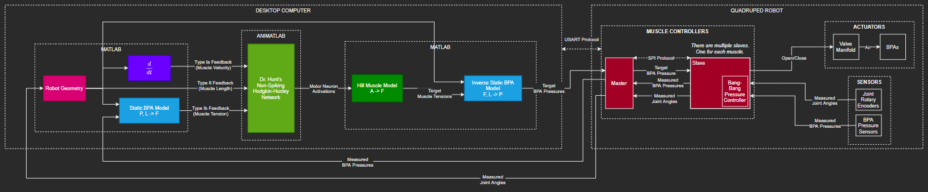
Existing Hardware Organization

Slide 3
Master Micro Duties
Read desired muscle pressures from Matlab.
Write desired muscle pressures to appropriate slave microcontrollers.
Read sensor data from the slave microcontrollers.
Write sensor data to Matlab.

Slide 4
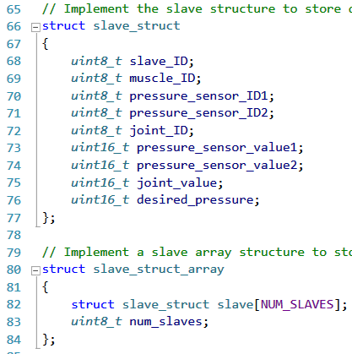
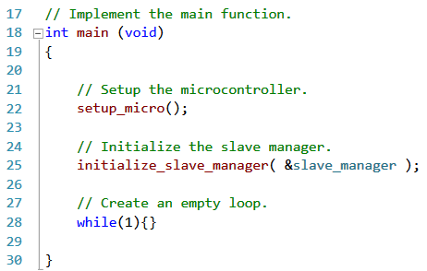
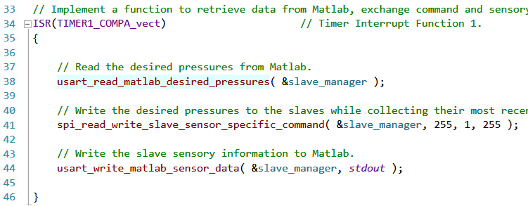
Master Micro approach
Setup microcontroller in main function.
In a timer interrupt, perform the required duties:
Read Matlab commands.
Write Slave commands.
Read Slave sensors.
Write Matlab sensors.
Slave information is stored in a data structure: “slave manager”

Slide 5
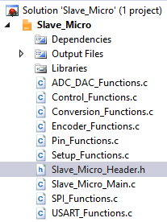
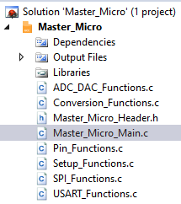
A note about functions…
Functions are stored in separate C files.
Function files include:
Setup_Functions.c
SPI_Functions.c
USART_Functions.c
ADC_DAC_Functions.c
Conversion_Functions.c
Pin_Functions.c
Control Functions
Encoder Functions
Master & Slave micros have their own versions of each of these files.

Slide 6
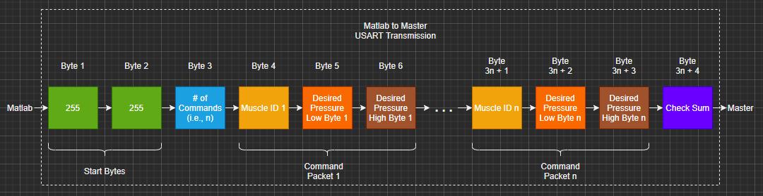
Master Micro: Reading Matlab Commands
Usart_read_matlab_desired_pressures
Waits for the “start sequence” from Matlab.
Reads the number of commands to expect.
Reads each set of command values.
Stores the desired pressure commands into the slave manager.

Slide 7
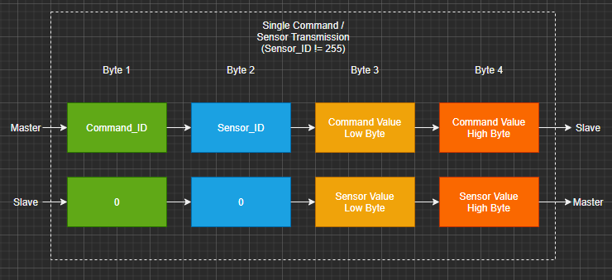
Master Micro: Read / Write to Slaves
Spi_read_write_slave_sensor_specific_command
Builds a byte array to send to the slave.
Writes the command ID.
Writes the sensor ID.
Writes the command low & high bytes.
Writes 4 more dummy bytes if we want to read all sensors from the slave.
Stores the received data in the slave manager.

