Slide 1
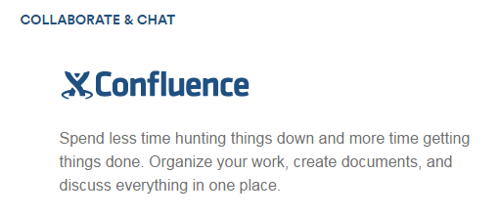
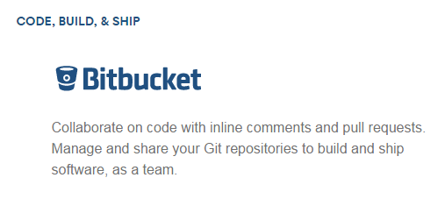
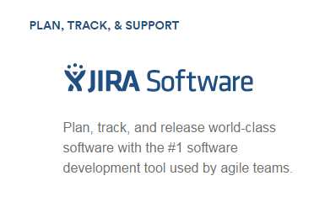
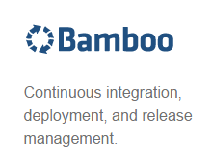
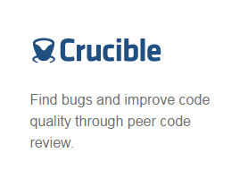
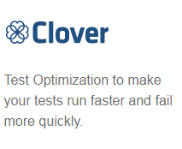

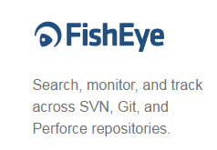
Mapping out Agile with the Atlassian Tool Suite
GIT is a version control system that is used for software development and other version control tasks. As a distributed revision control system it is aimed at speed, data integrity, and support for distributed, non-linear workflows
From: www.atlassian.com
https://try.github.io/levels/1/challenges/1
https://www.atlassian.com/university

