Slide 1
Digital Assistant for Students
Agile Business Analysis tool

Slide 2
Future state

Slide 3


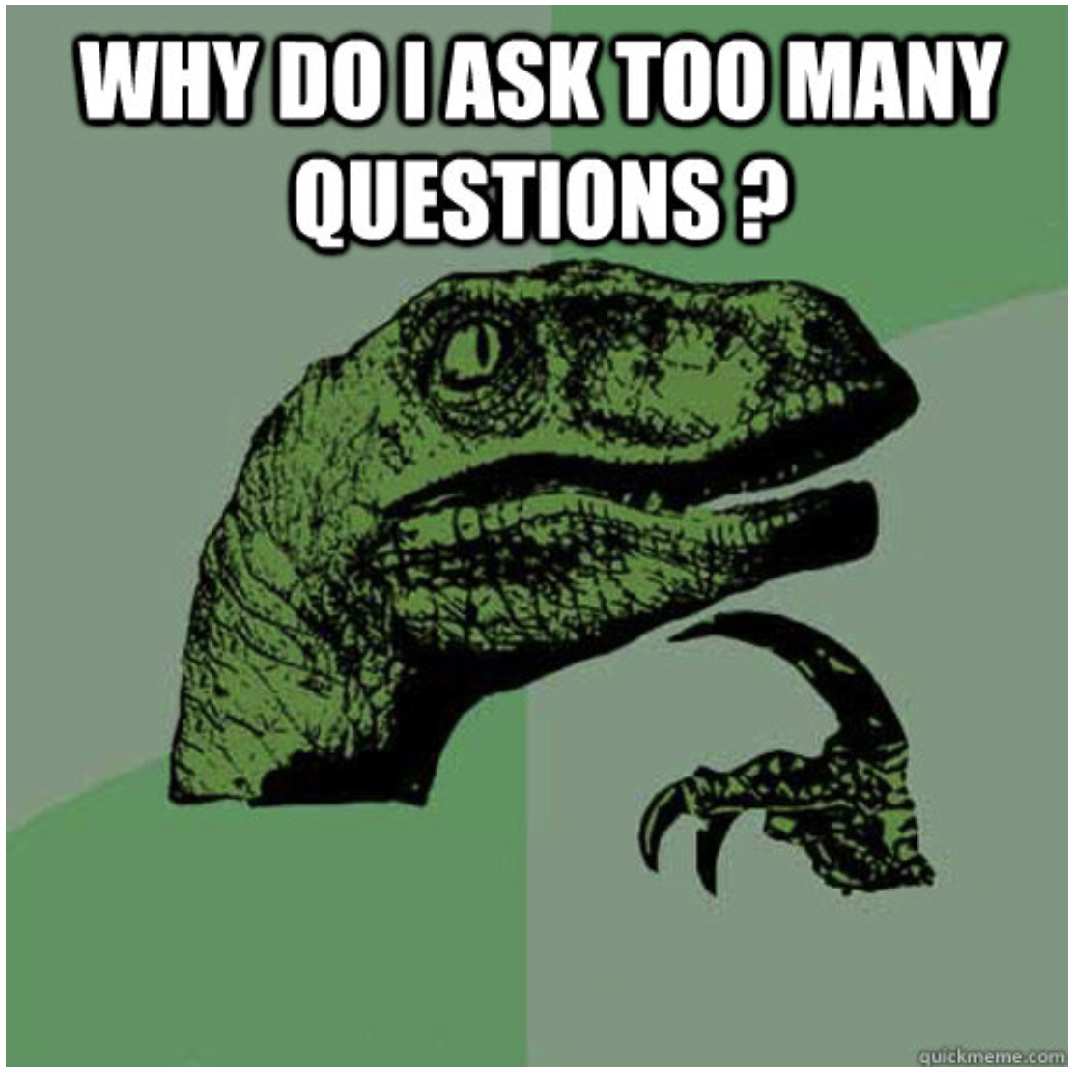

Current state
FHNW receives a lot of different questions:
Administrative questions
Curriculum-related questions
Module-related questions
Answering these questions takes a lot of time

Slide 4
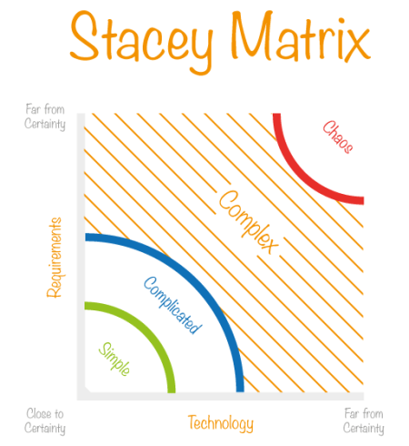
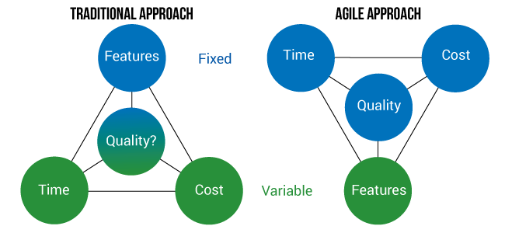
Why agile?
Fixed Timeframes
No clear requirements given
No clear technology given
People with very different knowledge and skills
Source: Robbin Schuurmann
https://i2.wp.com/burozeven.nl/robbinschuurman/wp-content/uploads/2017/05/Stacey-Matrix.png?w=513
Source: https://www.quanta.co.uk/blog/2015/09/traditional-project-management-vs-agile

