Slide 1
Digital Assistant for Students
Agile Business Analysis tool

Slide 2
Future state

Slide 3
Current state

Slide 4
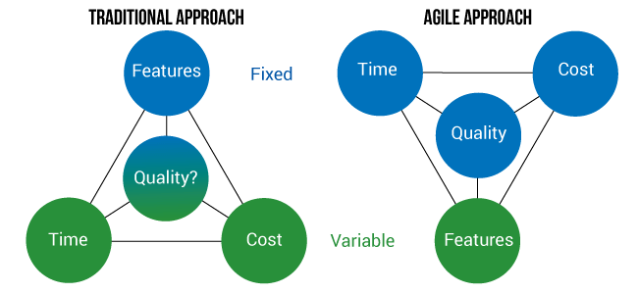
Why agile?
Fixed Timeframe
Complex setting - No fixed feature set
No fixed technology

