Slide 1

Business Intelligence dashboard
Powered by .

Slide 2

Need
Stakeholders: Demand Planers Leaders, Head of Supply
Daily automated update
Clear overview of the inventory (using different KPIs and Hierarchy)
Present history data
Combine old reports to one with Power Bi to get a better visibility and reduce the manpower

Slide 3
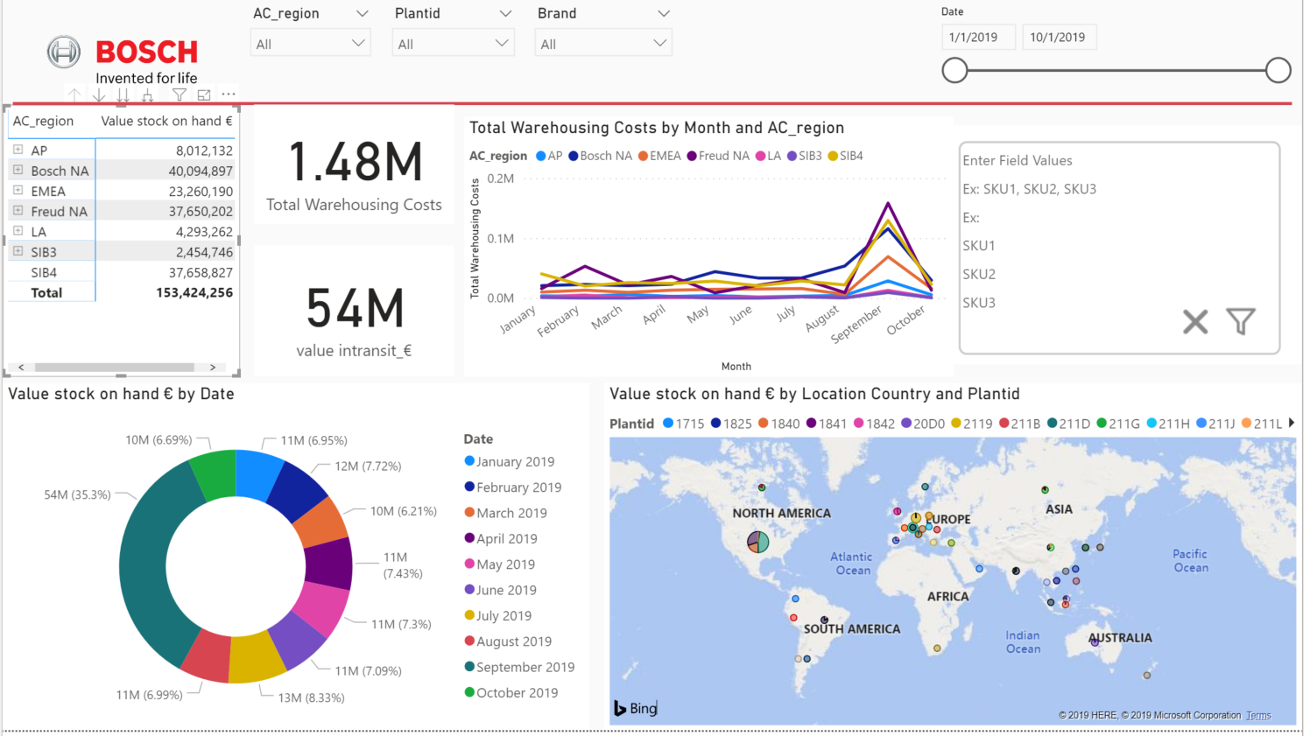
Approach
Replace old manual Excel report
Using Power Bi as a visualization tool and the company has the license for it.
Optimization of SQL
Alignment on Dashboard format/KPI

Slide 4
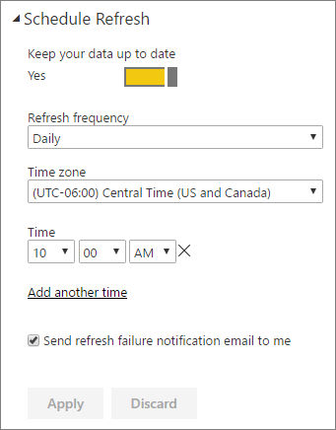
Benefits
Clear and fast understand if there is a problem at a site.
Automated Reduce risk
The report is updated daily

Slide 5

Competition
Current manual procedure using Excel
Several files
3rd Party companies (BI Consultancy)
Other software's (Qlik, Tableau, etc)

Slide 6

Future
Our solution is scalable
Easy to add more data from other tables
Solution is already partially implemented
The stakeholders are coming with new requirements

