Slide 1
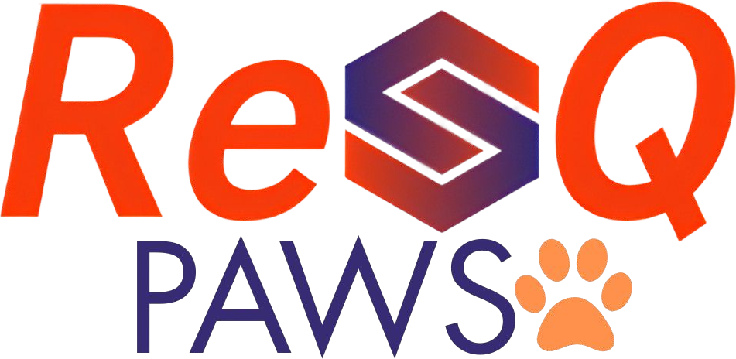
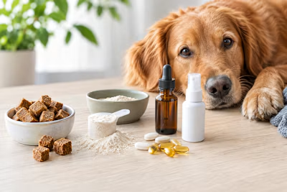
India's first integrated pet mobility and rehabilitation ecosystem
RESCUE EVERY SOUL QUICKLY
Innovating quick ways to serve souls at distress
TiE University pitch
Notes:
OPEN (15 seconds). Do not start with the company name; let the logo sit on screen while you say the first line of slide 2.
Tagline: Rescue Every Soul Quickly. ResQ PAWS is building India's integrated pet mobility and rehabilitation ecosystem: engineering, veterinary care, rehabilitation and technology on one connected platform.

Slide 2
Mobility loss carries a stigma. Rehab support is what breaks it
DIABETES
Stigma
Insulin
Normal life
MOBILITY LOSS
Stigma
Rehab support
Normal life
The stigma is curable.
Notes:
SCRIPT (30-40 seconds). Not long ago, diabetes carried a heavy stigma. Insulin changed that. It became a condition people manage and live full lives with. Mobility loss carries the same stigma today. Someone is told they can't walk, and people assume the story is over. It isn't. Rehab support breaks that stigma, the way insulin did for diabetes. We see people walk, play and compete again. That is true for people. It should be true for animals too, and that is where ResQ starts.
SAY: 'the stigma is curable', not 'the injury is curable'. Never overpromise recovery.
TO VERIFY: your outline says insulin was first used in 1921. Insulin was discovered in 1921; the first patient was treated in 1922. Leave the year out or phrase it carefully.
PHOTO: one strong image of a person thriving after mobility loss, licensed or with permission.
INVESTORS MAY ASK: Why compare mobility loss to diabetes? Is mobility loss really curable?

Slide 3




A crisis hidden in plain sight: joint disorders affect dogs at every stage of life
20–25%
37–40%
70–80%
20%
All dogs
Adult dogs
Senior dogs
Young dogs
Experience clinical joint disorders during their lifetime
Estimated to suffer from osteoarthritis
Show signs of arthritic joint degeneration
May show early joint deterioration before adulthood
Source: American Animal Hospital Association (AAHA) and veterinary research. Large breeds such as Labradors, Golden Retrievers, German Shepherds and Rottweilers are among the most vulnerable.
Notes:
SAY: Joint disorders are not rare exceptions. They are a global epidemic affecting dogs at every stage of life. About one in four to five dogs develops a clinical joint disorder, close to two in five adult dogs have osteoarthritis, and most senior dogs show arthritic degeneration.
SOURCE: the figures come from the earlier ResQ deck, which cites the American Animal Hospital Association and veterinary research. Add the exact publication and year before you pitch.
NOTE: this slide replaces the two overlapping stats slides in the earlier deck (25/40/80% and 20-25/37-40/70-80%). It uses the ranges, which are easier to defend.
INVESTORS MAY ASK: How big is this really, or is it just a few sad cases? Add the number of injured or disabled dogs per year in India when you have a sourced figure.

Slide 4


Humans have a mobility care market. Dogs do not. That gap is ResQ
Humans
Dogs
Famous examples
Paralympics and elite adaptive sport
Few or none. Even bomb-squad dogs get no standard support
Wheelchairs and prosthetics
Widely available
No affordable wheelchair
Rehab network
Physiotherapy and rehab centres
No rehab network
Insurance
Available
No insurance
After a severe injury
Care and recovery
Often euthanasia
The solution works: dogs in wheelchairs run, play and live happy lives.
Notes:
SCRIPT (30-40 seconds). Look at the human side: Paralympians, a whole industry of rehab, role models, funding and insurance. Now look at dogs. A dog that loses mobility gets no affordable wheelchair, no rehab network, no insurance, and it often means euthanasia. But the solution works: dogs in wheelchairs run, play and live happy lives. Bomb-squad and other working dogs have lost legs in the line of duty, and they deserve the same chance. We are not inventing a new market. We are bringing a proven one to the species that has none.
PROOF TO HAVE READY: two or three human rehab examples with sources; photos or video of dogs recovering mobility (own or licensed); one real working-dog case (name, source, photo; verify before using); the size of the human rehab market.
INVESTORS MAY ASK: Who else offers dog rehab or wheelchairs today? (See slide 7 and slide 14.) Why would owners pay for a dog when they cannot afford it for themselves? Are service dogs a real customer segment (police, army and K9 units; validate)?

Slide 5




Owners are not just looking for a wheelchair. They need a complete support system
The right specialist
Affordable treatment
Continuous rehabilitation
Long-term mobility support
Access to qualified orthopaedic and rehabilitation experts.
Care that does not force families to choose between cost and care.
Ongoing therapy, not a one-time fix.
A trusted ecosystem for the whole recovery journey.
Owners need all four in one place. ResQ is built around them.
Notes:
SAY: When we looked closely, we found that owners are not simply searching for a wheelchair. They are searching for a complete support system that stays with them through every stage of recovery: the right specialist, treatment they can afford, rehabilitation that continues, and long-term mobility support.
This sets up the market failure on the next slide and the platform after it.

Slide 6
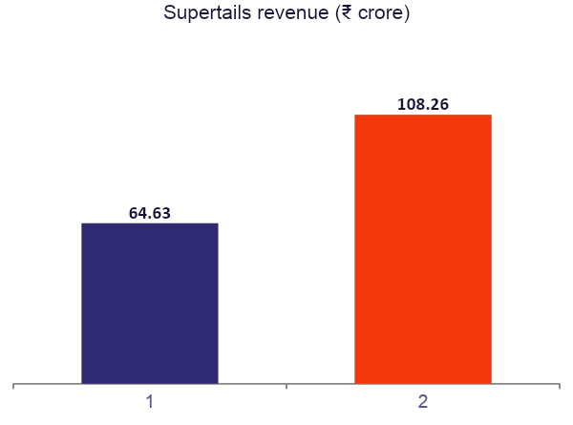



Our current competitor is Supertails: strong on products and clinics, not on mobility
What Supertails sells
Pet products with quick delivery, at-home vet visits and a growing clinic network.
How big it is
Close to 1 million pet parents and about $51M raised, including a $30M round in 2026.
The gap we target
Mobility and rehabilitation are not part of its stated focus. ResQ is built around them, wheelchair included.
Sources: Entrackr (FY25 revenue and funding); Business Standard, Feb 2026 (clinics, customers). Loss in FY25 was ₹52 crore.
Notes:
SAY: Our current competitor is Supertails. It is the scaled player in Indian pet care: products, quick delivery, at-home vets and now clinics. Its revenue grew from about 65 crore rupees in FY24 to about 108 crore in FY25. We are not trying to out-spend them on food and accessories. ResQ is built around mobility: specialists, continuous rehabilitation and affordable care in one subscription.
FACTS USED: revenue FY24 Rs 64.63 crore and FY25 Rs 108.26 crore, loss Rs 52.47 crore in FY25, about $51M raised in total including a $30M round led by Venturi Partners (Entrackr). Business Standard (Feb 2026): about 15 clinics planned in Bangalore, 60+ dark stores in Mumbai, Delhi and Bangalore, close to one million pet parents, 60 to 70 percent annual growth, and a target of Rs 1,000 crore ARR.
TO VERIFY BEFORE PITCHING: 'mobility is not part of its stated focus' comes from the articles reviewed, which describe products, clinics, at-home vet care and quick delivery and do not mention physiotherapy or rehabilitation. Check Supertails' current clinic services page, because a clinic could offer physiotherapy without announcing it.
INVESTORS MAY ASK: Why can't Supertails add rehab next quarter? What do you do that a funded clinic chain cannot? (Answer: specialist network and a rehab programme designed around mobility, not an add-on.)

Slide 7


One subscription: a wheelchair included, affordable care and continuous rehabilitation
Mobility
Care
Wellness
A wheelchair included with the subscription
Locally engineered, patent owned by ResQ
Continuous rehabilitation
Cheap, quick vet appointments
Specialist matching
Affordable treatment and medicines
Grooming and spa
Red light therapy
One place for a pet's health and wellbeing
THE OWNER'S JOURNEY
1 Wheelchair included
2 Quick vet appointment
3 Specialist match
4 Continuous rehab
5 Grooming and wellness
Notes:
SCRIPT (30-40 seconds). The subscription is the product, and the wheelchair comes with it. We help owners find the right specialist, get a quick and affordable appointment, and keep up rehab so the dog actually recovers. Beyond rehab, we offer grooming, spa and red light therapy, so ResQ becomes the one place for a pet's health and wellbeing.
KEEP IT TO THREE HEADINGS: Mobility, Care, Wellness. Do not read every feature.
TO CHECK: your outline lists 'spa, grooming, laser therapy' and your project notes say 'red light therapy'. The slide uses red light therapy and places it under Wellness. Change if needed.
ADD when ready: wheelchair photo or render, specs, production cost per unit, patent number, 2 to 3 app screens or a demo clip, the list of vets and specialists onboarded, and what a rehab plan looks like week by week.
INVESTORS MAY ASK: Who manufactures the wheelchair and at what cost? How do you guarantee vet quality? What does a subscriber get in month one?

Slide 8
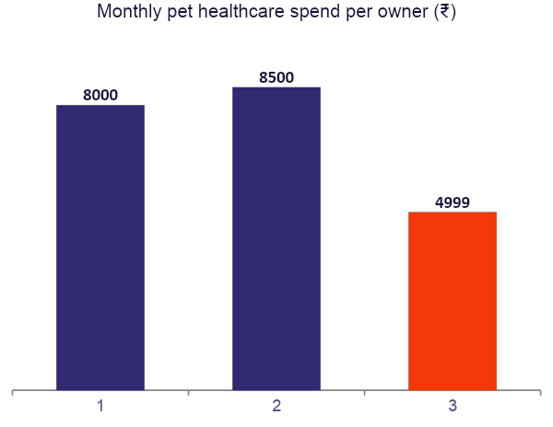
Owners spend about ₹8,000 to ₹8,500 a month today. With ResQ it is ₹4,999, wheelchair included
about 40% less
for the owner, and the wheelchair is included
What ₹4,999 a month includes
A wheelchair, worth ₹60,000 to ₹1,80,000 imported
Quick vet appointments and specialist matching
Continuous rehabilitation
Medicinal care and supplements
Grooming
Red light therapy
Notes:
SCRIPT (30 seconds). Today an average owner spends 8,000 to 8,500 rupees a month on healthcare for a pet. With ResQ they spend 4,999 rupees a month, and that already includes the wheelchair, vet care, specialist matching, rehabilitation, medicines, grooming and red light therapy. The wheelchair alone costs 60,000 to 1.8 lakh rupees when imported.
BILLING PERIOD: the slide says monthly, based on your project notes. Investors ask this first, so confirm it. The 8,000 to 8,500 comparison must also be monthly. Your earlier deck had mobility-impaired pets at 10,000 to 30,000 rupees a month and an average Bengaluru owner at 4,000 to 8,000.
SOURCE NEEDED: where does 8,000 to 8,500 come from (owner survey, vet data, market report)? Even a 50-owner survey you ran yourself is strong evidence; say how many people you asked.
'About 40% less' holds: 4,999 is 62.5% of 8,000 and 58.8% of 8,500, so the saving is 37.5% to 41%. The old 3,999 price gave about 50%. If investors push, say 'roughly 40%'.
WHO PAYS FOR THE WHEELCHAIR: it is now inside the subscription, so its cost must be recovered from subscribers. At 4,999 a month, a wheelchair costing X rupees is paid back in X / (monthly margin) months. Get the production cost per unit and the monthly margin before pitching.
INVESTORS MAY ASK: Do you make money at 4,999 once the wheelchair is included, and what happens if a subscriber leaves in month three? Add revenue, cost to serve and gross margin per subscriber once you have real numbers.

Slide 9
Four plans, from ₹4,999 a month
PLAN 1
PLAN 2
PLAN 3
PLAN 4
Basic Rehab Plan
Core Plan
Intensive Rehab Plan
Ultimate Plan
₹4,999
₹ TBD
₹ TBD
₹ TBD
per month + GST
price to be finalised
price to be finalised
price to be finalised
Supplements
2 grooming sessions
Food discounts
Vet consultation
Laser therapy
Vet and food discounts
Supplements
2 grooming sessions
Wheelchair, limited time
Vet consultations
Vet and food discounts
Supplements
2 grooming sessions
Basic medicated food
Exclusive laser access
Wheelchair included
Everything in Intensive
Physio, laser and hydro
Advance vet consultation
Pharma supplements
Advance medicated food
Every plan includes supplements and 2 grooming sessions. Each tier adds more care.

Slide 10



Business model: a subscription with a wheelchair included, and low costs through partnerships
Owner subscribes
Wheelchair included
Care and rehab delivered
Partner services
Recurring revenue
Subscription
Partner commissions
Bulk pharma and supplement margins
₹4,999 a month. Recurring revenue that pays for the wheelchair, care, supplements and the platform.
Food, grooming and vet partners. Home meal delivery is a proven model for humans; we bring it to dogs.
Fixed rates from pharmaceutical companies and fixed fees for doctor appointments keep prices low.
Wheelchair patents owned by ResQ
Pawful: household meals
Vets and specialists
Grooming partners
Notes:
SCRIPT (30-40 seconds). The subscription is the MVP and the core of the business. Owners pay 4,999 rupees a month and get a wheelchair plus care built around mobility. ResQ owns the wheelchair patents, so it can't be copied cheaply. We keep prices low because we buy from pharmaceutical companies at fixed rates and agree fixed fees for doctor appointments. Home food delivery for humans is a proven model. We bring the same to dogs with partners like Pawful, plus grooming companies.
PROOF TO HAVE READY: cost per wheelchair and who manufactures it; patent number or filing proof; signed or verbal commitments from pharma suppliers, vets, Pawful and grooming partners; how many subscribers the MVP has or is targeting first.
SHOW THREE REAL LOGOS here when you have them; they are stronger than any paragraph. Only Pawful is named in your files, so the other partner pills are generic.
NOTE: the earlier deck sold the wheelchair for 15,000 to 20,000 rupees and relied on crowdfunding. This deck follows your latest direction: the wheelchair is included in the 4,999 subscription, and crowdfunding is not mentioned. Retire the old device-sales slides so the story is consistent.
INVESTORS MAY ASK: Why will partners give you fixed rates? What stops a bigger player such as Supertails from copying you?

Slide 11
One subscriber brings in ₹59,988 a year, and referrals keep the cost of finding them low
PER SUBSCRIBER
Customer acquisition
₹4,999 a month
Paid CAC is expected to be near zero, driven by referrals
The included wheelchair is the main upfront cost per subscriber
Every wheelchair delivered is a story people share
× 12 months
₹59,988
revenue per subscriber per year, before cost to serve
How we will track it
Payback period = CAC ÷ monthly margin per subscriber
Lifetime value = monthly margin × months retained
Notes:
SAY: 'We expect paid CAC to be near zero, driven by referrals, and we will measure it from the first subscribers.' Say near-zero, never zero. It is more believable. Supertails spends heavily on growth (its FY25 loss was Rs 52 crore on Rs 108 crore revenue), so a referral-led model is a real contrast, but only if the numbers bear it out.
MATH: 4,999 x 12 = 59,988 rupees of revenue per subscriber per year, if they stay twelve months. This is revenue, not margin. Cost to serve and gross margin per subscriber are NOT in your files; add them before investors ask.
Partner commissions and bulk pharma margins are upside beyond the subscription and are deliberately not counted here.
CORRECTION to the earlier deck: its Year 1 table showed Care+, vet and pharmacy rows as one month's revenue, not a year (5,000 x 3,999 = 1,99,95,000 was one month at the old price). Do not reuse that table until it is annualised and consistent with 5,000 subscribers.
INVESTORS MAY ASK: Is CAC really zero? How long does an owner stay (retention)?

Slide 12



An included wheelchair is our marketing
1 Wheelchair included
2 Subscription pays for ongoing care
Publicity
NGO initiatives
Pet communities
Every wheelchair delivered is a story people share.
NGOs already run initiatives for animals, and we plug into them.
Owners spread the word through referrals.
NEXT 6 TO 12 MONTHS
Scale the subscription MVP, produce more wheelchairs, and onboard vets and specialists
Notes:
SCRIPT (30-40 seconds). Every wheelchair delivered is a story people share, so our paid customer acquisition cost is expected to be near zero, driven by referrals. NGOs and pet communities already run initiatives, and we plug into them.
TO ADD: MVP status (what is built, what is next) and dated milestones for the next 6 to 12 months. Your files describe the plan to scale the MVP, produce more wheelchairs and onboard vets, but no dates, so none are shown. Which milestones unlock the next round?
INVESTORS MAY ASK: What will you do with the money in the first 12 months? How many NGOs have committed?

Slide 13
A $3.6 billion market, and about ₹36 crore of annual run-rate within reach
TAM
India’s total pet-care opportunity: $3.6 billion
TAM $3.6B
40M pets (74% dogs). Market $841M, 23% CAGR
Arthritis sets in at 3.5–4 years of age
SAM $25M
SAM
Serviceable market: about $25 million a year
40,000 dogs × ₹4,999 × 12 months ≈ ₹240 crore
1 in 5 dogs show radiographic joint disease or osteoarthritis
SOM
$3.8M
SOM
Year 1 target: 6,000 subscribers
6,000 × ₹4,999 × 12 months ≈ $3.8 million
≈ ₹36 crore annual run-rate
Notes:
SAY: India has about 40 million pets, 74 percent of them dogs. The pet-care market is $841 million today and growing at 23 percent a year. The total potential market for us is $3.6 billion.
SERVICEABLE MARKET: 40,000 dogs x Rs 4,999 x 12 months = Rs 23.99 crore, about $25 million. Arthritis typically shows up at 3.5 to 4 years of age, and 1 in 5 dogs show radiographic evidence of degenerative joint disease or osteoarthritis.
SOM: Year 1 target of 6,000 subscribers x Rs 4,999 x 12 = Rs 35.99 crore, about $3.8 million (at roughly Rs 95 per US dollar). Say run-rate, since subscribers ramp up through the year. The price is Rs 4,999 plus GST.
TO VERIFY: source and year for the $841.13M market size, the $3.6B TAM and the 23% CAGR; where the 40,000-dog SAM figure comes from (launch cities or share of dogs with joint disease); the exchange rate used. Earlier decks used 5,000 subscribers; this one uses 6,000.

Slide 14
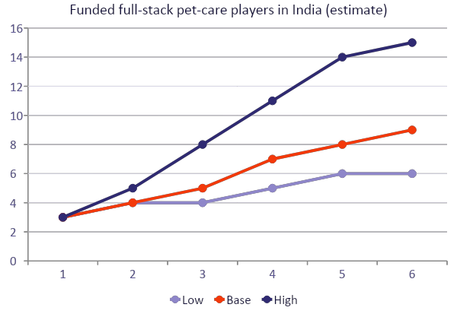
Expect about 8 scaled pet-care competitors in India by 2030, within a range of 6 to 14
Why entry will rise
New firms enter faster as more firms prove the market (Gort and Konakayama, 1978). Market forecasts run 9% to 20% a year.
Who is already here
Supertails, Vetic and Heads Up For Tails have each raised roughly $50M to $75M.
Mobility is still open
We found no dedicated mobility and rehab subscription. Expect about half of scaled players to add rehab by 2030.
Estimate, not a published figure. Today's 3: Supertails, Vetic, Heads Up For Tails. Sources: Inc42 (500+ startups), Entrackr, Entrepreneur India citing Tracxn, Gort and Konakayama (NBER, 1978).
Notes:
SAY: Competition will grow, and we plan for it. We expect about eight scaled, funded pet-care players in India by 2030, with a plausible range of six to fourteen. Today there are three: Supertails, Vetic and Heads Up For Tails. Our edge is that mobility is not an add-on for us. It is the identity.
IMPORTANT, BE HONEST ON STAGE: no research paper publishes a competitor count for Indian pet care. This is a model estimate built from sourced inputs. Say 'we estimate' every time.
METHOD: (1) Startups. Inc42 reports 500+ pet care startups in India over 15 years, so about 33 a year. Low, base and high cases assume 33, 50 and 70 new startups a year from a base of 500 in 2024, which gives roughly 700, 800 and 920 by 2030. (2) Scale. Of those, only a small share reach scale (funded roughly $25M or more). Today it is 3 of about 570 to 640, about 0.5 percent. We assume that rises to 0.8 percent (low), 1.0 percent (base) or 1.5 percent (high) by 2030, which gives 6, 8 and 14. (3) Mobility. We assume about half of scaled players add a rehab line by 2030. That is a judgement, not a sourced figure.
THEORY: Gort and Konakayama (NBER Working Paper 297, 1978) find that entry into a new product market rises with the number of firms already in it (the demonstration effect), slows as incumbents build experience and goodwill, and traces a logistic path toward a ceiling set by the pool of potential entrants. Gort and Klepper (1982) add that the count of firms later peaks and then falls in a shakeout. We do not model the shakeout, so the 2031 values are a plateau, not a forecast of decline.
OTHER COUNTS FOUND (different definitions, do not mix them): Kenresearch lists over 250 players in online pet care and vet platforms and over 500 in veterinary healthcare, with 8 new entrants in the last 5 years; Tracxn lists 316 pet care product startups (May 2026).
MARKET SIZE DISAGREES: Vyansa says US$755 million in 2024 growing 9.2 percent a year to 2030; Kenresearch says the online platform market is Rs 50 billion in 2025 growing 17.8 percent a year; Inc42 and Market Decipher say 18 to 20 percent a year; IBEF (cited in Entrepreneur, June 2026) says US$3.6 billion in 2024 reaching US$24.8 billion in six years, which implies about 38 percent a year and looks too high. Do not quote one number as settled.
INVESTORS MAY ASK: Why won't Supertails or Vetic add rehab? What happens when five more funded players arrive? Which of your assumptions would change the answer most? (Answer: the share that reach scale.)

Slide 15


We are raising ₹10 crore to scale ResQ
₹10 Cr
USE OF FUNDS
Product and manufacturing
Wheelchair production and patents
Technology
App, vet booking, rehab tracking
to scale the MVP, produce more wheelchairs and onboard vets and specialists
Partnerships and supply
Stock, vets and grooming partners
Team and operations
Hiring, field ops and support
Rescue Every Soul Quickly.
Community and NGO programmes
NGO programmes and outreach
Reserve
Runway buffer
For Rani, and every soul like her.
Notes:
SCRIPT (20-30 seconds). We are raising 10 crore rupees to scale the MVP, produce more wheelchairs and onboard vets and specialists. [Say what the first 12 months will deliver and which milestones unlock the next round.] Then close on the tagline and Rani: Rescue Every Soul Quickly.
ONE NUMBER EVERYWHERE: your outline had both 10 Cr and 20 Cr. This deck uses 10 Cr, as in your project notes. Do not mention the other number anywhere.
USE OF FUNDS: the six categories come from your outline, but no percentages exist yet, so no pie chart is shown. When you set the split, add a chart that sums to 100% and matches Rs. 10 Cr.
REHEARSE: What is your margin at 4,999 with a wheelchair included? What if Supertails or Vetic adds rehab? What if a bigger player copies you? Which milestones unlock the next round?

