Slide 1
Node.js

Slide 2
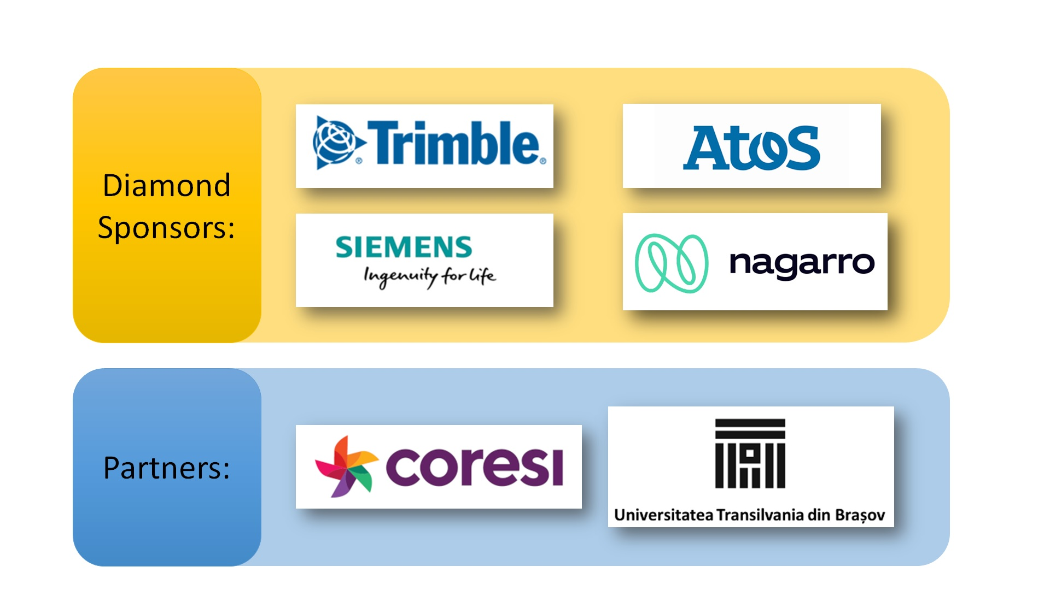

Slide 3
Objectives
Create a mental model on how Node.js works.
Better understand JavaScript concepts like Event Loop, Callbacks.
Create an endpoint with in memory database using Express.

Slide 4
What do we think Node.js is?

Slide 5
Client – Server Model of Computing
Server: performs services (Responds for a request)
Client: asks for services (Requests for a service)
Communication format that both Client and Server can understand

Slide 6
So what is a server?
Computer connected to the internet:
a permanent store of code/data,
always on,
ready to receive messages over the internet from clients requesting code/data and
send it back to them!

Slide 7
What features of the OS would a server need access to?
Network: receive and send back messages over the internet
Filesystem: store our HTML/CSS/JavaScript code
Kernel – I/O
We know that we can’t use JavaScript to access these internal features of the computer, so how do we accomplish that?
What programming language would allow us to interact with these features?

Slide 8
Wait.. Let’s get back to what we know. How does JavaScript run in the browser?
V8
Spider Monkey
Chakra
etc.

Slide 9
What features are available to JavaScript (in the browser) but not part of the actual language itself?
We see that this idea already exists implemented by the browser, extending the languages functionality with extra features:
DOM API,
AJAX request,
Timeout functionality
These are outside of ECMAScript specification.

Slide 10
So we can see we have a pattern here
JavaScript is enhanced by the Browser to have all these extra features.
So the question is how will it have access to all the features we need on the server?

Slide 11
What does JavaScript need to manage a Server?
Better way of organize code in reusable pieces (ES6 solved these issues) but Node implemented them beforehand
Ways to deal with Files
Ways to deal with Databases
Ability to communicate through internet
The ability to accept Requests and send Responses
Deal with work that takes a long time

Slide 12
In that case what language has access to these features?
❓

Slide 13
JavaScript will have to work together with C++
C++ + JavaScript = Node.js
We have labels in JavaScript that will give us access to C++ features 😁similar to what we have in the browser.

Slide 14
What happens if we open up the browser and enter www.pinterest.com ?

Slide 15
DNS Server
JavaScript
request
My PC
response
www.pinterest.com
request
response
Computer features
Node C++ Features
Request Line
Headers
Body
Get / HTTP 1.1
Content-Type: …
{ … }
Nework
pinterest.com
(23.34.21.1)
Notes:
We want to write JavaScript. How am I going to have access from JS to the computer internal features? We are going to use labels (facades) commands to C++ features
All the node.js work is going on in C++
C++ is going to interact with the abstarction layer of the OS itself

Slide 16
Questions that we might ask:
How does Node.js get notified by the network request?
How does javascript code get called when Node.js is notified?

Slide 17
How does Node.js get notified by the network request?
The answer is: libuv

Slide 18
JavaScript call stack

Slide 19
OS
Request
JavaScript call stack
libuv

Slide 20
Event
OS
Request
JavaScript call stack
libuv

Slide 21
Event
OS
Event Queue
Request
JavaScript call stack
libuv

Slide 22
Event
Task complete
Task complete
OS
Event Queue
Request
JavaScript call stack
libuv

Slide 23
Event
Task complete
Task complete
OS
Event Queue
Request
Event Loop
JavaScript call stack
libuv

Slide 24
Event
Task complete
OS
Event Queue
Request
doOnRequest
execute
callback
Event Loop
JavaScript call stack
libuv

Slide 25
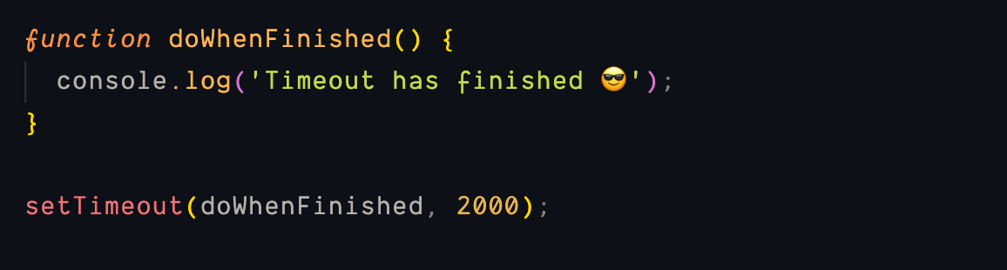
So…. What’s a callback?

Slide 26
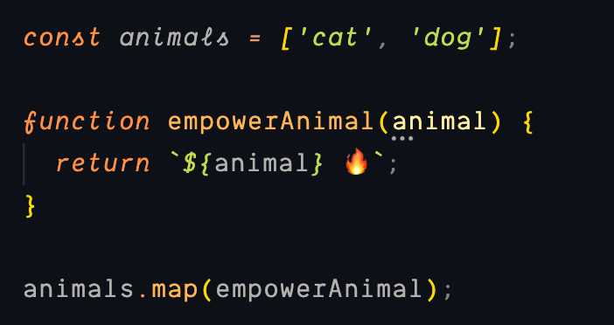
So…. What’s a callback?

Slide 27
So now that we know all these, can we finally have a look at how to write some node code?

Slide 28


JavaScript
const server = http.createServer()
server.listen(80)
My PC
www.pinterest.com
Computer features
Node C++ Features
Network -> socket
http module
pinterest.com
(23.34.21.1)

Slide 29
JavaScript
const server = http.createServer()
server.listen(80)
My PC
www.pinterest.com
request
Computer features
Node C++ Features
libuv
pinterest.com
(23.34.21.1)

Slide 30
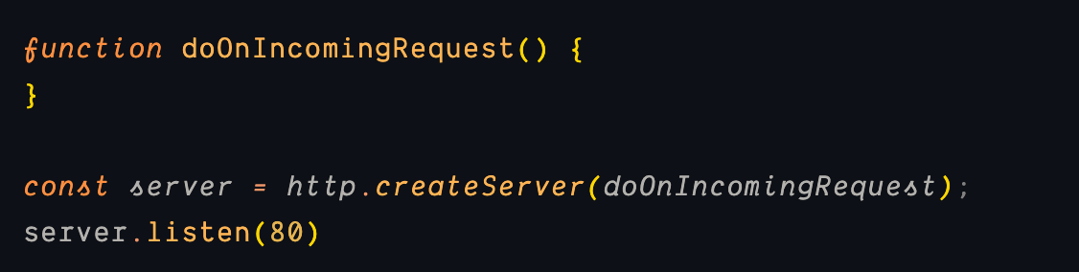
JavaScript
function doOnIncomingRequest() {}
const server = http.createServer(doOnIncomingRequest)
server.listen(80)
My PC
www.pinterest.com
request
Computer features
Node C++ Features
doOnIncomingRequest
libuv
pinterest.com
(23.34.21.1)

Slide 31
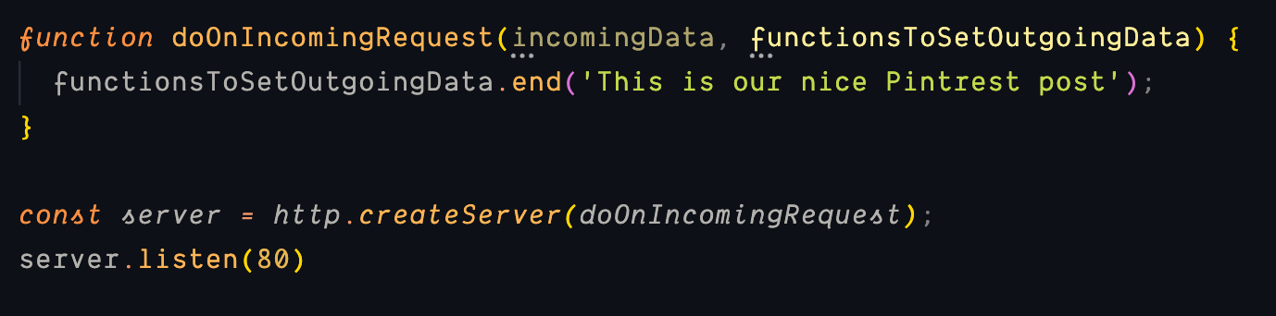
JavaScript
function doOnIncomingRequest(
incomoningData,
functionsToSetOutgoingData
) {}
const server = http.createServer(doOnIncomingRequest)
server.listen(80)
My PC
www.pinterest.com
request
Computer features
Node C++ Features
doOnIncomingRequest
libuv
{ … }
{ … }
pinterest.com
(23.34.21.1)
{}

Slide 32
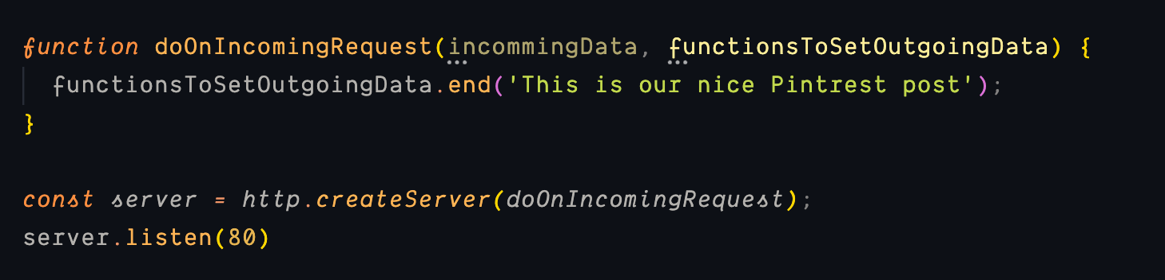
Node auto runs code for us when a request arrives from a user

Slide 33
Hands on example!

Slide 34
Using Express to prettify our code 😁

Slide 35
🚶‍♂️Where to go from here?
Get a deeper understanding of the Event Loop.
Get familiar with all the Queues.
Learn a framework like: Express, Loopback.io, Nest.js, etc.
Continue learning JavaScript 😁

Slide 36

Feedback
Completați acum
Durează 2-3 minute
Feedback anonim - pentru formator și AgileHub
http://bit.ly/peakit003-feedback

