Slide 1
AWS
Amazon Web Services

Slide 2
Background
Publicly launched on March 19, 2006, AWS offered Simple Storage Service (S3) and Elastic Compute Cloud (EC2), with Simple Queue Service (SQS) following soon after. By 2009, S3 and EC2 were launched in Europe, the Elastic Block Store (EBS) was made public, and a powerful content delivery network (CDN), Amazon CloudFront, all became formal parts of AWS offering.

Slide 3


Slide 4


Slide 5
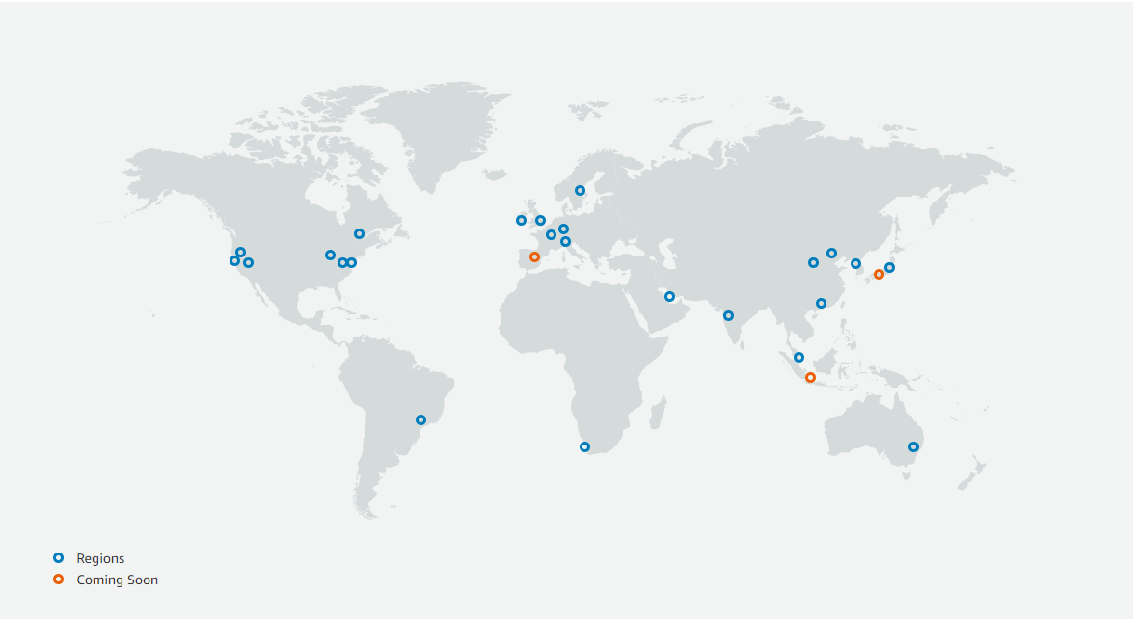
AWS Global Infrastructure Map

Slide 6
AWS Summary
Regions - 24
Availability Zones - 77
Points of Presence - 216

Slide 7
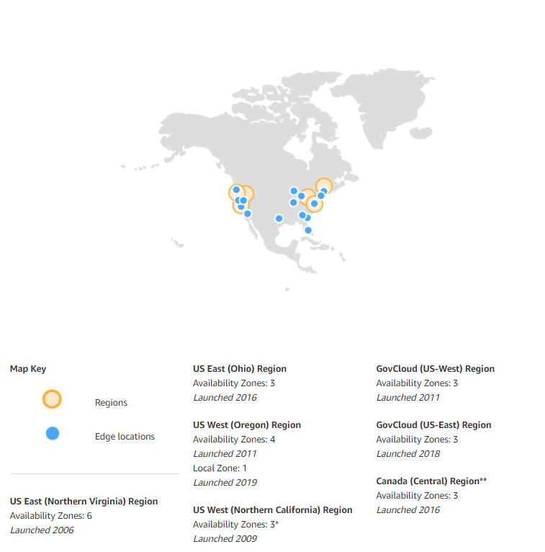
North America

Slide 8
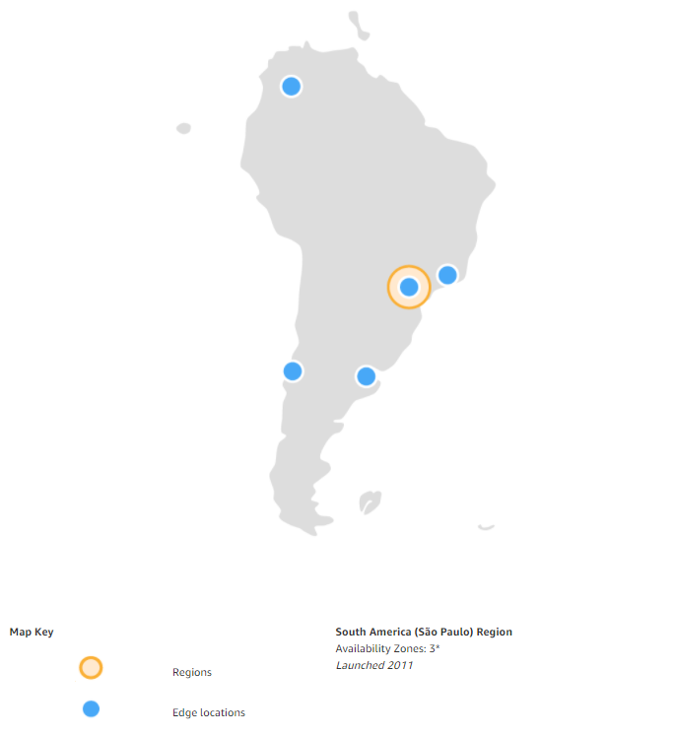
South America

Slide 9
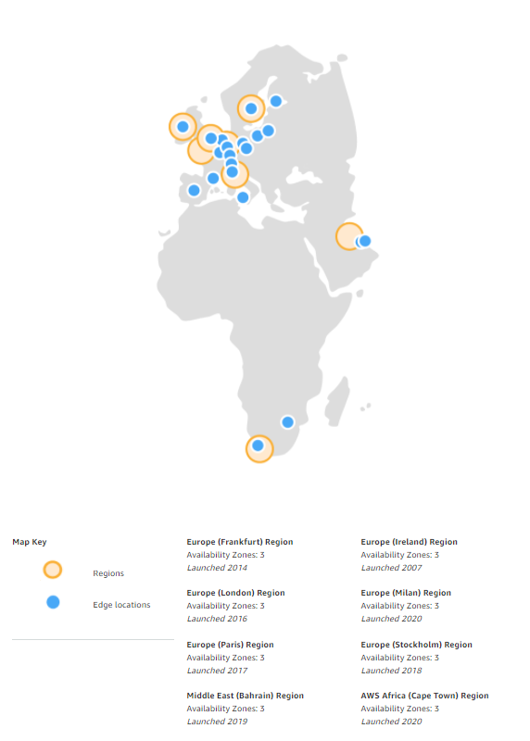
Europe / Middle East / Africa

Slide 10
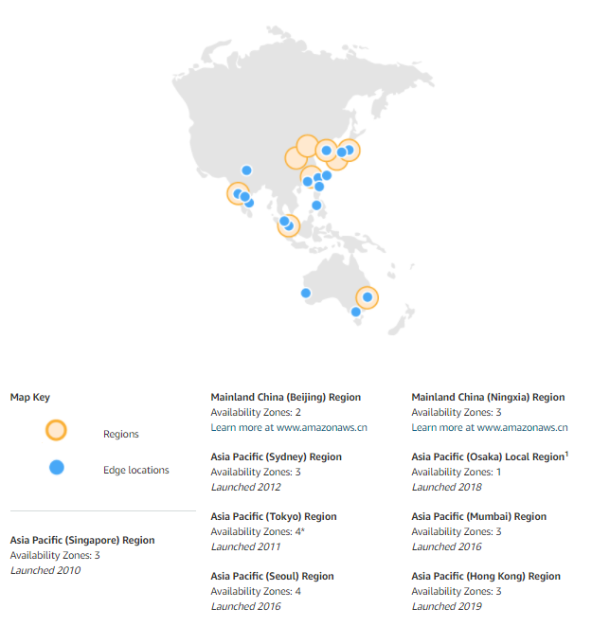
Asia

Slide 11
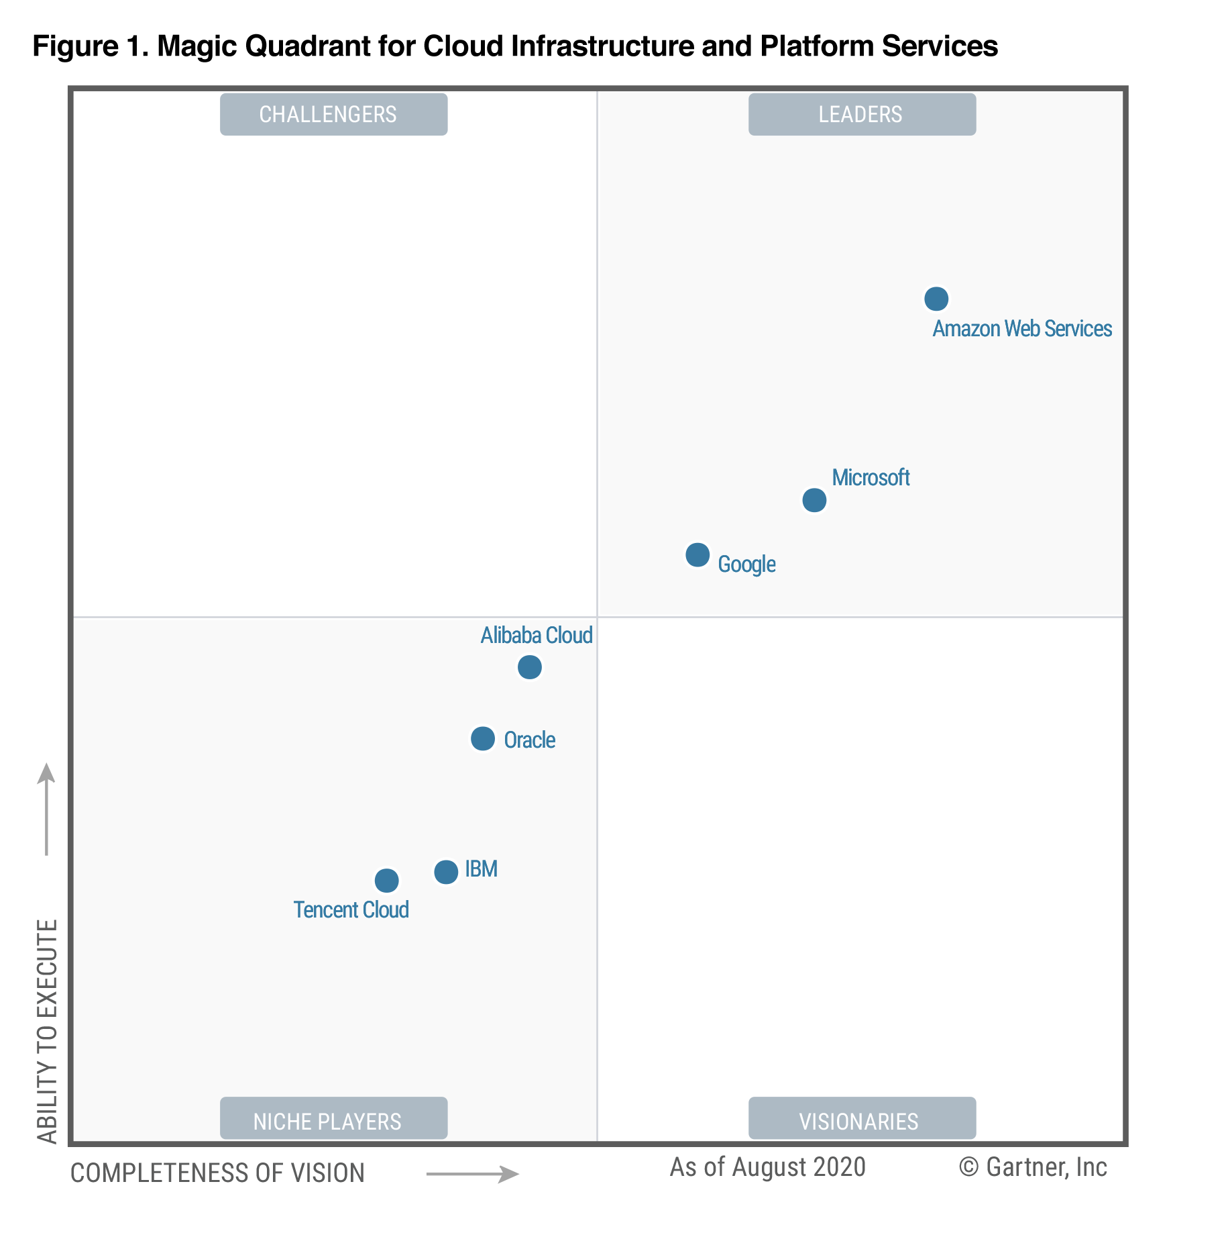
Magic Quadrant for Cloud Infrastructure as a Service, Worldwide (2020)

Slide 12
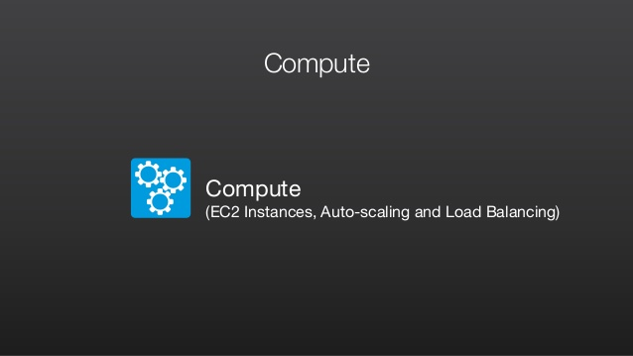
AWS

Slide 13
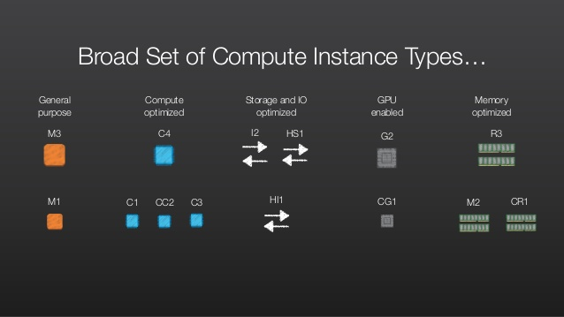
AWS

Slide 14

AWS

Slide 15
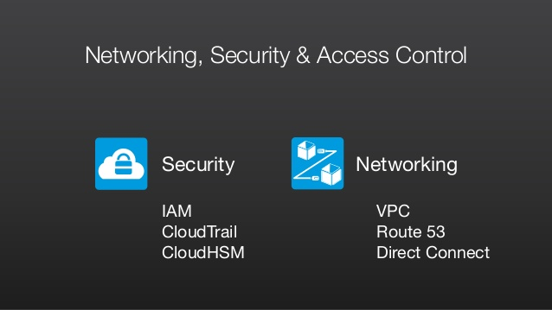
AWS

Slide 16
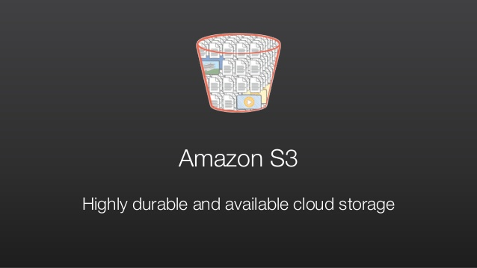
AWS

Slide 17
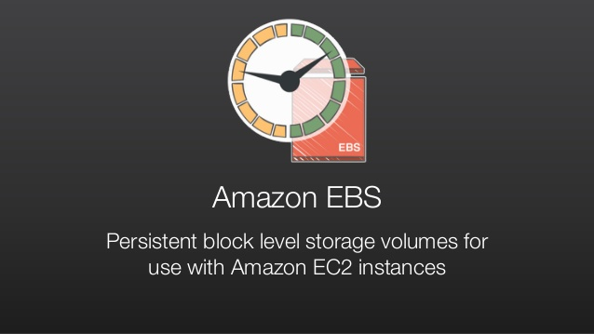
AWS

Slide 18
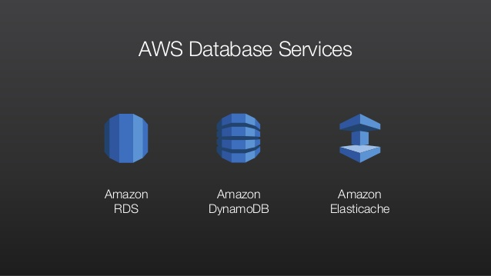
AWS

Slide 19
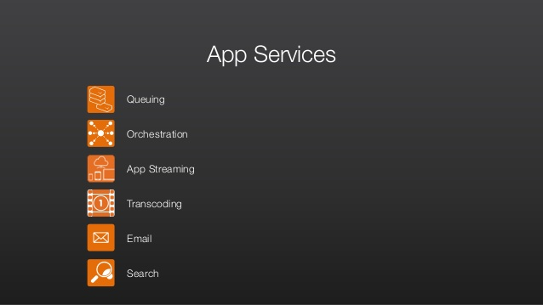
AWS

Slide 20
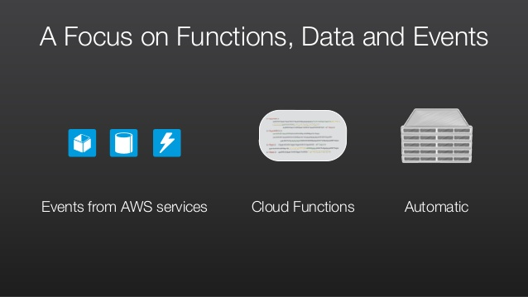
AWS

Slide 21
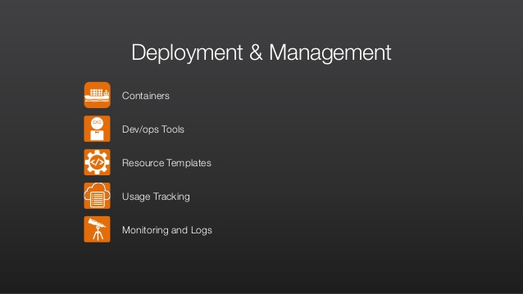
AWS

Slide 22
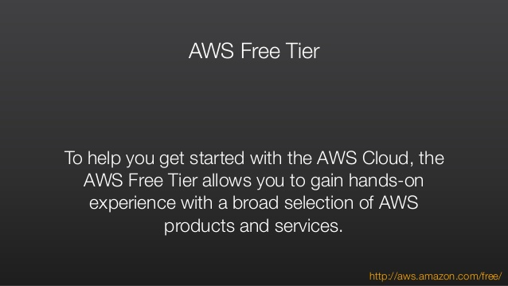
AWS

Slide 23
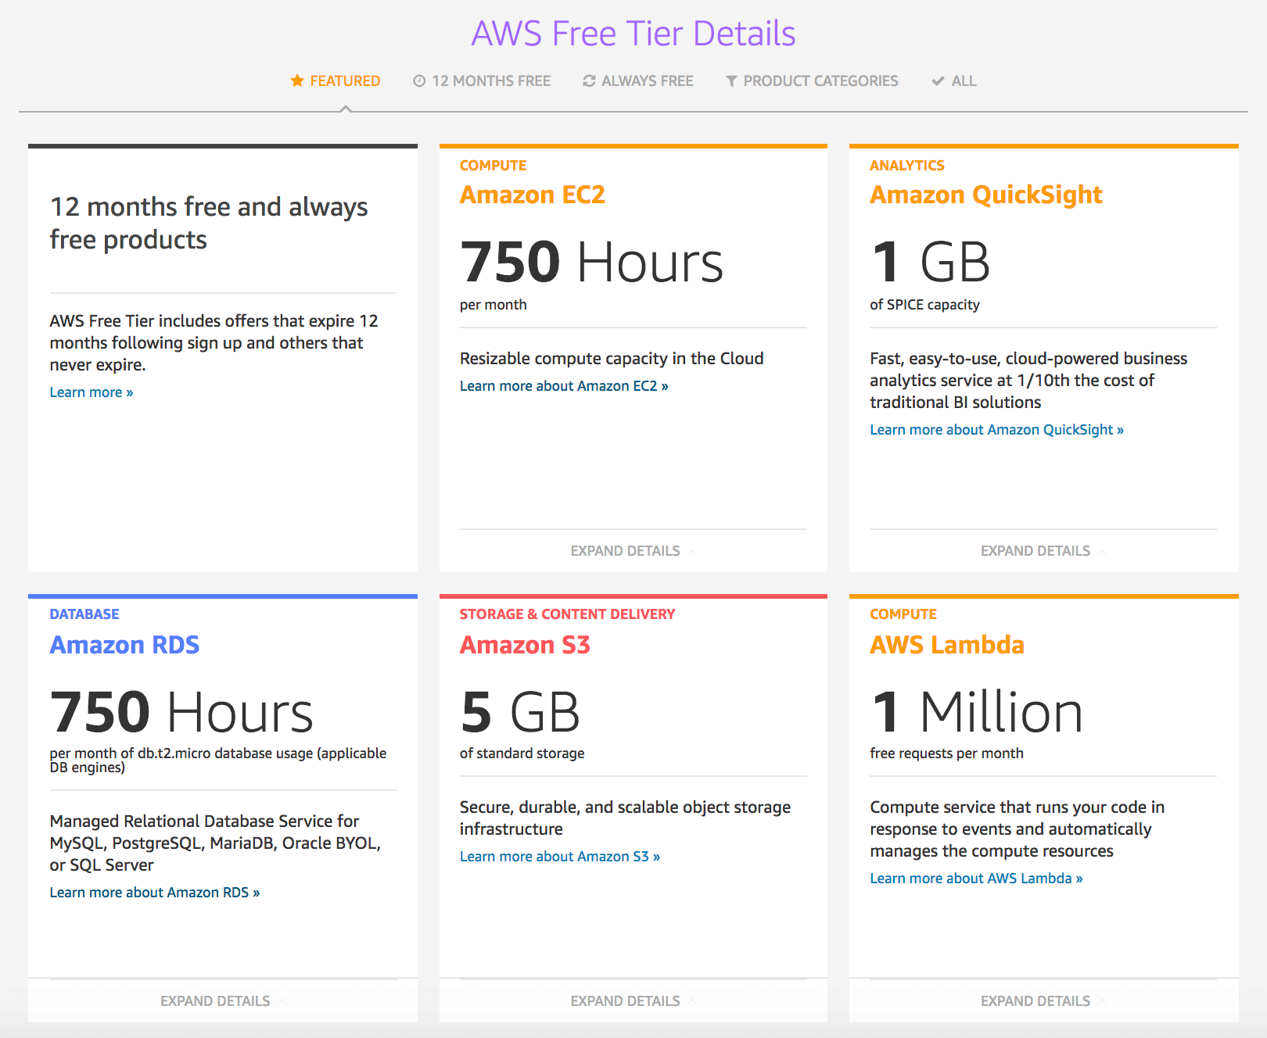
AWS

