Slide 1
GCP
Google Cloud Platform

Slide 2
Background
April 2008 — App Engine launches in preview for 20,000 developers (10,000 at launch, then expanded by another 10,000 four days later), as a tool to run web applications on Google’s infrastructure. Applications had to be written in Python, and were limited to 500MB of storage, 200M megacycles of CPU per day, and 10GB bandwidth per day. Services offered included dynamic webserving, persistent storage (Datastore), and APIs for authenticating users and sending email

Slide 3
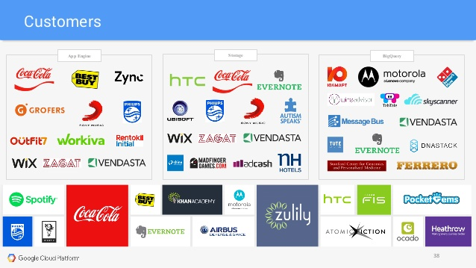

Slide 4
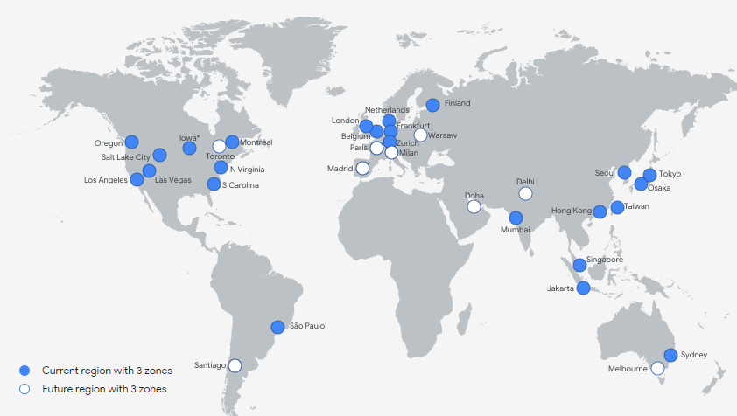
GCP Presence

Slide 5
GCP Summary
Regions - 24
Zones - 73
Network Edge Location - 144

Slide 6
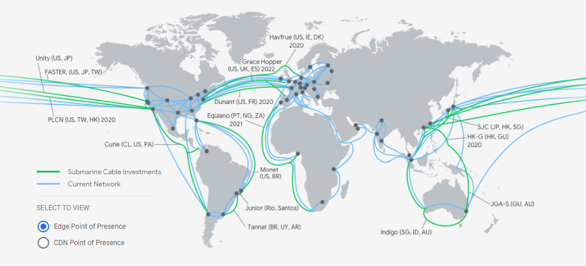
GCP Network

Slide 7
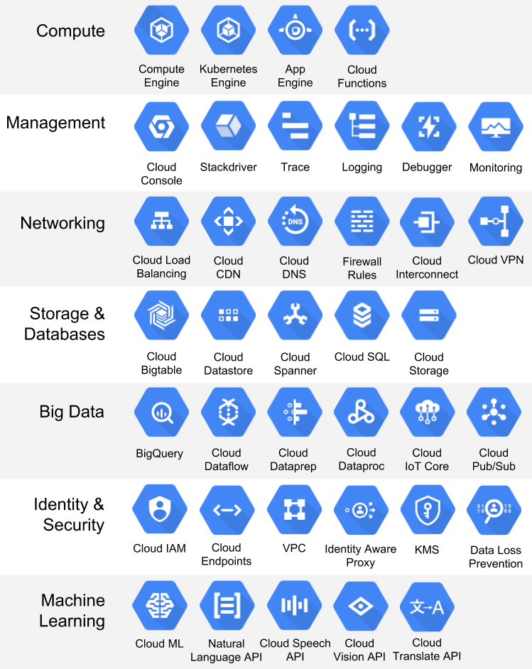
GCP

Slide 8
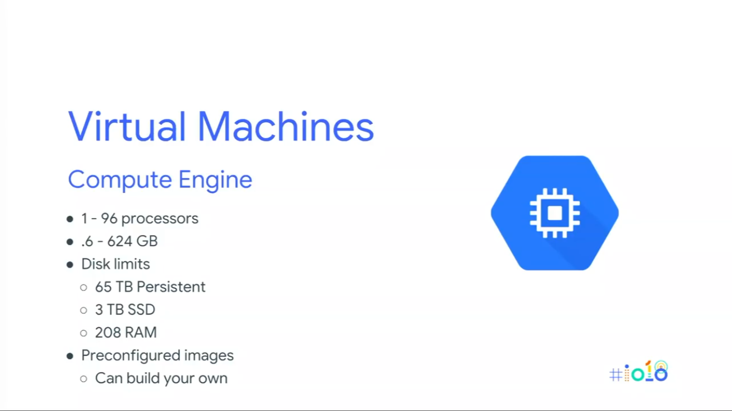
GCP

Slide 9
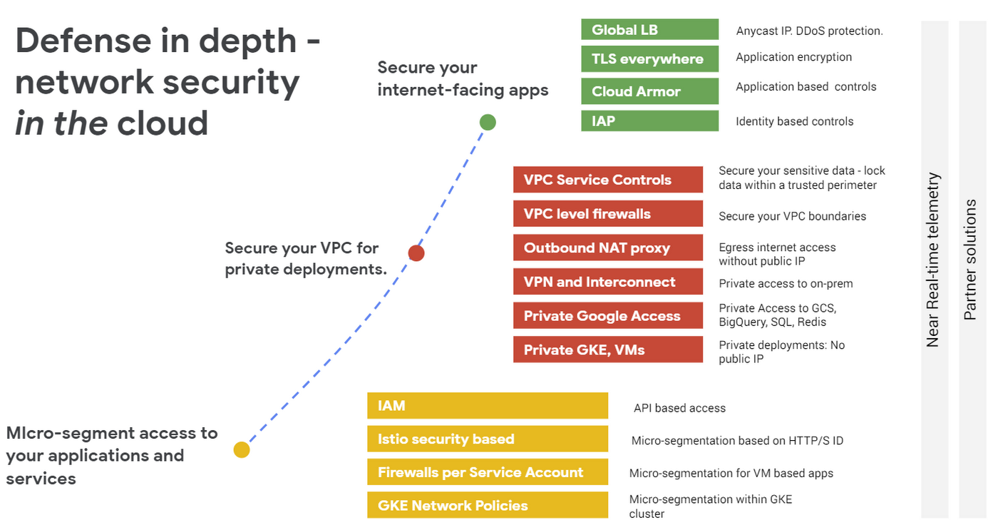
GCP

Slide 10
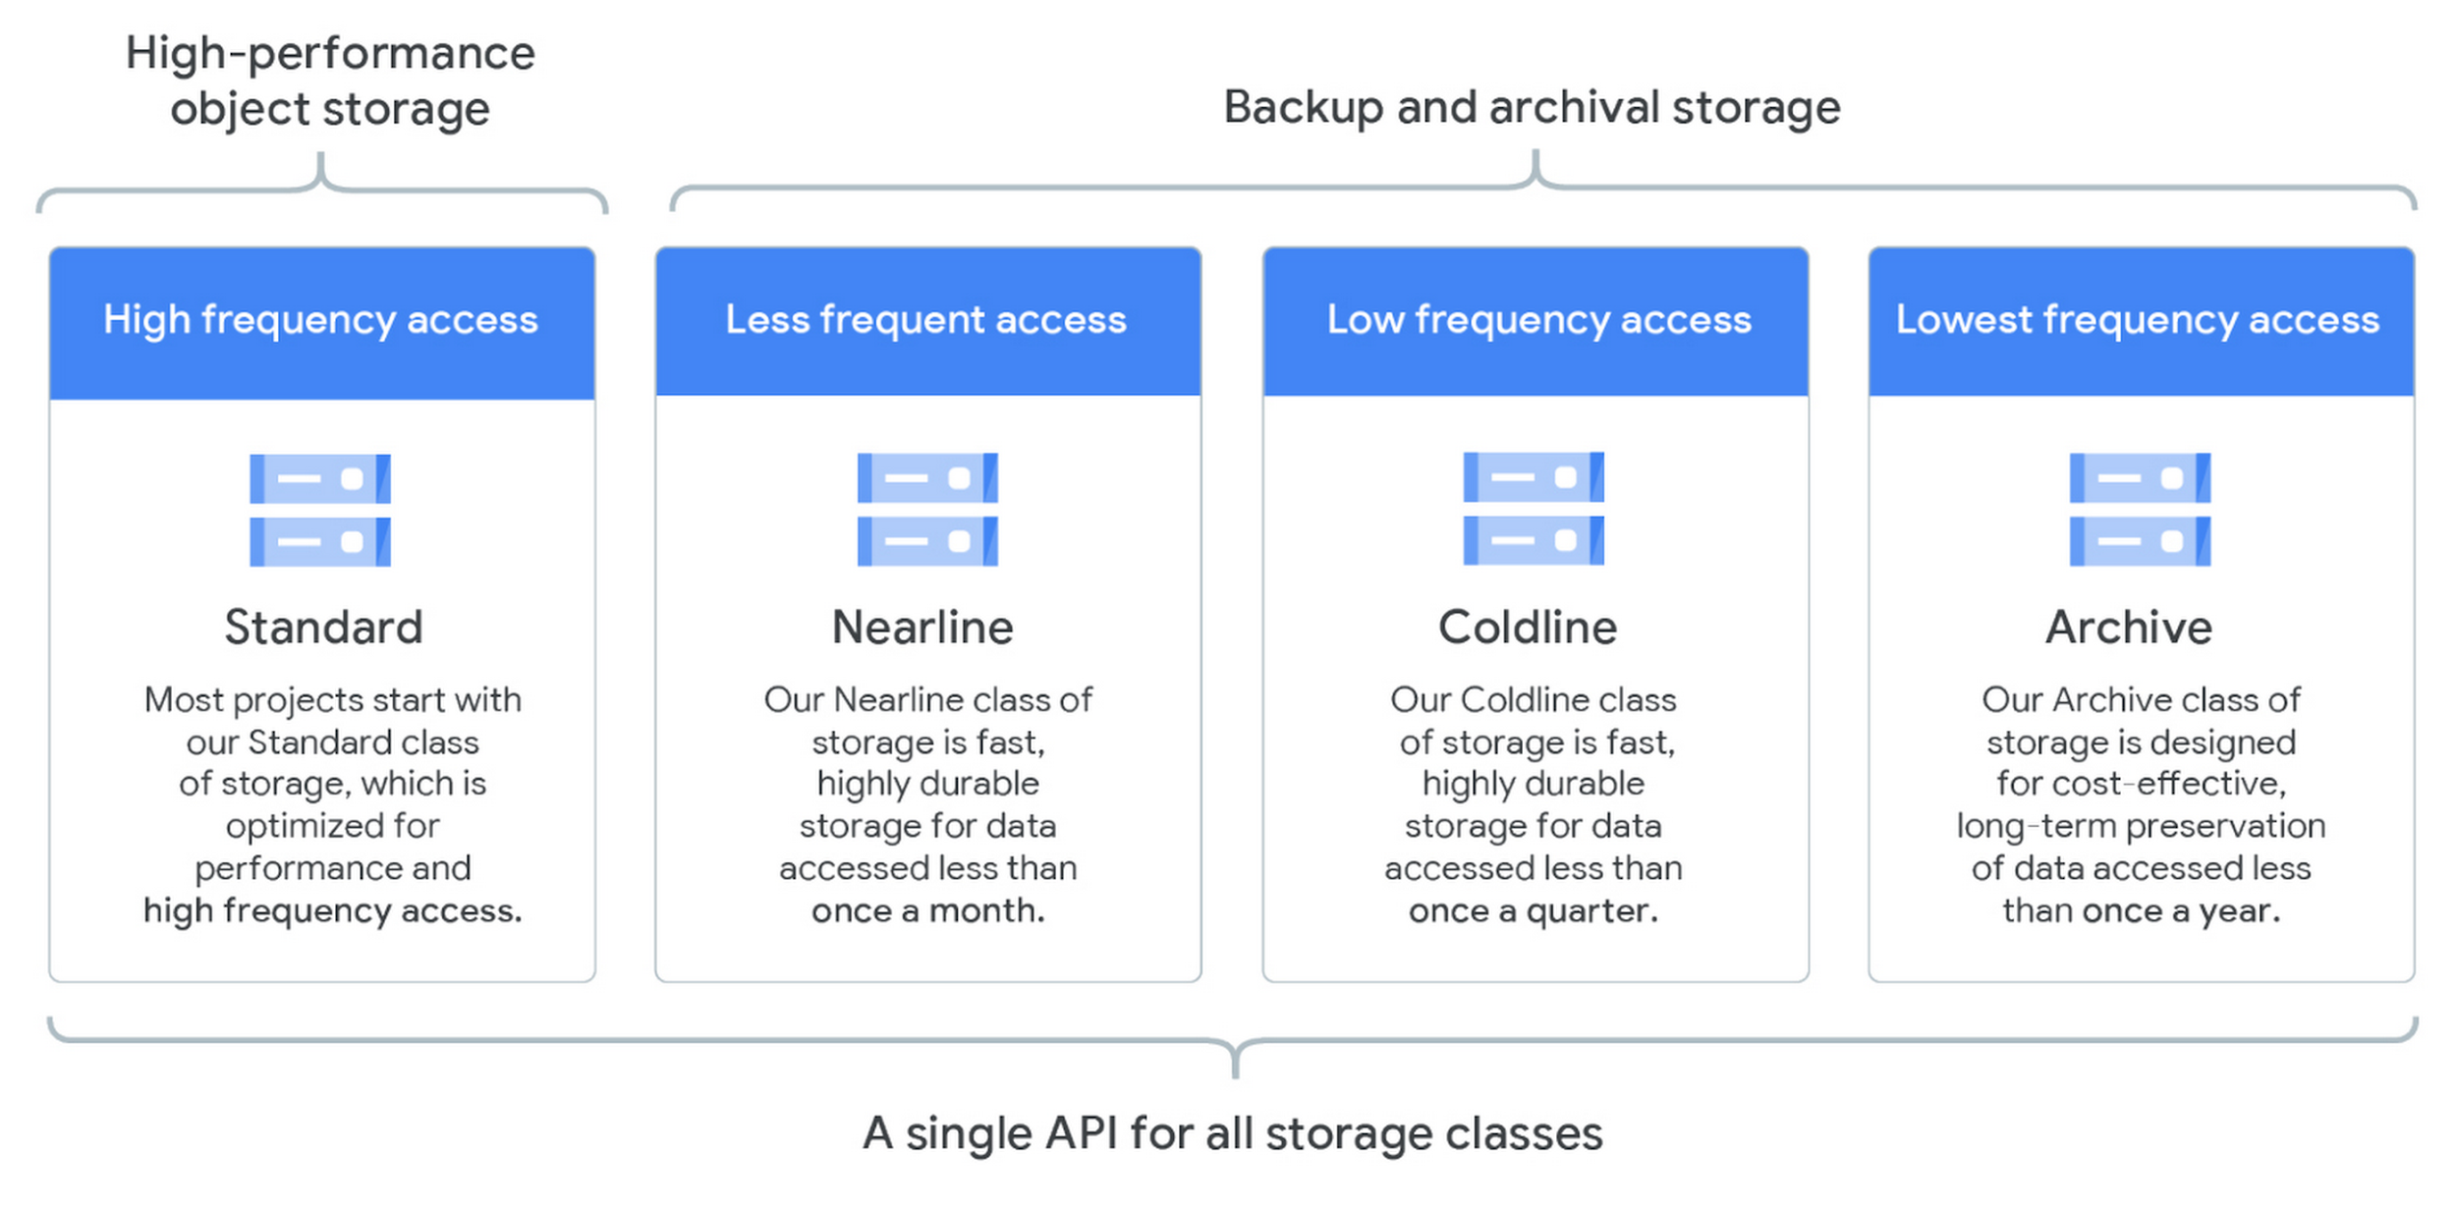
GCP

Slide 11
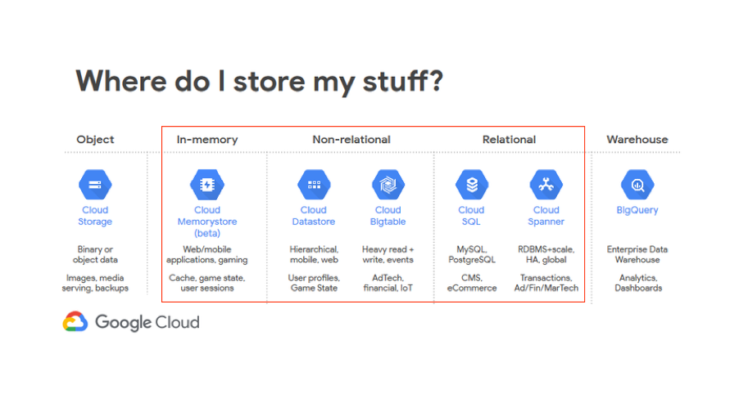
GCP

Slide 12
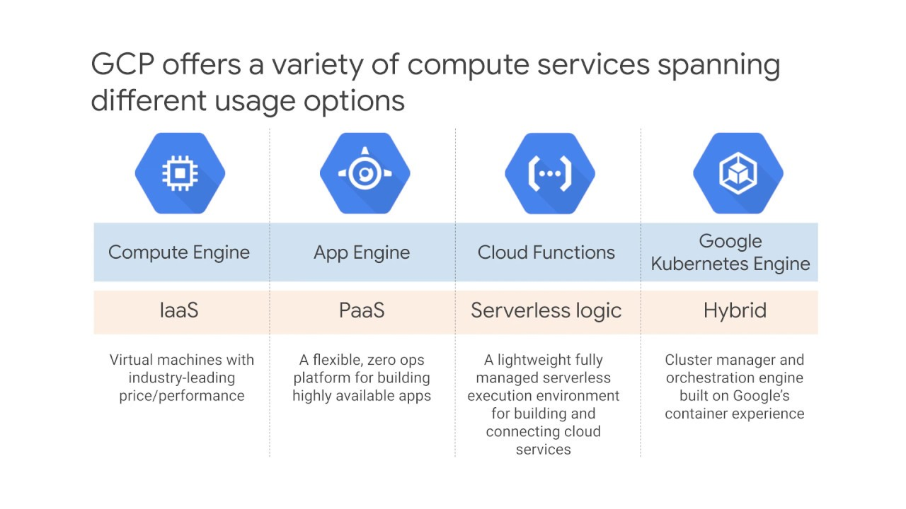
GCP

Slide 13
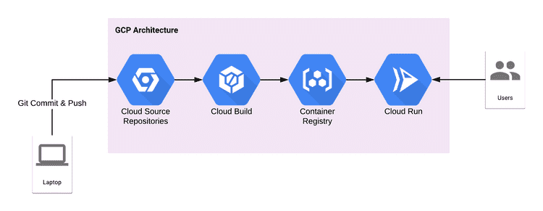
GCP

Slide 14
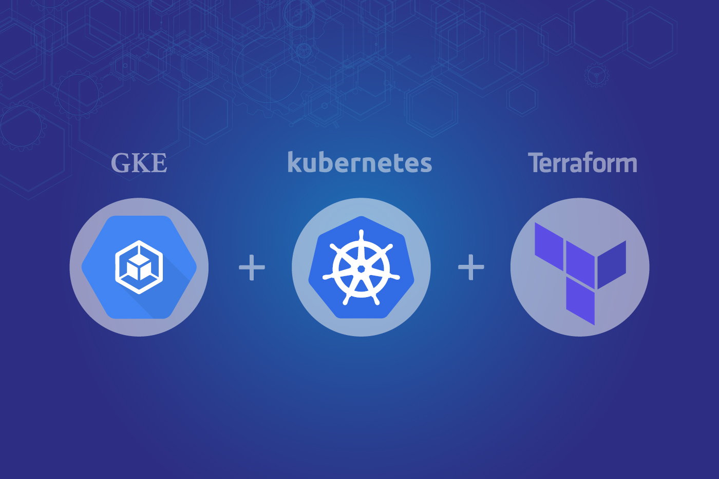
GCP

Slide 15
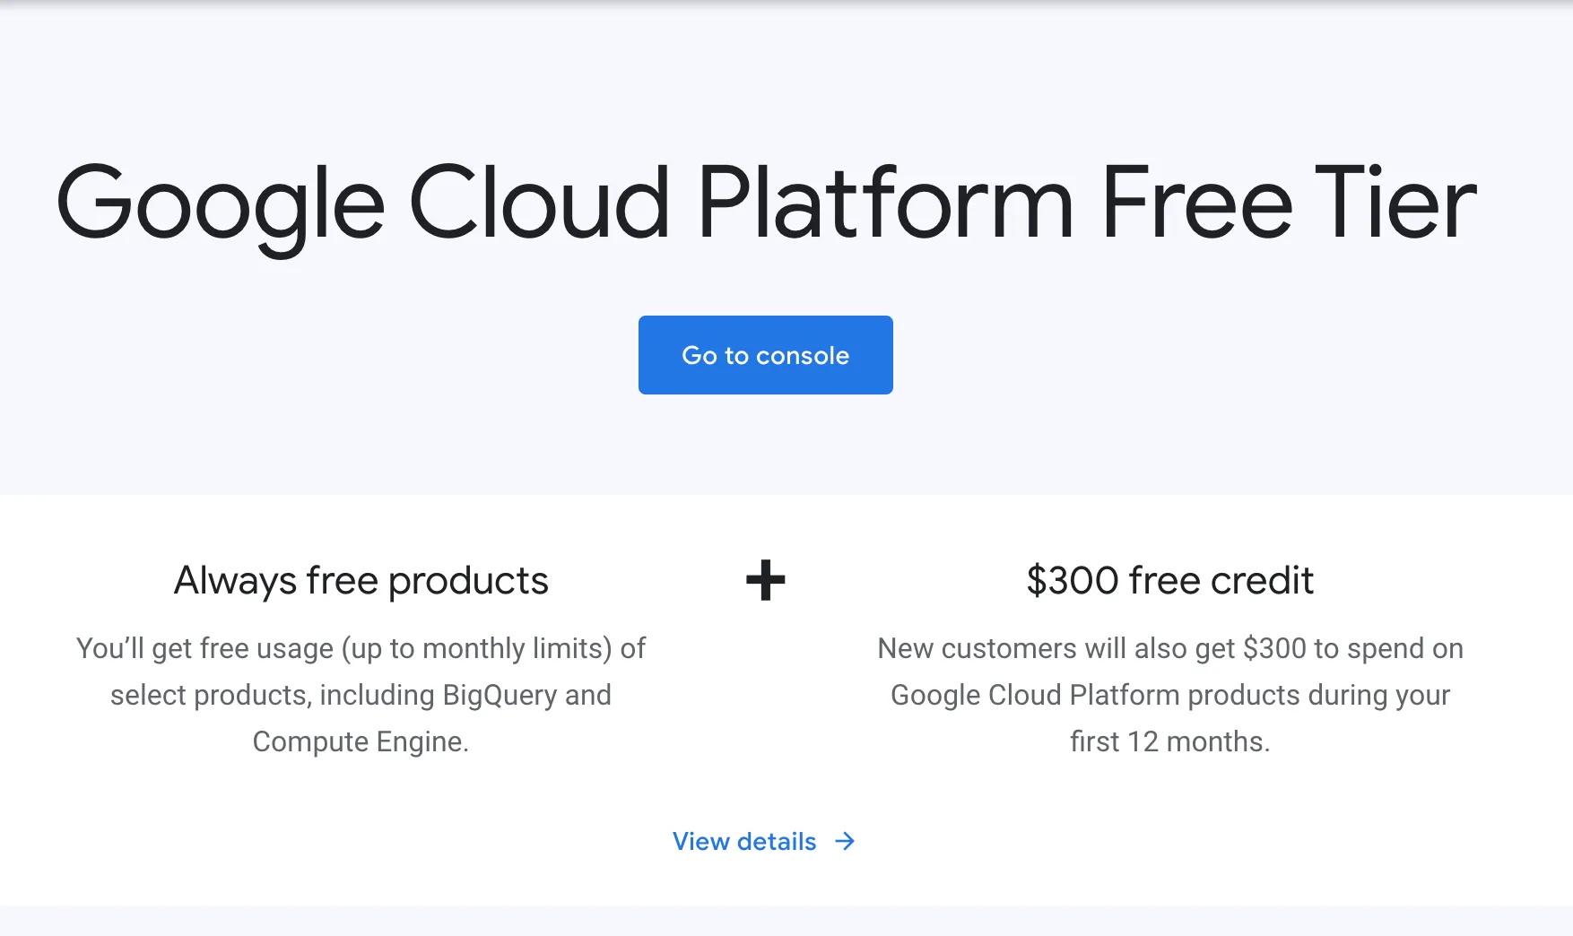
GCP

