Slide 1
Deploying to multiple clouds with one tool -
Terraform
Radu Neda

Slide 2
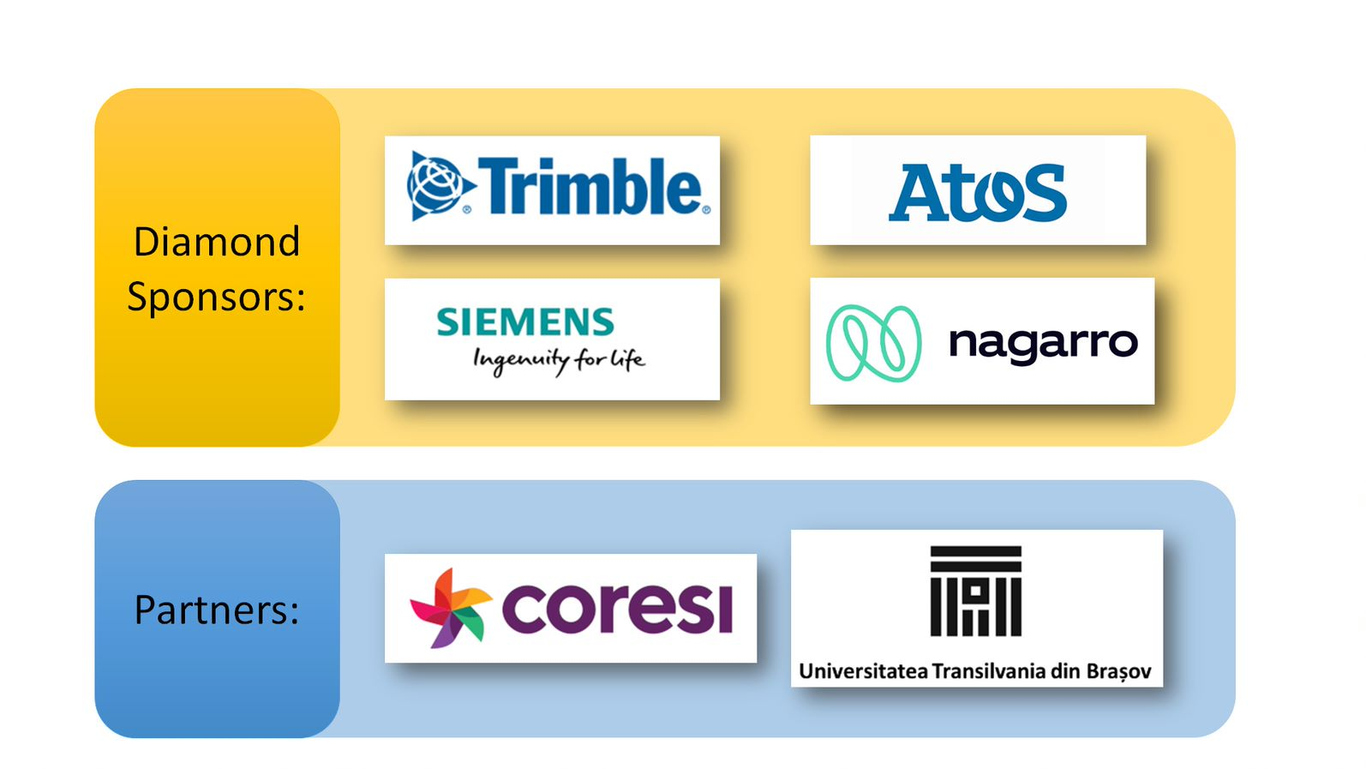

Slide 3
Canal Slack
https://peakit003.slack.com/archives/G01BYEAQXH7
https://peakit003.slack.com/archives/G01BYEAQXH7

Slide 4
Cuprins - Teorie
Docker
AWS - Amazon Web Services
GCP - Google Cloud Platform
Terraform

Slide 5
Cuprins - Practica
Crearea unei imagini Docker pentru infrastructura
Parametrizarea acestei imagini
Folosirea fisierului docker-compose
Vizualizarea datelor de output
Editarea state-ului terraform
Importarea elementelor existent in state-ul terraform
Folosirea unui modul de terraform cu mai multi Cloud Provideri
Ridicarea unei infrastructuri complete cu mai multi Cloud Provideri

Slide 6
Repo GitHub
Puteti descarca repo-ul de la:
https://github.com/AgileHubAssociation?tab=repositories
https://github.com/raduneda/peak-it-infra

Slide 7
