Slide 1

AirtelSync
Small businesses go digital in one sitting: advice, quote, KYC and activation on a phone, in their language.
Team CTRL ALT ELITE
Vishal Dev Verma · Kartik Patel
▶ Watch the demo video (2:52)
Code: github.com/AgileSeagull/AirtelSync
Notes:
AirtelSync: a working digital-first acquisition and onboarding journey for Accel Business's MSME customers. The demo video and the code repository are linked on this slide; every figure is backed by the case data and the running prototype.

Slide 2

THE PROBLEM & WHO WE TARGET FIRST (Q1)
Only 7.4% of small-business leads become customers
7.4%
of leads activate
17.6 days
from lead to activation
SEGMENT
SHARE
ACTIVATION
COST / ACT.
CHURN
Professional offices
25%
11.1%
₹10,695
14%
1 · Lead: self-serve + calls
₹15,053
spent per activation
3.0
calls chasing status, per customer
Small multi-site
15%
11.0%
₹15,614
11%
2 · Digital quote, field rollout
Where leads are lost
The steepest drop is needs assessed → quote accepted (44%). 1,624 of 4,632 lost leads (35%) dropped for reasons a digital journey removes: no visit possible (827), slow or confusing quotes (385), paperwork (273), install delays or no fibre (139).
Small manufacturers
6%
12.8%
₹15,324
8%
3 · Field sales: leased lines
Micro retail & services
54%
4.1%
₹20,007
23%
Volume · self-serve only
Source: smb_leads.csv, 5,000 leads, Apr–Jun 2026 (synthetic). Cost per activation = acquisition cost ÷ activations; churn at 6 months.
Notes:
Field-led selling is slow and expensive, and a third of losses come from visits, quotes and paperwork. Professional offices convert at 11.1% with low churn: the lead segment. Micro retail is 54% of leads but only pays back if acquisition is digital.

Slide 3
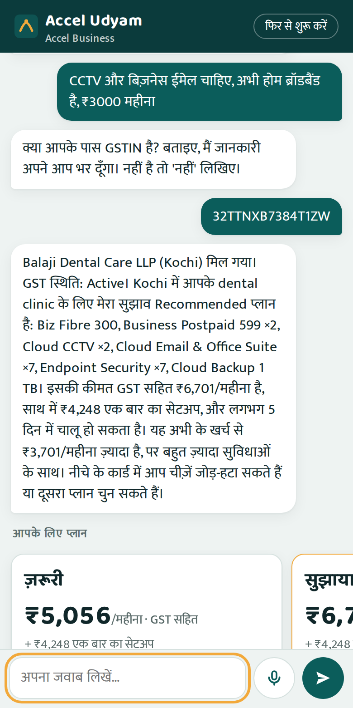
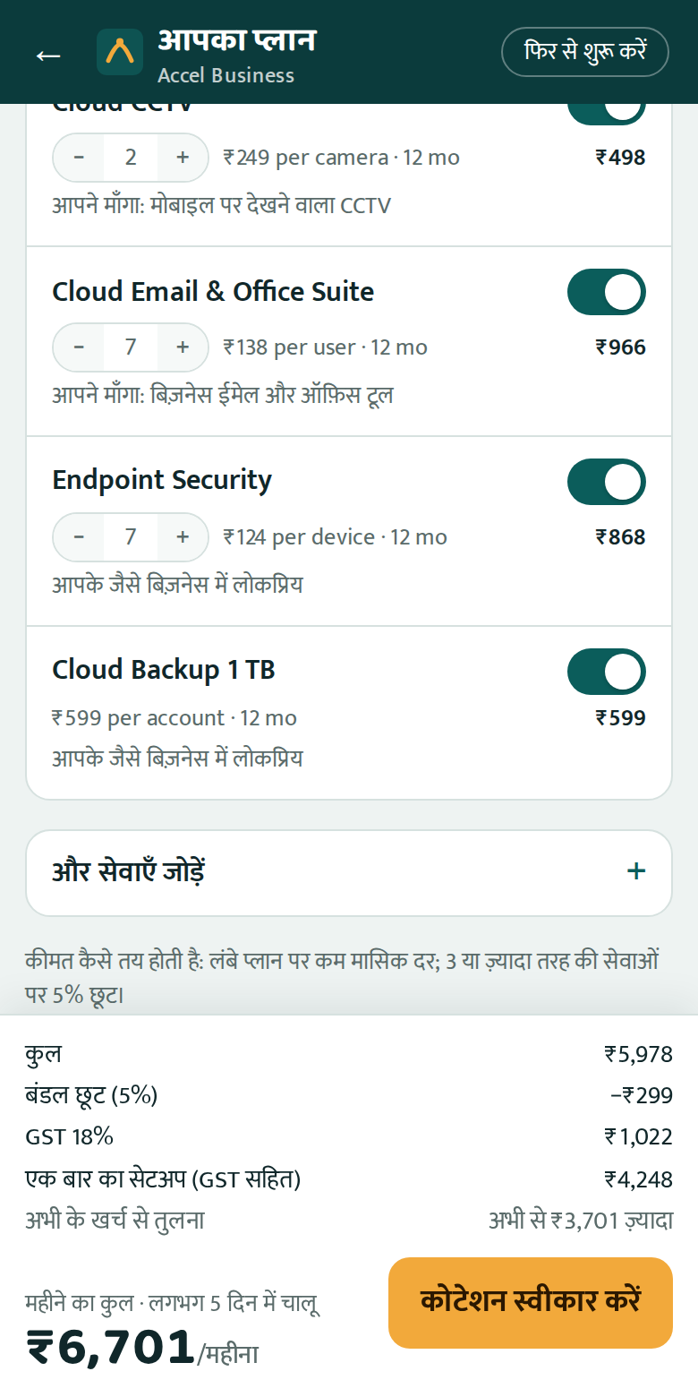
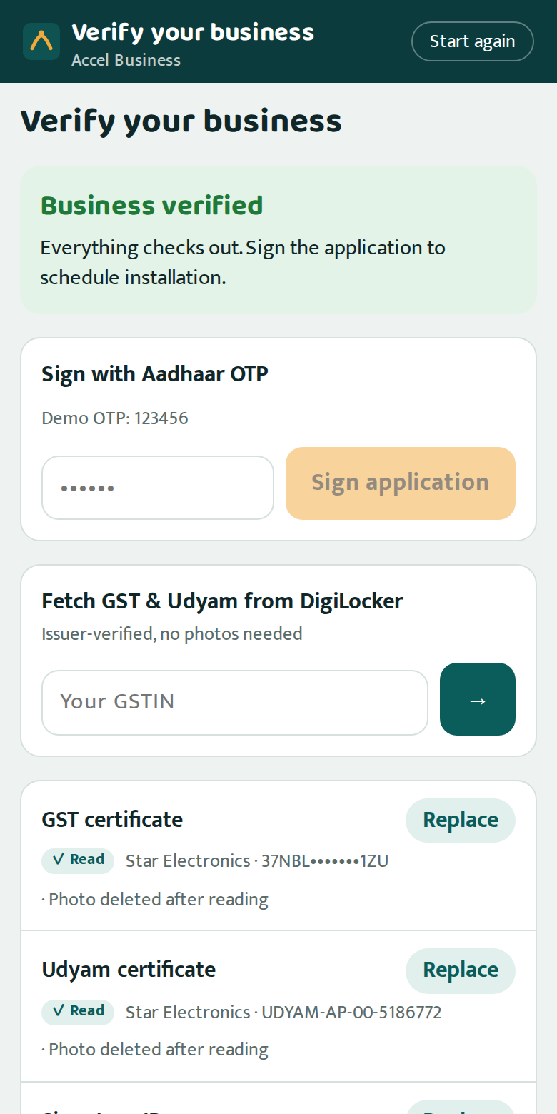
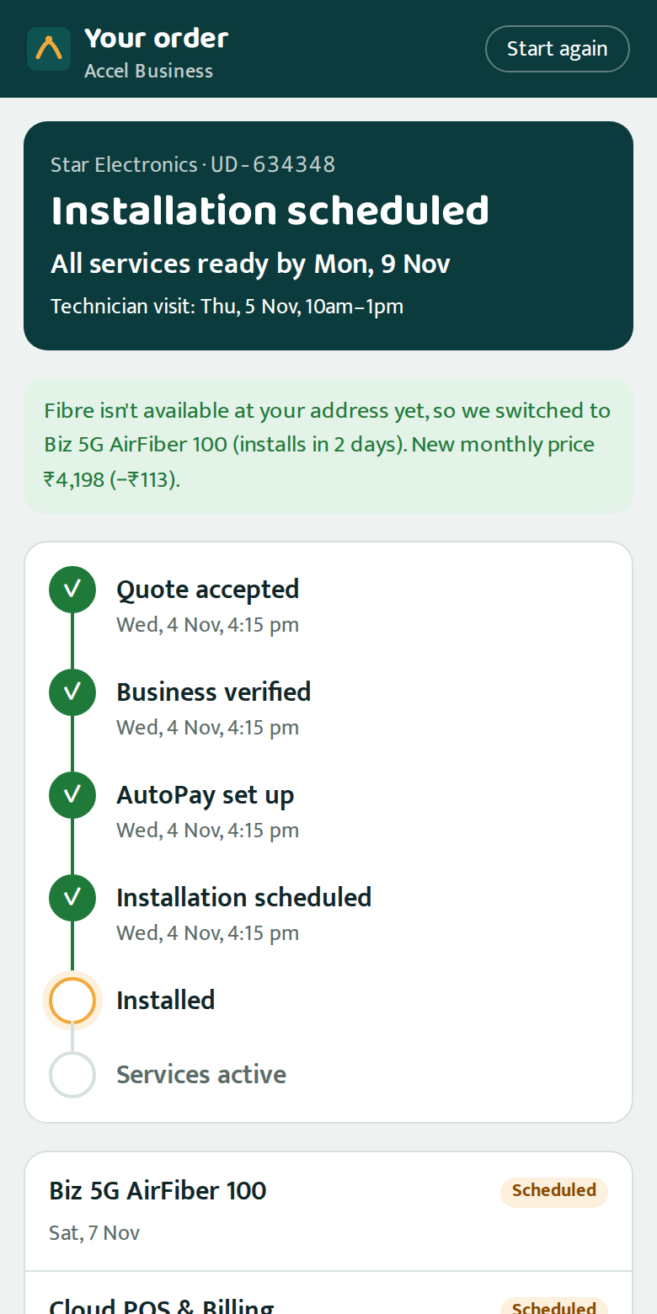
THE SOLUTION: NEEDS DISCOVERY WITHOUT A SALESPERSON (Q2)
From “what do I need?” to activated, in one sitting
1 Talk
An AI advisor asks about 5 questions in the owner's language, by text or voice. A GSTIN fills in the details.
2 Choose
Three bundles with a reason for every item. One monthly price incl. GST; switch add-ons on or off.
3 Verify
Consent, then DigiLocker or a photo, checked against GST and Udyam records. Aadhaar e-sign.
4 Track
UPI AutoPay, technician slot, live ETAs and WhatsApp updates. No calls to chase status.
WHAT OWNERS PAY · REAL QUOTES FROM THE PROTOTYPE, 12-MONTH PLANS INCL. GST
Dukaan Digital
Kirana, 2 people, Patna
₹3,004/month
Fibre 100 · 2 SIMs · Cloud POS & UPI billing
No setup fee · live in 5 days
Clinic & Office Pro
Dental clinic, 12 staff, Kochi
₹6,701/month
Fibre 300 · SIMs · CCTV · email · security · backup
₹4,248 setup · live in 5 days
Chain Connect
Restaurant chain, 6 outlets, Pune
₹23,339/month
Fibre 300 ×6 · failover ×6 · POS ×6 · 3 SIMs
₹28,320 setup · live in 5 days
Factory Line
Textile unit, 80 staff, Surat
₹18,308/month
Leased line · 8 machine IoT · SIMs · security
₹40,120 setup · live in 21 days
Screens from the working prototype. Prices from its rules engine: 5% off for 3+ categories, setup waived for micro firms on 12+ months, 24 months is cheaper.
Notes:
Demo flow: a dental clinic owner chats in Hindi, shares a GSTIN that pre-fills the profile, gets three plans, toggles items, verifies the business in minutes and tracks installation without calling.

Slide 4
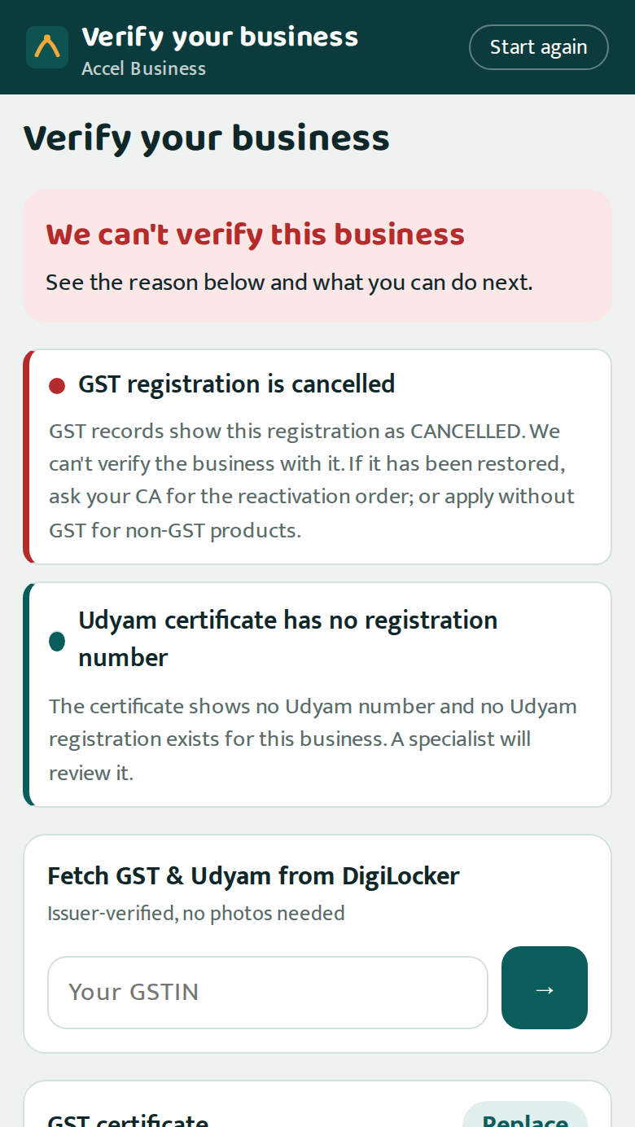
NEAR-INSTANT KYC, DPDP-COMPLIANT (Q3)
Documents checked in seconds, against the source of truth
1 Quality blur score, auto-straighten
12 SAMPLE APPLICANTS, ALL CALLED CORRECTLY
K01 Blocked
GSTIN cancelled
K02 Approved
tilted scan fixed
K03 Approved
clean
2 Format GSTIN checksum repairs OCR errors
3 Completeness GST/Udyam, signatory ID, address proof
K04 Fix
photo too blurry
K05 Fix
Udyam missing → confirm
K06 Approved
clean
4 Registry GSTIN active? names & address match
K07 Review
legal name altered
K08 Approved
clean
K09 Approved
clean
5 Consistency same business on every document
K10 Approved
clean
K11 Fix
bill > 90 days old
K12 Approved
clean
6 Recency utility bill ≤ 90 days, ID valid
Privacy by design purpose-wise consent, optional purposes unticked · documents never sent to the AI; Aadhaar, PAN and account numbers stripped from chat · photos encrypted and deleted once decided · IDs masked · audit log of every decision
K01–K12: specimen documents and mock GSTIN/Udyam registries from the case pack; verdicts from the prototype vs our own answer key.
Notes:
K01's certificate looks perfect but GST records say cancelled; only a registry check catches it. Owners fix most issues themselves (retake, DigiLocker, one-tap Udyam confirmation); only suspected tampering goes to a person.

Slide 5
FIELD FORCE & PARTNERS (Q4)
People where they add value, paid for activations
COST PER ACTIVATION BY CHANNEL, Q2
Inside sales
Call the leads the advisor didn't close, best first. The lead score lifts conversion: the top 10% activate at 18.2% vs 7.4% overall.
WhatsApp
₹4,026
Referral
₹4,099
Inbound call
₹5,113
Field sales
Multi-site chains and manufacturers: leased lines, site surveys, SD-WAN. The quote and KYC are done online before the visit.
Website
₹6,352
Channel partner
₹20,851
Channel partners
Tier-2 micro retail: installers and assisted sign-up on the owner's own journey (the owner shares a code). Paid on activation, not on leads.
Field sales
₹24,335
Digital channels cost a fifth as much per customer. People should do the work digital can't.
Win-back: 3,026 Q2 leads lost before a needs assessment (unreachable, no time for a visit) get a WhatsApp link to the self-serve advisor.
Cost per activation = acquisition cost of all leads from a channel ÷ its activations (smb_leads.csv). Lead score tested on June leads it never saw (AUC 0.70).
Notes:
The console ranks leads the advisor didn't close by activation probability × value and routes them. Partners stop competing with the digital journey because they are paid when a customer activates, whichever path they came through.

Slide 6
HOW IT'S BUILT
A working prototype: the AI talks, the rules decide
CHANNELS
Backend (FastAPI)
AROUND THE CORE
Owner app
phone web app · 10 languages · voice
AI services
Gemini (Claude optional) for conversation only · Tesseract OCR runs locally
AI advisor
5 tools · price guard
Rules engine
eligibility · price
WhatsApp updates
with the owner's opt-in
Mock integrations
GSTIN · Udyam · DigiLocker · e-sign · UPI AutoPay · fibre feasibility
Smart KYC
OCR · 6 check layers
Consent & audit
DPDP ledger
Sales & partner console
lead scores · reviews · assisted mode
Order tracker
states · ETAs · SLA
Lead score
explainable model
Data
SQLite store · encrypted document vault with auto-delete · catalogue & registries
128
automated tests
30 / 30
advisor test conversations
12 / 12
KYC applicants called correctly
49 / 49
rule-breaking Q2 sales rejected
5,000
lead profiles get valid bundles
Prices, eligibility and KYC verdicts are deterministic code; a guard rejects AI replies with unverified prices; a rule-based advisor covers AI outages.
Notes:
Single FastAPI backend serving the owner app, WhatsApp notifications and the console. AI is used for conversation only. Swapping mocks for GSTN, Udyam, DigiLocker and NPCI APIs is an adapter change.

Slide 7
HOW WE MEASURE SUCCESS (Q5)
Five numbers, measured from day one
METRIC
Q2 BASELINE
6-MONTH TARGET
WHAT MOVES IT
Lead → activation
7.4%
15%
Self-serve advisor, instant quote, online KYC
Lead → activation time
17.6 days
≤ 7 days
Same-day KYC, feasibility before payment, parallel installs
Cost per activation
₹15,053
≤ ₹5,000
Digital-first acquisition; partners paid on activation
Status-chase calls per customer
3.0
≤ 0.5
Live tracker and proactive WhatsApp updates
6-month churn
15.2%
≤ 10%
Right-fit bundles, no rule-breaking sales, fewer delays
Micro retail pays back in ~2 months, not 8
Today ₹20,007 to acquire a ₹2,470/month customer. Digital channels cost ₹4,000–6,400 per activation.
Zero rule-breaking sales
Q2 sold 49 ineligible items and activated 22 customers on cancelled or suspended GSTINs. The rules engine and KYC block both.
Baselines from smb_leads.csv (368 activations, Apr–Jun 2026). Targets assume pilot results in two cities; all five are tracked live in the console.
Notes:
Targets are deliberately conservative: doubling conversion still leaves room below the 11% professional offices already reach with field sales.

Slide 8
ROLLOUT & RISKS
An 8-week pilot, then scale city by city
Weeks 0–8 · Pilot
Pune + Kochi · professional offices and micro retail · web + WhatsApp · 2 partner networks
Months 3–6 · Scale
10 cities · voice in 6 languages · live GSTN, Udyam, DigiLocker, UPI AutoPay
Months 6–12 · National
All tier-1/2 cities · partner app · field-assisted multi-site and manufacturing
RISK
MITIGATION BUILT INTO THE PROTOTYPE
AI gives wrong advice
AI only talks; rules decide eligibility and price; output guard; tested scenarios; rule-based fallback
Forged or altered documents
Registry checks on every number, cross-document matching, specialist review, Aadhaar e-sign
Privacy (DPDP Act 2023)
Purpose-wise consent, minimal data, photos deleted after decision, masked IDs, audit log
Channel conflict
Partners paid on activation and can complete the owner's own journey with consent
Install delays, no fibre
Feasibility before payment, automatic switch to 5G AirFiber, SLA alerts and escalation
Ask: approve an 8-week, two-city pilot with one inside-sales pod and two partner networks; success = the five metrics on the previous slide.
Notes:
Close with the ask: a two-city pilot measured on the five metrics. Every risk listed has a mitigation that already runs in the prototype.

