Slide 1

AirtelSync
Small businesses go digital in one sitting: advice, quote, KYC and activation on a phone, in their language.
Project Udyam Digital · Enterprise Track A
Business case · Team AirtelSync · github.com/AgileSeagull/AirtelSync
Notes:
AirtelSync: a working digital-first acquisition and onboarding journey for Accel Business's MSME customers. Everything in this deck is backed by the synthetic case data and the running prototype.

Slide 2

THE PROBLEM
Only 7.4% of small-business leads become customers
Leads
5,000
7.4%
of leads activate
17.6 days
from lead to activation
Contacted
3,406 68%
Needs assessed
1,974 58%
₹15,053
spent per activation
3.0
calls chasing status, per customer
Quote accepted
861 44%
KYC complete
588 68%
Activated
368 63%
1,624 of the 4,632 lost leads (35%) dropped for reasons a digital journey removes: no visit possible (827), slow or confusing quotes (385), paperwork and documents (273), installation delays or no fibre (139).
Source: smb_leads.csv, 5,000 leads, Apr–Jun 2026 (synthetic). Cost per activation = total acquisition cost ÷ activations.
Notes:
The steepest drop is needs assessed → quote accepted (44%). Field-led selling is slow (17.6 days) and expensive (₹15k per activation). A third of losses are caused by visits, quotes and paperwork, exactly what a digital journey removes.

Slide 3
WHO WE TARGET FIRST (Q1)
Lead with professional offices; micro retail goes self-serve
SEGMENT
SHARE
ACTIVATION
COST / ACTIVATION
MEDIAN BUNDLE
6-MO CHURN
PLAY
Professional offices
25%
11.1%
₹10,695
₹6,575
14%
1 · Lead segment: self-serve + inside sales
Small multi-site
15%
11.0%
₹15,614
₹28,080
11%
2 · Digital quote, field-assisted rollout
Small manufacturers
6%
12.8%
₹15,324
₹15,910
8%
3 · Field sales for leased lines and IoT
Micro retail & services
54%
4.1%
₹20,007
₹2,470
23%
Volume · Self-serve only (app + WhatsApp)
Dukaan Digital
Kirana, 2 people, Patna
₹3,004/month incl. GST
Biz Fibre 100 · 2 business SIMs · Cloud POS & UPI billing
No setup fee · live in 5 days
Clinic & Office Pro
Dental clinic, 12 staff, Kochi
₹6,701/month incl. GST
Fibre 300 · 2 SIMs · 2 CCTV · email ×7 · security · backup
₹4,248 setup · live in 5 days
Chain Connect
Restaurant chain, 6 outlets, Pune
₹23,339/month incl. GST
Fibre 300 ×6 · failover ×6 · POS ×6 · 3 SIMs
₹28,320 setup · live in 5 days
Factory Line
Textile unit, 80 staff, Surat
₹18,308/month incl. GST
Leased line 20 · 8 machine IoT · 4 SIMs · email · security
₹40,120 setup · live in 21 days
Segment economics from smb_leads.csv (Q2 activations). Bundles: the prototype's recommendation engine, 12-month plans; 24 months is cheaper.
Notes:
Professional offices convert at 11.1% with ₹6.6k bundles and low churn, and are ideal for self-serve. Micro retail is 54% of leads, but at ₹20k cost per activation against ₹2.5k a month and 23% churn it only pays back if acquisition is digital.

Slide 4
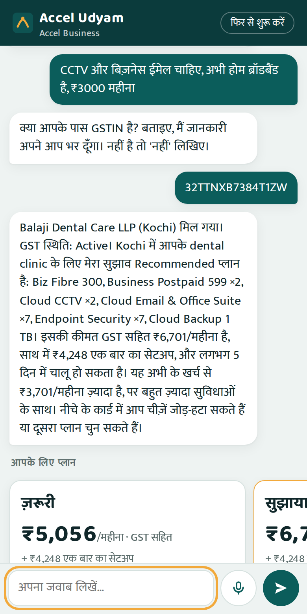
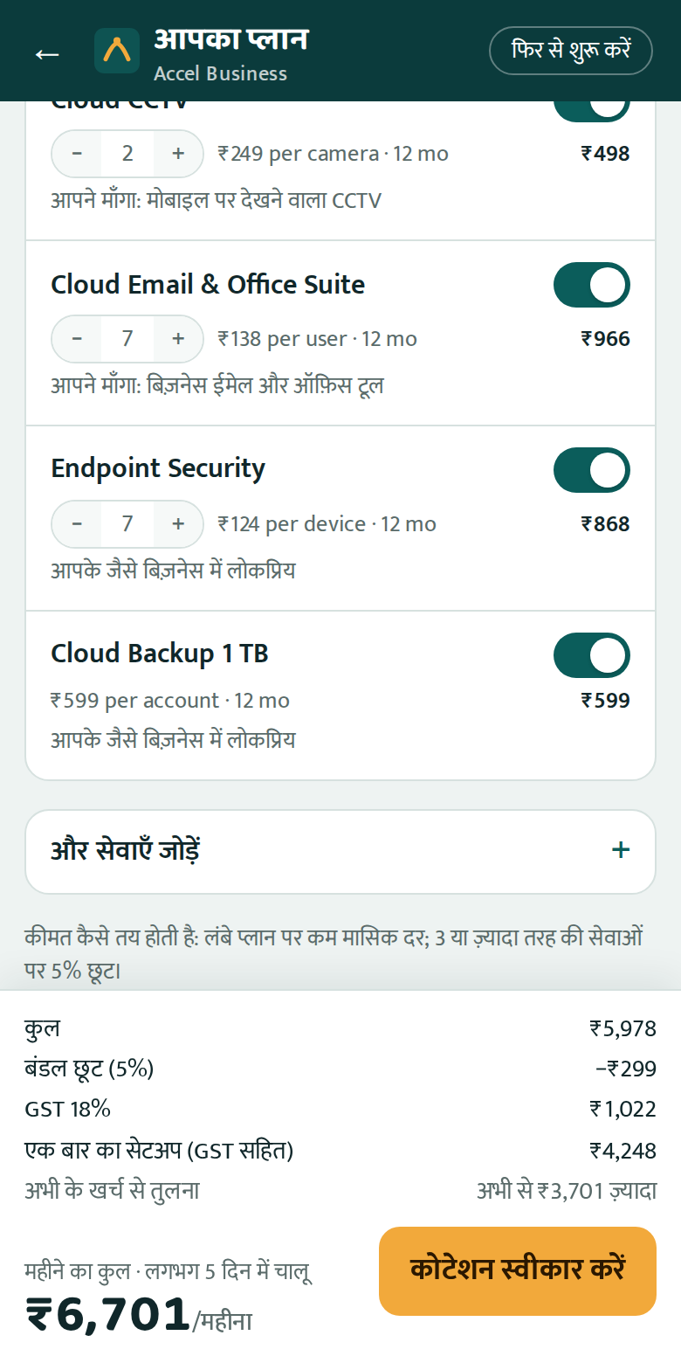
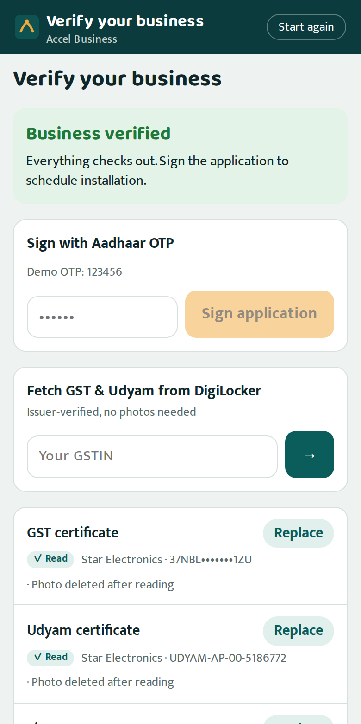
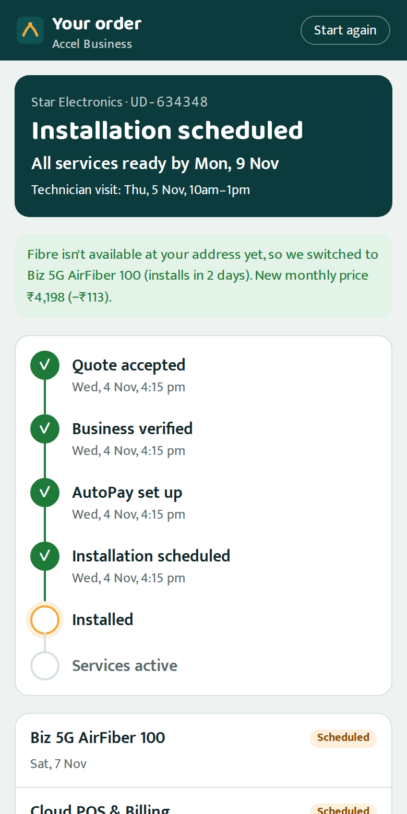
THE SOLUTION
From “what do I need?” to activated, in one sitting
1 Talk
≤6 questions in 10 languages, by text or voice; GSTIN fills the details
2 Choose
One monthly price incl. GST; switch add-ons on/off; 12 or 24 months
3 Verify
Consent, DigiLocker or a photo, checked against GST & Udyam; e-sign
4 Track
AutoPay, technician slot, live ETAs and WhatsApp updates; no calls
Screens from the working prototype (Hindi conversation, quote builder, Smart KYC approved, tracker after a fibre-to-AirFiber reroute).
Notes:
Demo flow: a dental clinic owner chats in Hindi, shares a GSTIN that pre-fills the profile, gets three plans, toggles items, verifies the business in minutes and tracks installation without calling.

Slide 5
NEEDS DISCOVERY WITHOUT A SALESPERSON (Q2)
The AI talks. The rules decide.
1
Talks like a good advisor
Gemini (or Claude) chats in the owner's language, by text or voice, and asks at most six questions.
49 / 49
rule-breaking sales from Q2 rejected by the engine
5,000/5,000
lead profiles get a valid bundle
30 / 30
advisor test conversations pass (English, Hindi)
2
Knows the business already
A GSTIN lookup fills the name, city and registration status, so fewer questions and no typos.
3
Never invents a price
Eligibility, dependencies and prices come from a rules engine over the catalogue; a guard blocks any number the engine didn't return.
Owner
text or voice
AI model
conversation
Tools
lookup · profile · recommend
4
Explains and hands over
Three options with a reason for every item; a person calls back on request or above ₹25k/month.
Guard
only engine numbers
Rules engine
eligibility · price
Tested with the prototype's eval harness; if the AI is unavailable the advisor continues in a rule-based mode, so the journey never dead-ends.
Notes:
The language model only converses and explains. Every product, eligibility decision and price comes from deterministic code, so judges' scenarios cannot trip it into selling something the catalogue forbids.

Slide 6
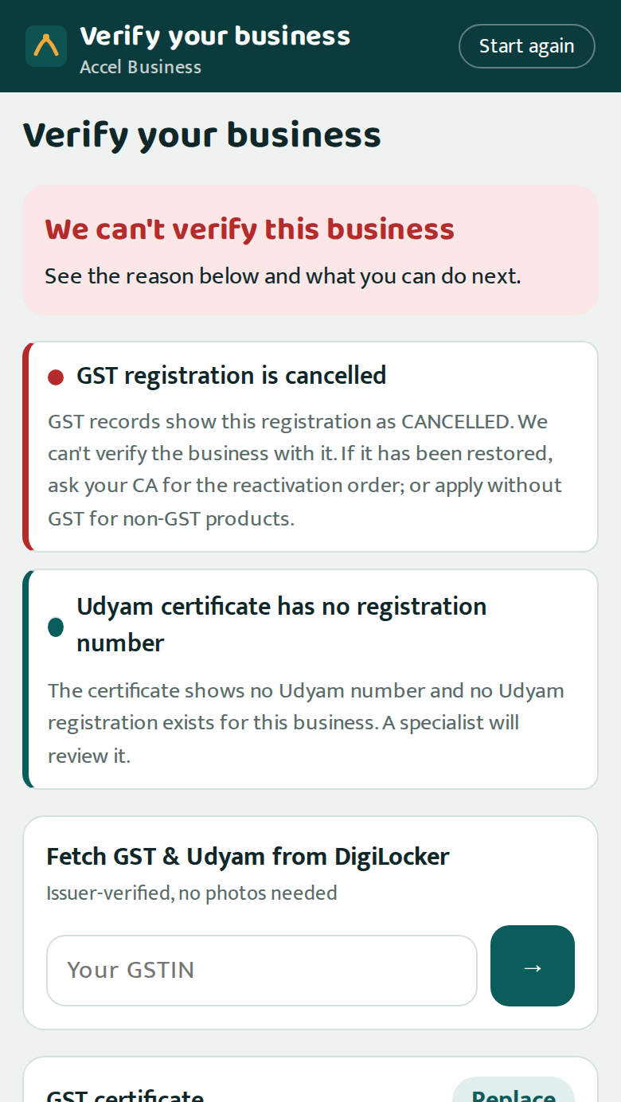
NEAR-INSTANT KYC, DPDP-COMPLIANT (Q3)
Documents checked in seconds, against the source of truth
1 Quality blur score, auto-straighten
12 SAMPLE APPLICANTS, ALL CALLED CORRECTLY
K01 Blocked
GSTIN cancelled
K02 Approved
tilted scan fixed
K03 Approved
clean
2 Completeness GST/Udyam, signatory ID, address proof
K04 Fix
photo too blurry
K05 Fix
Udyam missing → confirm
K06 Approved
clean
3 Format GSTIN checksum repairs OCR errors
K07 Review
legal name altered
K08 Approved
clean
K09 Approved
clean
4 Registry GSTIN active? names & address match records
5 Consistency & recency same business everywhere; bill ≤ 90 days
K10 Approved
clean
K11 Fix
bill > 90 days old
K12 Approved
clean
Privacy by design consent per purpose, nothing pre-ticked · documents read on our servers, not sent to the AI · photos encrypted and deleted once decided · IDs masked everywhere · every access audit-logged
K01–K12: specimen documents and mock GSTIN/Udyam registries from the case pack; verdicts from the prototype vs our own answer key.
Notes:
K01's certificate looks perfect but GST records say cancelled; only a registry check catches it. Owners fix most issues themselves (retake, DigiLocker, one-tap Udyam confirmation); only suspected tampering goes to a person.

Slide 7
FIELD FORCE & PARTNERS (Q4)
People where they add value, paid for activations
COST PER ACTIVATION BY CHANNEL, Q2
Inside sales
Call the leads the advisor didn't close, best first. The lead score lifts conversion: the top 10% activate at 18.2% vs 7.4% overall.
WhatsApp
₹4,026
Referral
₹4,099
Inbound call
₹5,113
Field sales
Multi-site chains and manufacturers: leased lines, site surveys, SD-WAN. The quote and KYC are done online before the visit.
Website
₹6,352
Channel partner
₹20,851
Channel partners
Tier-2 micro retail: installers and assisted sign-up on the owner's own journey (the owner shares a code). Paid on activation, not on leads.
Field sales
₹24,335
Digital channels cost a fifth as much per customer. People should do the work digital can't.
Win-back: 3,026 Q2 leads lost before a needs assessment (unreachable, no time for a visit) get a WhatsApp link to the self-serve advisor.
Cost per activation = acquisition cost of all leads from a channel ÷ its activations (smb_leads.csv). Lead score tested on June leads it never saw (AUC 0.70).
Notes:
The console ranks leads the advisor didn't close by activation probability × value and routes them. Partners stop competing with the digital journey because they are paid when a customer activates, whichever path they came through.

Slide 8
HOW IT'S BUILT
A working prototype: rules at the core, AI at the edges
CHANNELS
Backend (FastAPI)
AROUND THE CORE
Owner app
phone web app · 10 languages · voice
AI services
Gemini or Claude (conversation) · Tesseract OCR runs locally
Advisor
AI + tools
Rules engine
eligibility · price
WhatsApp updates
every order change
Mock integrations
GSTIN · Udyam · DigiLocker · e-sign · UPI AutoPay · fibre feasibility
Smart KYC
OCR · 5 check layers
Consent & audit
DPDP ledger
Sales & partner console
leads · reviews · assisted mode
Order tracker
states · ETAs · SLA
Lead score
explainable model
Data
SQLite store · encrypted document vault with auto-delete · catalogue & registries
Tested 112 automated tests · 30 advisor conversations · 12/12 KYC applicants · 4 end-to-end browser journeys · code: github.com/AgileSeagull/AirtelSync
Government and payment integrations are mocks behind the interfaces a production adapter would implement.
Notes:
Single FastAPI backend serving the owner app, WhatsApp notifications and the console. All decisions are deterministic code; AI is used for conversation only. Swapping mocks for GSTN, Udyam, DigiLocker and NPCI APIs is an adapter change.

Slide 9
HOW WE MEASURE SUCCESS (Q5)
Five numbers, measured from day one
METRIC
Q2 BASELINE
6-MONTH TARGET
WHAT MOVES IT
Lead → activation
7.4%
15%
Self-serve advisor, instant quote, online KYC
Lead → activation time
17.6 days
≤ 7 days
Same-day KYC, feasibility before payment, parallel installs
Cost per activation
₹15,053
≤ ₹5,000
Digital-first acquisition; partners paid on activation
Status-chase calls per customer
3.0
≤ 0.5
Live tracker and proactive WhatsApp updates
6-month churn
15.2%
≤ 10%
Right-fit bundles, no rule-breaking sales, fewer delays
Micro retail pays back in ~2 months, not 8
Today ₹20,007 to acquire a ₹2,470/month customer. Digital channels cost ₹4,000–6,400 per activation.
Zero rule-breaking sales
Q2 sold 49 ineligible items and activated 22 customers on cancelled or suspended GSTINs. The rules engine and KYC block both.
Baselines from smb_leads.csv (368 activations, Apr–Jun 2026). Targets assume pilot results in two cities; all five are tracked live in the console.
Notes:
Targets are deliberately conservative: doubling conversion still leaves room below the 11% professional offices already reach with field sales.

Slide 10
ROLLOUT & RISKS
An 8-week pilot, then scale city by city
Weeks 0–8 · Pilot
Pune + Kochi · professional offices and micro retail · web + WhatsApp · 2 partner networks
Months 3–6 · Scale
10 cities · voice in 6 languages · live GSTN, Udyam, DigiLocker, UPI AutoPay
Months 6–12 · National
All tier-1/2 cities · partner app · field-assisted multi-site and manufacturing
RISK
MITIGATION BUILT INTO THE PROTOTYPE
AI gives wrong advice
AI only talks; rules decide eligibility and price; output guard; tested scenarios; rule-based fallback
Forged or altered documents
Registry checks on every number, cross-document matching, specialist review, Aadhaar e-sign
Privacy (DPDP Act 2023)
Purpose-wise consent, minimal data, photos deleted after decision, masked IDs, audit log
Channel conflict
Partners paid on activation and can complete the owner's own journey with consent
Install delays, no fibre
Feasibility before payment, automatic switch to 5G AirFiber, SLA alerts and escalation
Ask: approve an 8-week, two-city pilot with one inside-sales pod and two partner networks; success = the five metrics on the previous slide.
Notes:
Close with the ask: a two-city pilot measured on the five metrics. Every risk listed has a mitigation that already runs in the prototype.

