Slide 1
Test Scripts
WinAppDriver
eRecipeBox Client

Slide 2
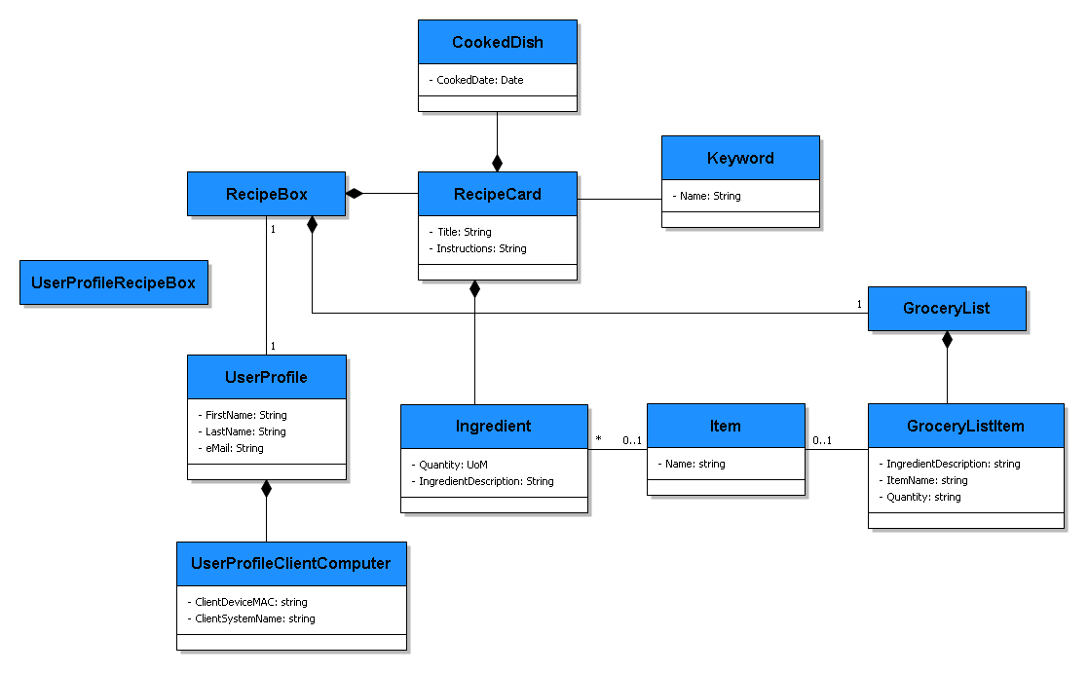

Slide 3
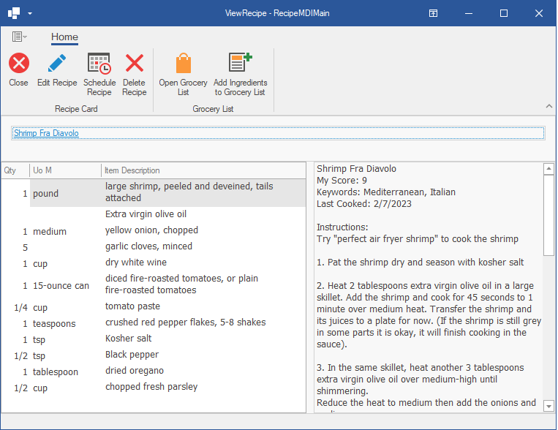
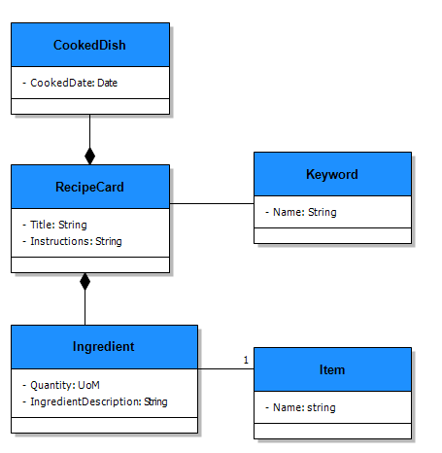
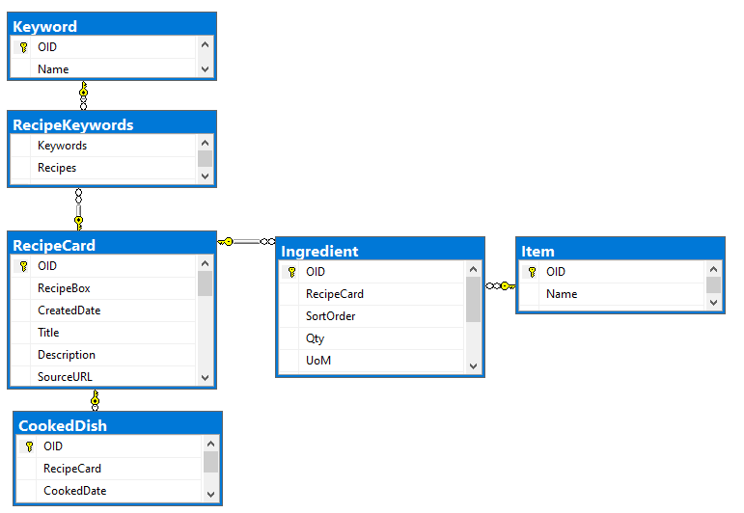
View
Model
Data Store

Slide 4
EditGroceryList
ImportRecipeCard
SelectIngredients
ForGroceryList
AskGPT
RecipeCard
ViewRecipeCard
EditRecipeCard
SearchRecipeBox
ScheduleRecipeCard
start
Login

Slide 5
RecipeBoxDataServiceMain
eRecipeBox
RecipeBoxDataService
SimpleCRUDFramework
RecipeBox
SolutionModel
DataStoreUtils
*Foundation
*Note: All components import Foundation
Shaded components are reusable components that support any CRUD application. They have no knowledge of eRecipeBox.

Slide 6
eRecipeBoxSystemTests
DxWinAppDriverUtils
DxWinAppDriverUtils can be used to test any DevExpress Winforms Ribbon app

Slide 7
RecipeBoxDataServiceMain
eRecipeBox
RecipeBoxDataService
SimpleCRUDFramework
RecipeBox
SolutionModel
DataStoreUtils
*Foundation

Slide 8
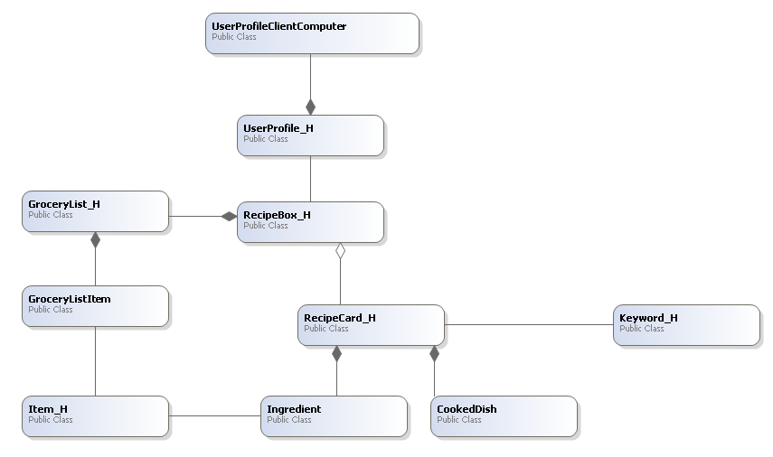

Slide 9
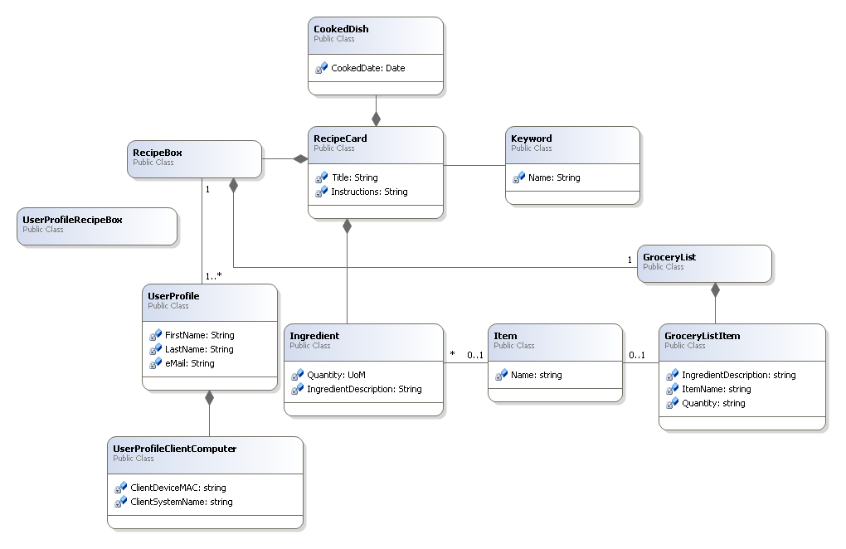

Slide 10










Web Recipes
AI/LLM Service
Email Service
Speech Service
eRecipeBox Network
HTTPs
Client
App Server
Database
eRecipeBox.exe
HTTPs
Windows Service
Database Server
TCP/IP
RecipeBoxDataService
or
Operating System
Operating System
Operating System
or

Slide 11
Client Network
eRecipeBox Network
Client
App Server
Database
eRecipeBox.exe
Windows Service
Database Server
HTTPs
TCP/IP
RecipeBoxDataService
or
Operating System
Operating System
Operating System
or
Install and Configure

Slide 12
Dev Machine
eRecipeBox.exe
Windows Service
Database Server
HTTPs
TCP/IP
RecipeBoxDataService
or
Operating System
Install and Configure

