Slide 1
Mock-Ups
Last updated: June 2, 2017

Slide 2
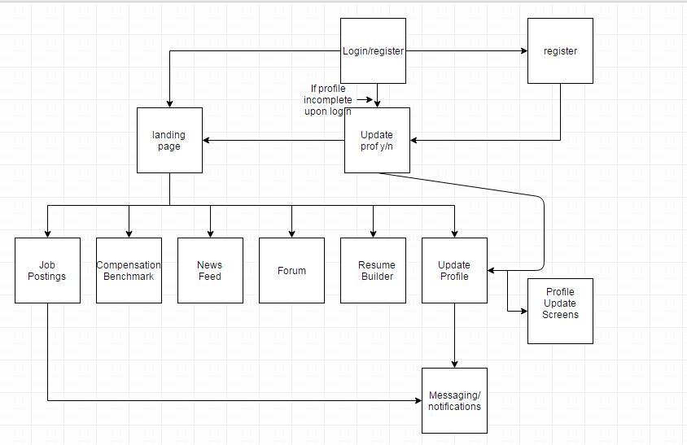
1
2
4
3
X
X
X
5
6
7

Slide 3
Amazon Web Services
0
Agility Virtual Private Network
AngularJS
Code Base
Applicant Stack API
7
iOS App
1
REST api
10
4
8
2
6
Android App
User Profiles
Ionic2 + Cordova
3
Push Notifications
MySQL
8
REST api

Slide 4
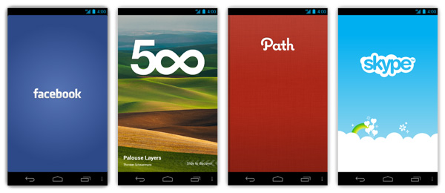
Sample App splash screens

Slide 5
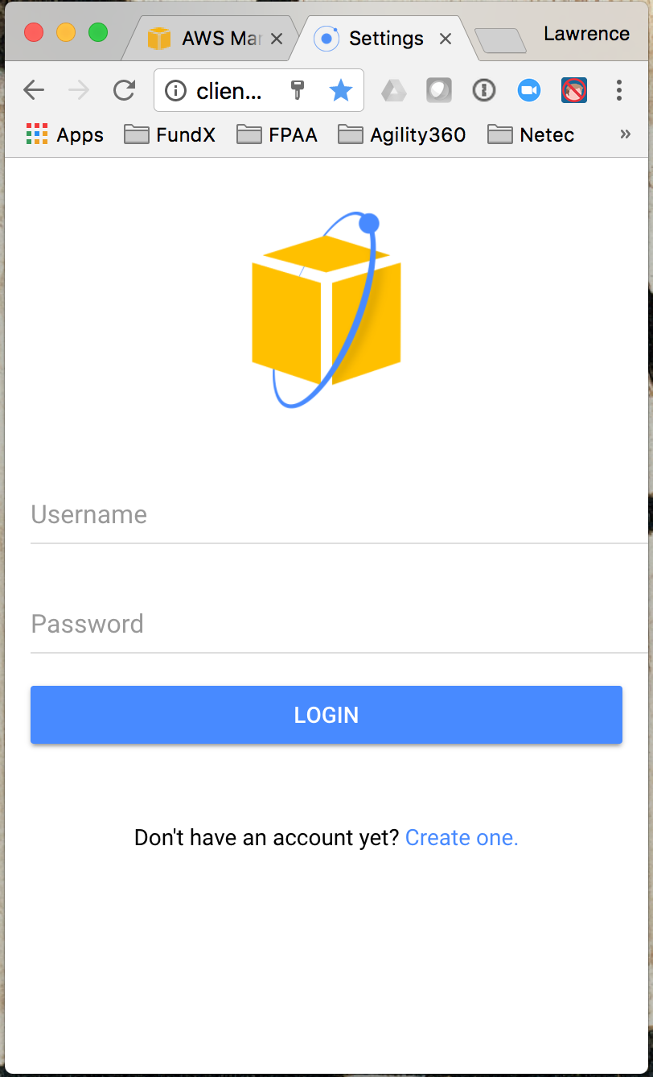
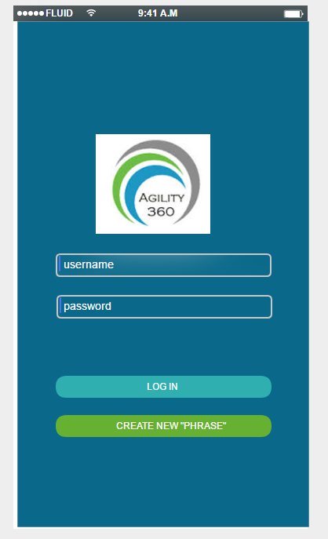
1
Fix Logo / backdrop
Pre-register and send login credentials
Done.

Slide 6
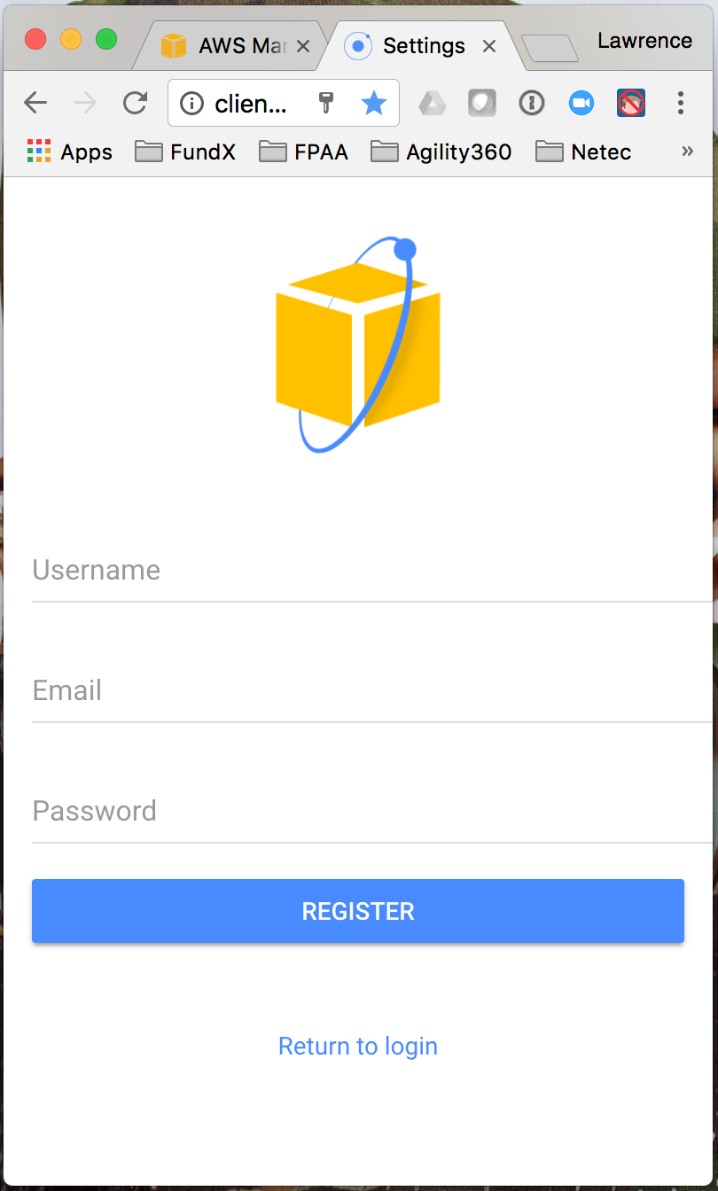
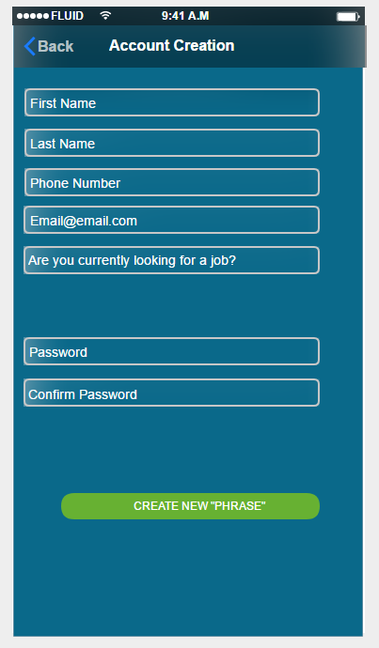
2.
Review and decide final list of questions
Security parameters

Slide 7
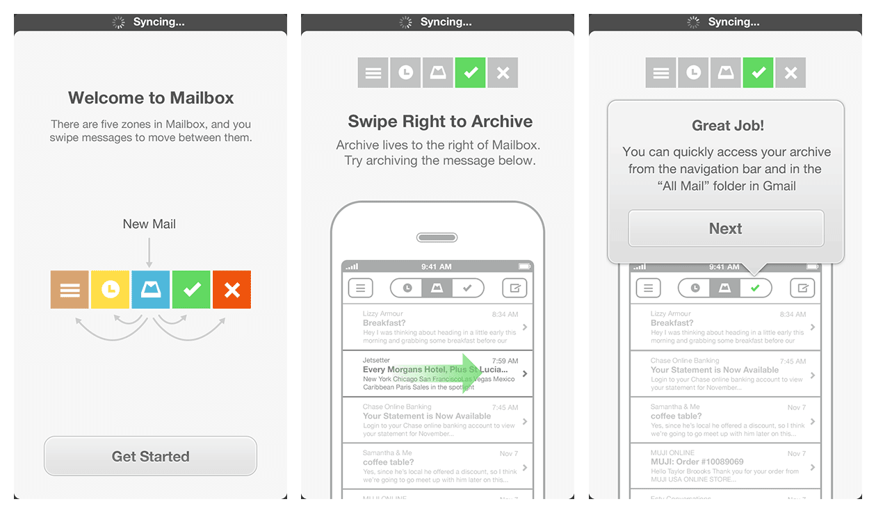
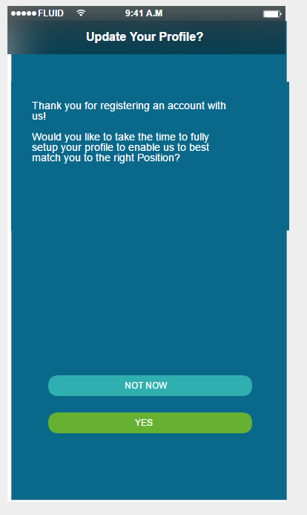
3. “Show Only Once” app tour screens
Style and format
McDaniel: The style framework that I’m using (Ionic2) has some off-the-shelf styles that might be working considering. In many cases developers start with these generics styles, and then tweak fonts and colors, which works well in most cases.

Slide 8
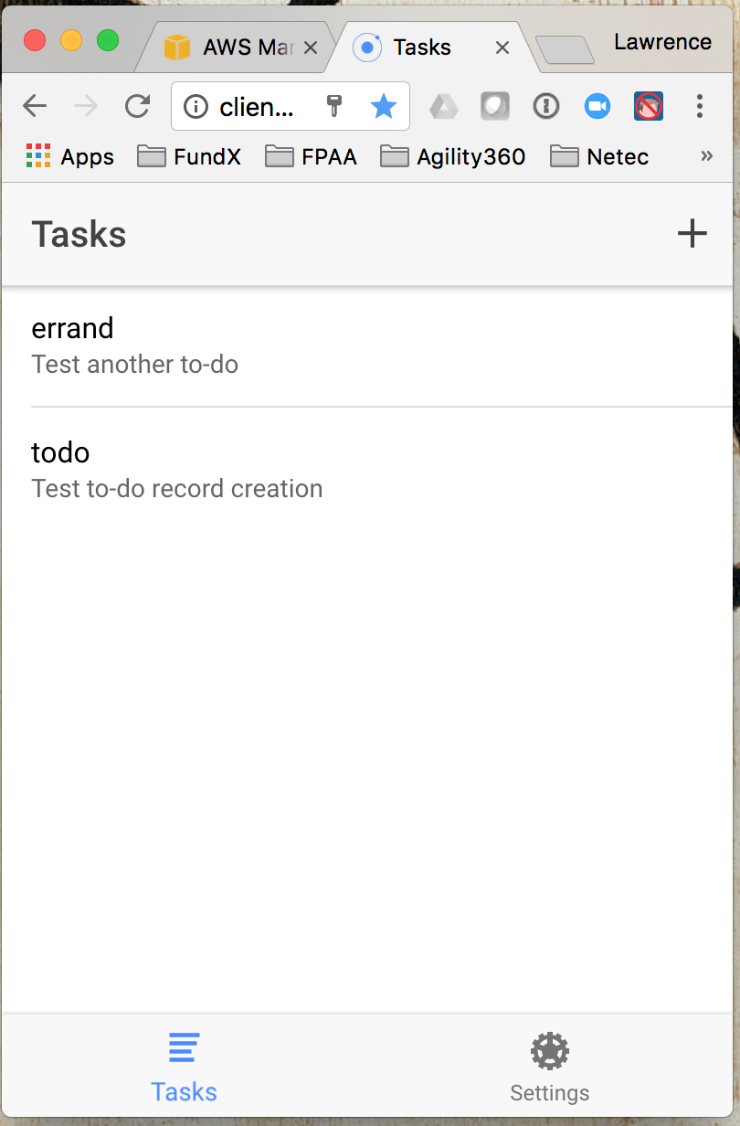
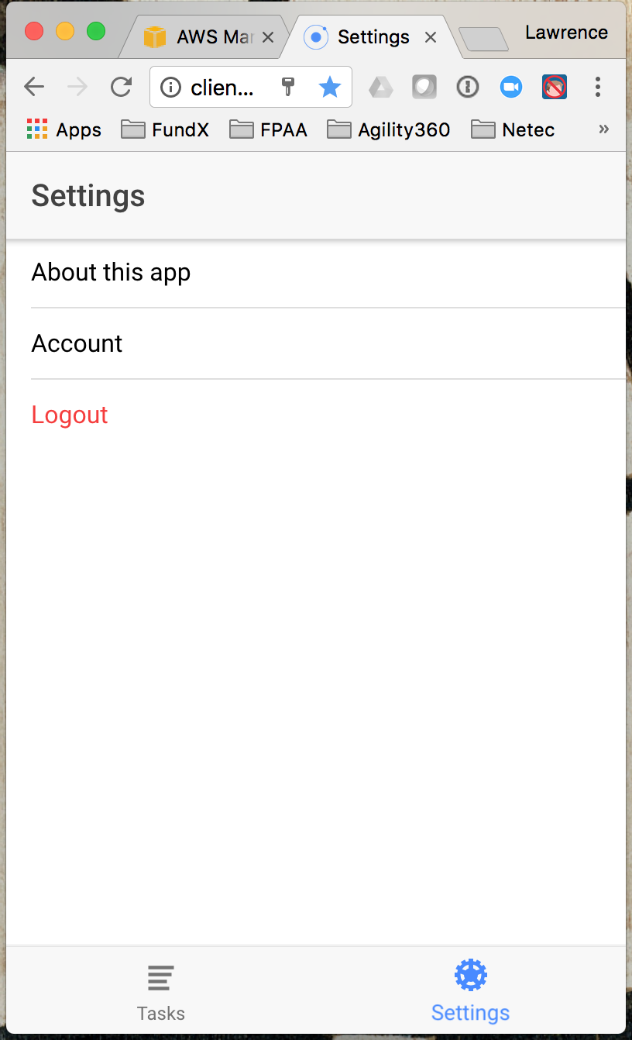
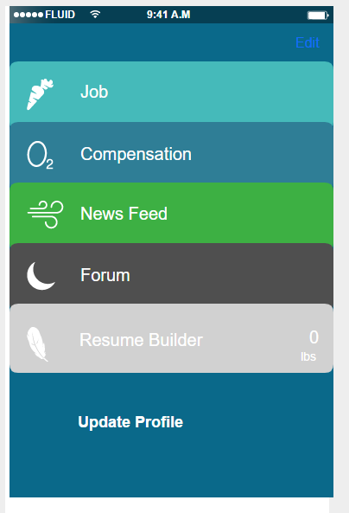
4.
Note: Default data feed. This is the screen that you see immediately after successful login
Note: All are part of profile.
Style and format
Add Push Notifications?

Slide 9
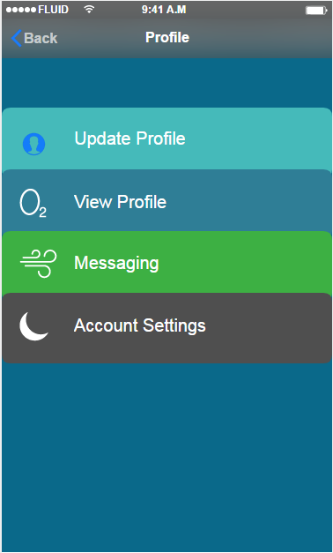
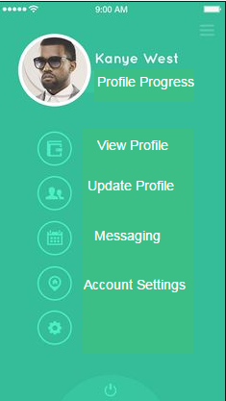
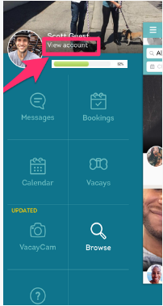
5.
-Current Sample landing pages
- Think its important to have a different layout than the landing page to avoid confusion in app
- All options in final consideration would use progress bar like example 2
- example 2 current favorite
- style and layout
- have not nailed down what we want each option/how many options to be on this screen
3.
1.
2.

Slide 10
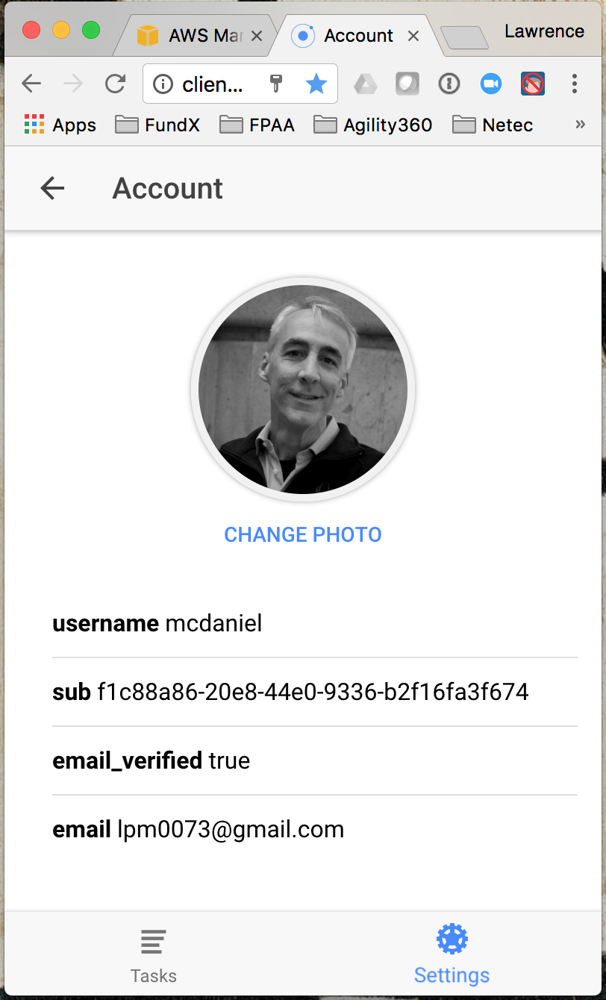
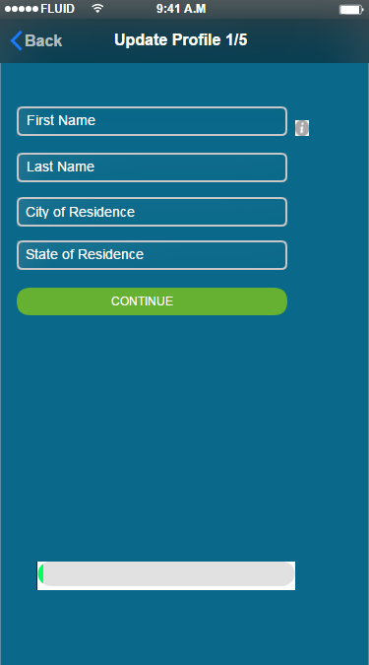
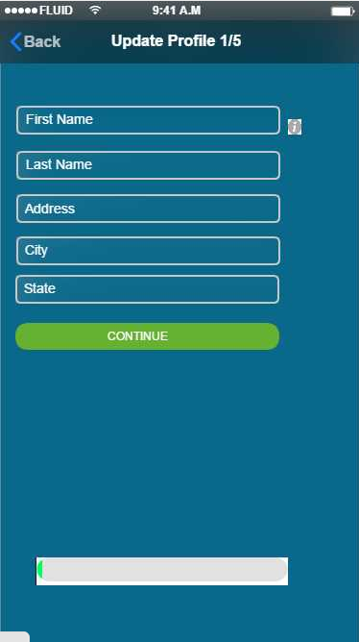
6. 1/5
1.
2.
- "6" is broken into 5 screens each viewed one after the next in chronological order
- The ability to cascade all screens in the "6" chain based on completion/progress?
- All screens on 6 will include the "i" icon which users can click to see exactly how we want each screen to be filled
- All screens will have progress bar
- progress bar styling/coloring TBD
- 1vs2 is whether or not we want to ask the addition information

Slide 11
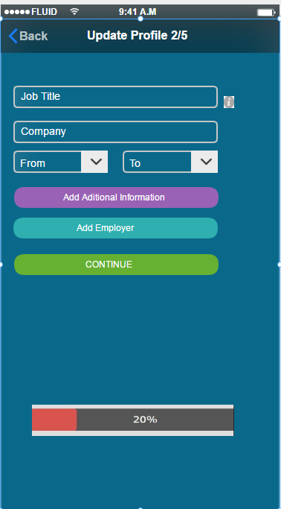
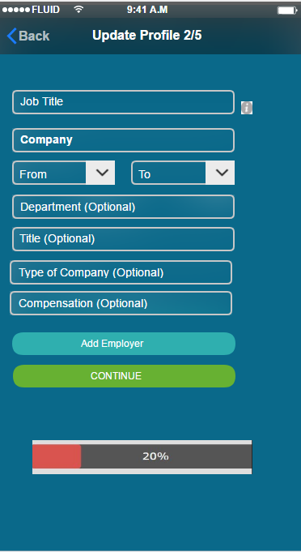
6. 2/5
- 1. shows screen by default. 2. shows screen once add additional information is pressed
- dates to be Month/year month/year
1.
2.

Slide 12
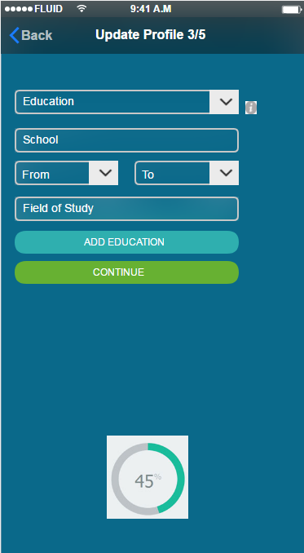
6. 3/5
- Different progress bar shown just as another example

Slide 13
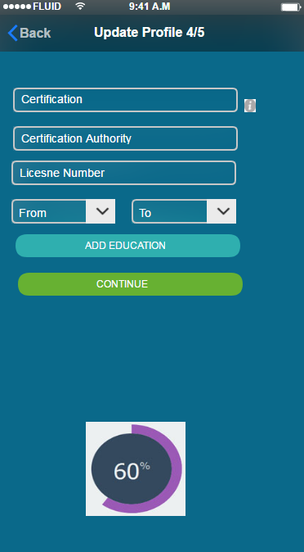
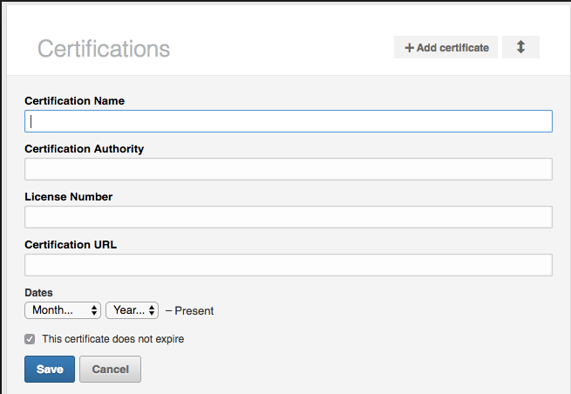
6. 4/5
- example from Linkedin to show another way we could format screen

Slide 14
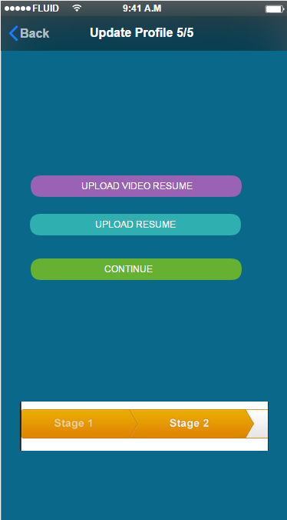
6. 5/5
- another example of how the progressbar could look

Slide 15
7.
Job Postings *
Newsfeed *
Forum *
Comp Benchmark #
Resume Builder +
* These will all be curated pages, scrolled
# TBD – Eventually software driven but start w/ list of comp for top 20-30 job titles/positions)
+ TBD – Eventually software driven but could start with “resume writing tips”
<---- Yes, part of V1
<---- No, not part of V1
<---- No, not part of V1
<---- No, not part of V1
<---- Yes, part of V1

