Slide 1
Mock-Ups
Last updated: July 13, 2017

Slide 2
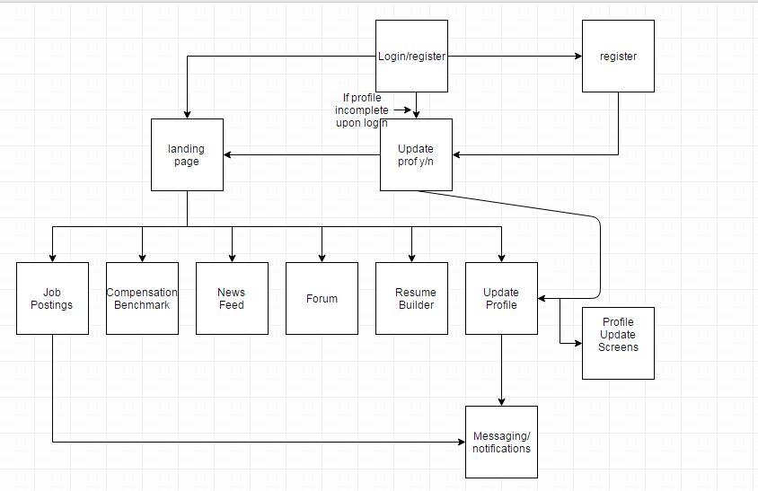
1
2
4
3
X
X
X
5
6
7

Slide 3
Amazon Web Services
0
Agility Virtual Private Network
AngularJS
Code Base
Applicant Stack API
7
iOS App
1
REST api
10
4
8
2
6
Android App
User Profiles
Ionic2 + Cordova
3
Push Notifications
MySQL
8
REST api

Slide 4
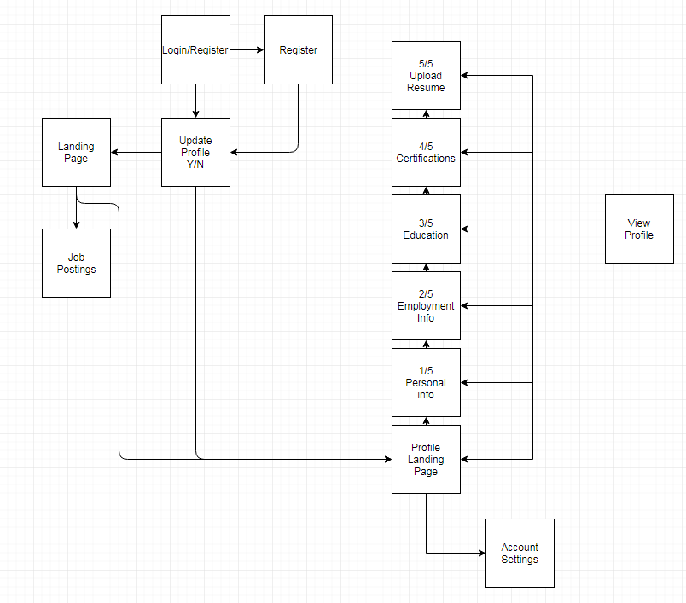
"Alpha" Flow Chart
1
2
6e
4
3
6d
6c
10
7a
5
6b
6a
5
9

Slide 5
Flow Chart
1
2
1. Need to add a notification screen
2. Research "chat" options vs. Messenger type option
4
3
5
6
7

Slide 6
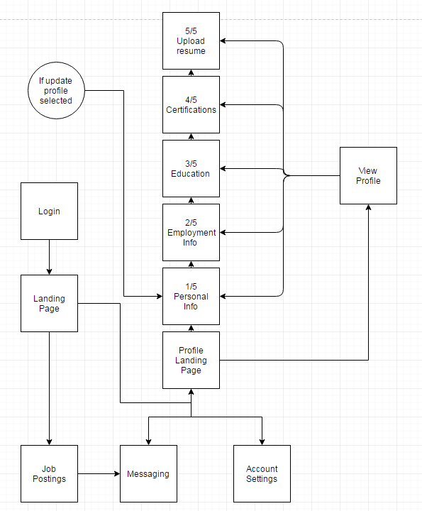
Flow Chart "6" Expanded
6e
6d
6c
10
1
6b
4
6a
5
7
8
9

Slide 7
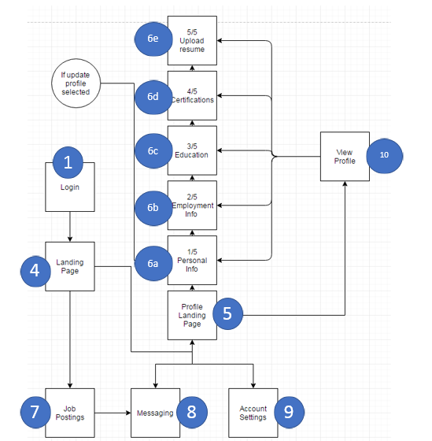
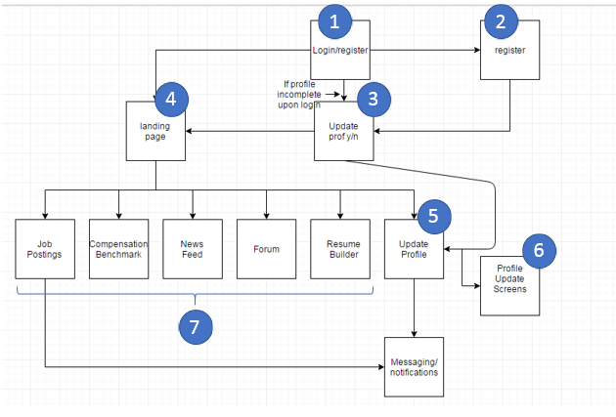
Flow Chart
8

Slide 8
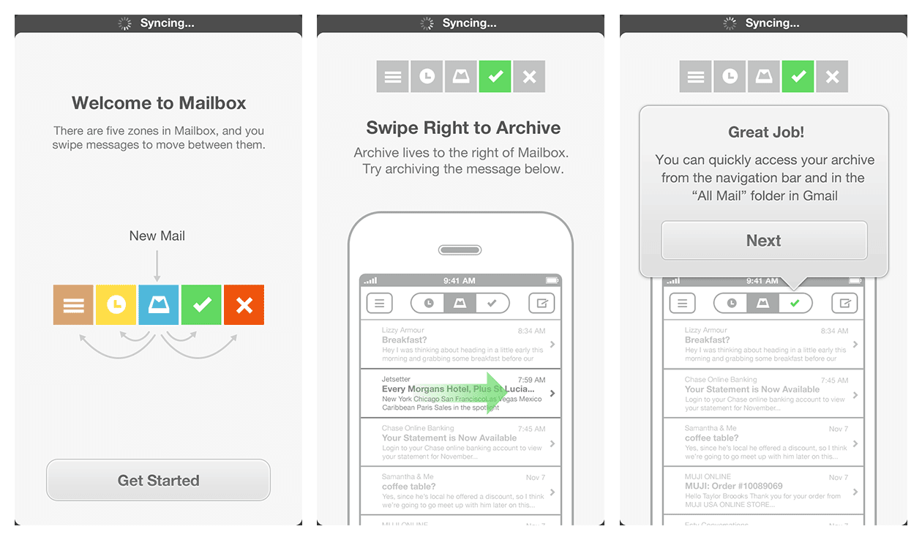
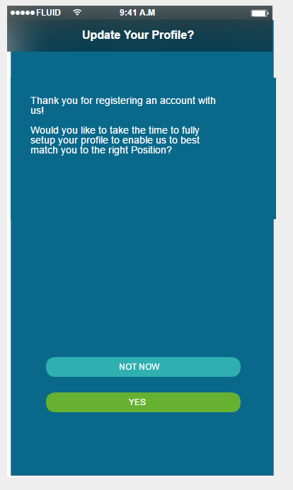
3. “Show Only Once” app tour screens
Style and format
McDaniel: The style framework that I’m using (Ionic2) has some off-the-shelf styles that might be working considering. In many cases developers start with these generics styles, and then tweak fonts and colors, which works well in most cases.

Slide 9
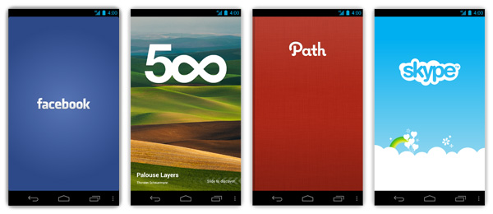
Example app splash screens

Slide 10
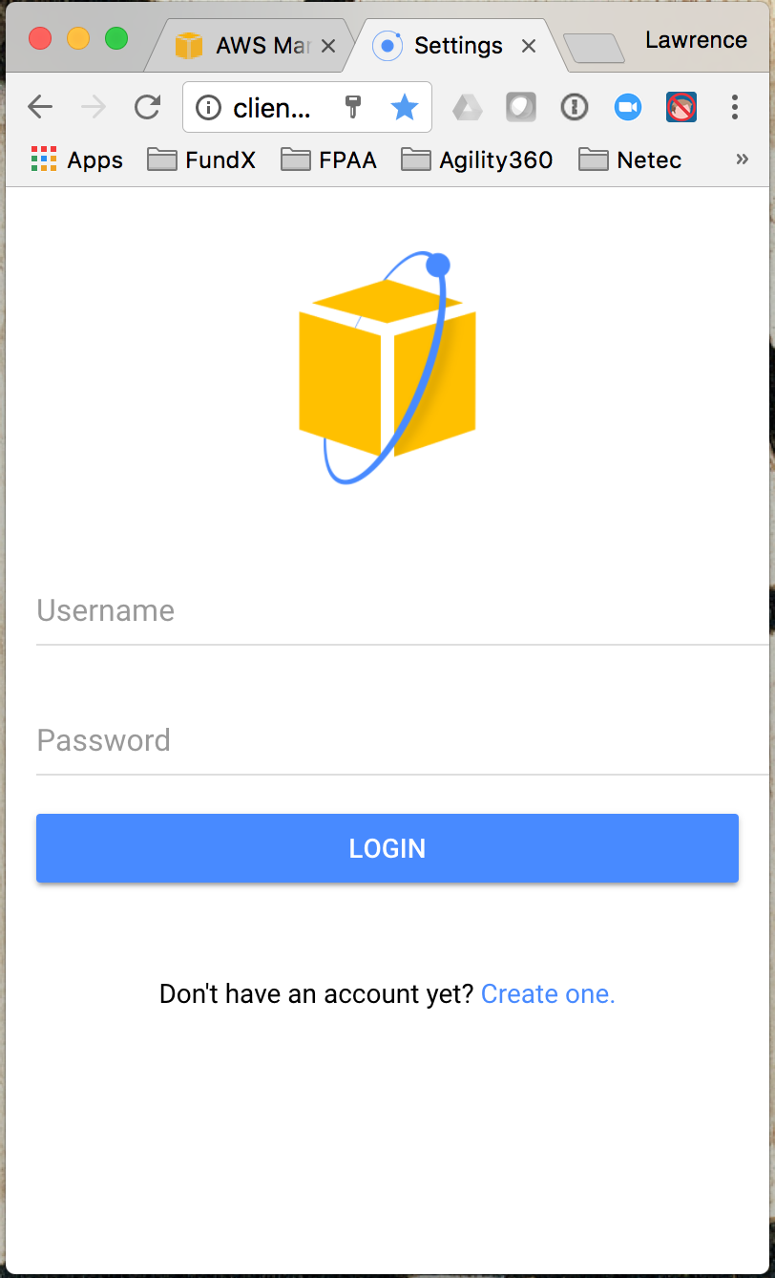
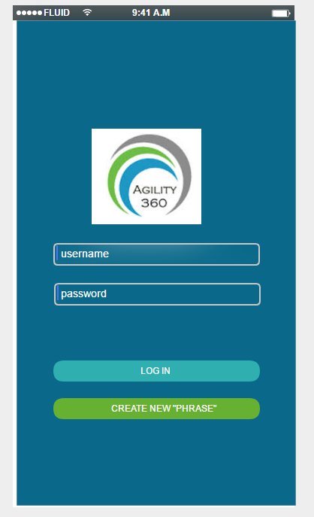
1
Fix Logo / backdrop
Pre-register and send login credentials

Slide 11
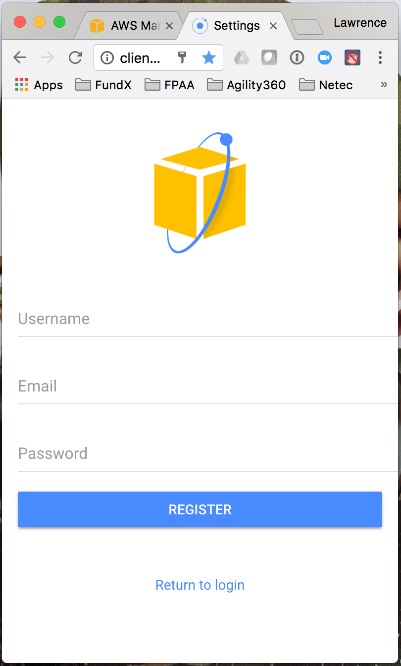
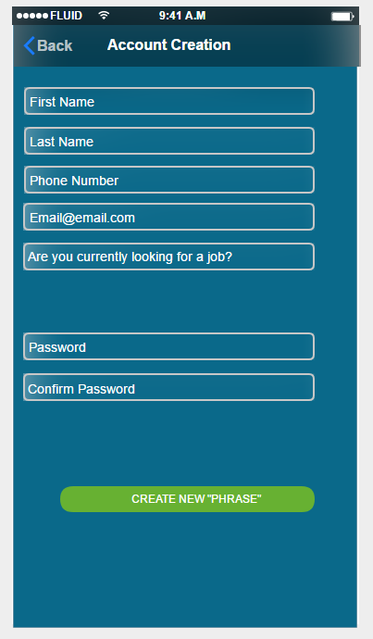
2.
Review and decide final list of questions
Security parameters

Slide 12
3.
Style and format

Slide 13
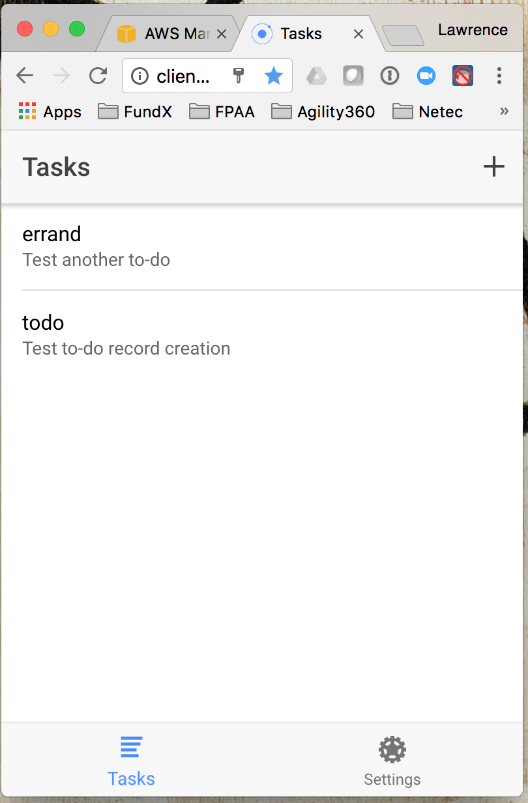
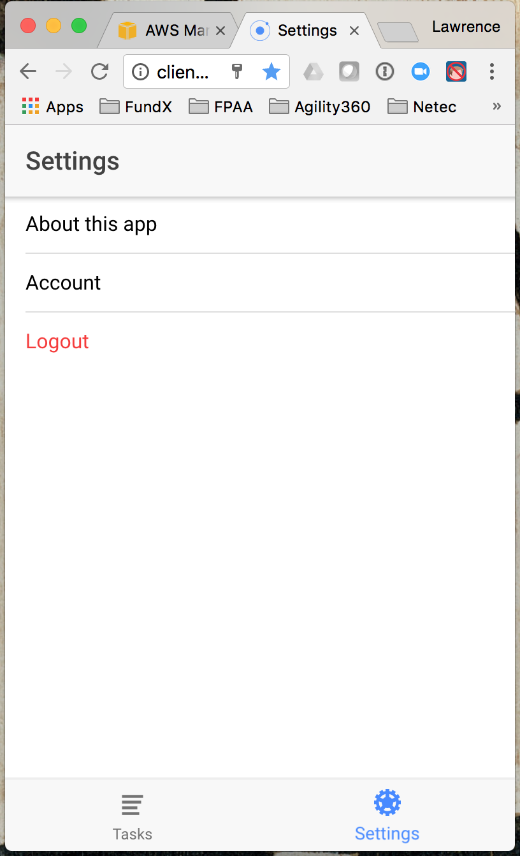
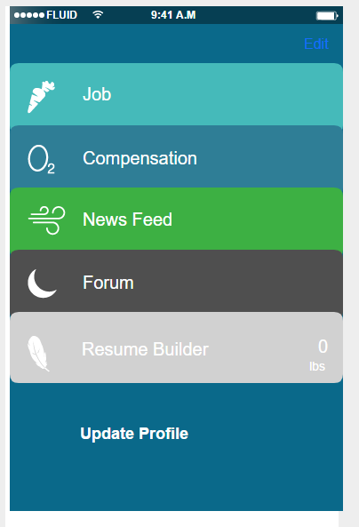
4.
Note: Default data feed. This is the screen that you see immediately after successful login
Note: All are part of profile.
Style and format
Add Push Notifications?

Slide 14
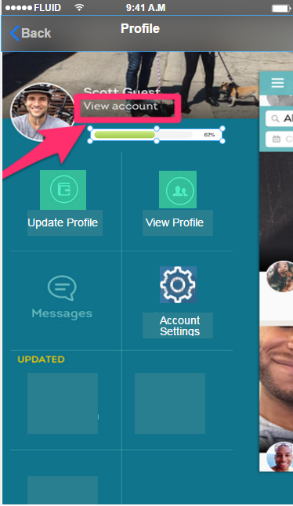
5.
- Think its important to have a different layout than the landing page to avoid confusion in app
- Want to keep the square style menu
- style and formatting not finalized

Slide 15
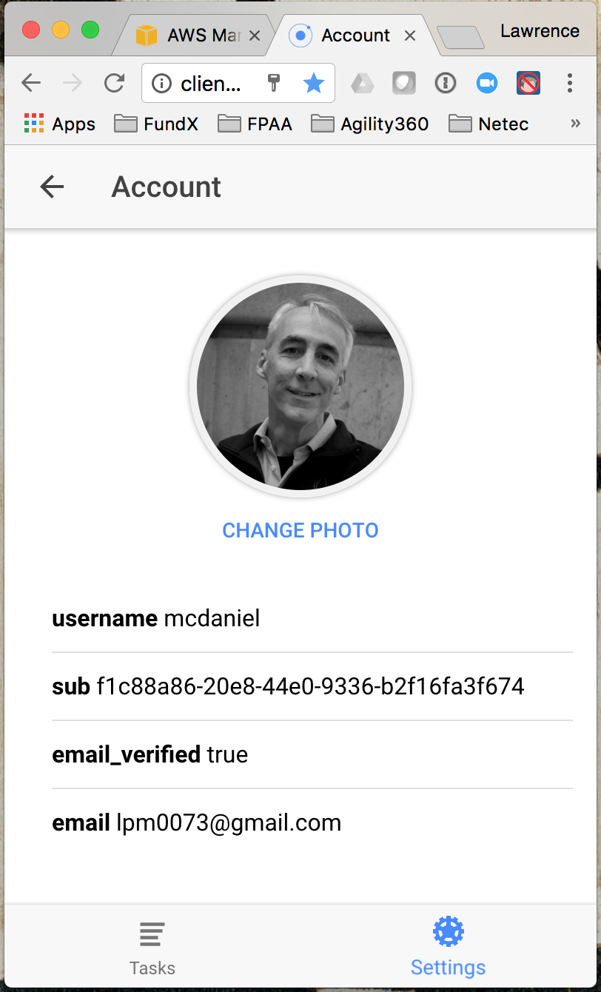
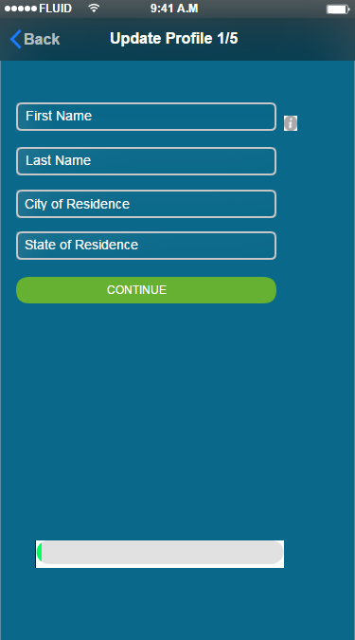
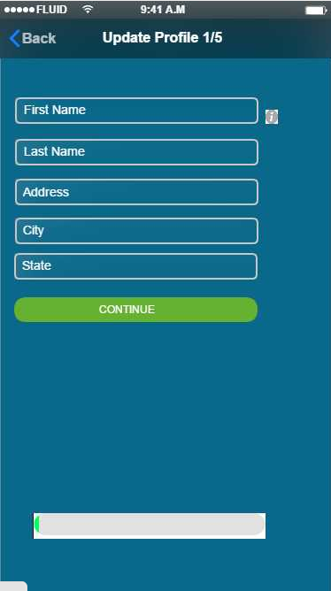
6. 1/5
1.
2.
- "6" is broken into 5 screens each viewed one after the next in chronological order
- The ability to cascade all screens in the "6" chain based on completion/progress?
- All screens on 6 will include the "i" icon which users can click to see exactly how we want each screen to be filled
- All screens will have progress bar
- progress bar styling/coloring TBD
- 1vs2 is whether or not we want to ask the addition information

Slide 16
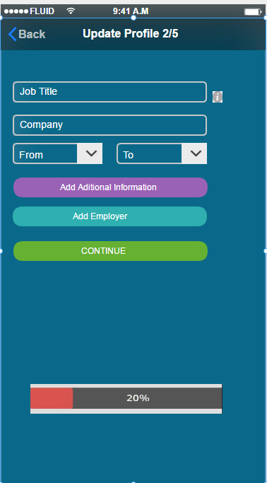
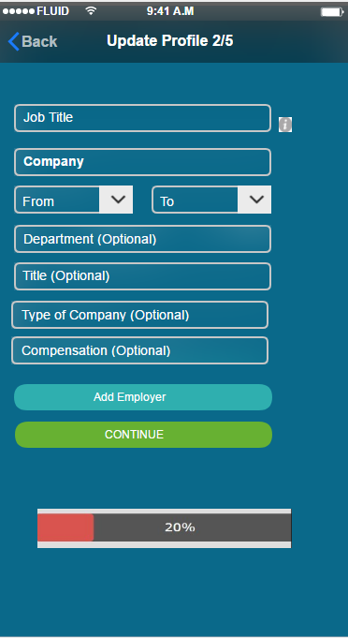
6. 2/5
- 1. shows screen by default. 2. shows screen once add additional information is pressed
- dates to be Month/year month/year
1.
2.

Slide 17
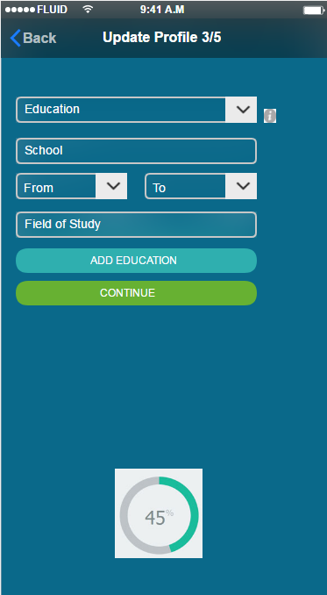
6. 3/5
- Different progress bar shown just as another example

Slide 18
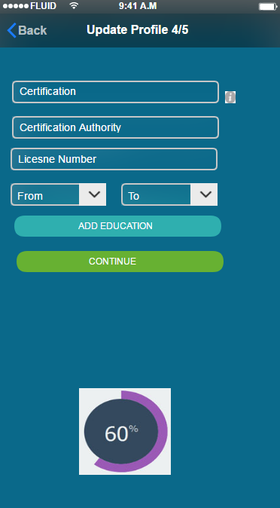
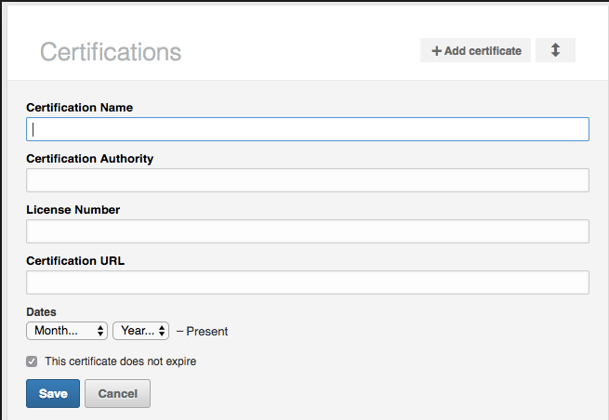
6. 4/5
- example from Linkedin to show another way we could format screen

Slide 19
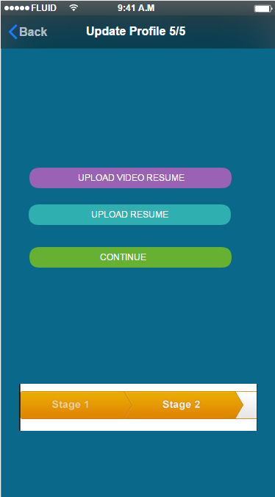
6. 5/5
- another example of how the progressbar could look

Slide 20
7.
Job Postings *
Newsfeed *
Forum *
Comp Benchmark #
Resume Builder +
* These will all be curated pages, scrolled
# TBD – Eventually software driven but start w/ list of comp for top 20-30 job titles/positions)
+ TBD – Eventually software driven but could start with “resume writing tips”
<---- Yes, part of V1
<---- No, not part of V1
<---- No, not part of V1
<---- No, not part of V1
<---- Yes, part of V1

Slide 21
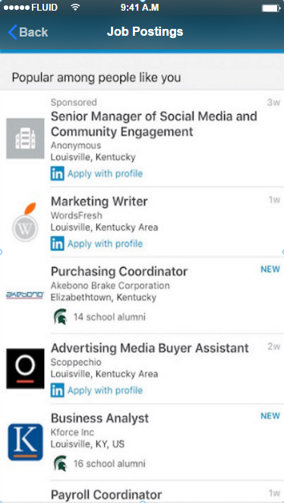
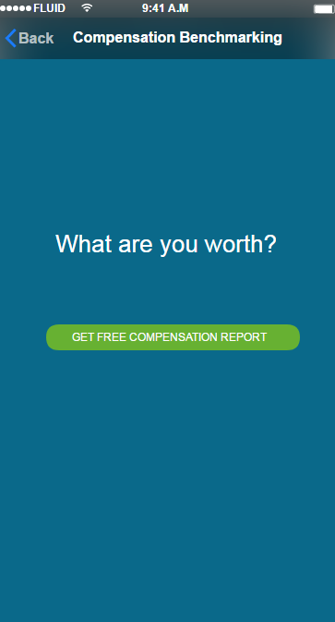
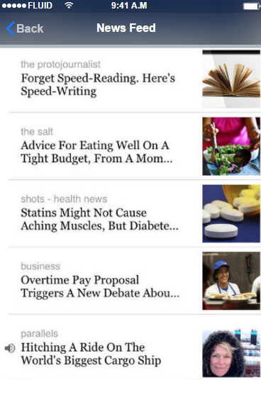
7a-c
7a.
7b.
7c.
- All of 7 not planned to be in "alpha" version
- style and layout still TBD
- each screenshot is an example of how we think we want each screen

Slide 22
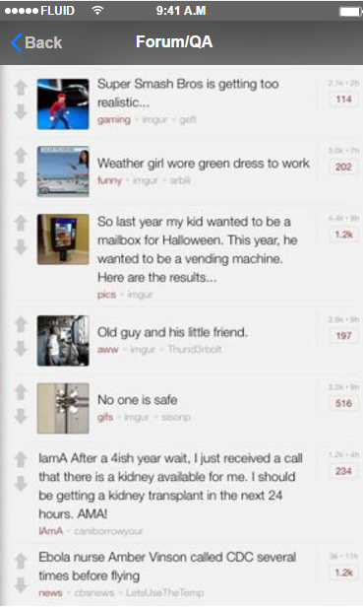
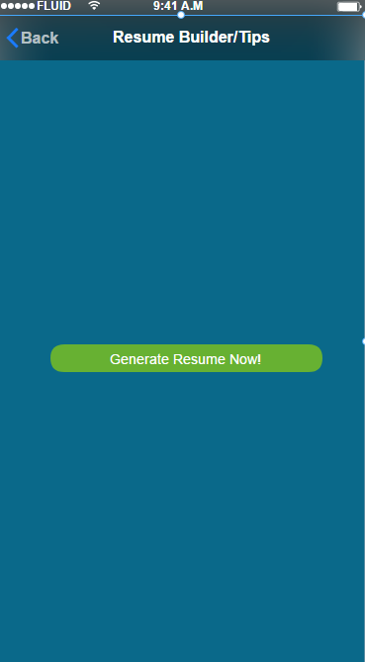
7d-e
7d.
7e.

Slide 23
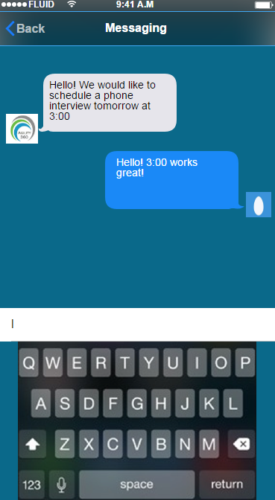
8.
- Simple messaging app that allows us to communicate directly to user

Slide 24
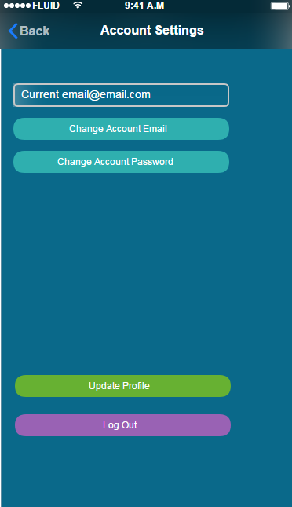
9.
- style and layout

Slide 25
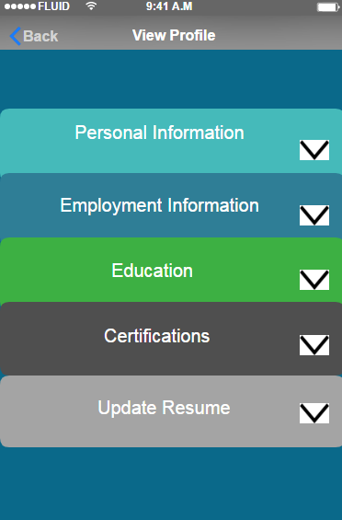
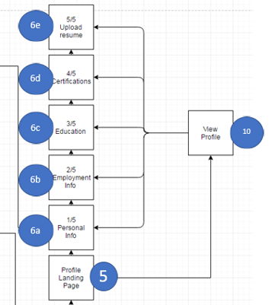
10.
- style and layout
- unsure how difficult this would be to create however, the ability for the "view profile" to go to the separate "update profile" screens as the user sees fit would be smooth and useful for keeping information as current as possible

Slide 26
Admin Console
User Management
Add/Delete/Edit User
Password Re-set
Export / Report Builder
Start with simple data download (csv, text file)
Content Management
Messenger

