Slide 1


Tic Tac Toe in C using Two Dimensional Arrays
Implemented by:
Apoorv Gupta
Vishesh Dvivedi

Slide 2
Index
Brief introduction to Program
Program features
Program design
Execution flow
Function-wise Analysis
Screenshots

Slide 3

Brief Introduction To Our Program
This program is a console-based implementation of the game 'Tic Tac Toe' using the concept of Two Dimensional Array
The program consists of a single .c file containing all the required code.
The program uses 2D array to mark data of each character on every position of the board, which is both retrieved and updated as the game progresses.

Slide 4
Program Features
Proper Input Validation: Implementing proper user input validation to prevent unnecessary crashes or infinite loop situations.
Dealing with all game scenarios: The program has well - formed mechanisms to deal with all possible game scenarios.
Clean Code: The program consists of multiple functions and proper variable declarations to ensure code cleanliness.
Attractive ASCII art: The program also inculcates attractive ASCII art to provide better user experience.

Slide 5

Program Design
1. The program is designed in such a way that it is easy to understand and play for all age groups
2. The program requires two users to play
3. one-by-one, each user gets a chance to place his/her mark, (either 'X' or 'O' ), somewhere on the board, by typing the number which is associated to that specific position in board.
4. Whichever user connects three of his/her marks on the board consecutively, either horizontally, vertically or diagonally, wins.
5. If all the empty places are occupied and no user is able to connect their marks consecutively, the game is considered to be draw.

Slide 6

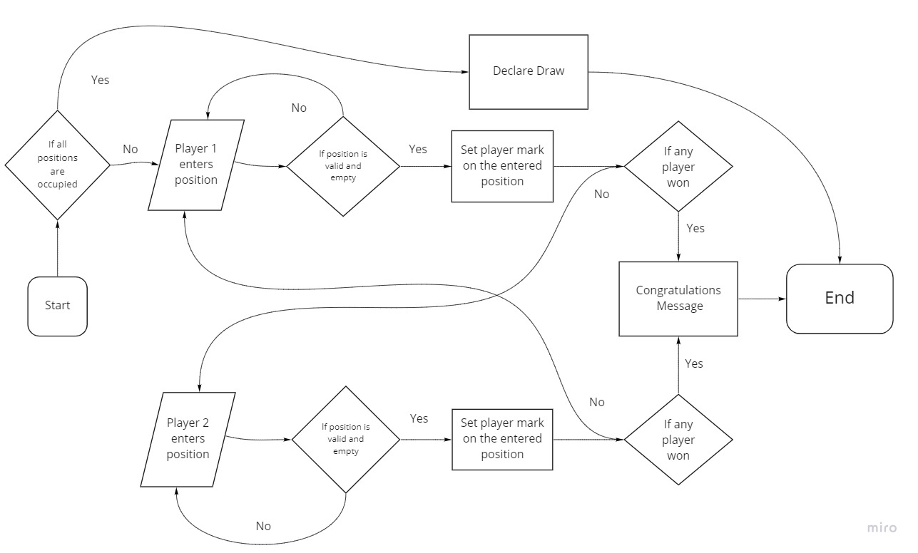
Execution Flow

Slide 7
Function-Wise Analysis
The program contains 4 functions:
1. check()
2. chessboard()
3. printWelcomeMessage()
4. main()

Slide 8
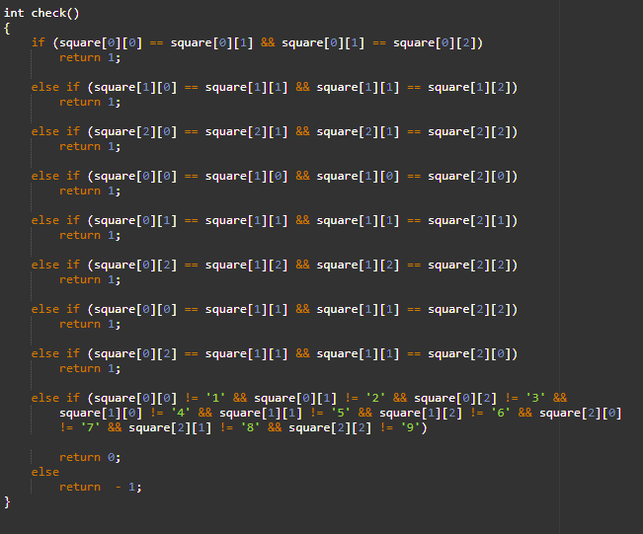
check()
Parameters: none
Return Type: int
Possible Return Values: (0, 1 or –1)
Description:
This function is responsible to check whether the game is won, drawn or in progress.
1. returns 0 for draw
2. returns 1 for win
3. returns –1 for game in progress

Slide 9
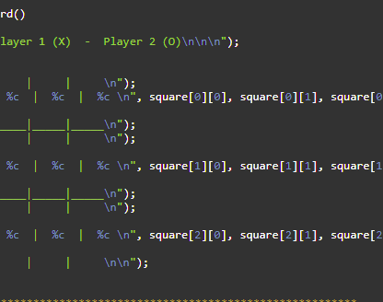
chessboard()
Parameters: none
Return Type: void
Description:
This function is responsible to display the board with all the values retrieved from the 2D array.

Slide 10
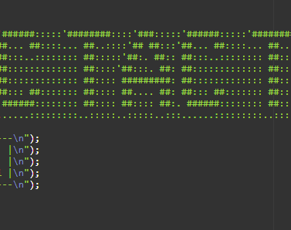
printWelcomeMessage()
Parameters: none
Return Type: void
Description:
This function is responsible for displaying the welcome message containing the ASCII art along with creator's names

Slide 11
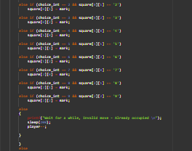
main()
Parameters: none
Return Type: int (return 0)
Description:
This function is where the execution flow starts. It is responsible for taking user input, calling other functions, and executing the main flow.

Slide 12
Screenshots

Slide 13
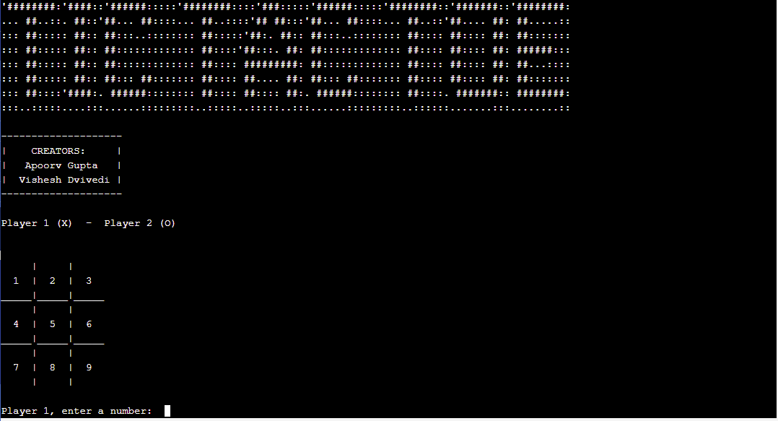
Start of the program

Slide 14
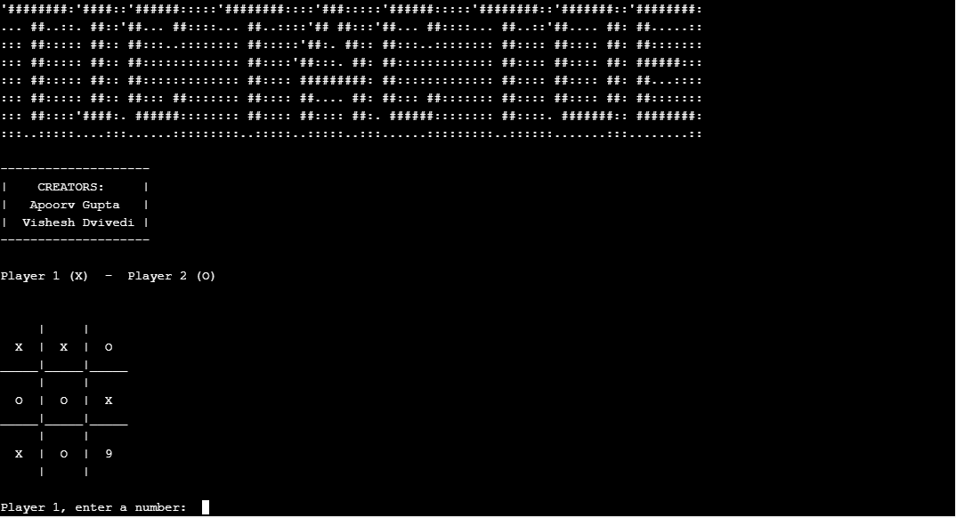
Program output after few user inputs

Slide 15
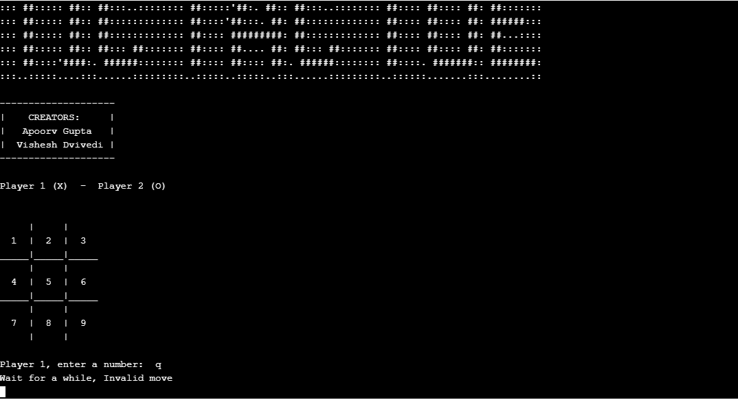
Program output when user enters invalid input

Slide 16
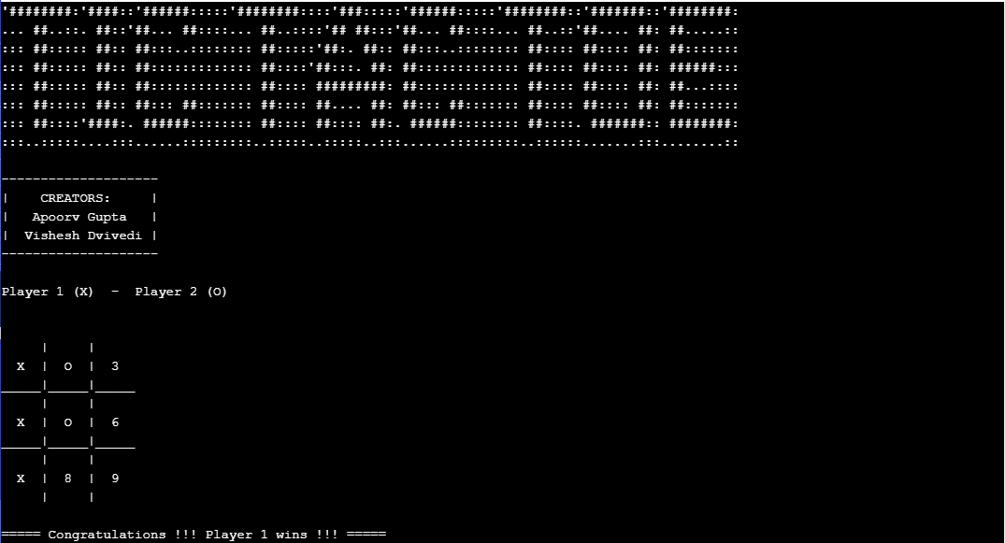
Program output when any user wins

Slide 17
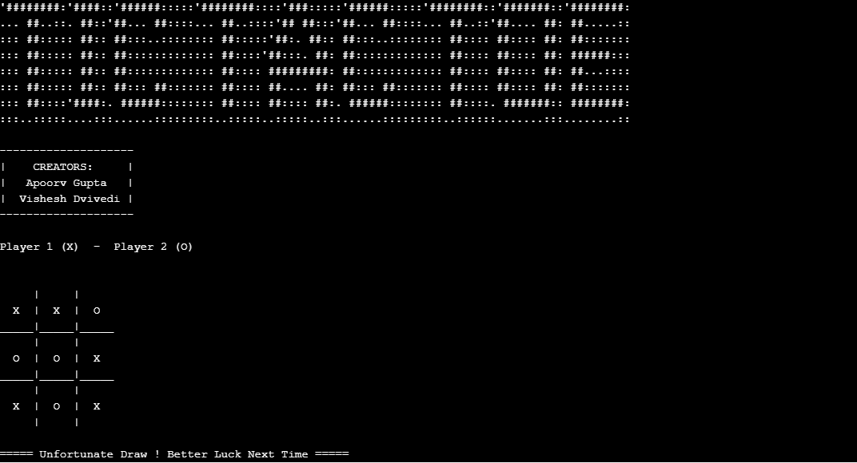
Program output when game is drawn

Slide 18
Thank You
-by Apoorv Gupta, Vishesh Dvivedi

