Slide 1
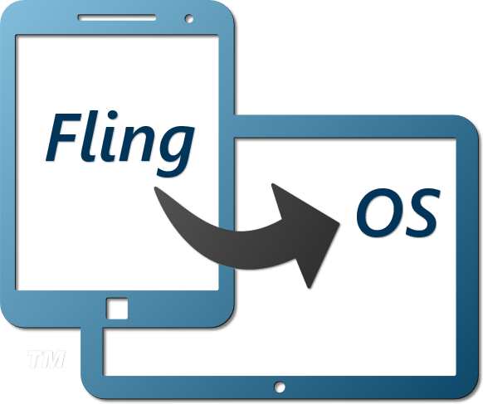
An educational OS

Slide 2
Our Aims
To educate,
With comprehensive resources,
Made easily accessible.
Available freely,
Online,
And open-source.

Slide 3
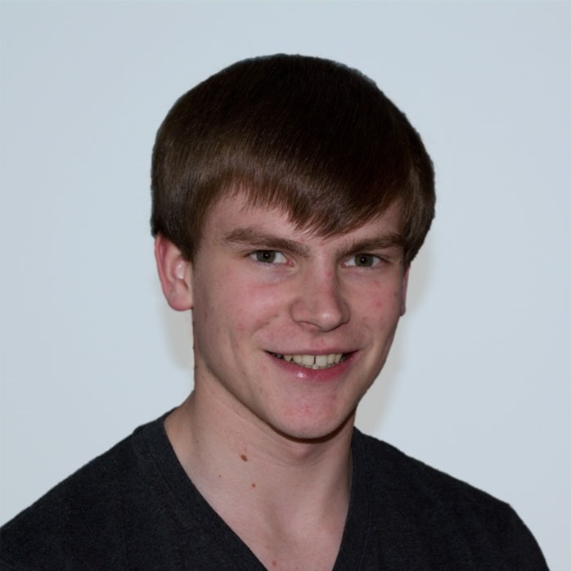
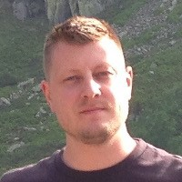
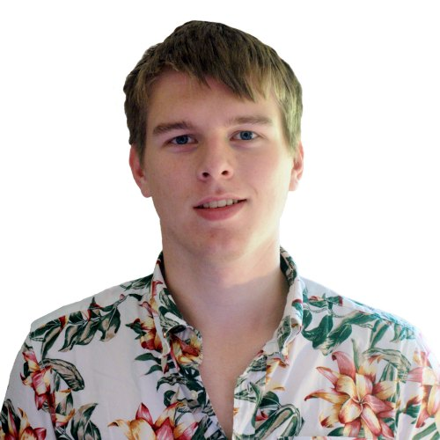
Who are we
Founder: Ed Nutting
Intern: Roland Baranyi
Website: Ross Gardiner
Others:
India: Shivranjan, Sanil
Argentina: Ezequiel
Supported by University of Bristol
Working with prpl Foundation

Slide 4
Our Progress
30 articles
10 tutorial videos
Intern sponsored by Imagination Technologies
x86 Kernel:
USB2.0 support
ELF drivers
MIPS Kernel
Cross-platform verification kernel

Slide 5
Articles & Tutorials
Tutorial videos:
From only understanding programming
Covers fundamental computer architecture
Building your own basic OS from scratch
Complete resources in ASM, C and C#
Articles:
30 covering wide range of fundamental topics
History, Hardware, Software (practical), Sample code, Further Reading

Slide 6
Codebase
C# not C
125,538 lines of code
60% comment ratio
90% summary documentation
Simple
Un-optimised
Easy to read

Slide 7
Our Future
Roland continuing work on the project
Already planned:
21 more articles
4 more tutorial videos
Add more architectures and educational platforms
We’d like all three major ones!
E.g. ARM & Raspberry Pi, BBC Micro?
Grow the community and codebase
Sponsorship for interns next year
Aim: £20,000 for next summer
5 interns: 12 weeks work inc. 3 weeks training (if required)
Sponsorship to cover project expenses
Around £500 existing expenses
Further expenses for organising events, software licenses, website

Slide 8
Lectures & Workshops
Weekly lecture & workshop
20 to 30 min lecture
Followed by 1.5 hour workshop
Assumes basic (first year) programming knowledge
Covers:
Computer architecture
Hands-on experience with OS dev
x86 Laptops and Creator CI20s available

Slide 9
Get involved…
www.flingos.co.uk
@Fling_OS
Facebook.com/FlingOperatingSystem

Slide 10
Thank you
Edward Nutting
Founder of FlingOS
Social Secretary of Bristol Electronic and Electrical Engineering Society (BEEES)

