Slide 1
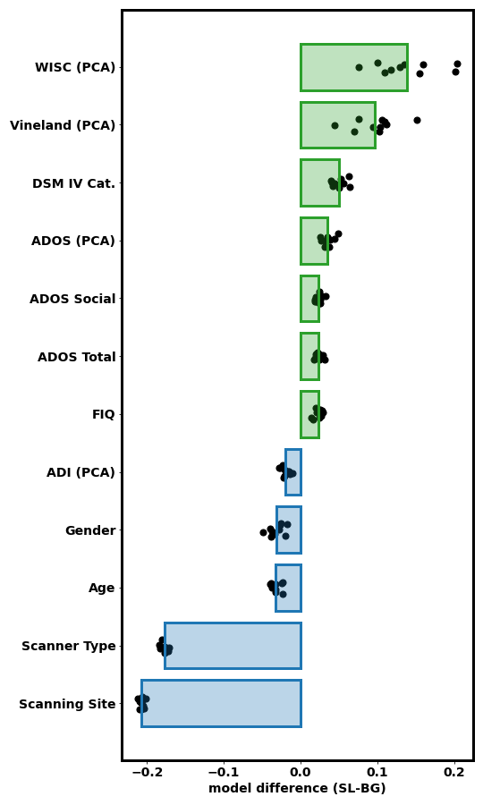
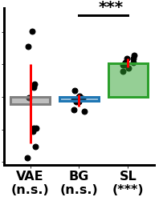
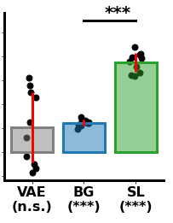
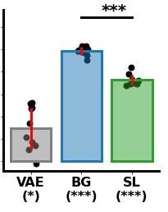
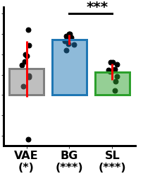
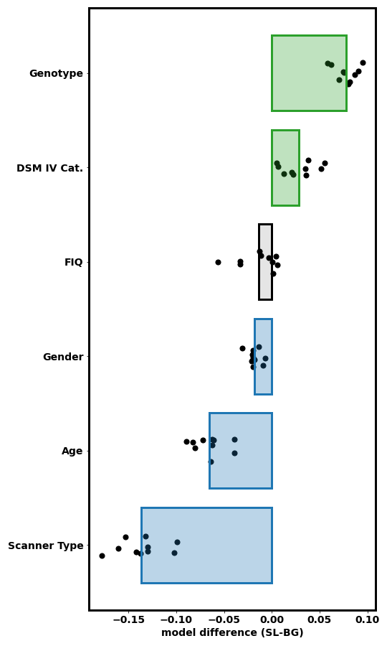
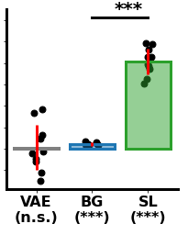
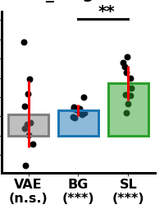
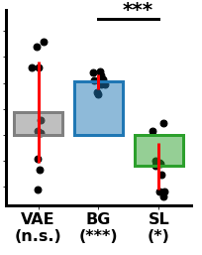
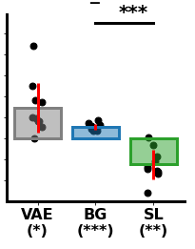
RSA results: ABIDE
Optimal clustering
WISC (PCA)
ADOS total
DSM (IV) Cat.
Shared-feature space
Vineland (PCA)
.04
.1
Subject similarity
Cluster fit
DSM (IV) Cat.
.02
.06
ADOS (PCA)
Model fit (r)
Model fit (r)
ADOS Social
0
.02
ADOS Total
-.02
-.02
FIQ
-.04
VAE
(n.s.)
Shared
(n.s.)
ASD
(***)
VAE
(n.s.)
Shared
(***)
ASD
(***)
ADI (PCA)
Age
.08
Gender
Gender
.15
Age
.1
.04
Scanner Type
Model fit (r)
Model fit (r)
ASD-specific feature space
Scanning Site
.05
0
Subject similarity
Cluster fit
-0.2
-0.1
0.0
0.1
0.2
0
VAE
(*)
Shared
(***)
ASD
(***)
-.04
VAE
(*)
Shared
(***)
ASD
(***)
Model fit difference (ASD-specific - Shared)
RSA results: SFARI
Genotype
Genotype
.12
DSM (IV) Cat.
.12
.08
DSM (IV) Cat.
.08
Model fit (r)
Model fit (r)
0.04
0.04
0
VAE space
FIQ (n.s)
0
-.02
-.02
VAE
(n.s.)
Shared
(***)
ASD
(***)
VAE
(n.s.)
Shared
(***)
ASD
(***)
Subject similarity
Cluster fit
Gender
Age
Gender
Age
.08
.05
.04
.02
Model fit (r)
Model fit (r)
Scanner Type
0
0
-0.15
-0.10
-0.05
0.00
0.05
0.10
-.04
VAE
(n.s.)
Shared
(***)
ASD
(*)
-.02
VAE
(*)
Shared
(***)
ASD
(**)
Model fit difference (ASD-specific - Shared)

Slide 2
RSA results: ABIDE
Optimal clustering
WISC (PCA)
ADOS total
DSM (IV) Cat.
Shared-feature space
Vineland (PCA)
.04
.1
Subject similarity
Cluster fit
DSM (IV) Cat.
.02
.06
ADOS (PCA)
Model fit (r)
Model fit (r)
ADOS Social
0
.02
ADOS Total
-.02
-.02
FIQ
-.04
ADI (PCA)
Age
.08
Gender
Gender
.15
Age
.1
.04
Scanner Type
Model fit (r)
Model fit (r)
ASD-specific feature space
Scanning Site
.05
0
Subject similarity
Cluster fit
Model fit difference (SL-BG)
0
-.04
RSA results: SFARI
Genotype
Genotype
.12
DSM (IV) Cat.
.12
.08
DSM (IV) Cat.
.08
Model fit (r)
Model fit (r)
0.04
0.04
0
VAE space
FIQ (n.s)
0
-.02
-.02
Subject similarity
Cluster fit
Gender
Age
Gender
Age
.08
.05
.04
.02
Model fit (r)
Model fit (r)
Scanner Type
0
0
-.04
-.02
Model fit difference (SL-BG)

Slide 4
RSA results: ABIDE
Optimal clustering
WISC (PCA)
ADOS total
DSM (IV) Cat.
Background space
Vineland (PCA)
.04
.1
Subject similarity
Cluster fit
DSM (IV) Cat.
.02
.06
ADOS (PCA)
Model fit (r)
Model fit (r)
ADOS Social
0
.02
ADOS Total
-.02
-.02
FIQ
-.04
ADI (PCA)
Age
.08
Gender
Gender
.15
Age
.1
.04
Scanner Type
Model fit (r)
Model fit (r)
Salient space
Scanning Site
.05
0
Subject similarity
Cluster fit
Model fit difference (SL-BG)
0
-.04
RSA results: SFARI
Genotype
Genotype
.12
DSM (IV) Cat.
.12
.08
DSM (IV) Cat.
.08
Model fit (r)
Model fit (r)
0.04
0.04
0
VAE space
FIQ (n.s)
0
-.02
-.02
Subject similarity
Cluster fit
Gender
Age
Gender
Age
.08
.05
.04
.02
Model fit (r)
Model fit (r)
Scanner Type
0
0
-.04
-.02
Model fit difference (SL-BG)

Slide 5
RSA results: ABIDE
Optimal clustering
WISC (PCA)
ADOS total
DSM (IV) Cat.
Background space
Vineland (PCA)
.04
.1
Subject similarity
Cluster fit
DSM (IV) Cat.
.02
.06
ADOS (PCA)
Model fit (r)
Model fit (r)
ADOS Social
0
.02
ADOS Total
-.02
-.02
FIQ
-.04
ADI (PCA)
Age
.08
Gender
Gender
.15
Age
.1
.04
Scanner Type
Model fit (r)
Model fit (r)
Salient space
Scanning Site
.05
0
Subject similarity
Cluster fit
Model fit difference (SL-BG)
0
-.04
RSA results: SFARI
Genotype
Genotype
.12
DSM (IV) Cat.
.12
.08
DSM (IV) Cat.
.08
Model fit (r)
Model fit (r)
0.04
0.04
0
VAE space
FIQ (n.s)
0
-.02
-.02
Subject similarity
Cluster fit
Gender
Age
Gender
Age
.08
.05
.04
.02
Model fit (r)
Model fit (r)
Scanner Type
0
0
-.04
-.02
Model fit difference (SL-BG)

Slide 6
RSA results: ABIDE
Optimal clustering
WISC (PCA)
ADOS total
DSM (IV) Cat.
Background space
Vineland (PCA)
.04
.1
Subject similarity
Cluster fit
DSM (IV) Cat.
.02
.06
ADOS (PCA)
Model fit (r)
Model fit (r)
ADOS Social
0
.02
ADOS Total
-.02
-.02
FIQ
-.04
ADI (PCA)
Age
.08
Gender
Gender
.15
Age
.1
.04
Scanner Type
Model fit (r)
Model fit (r)
Salient space
Scanning Site
.05
0
Subject similarity
Cluster fit
Model fit difference (SL-BG)
0
-.04
RSA results: SFARI
Genotype
Genotype
DSM (IV) Cat.
.12
.12
.08
.08
DSM (IV) Cat.
Model fit (r)
Model fit (r)
0.04
0.04
0
VAE space
FIQ (n.s)
0
-.02
-.02
Subject similarity
Cluster fit
Gender
Age
Gender
Age
.08
.05
.04
.02
Model fit (r)
Model fit (r)
Scanner Type
0
0
-.04
-.02
Model fit difference (SL-BG)

