Slide 1
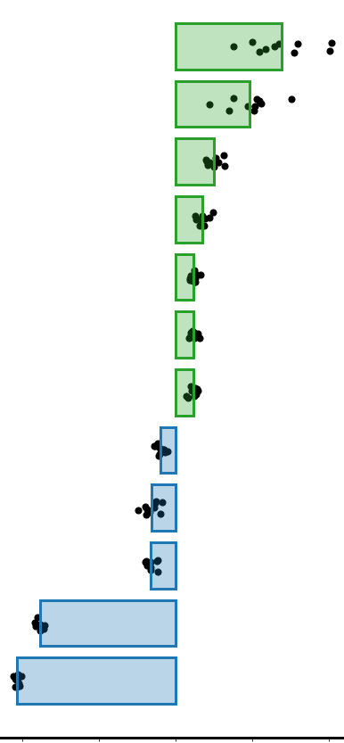
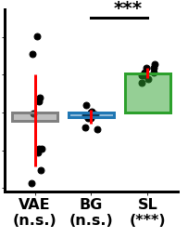
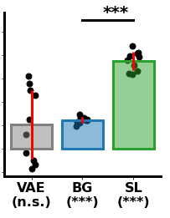
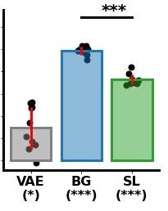
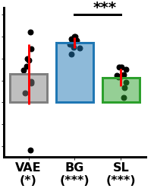
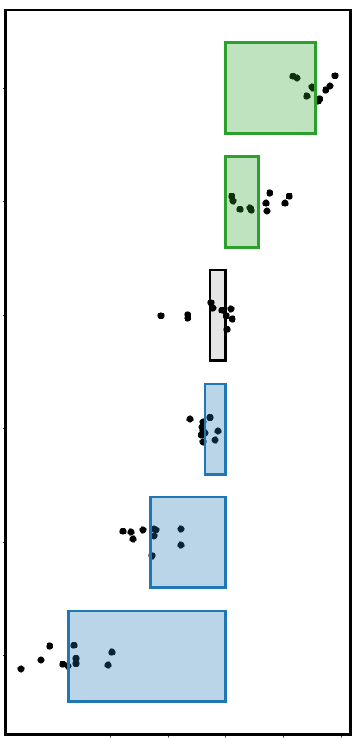
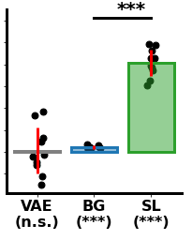
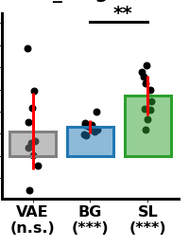
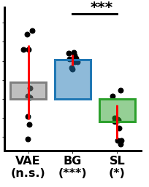
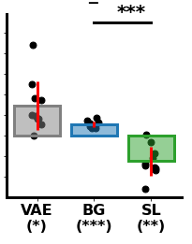
Feature similarity: ABIDE
Optimal clustering
WISC (PCA)
ADOS total
DSM (IV) Cat.
Shared-feature space
Vineland (PCA)
.04
.1
Subject similarity
Cluster fit
DSM (IV) Cat.
.02
.06
ADOS (PCA)
Model fit (r)
Model fit (r)
ADOS Social
0
.02
ADOS Total
-.02
-.02
FIQ
-.04
VAE
(n.s.)
Shared
(n.s.)
ASD
(***)
VAE
(n.s.)
Shared
(***)
ASD
(***)
ADI (PCA)
Age
.08
Gender
Gender
.15
Age
.1
.04
Scanner Type
Model fit (r)
Model fit (r)
ASD-specific feature space
Scanning Site
.05
0
Subject similarity
Cluster fit
-0.2
-0.1
0.0
0.1
0.2
0
VAE
(*)
Shared
(***)
ASD
(***)
-.04
VAE
(*)
Shared
(***)
ASD
(***)
Model fit difference (ASD-specific - Shared)
Feature similarity: SFARI
Genotype
Genotype
.12
DSM (IV) Cat.
.12
.08
DSM (IV) Cat.
.08
Model fit (r)
Model fit (r)
0.04
0.04
0
VAE space
FIQ (n.s)
0
-.02
-.02
VAE
(n.s.)
Shared
(***)
ASD
(***)
VAE
(n.s.)
Shared
(***)
ASD
(***)
Subject similarity
Cluster fit
Gender
Age
Gender
Age
.08
.05
.04
.02
Model fit (r)
Model fit (r)
Scanner Type
0
0
-0.15
-0.10
-0.05
0.00
0.05
0.10
-.04
VAE
(n.s.)
Shared
(***)
ASD
(*)
-.02
VAE
(*)
Shared
(***)
ASD
(**)
Model fit difference (ASD-specific - Shared)

