Slide 1
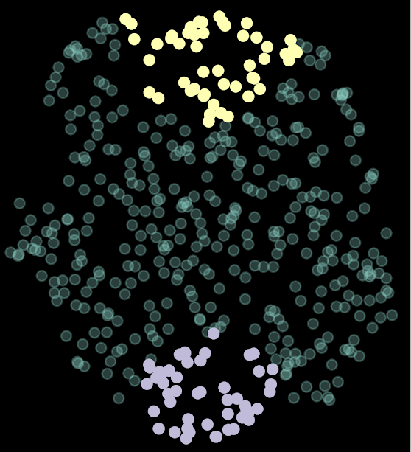
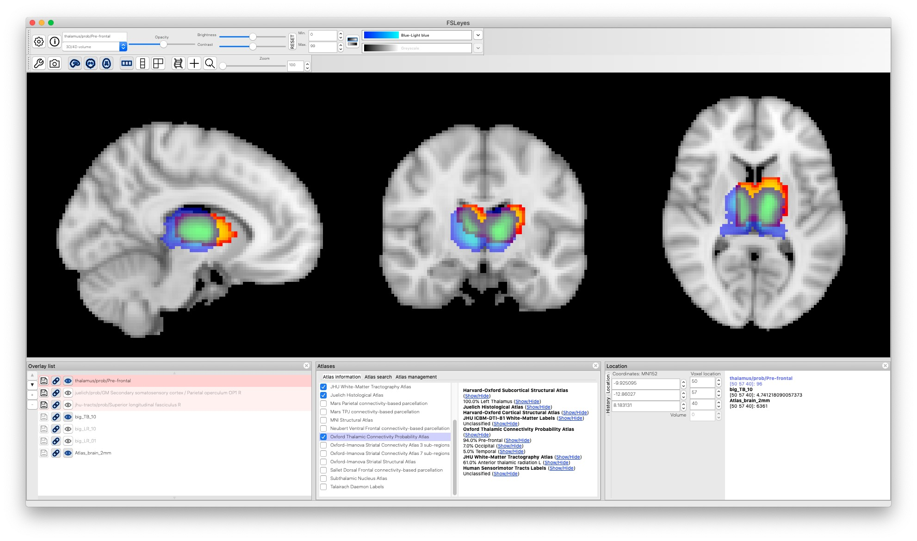
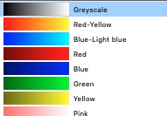
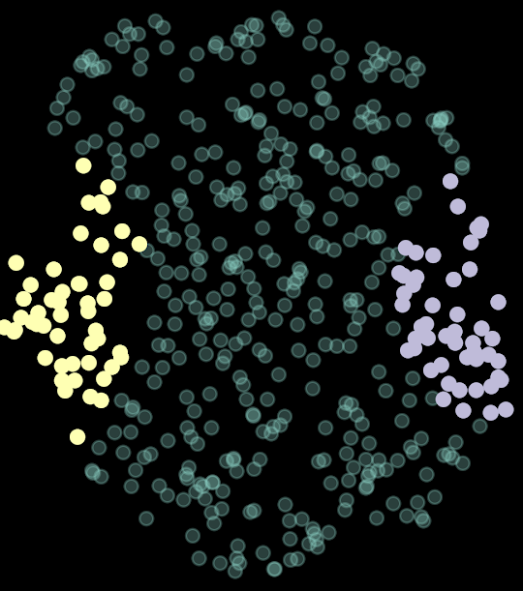
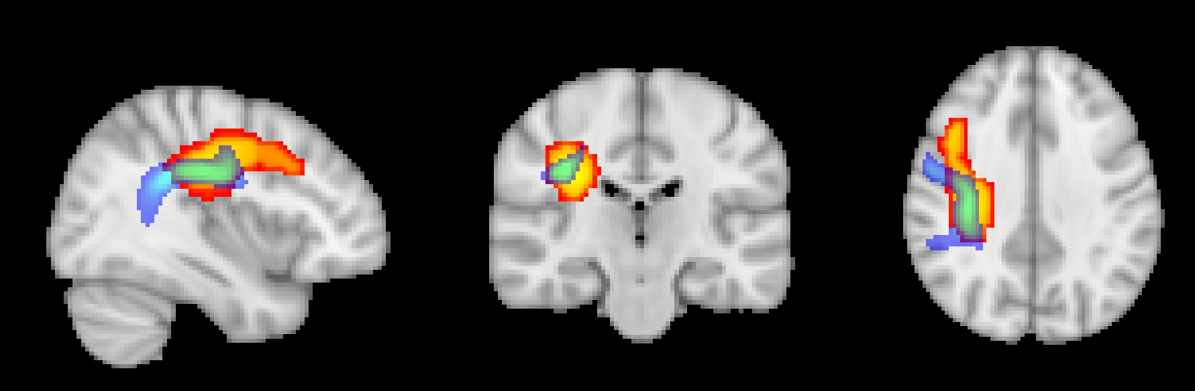
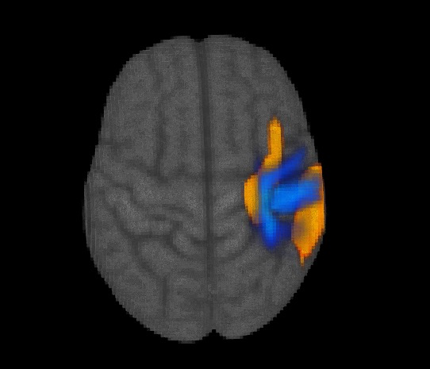
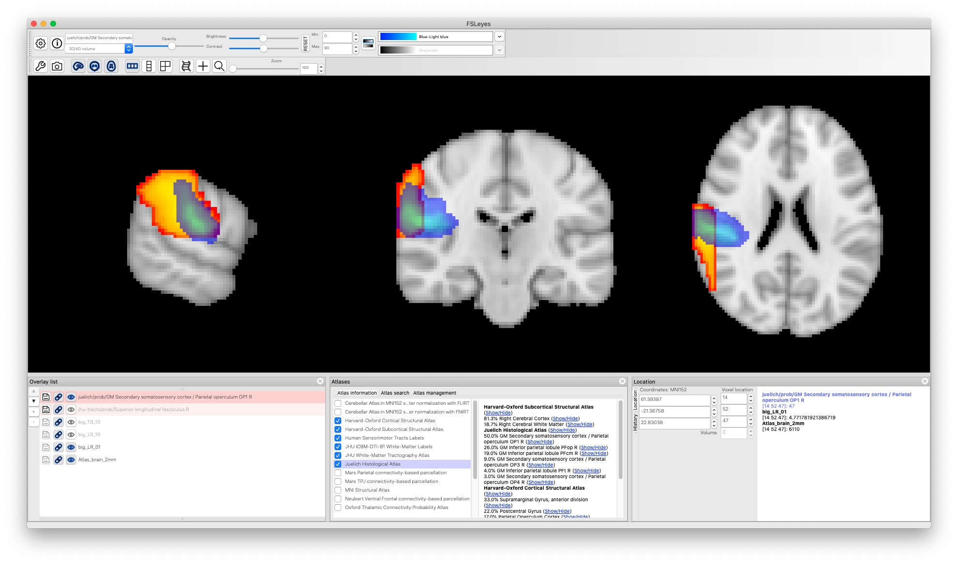
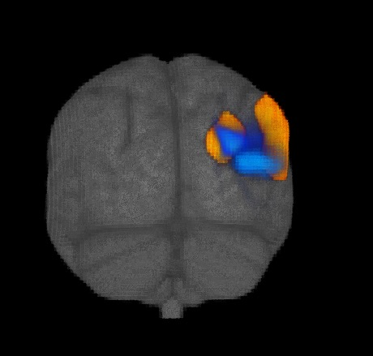
Y dimension
ASD-specific feature space
3
-2
-1
Latent Dim. 2 (UMAP A.U.)
0
1
2
-3
-3
-2
-1
0
1
2
3
Latent Dim. 1 (UMAP A.U.)
Cluster p < .05 (FWE)
Thalamus
t-value
low
high
3.2
4.7
prob.
X dimension
ASD-specific feature space
3
-2
-1
Latent Dim. 2 (UMAP A.U.)
0
1
2
-3
-3
-2
-1
0
1
2
3
Latent Dim. 1 (UMAP A.U.)
low
SLF.
t-value
Cluster p < .05 (FWE)
high
3.2
4.7
prob.
Right > Left
SII
t-value
Cluster p < .05 (FWE)
low
high
3.2
4.9
prob.

