Slide 1
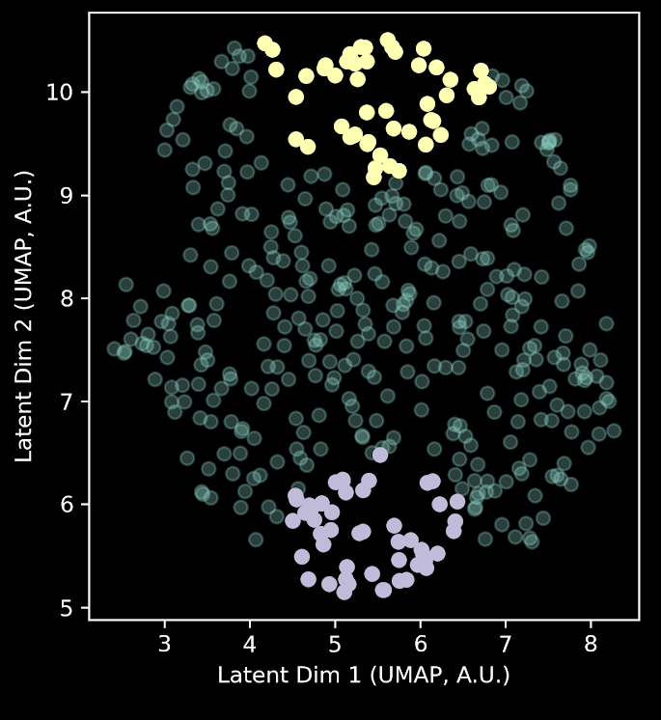
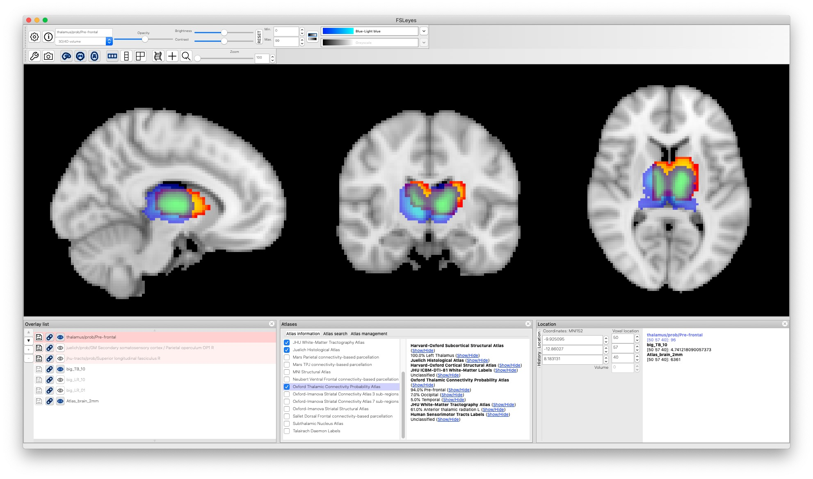
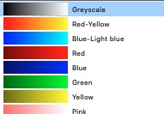
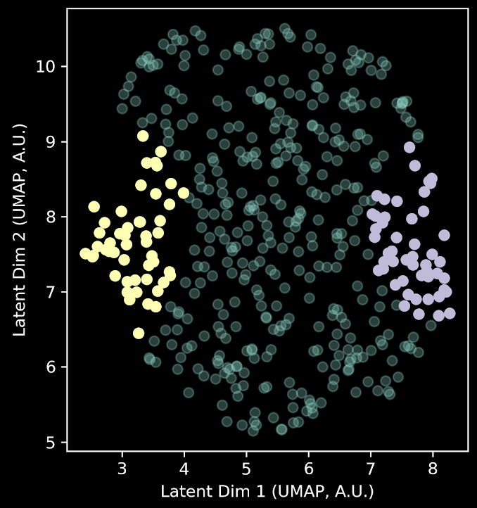
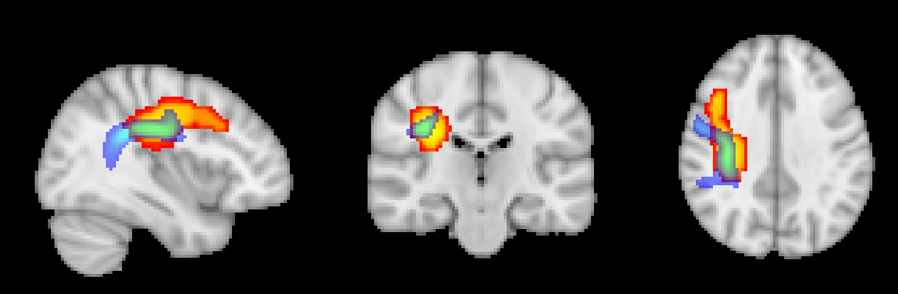
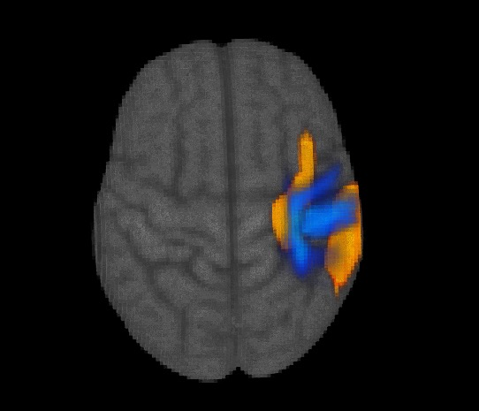
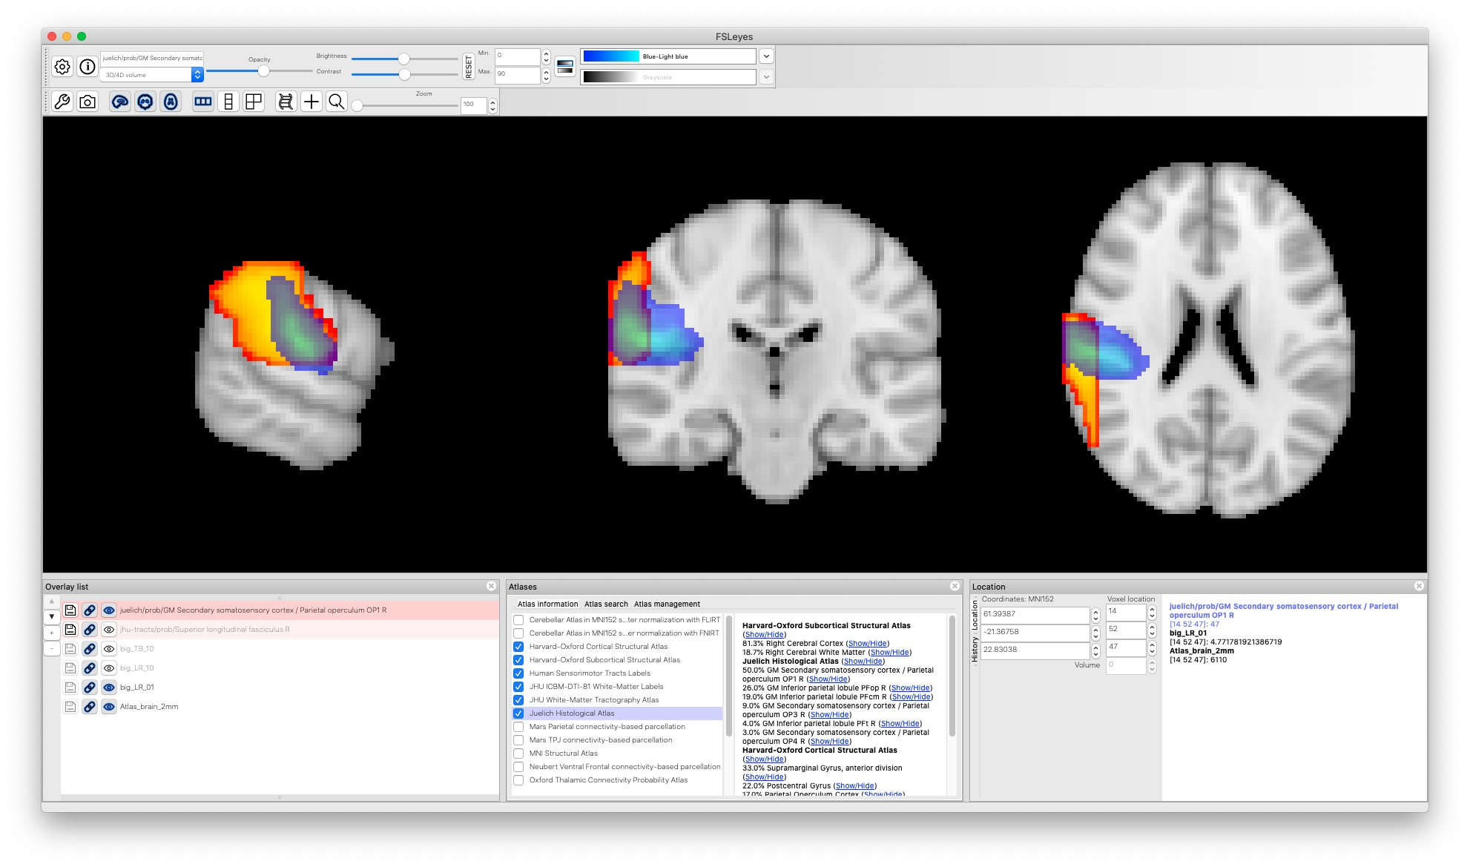
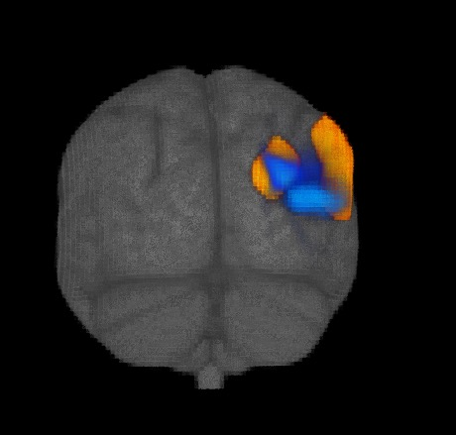
Top vs Bottom
Top > Bottom
ASD-specific feature space
Thalamus
t-value
Cluster p < .05 (FWE)
low
high
3.2
4.7
prob.
Left vs Right
Left > Right
ASD-specific feature space
low
SLF.
t-value
Cluster p < .05 (FWE)
high
3.2
4.7
prob.
Right > Left
SII
t-value
Cluster p < .05 (FWE)
low
high
3.2
4.9
prob.

Slide 2
Left vs Right
Left > Right
ASD-specific feature space
low
SLF.
t-value
Cluster p < .05 (FWE)
high
3.2
4.7
prob.
Right > Left
SII
t-value
Cluster p < .05 (FWE)
low
high
3.2
4.9
Top vs Bottom
prob.
ASD-specific feature space
Top > Bottom
Thalamus
t-value
Cluster p < .05 (FWE)
low
high
3.2
4.7
prob.

