Slide 1
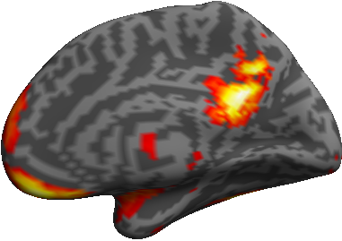
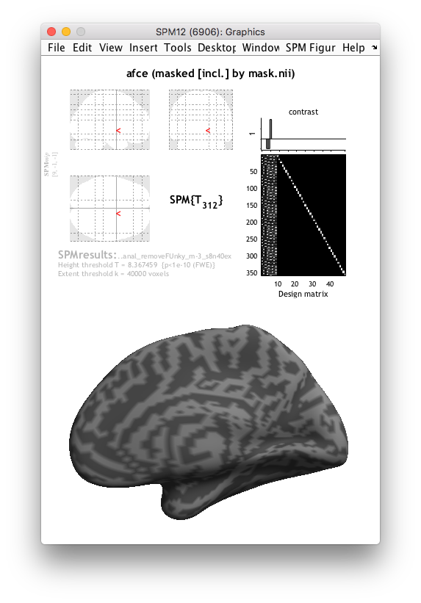
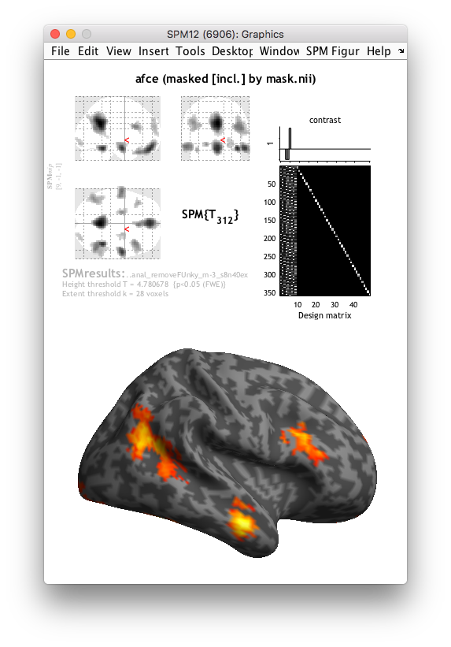
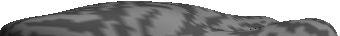
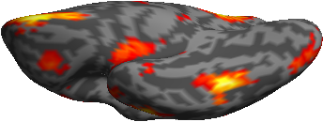
Prec.
vmPFC
IFG
Amyg.
pSTS
ATL
OFC
OFA
FFA
ATFP

Slide 2
Prec.
vmPFC
IFG
Amyg.
pSTS
ATL
OFC
OFA
FFA
ATFP

