Slide 1

Sales strategy needs to change
Online vs Offline sales

Slide 2
Agenda
3 year overview
Offline
Online
Recommendations
Q&A

Slide 3
During 3 years period
Offline
Online
Revenue 108.3 M
Revenue 32.4 M
AOV 28.4 K​
AOV 1.2 K​
Orders 3.8 K​​
Orders 26.7 K​​
Profit -2.3 M
Profit 11.7 M

Slide 4
Offline

Slide 5
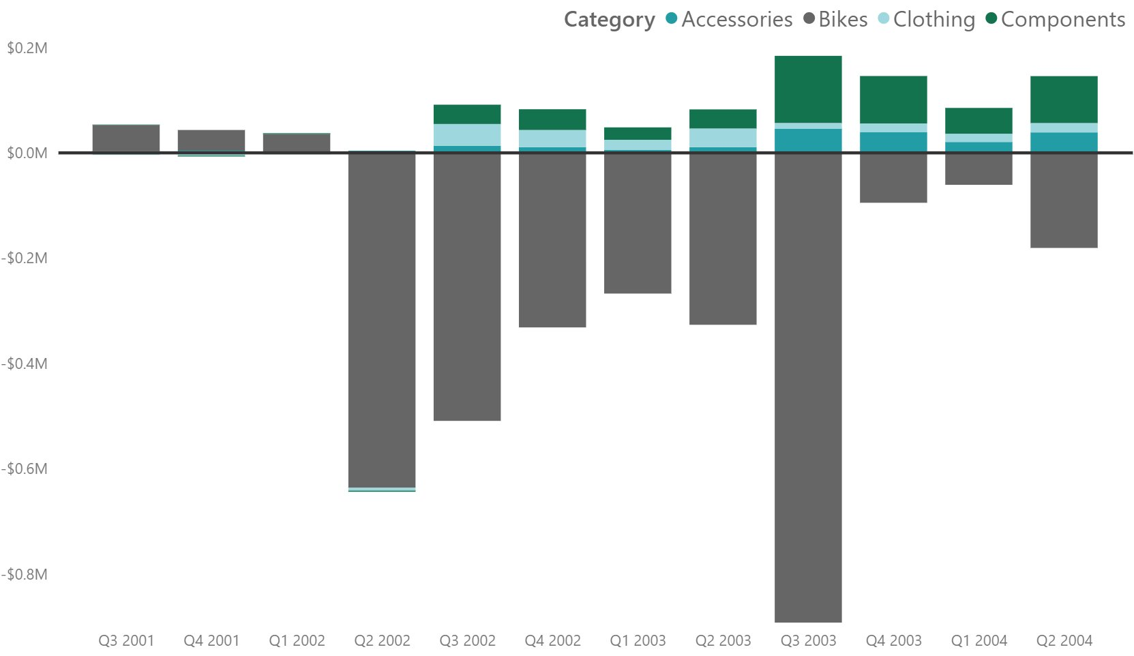
Bikes – reason of negative profit
Not profitable since 2002 Q2.
Bikes caused –3 M in profits.
Mountain bike were only profitable bike line offline.
Road bikes make most of profit losses.
Notes:
Offline

Slide 6
Online

Slide 7
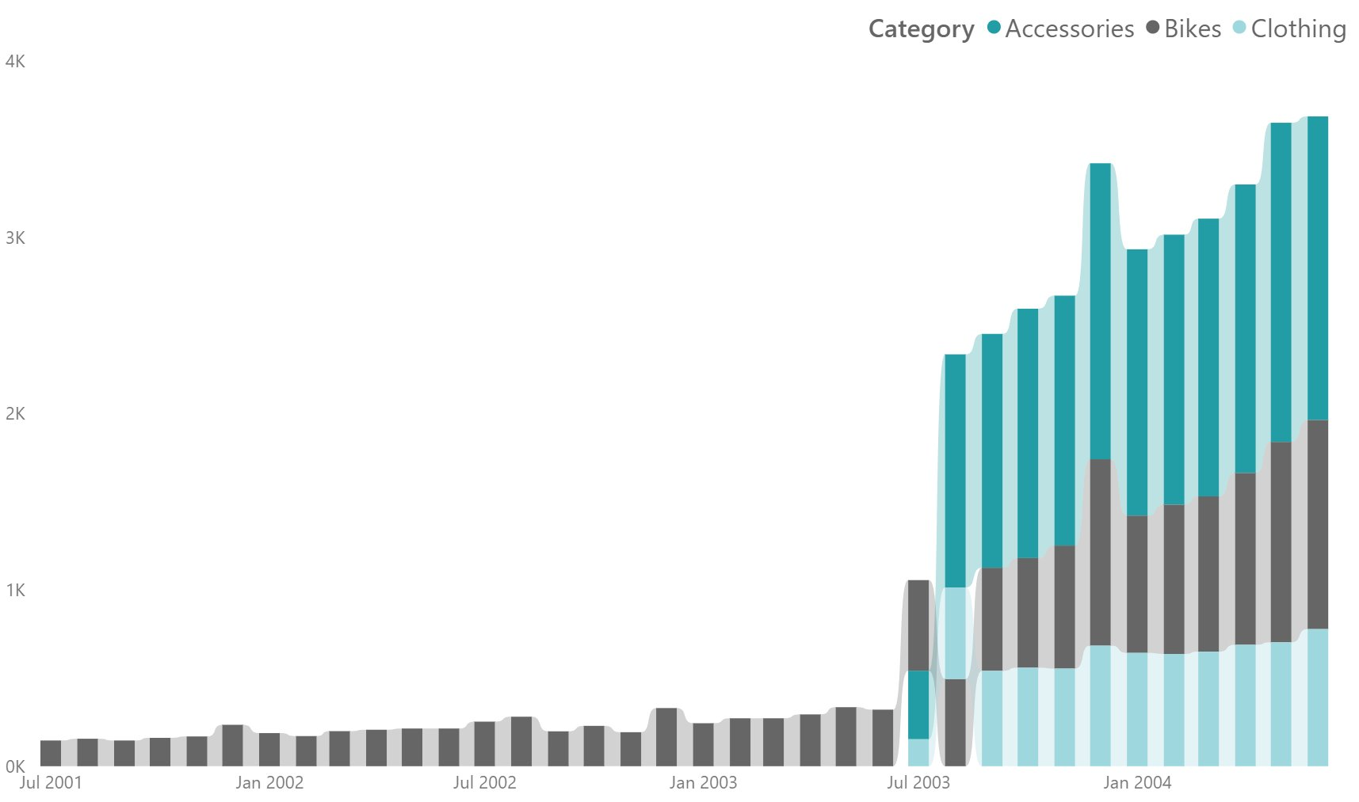
What caused order increase?
In 2003 July new products were introduced.
Most orders were made purchasing accessories.
It bike orders increased well.

Slide 8
What makes online sales profitable?
Price was main reason in all 3 categories.
95% of profit was made from bike orders.
Road bikes made 45% of profit.

Slide 9
What needs to change?

Slide 10
Review sales strategy
Pause selling road and touring bikes offline.
Reevaluating selling bikes via resellers.
Expanding new product categories, like components.
Shifting focus to online market as it's growing and is way more profitable.
Notes:
Offline they cost –2.4 M of profit.
Online these bikes types brought 6.8 M of profit.

Slide 11
Q&A

