Slide 1

Sales strategy needs to change
Online vs Offline sales

Slide 2
Agenda
3 year overview
Offline
Online
Recommendations
Q&A

Slide 3
During 3 years period
Offline
Online
Revenue 108.3 M
Revenue 32.4 M
AOV 28.4 K​
AOV 1.2 K​
Orders 3.8 K​​
Orders 26.7 K​​
Profit -2.3 M
Profit 11.7 M

Slide 4
Offline

Slide 5
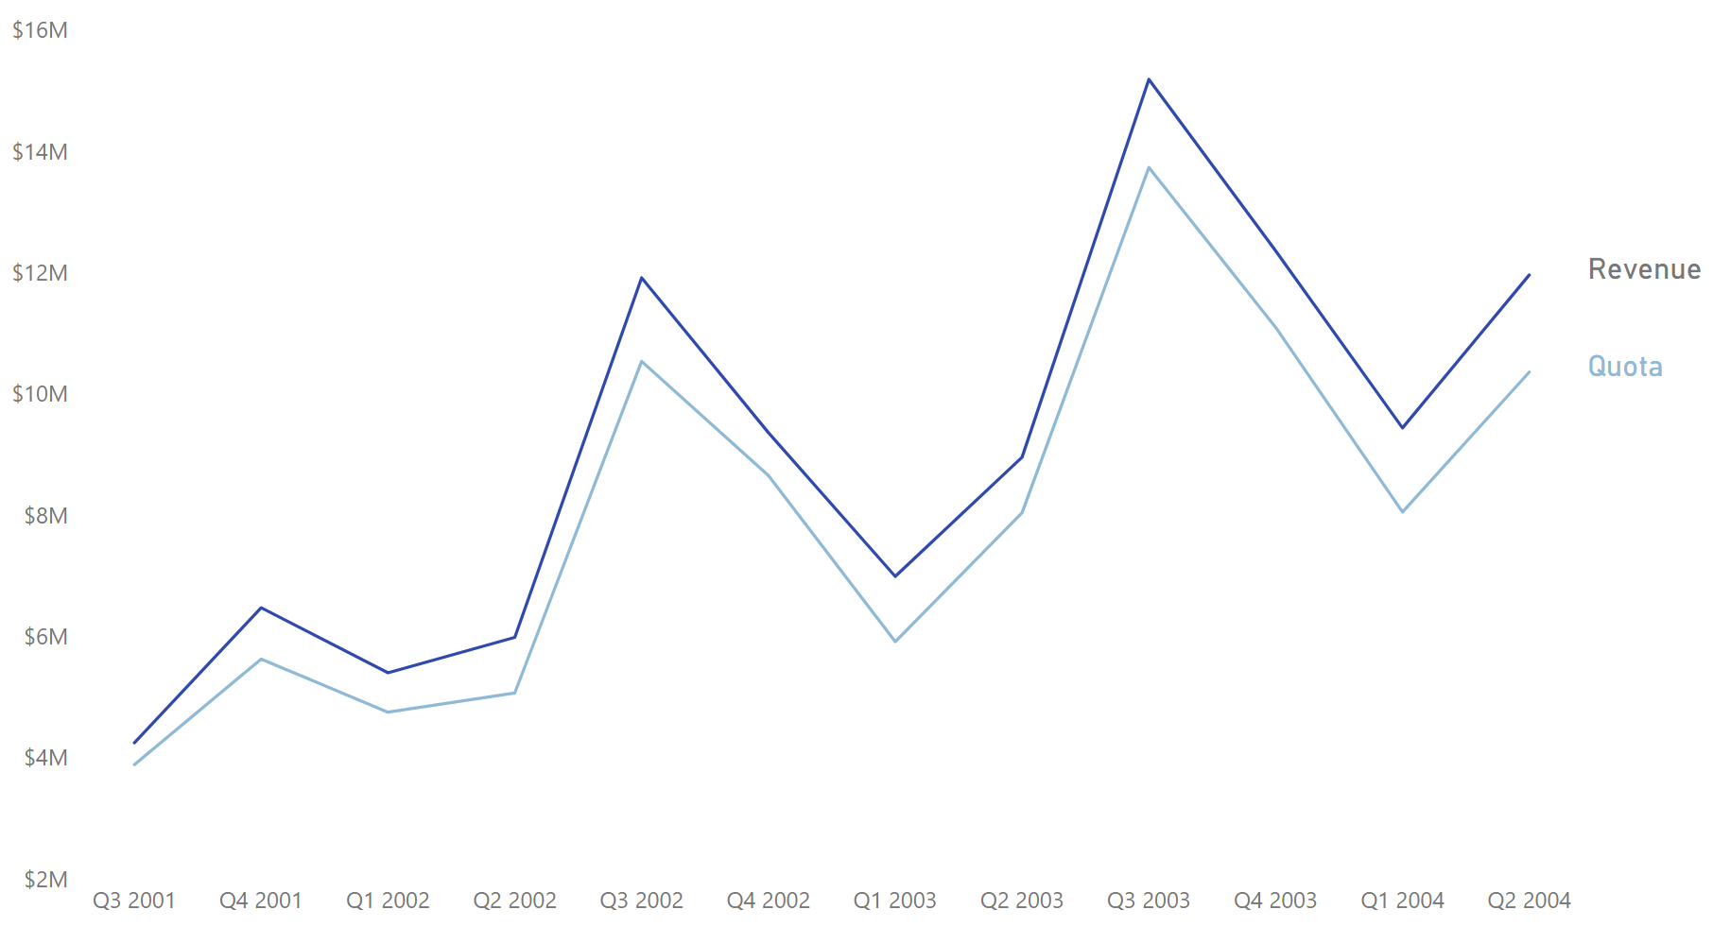
Was quota too ambitious?
It was always met by most.
Biggest increases in quota were in Q3 of 2002 and 2003.
During those quarters company was not profitable.

Slide 6
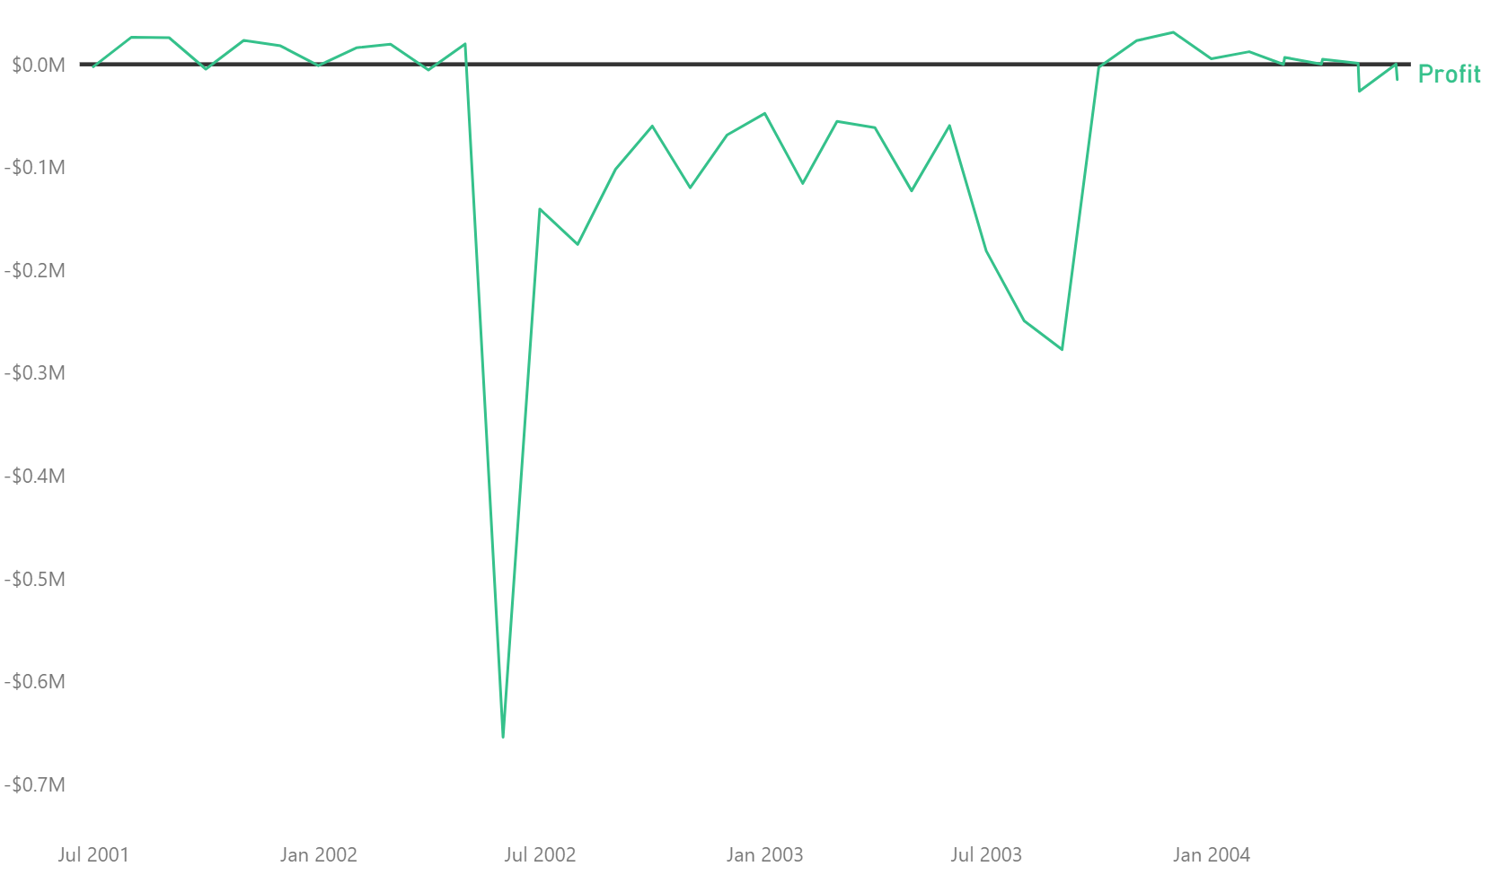
What caused profit dips?
During 2002 June 2 Mountain bike models discontinued.
In 2003 September, 2 new Turing bike models were released.

Slide 7
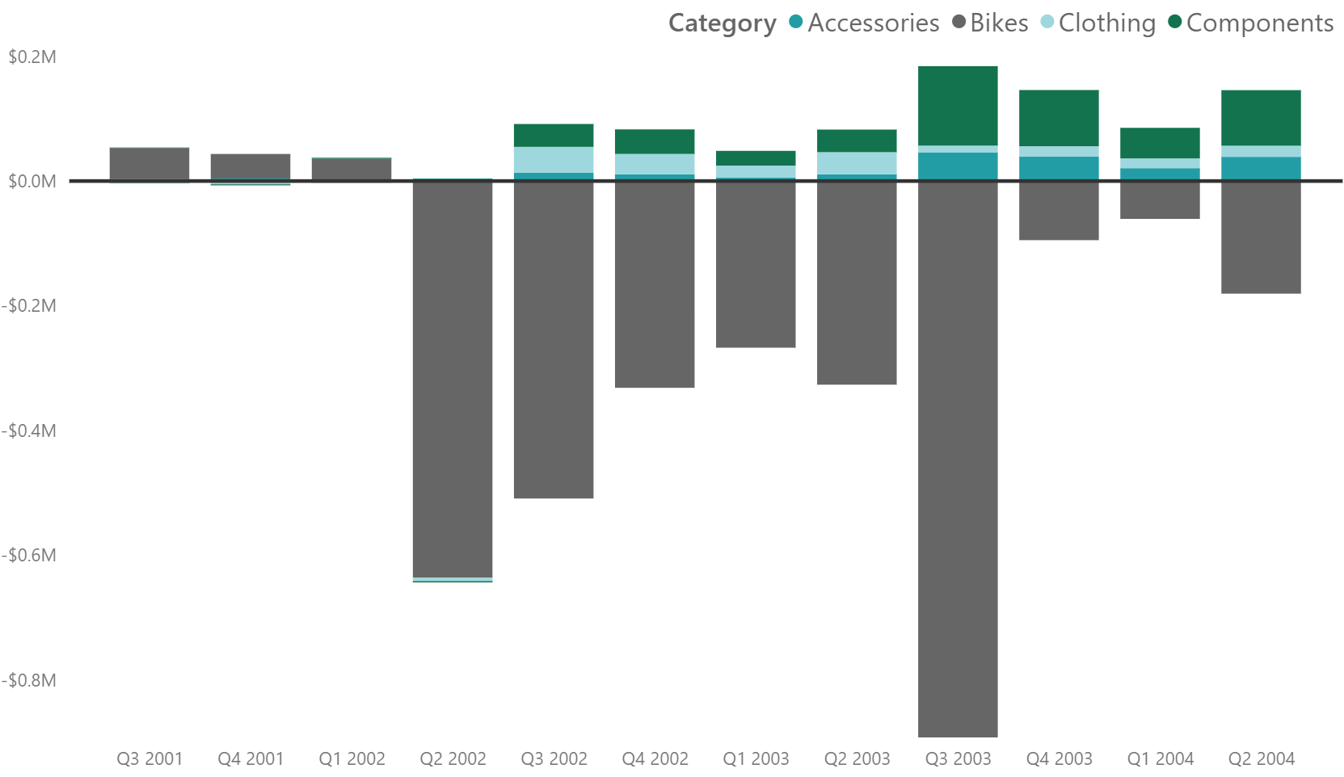
Bikes – reason of negative profit
Not profitable since 2002 Q2.
Bikes caused –3 M in profits.
Mountain bikes were only profitable bike line offline.
Road bikes make most of profit losses.

Slide 8
Online

Slide 9
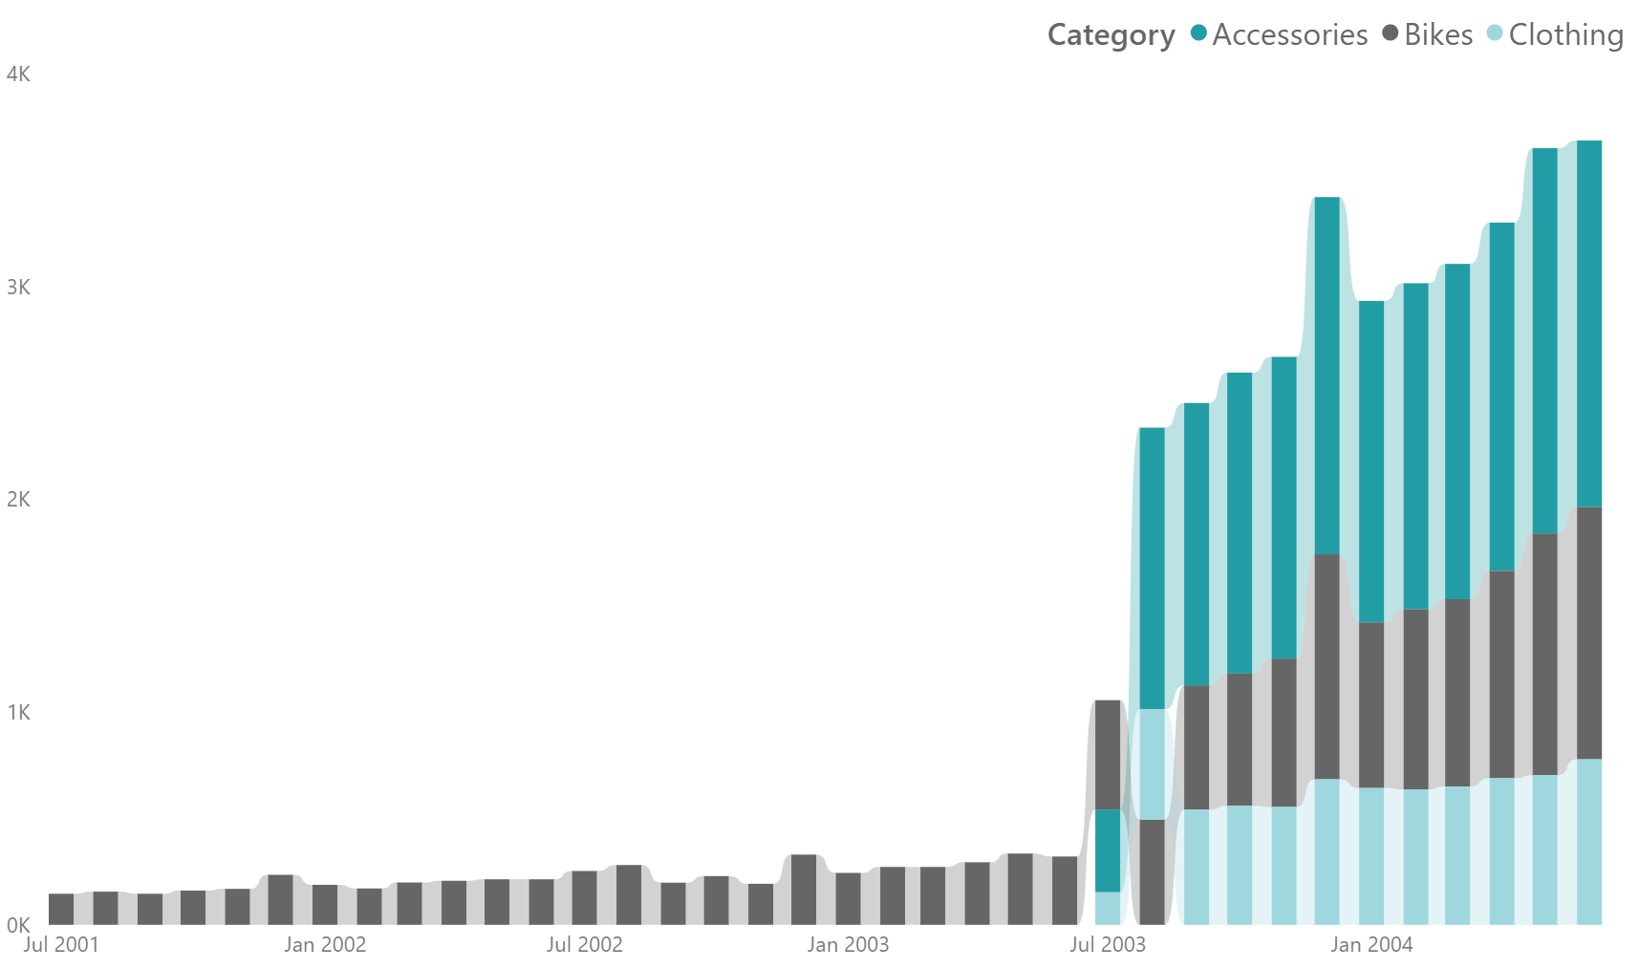
What caused order increase?
In 2003 July new products were introduced.
Most orders were made purchasing accessories.
After it bike orders increased well.

Slide 10
What makes online sales profitable?
Price was main reason in all 3 categories.
Most orders made without using discounts.
95% of profit was made from bike orders.
Road bikes made 45% of profit.
Mountain bikes being close 2nd (37%).

Slide 11
What needs to change?

Slide 12
Review sales strategy
Pause selling road and touring bikes offline.
Reevaluating selling bikes via resellers.
Expanding new product categories, like components.
Shifting focus to online market as it's growing and is way more profitable.
Review and invest in online sales marketing.
Updating our biggest resellers about these changes.
Quota needs to be updated.
Understanding reasons for not meeting quota.
Notes:
Offline they cost –2.4 M of profit.
Online these bikes types brought 6.8 M of profit.

Slide 13
Q&A

