Slide 1

PRESENTED BY-
AGNES LIBISHA GEORGE

Slide 2
Consider a word “Cut”. What exactly does this word mean to you?

Slide 3
If anybody say “cut” to these people………..
Surgeon
(incision)
CUT
Hair Stylist
(hair)
(Condition)
Actor
(stop the scene)

Slide 4
POLYMORPHISM
Definition 1:The condition of occurring in several different forms.
Definition 2: Same action in different forms.

Slide 5
Various ways to achieve polymorphism:
Polymorphism
Compile Time or Static Binding or Method Overloading
Run Time or Dynamic Binding or Method Overriding

Slide 6
METHOD OVERLOADING:
Method name is same but signature is different is called as Method Overloading.
Here, Signature consists of the following:-
a)Number of parameters.
Syntax-class_name.method_name(parameters);
b)Order of parameter.
Syntax-class_name.method_name(parameters1,parameters2);
c)Type of parameter.
Syntax-class_name.method_name(parameters1,parameters2);

Slide 7
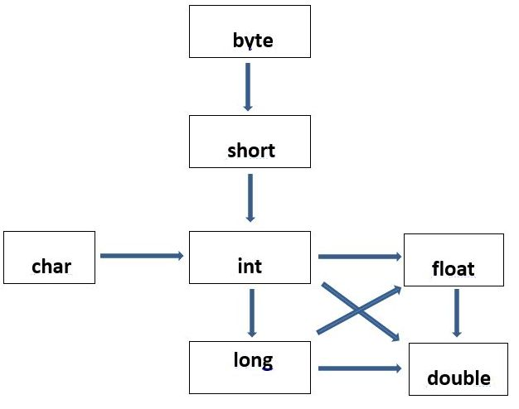
class OverloadingCalculation2
{
void sum(int a,int b)
{
System.out.println("int arg method invoked");
}
void sum(long a,long b)
{
System.out.println("long arg method invoked");
}
public static void main(String args[])
{
OverloadingCalculation2 obj=new OverloadingCalculation2();
obj.sum(20,20);//now int arg sum() method gets invoked
}
}
Type Promotion

Slide 8
METHOD OVERRIDING:
1)Method name is same but different implementation is said to be Method Overriding.
2)To implement this concept first there should be a parent-child relationship using “extends” keyword.
RULES FOR JAVA METHOD OVERRIDING:
1)The method must have the same name as in the parent class
2)The method must have the same parameter as in the parent class.
3)There must be an IS-A relationship (inheritance).

Slide 9
class Vehicle
{
void run()
{
System.out.println("Vehicle is running");
}
}
class Bike2 extends Vehicle
{
void run()
{
System.out.println("Bike is running safely");
}
public static void main(String args[])
{
Bike2 obj = new Bike2();
obj.run();//calling method
}
}

Slide 10
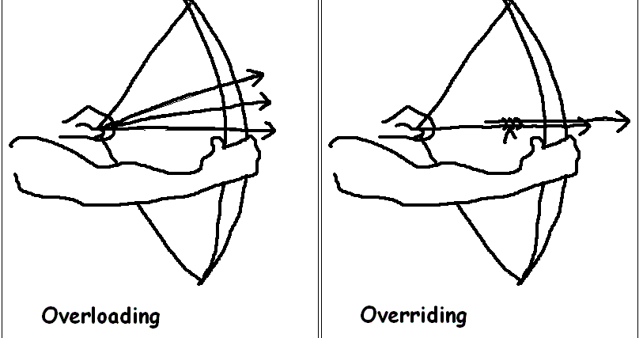
cONCLUSION:

Slide 11

For your valuable time

