Slide 1




Leveraging Meta-path based Context
for Top-N Recommendation
with a Neural Co-attention Model
Binbin Hu¹, Chuan Shi¹, Wayne Xin Zhao², Philip S. Yu³
¹Beijing University of Posts and Telecommunications, Beijing, China
²Renming University of China, Beijing, China
³University of Illinois at Chicago, IL, USA
Notes:
一级标题 36
二级标题 24

Slide 2
CONTENTS
1
Background
2
Proposed Method
3
Experiments
4
Conclusions

Slide 3
CONTENTS
1
Background
2
Proposed Method
3
Experiments
4
Conclusions

Slide 4
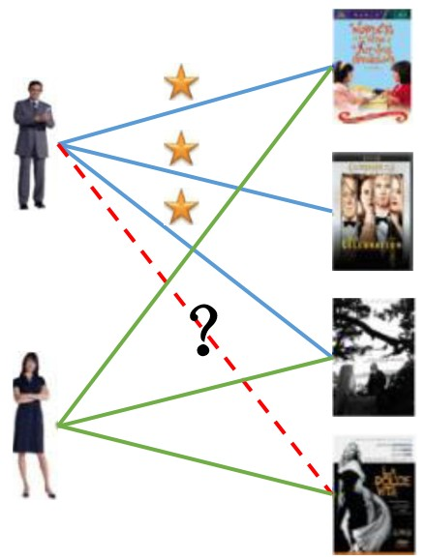


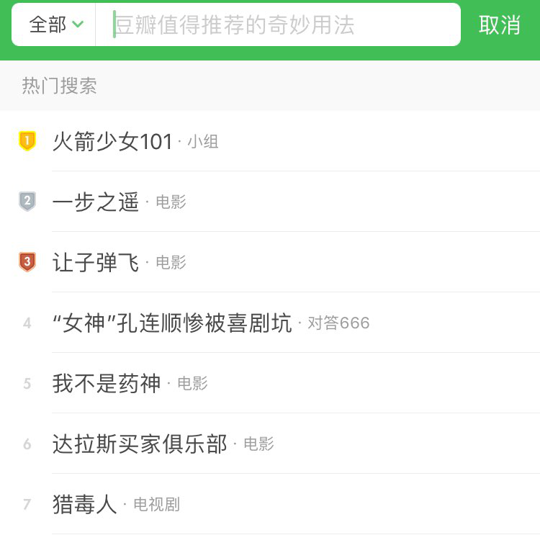
1
Background
Recommender System
Recommendation systems help users discover items of interest from a large resource collection
Recommender systems are everywhere, e.g., Amazon, Quora, Douban
Recommender systems play a pivotal role in various online services

Slide 5
1
Background
Recommendation Methods
Collaborative filtering: a basic recommendation method
Predict the interests of a user by collecting from many other users, e.g. matrix factorization
Suffer from cold-start problem: data sparseness, new users/items
Integrate more auxiliary information
Social network social recommendation
Location location based recommendation
Feature information context based recommendation
Heterogeneous information network is a promising way to integrate auxiliary data.
Notes:
一级标题不要黑体

Slide 6
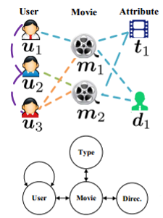
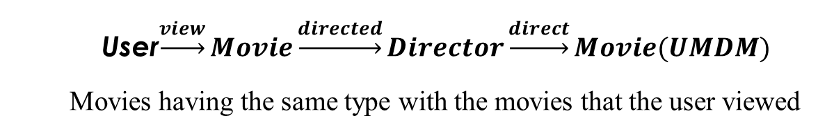
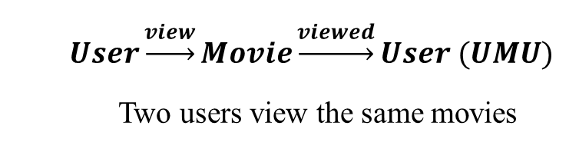
1
Background
Heterogeneous Information Network
Heterogeneous Information Network (HIN)
Include multiple types of nodes or links
Flexible to characterize heterogeneous data
Contain rich semantics
Meta-path
A relation sequence connecting two objects in HIN
Extract structural features
Embody path semantics
$$User\underset{→}{view}Movie\underset{→}{viewed}User (UMU)$$
Two users view the same movies
User$\underset{→}{view}Movie\underset{→}{directed}Director\underset{→}{direct}Movie(UMDM)$
Movies having the same type with the movies that the user viewed
Notes:
UMDM
Movies having the same type with the movies that the user viewed

Slide 7
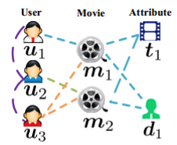
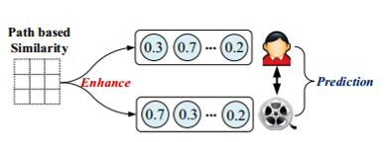
1
Background
HIN based Recommendation
Drawbacks
Representations are not tailored for recommendation
Seldom explicit representation for path/meta-path
Only capture two way user-item interactions, without considering the mutual eﬀect between user, item and path
Existing HIN based methods
Path based semantic relatedness as features for recommendation (e.g., OptRank, SemRec)
Path based similarities for enhancing user/item representations (e.g., HeteRec, FMG)
Notes:
ba

Slide 8
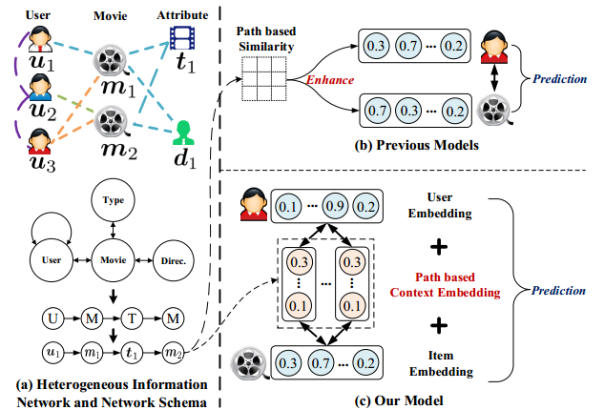
1
Background
Motivation
Our idea
Learn explicit representations for meta-path based context tailored for the recommendation task
Characterize a three-way interaction ⟨user, meta-path, item⟩
Notes:
突出Context embedding

Slide 9
CONTENTS
1
Background
2
Proposed Method
3
Experiments
4
Conclusions

Slide 10
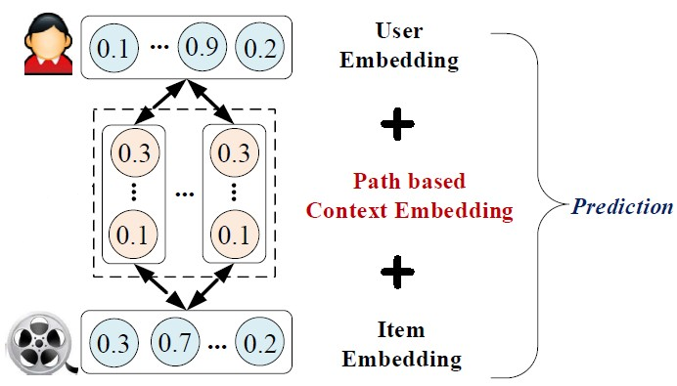
2
Challenges
Key Research Problems
Heterogeneity
Comprehensively and flexibly utilize heterogeneous information
Interpretability
Utilize context semantics for interpretable recommendation
Mutual Effect
Utilize the mutual effect between user-item pair and meta-path based context
Rank
A more useful ranking model for HIN based recommendation
Meta-path based Context for RECommendation (MCRec)
Notes:
换图

Slide 11
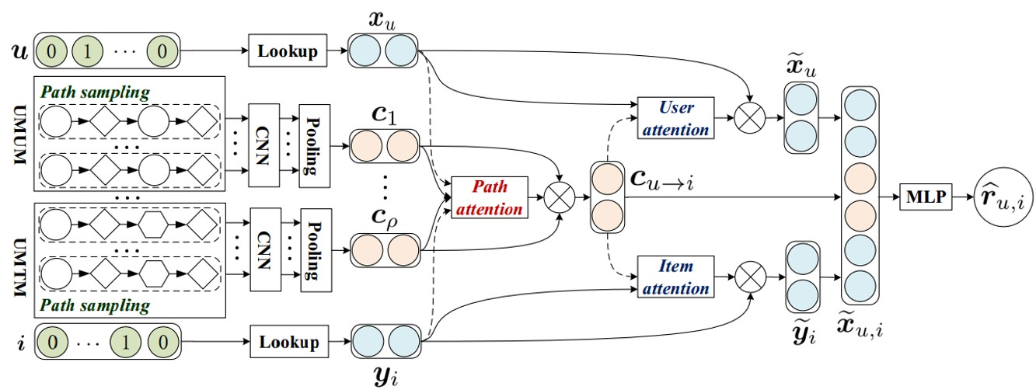
2
MCRec
Overall Framework
Heterogeneity
A flexible deep NN based framework
Interpretability
Mutual Effect
Rank
Meta-path based context embedding
Neural co-attention mechanism
Ranking predication model
Notes:
Heterogeneity -> A flexible deep NN based framework
Interpretability-> Meta-path based context embedding
Mutual Effect-> Neural co-attention mechanism
Rank -> Ranking predication model

Slide 12


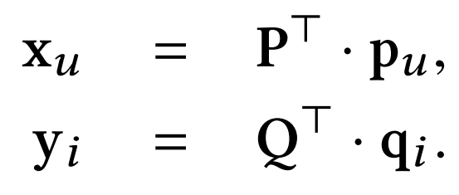
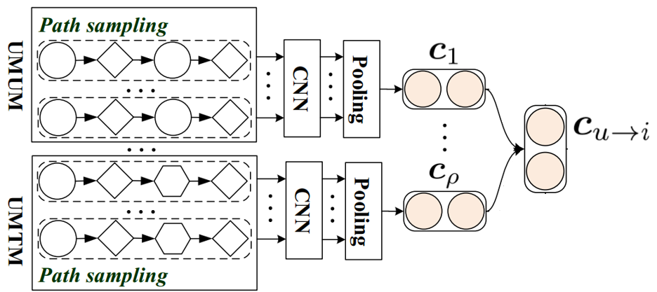


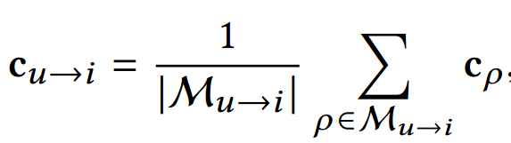
2
MCRec
Embedding Model for user, item and context
User/Item Embedding
Look up
Meta-path based Context Embedding
Priority based Sampling Strategy
SVD/FM for pre-training
Priority based random walk based on meta paths
CNN & Pooling for Encoding Context
Merge
Notes:
详细写一下采样策略

Slide 13
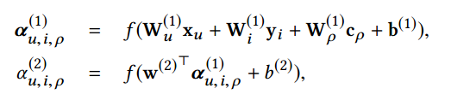
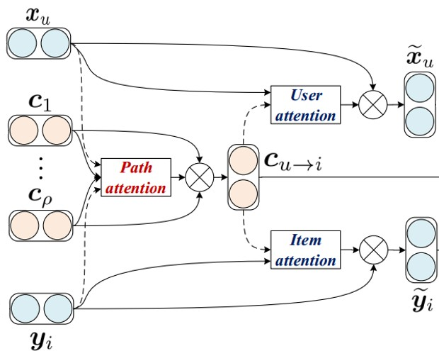




2
MCRec
Embedding Improvement Model
Neural Co-attention Model
Path Attention Part
Attention score
Softmax
Apply
User and Item Attention Part
Attention score
Apply

Slide 14

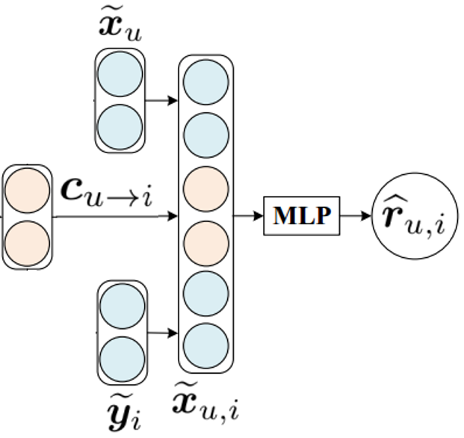
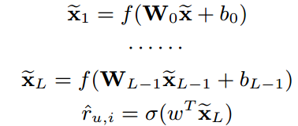

2
MCRec
Ranking prediction Model
Ranking Prediction Model based on MLP
Concatenate
Multi-layer Perceptron
Optimization with negative sampling

Slide 15
2
MCRec
Model Analysis
VS traditional recommendations
Add explicit representation of meta-path based context
Flexibly leverage heterogeneous information

Slide 16
2
MCRec
Model analysis
VS HIN based recommendations
Deep feature exploration with NN
Exploit mutual effect between users, items and context

Slide 17
CONTENTS
1
Background
2
Proposed Method
3
Experiments
4
Conclusions

Slide 18
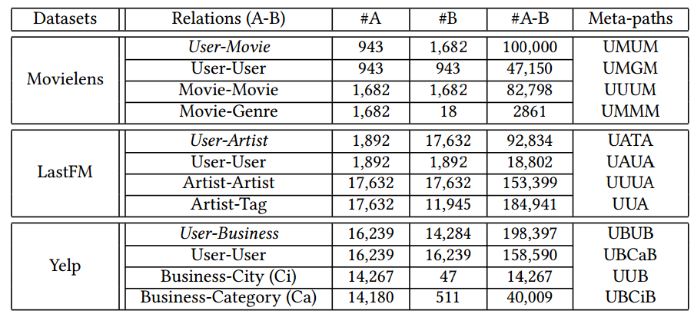
3
Experiments
Datasets and Baselines
Datasets
Metrics
Perc@10
Recall@10
NDCG@10
关键字
Baselines
CF based Methods
HIN based Methods
Our Methods
ItemKNN
SVDFeature_{hete}
MCRec_{rand}
BPR
SVDFeature_{mp}
MCRec_{avg}
MF
HeteRS
MCRec_{mp}
NeuMF
FMG_{rank}
MCRec
Notes:
16&17合并

Slide 19
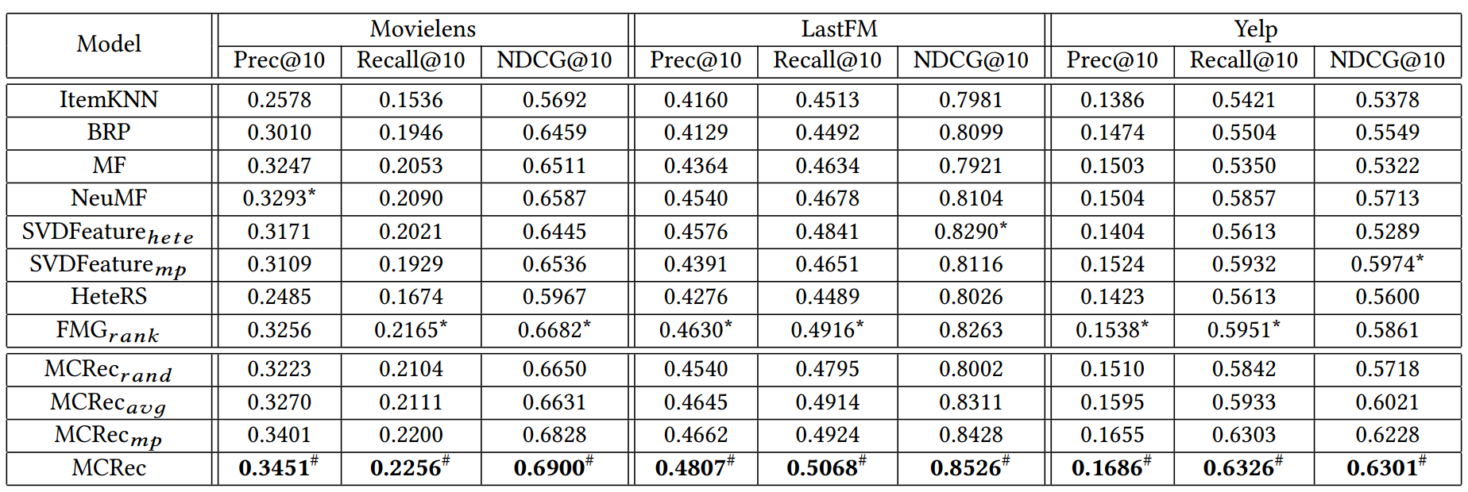
3
Experiments
Effectiveness
关键字
关键字
关键字
MCRec significantly outperforms CF, NN, and HIN based recommendations
Notes:
Our complete model MCRec is consistently better than all the baselines on the three datasets.
Overall performance: MCRec > MCRec_{mp} > MCRec_{avg} > MCRec_{rand}
Most of HIN based methods (SVDFeaturehete, SVDFeaturemp and FMGrank) outperform CF methods (ItemKNN, BPR and MF) in most cases
MCRec significantly outperforms CF, NN, HIN based recommendations

Slide 20
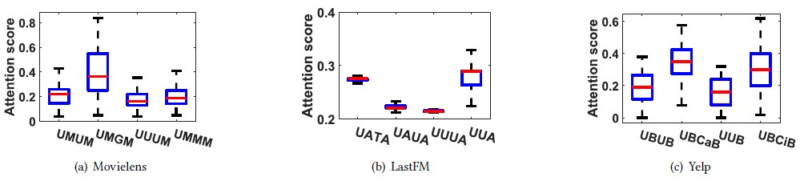
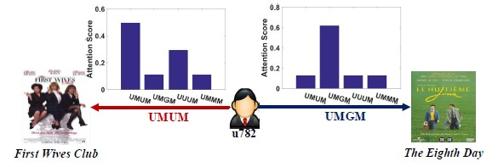
3
Experiments
Qualitative Analysis
Distribution of attention weights
关键字
Case study on Movielens dataset
关键字
关键字
MCRec provides personalized interpretable recommendation

Slide 21
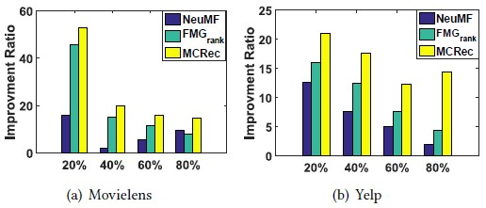
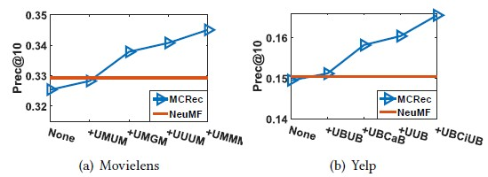
3
Experiments
Detailed Analysis
Cold-start recommendation
关键字
Impact of diﬀerent meta-paths
关键字
关键字
MCRec is promising for cold-start problem

Slide 22
CONTENTS
1
Background
2
Proposed Method
3
Experiments
4
Conclusions

Slide 23
4
Conclusions
We designed a three-way neural interaction model by explicitly incorporating meta-path based context
The co-attention model mutually improved the representations for path based context, users and items
Extensive experimental results have revealed the eﬀectiveness and interpretability of our model
Notes:
字放大

Slide 24
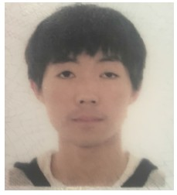


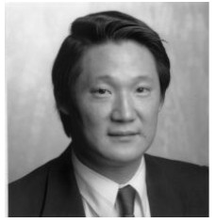


Thanks
Q&A
More materials in www.shichuan.org

