Slide 1
Topology

Slide 2
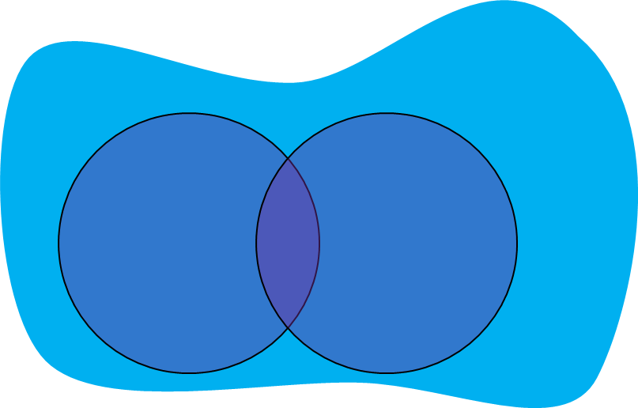
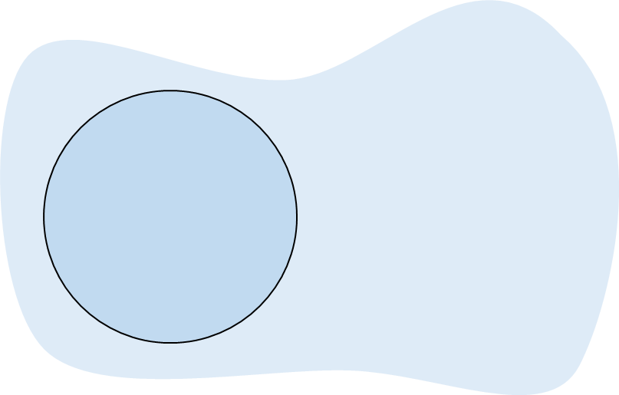

Slide 3
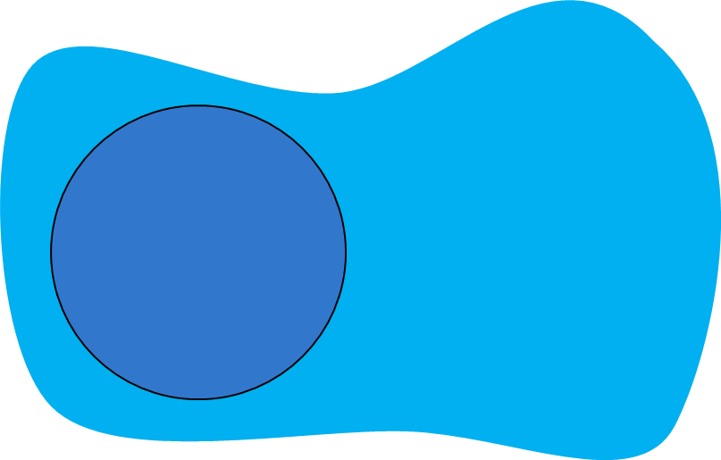

Slide 5
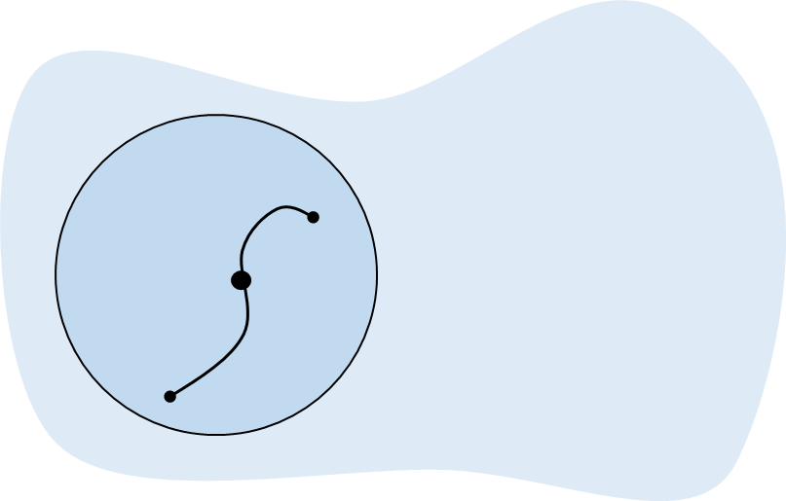




$$b$$
$$0$$
$$t:$$
$$a$$

Slide 6
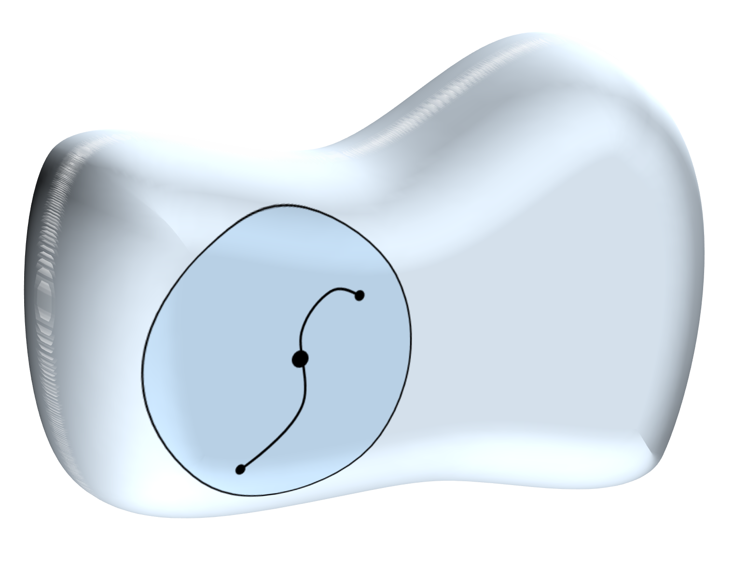
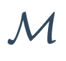

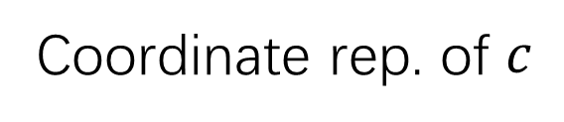








$$b$$
$$c$$
$$0$$
$$c(t)$$
$$t:$$
$$a$$
$$φ$$
$$φ∘c$$
Coordinate rep. of $c$
$$ℝ^{n}$$

Slide 7



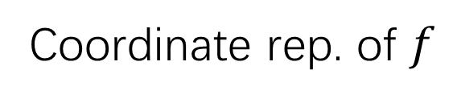





$$ℝ$$
$$f$$
$$f∘φ^{−1}(p)$$
$$p$$
$$φ$$
$$f∘φ^{−1}$$
$$ℝ^{n}$$
Coordinate rep. of $f$
$$\vec{x}(p)$$

Slide 8



$$ℝ$$
$$b$$
$$X$$
$$c$$
$$f$$
$$f∘φ^{−1}(p)$$
$$0$$
$$t:$$
$$c(0)$$
$$a$$
$$φ$$
$$φ∘c$$
$$f∘φ^{−1}$$
Coordinate rep. of $c$
$$ℝ^{n}$$
Coordinate rep. of $f$
$$\vec{x}(p)$$

Slide 9
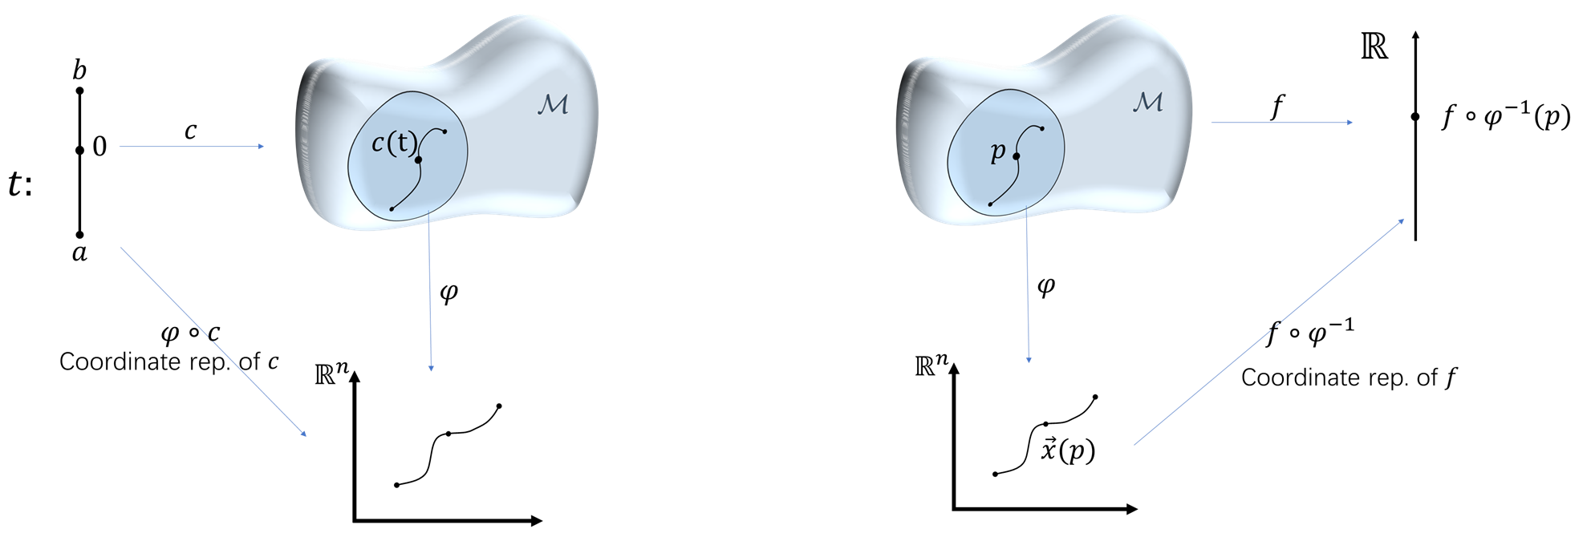
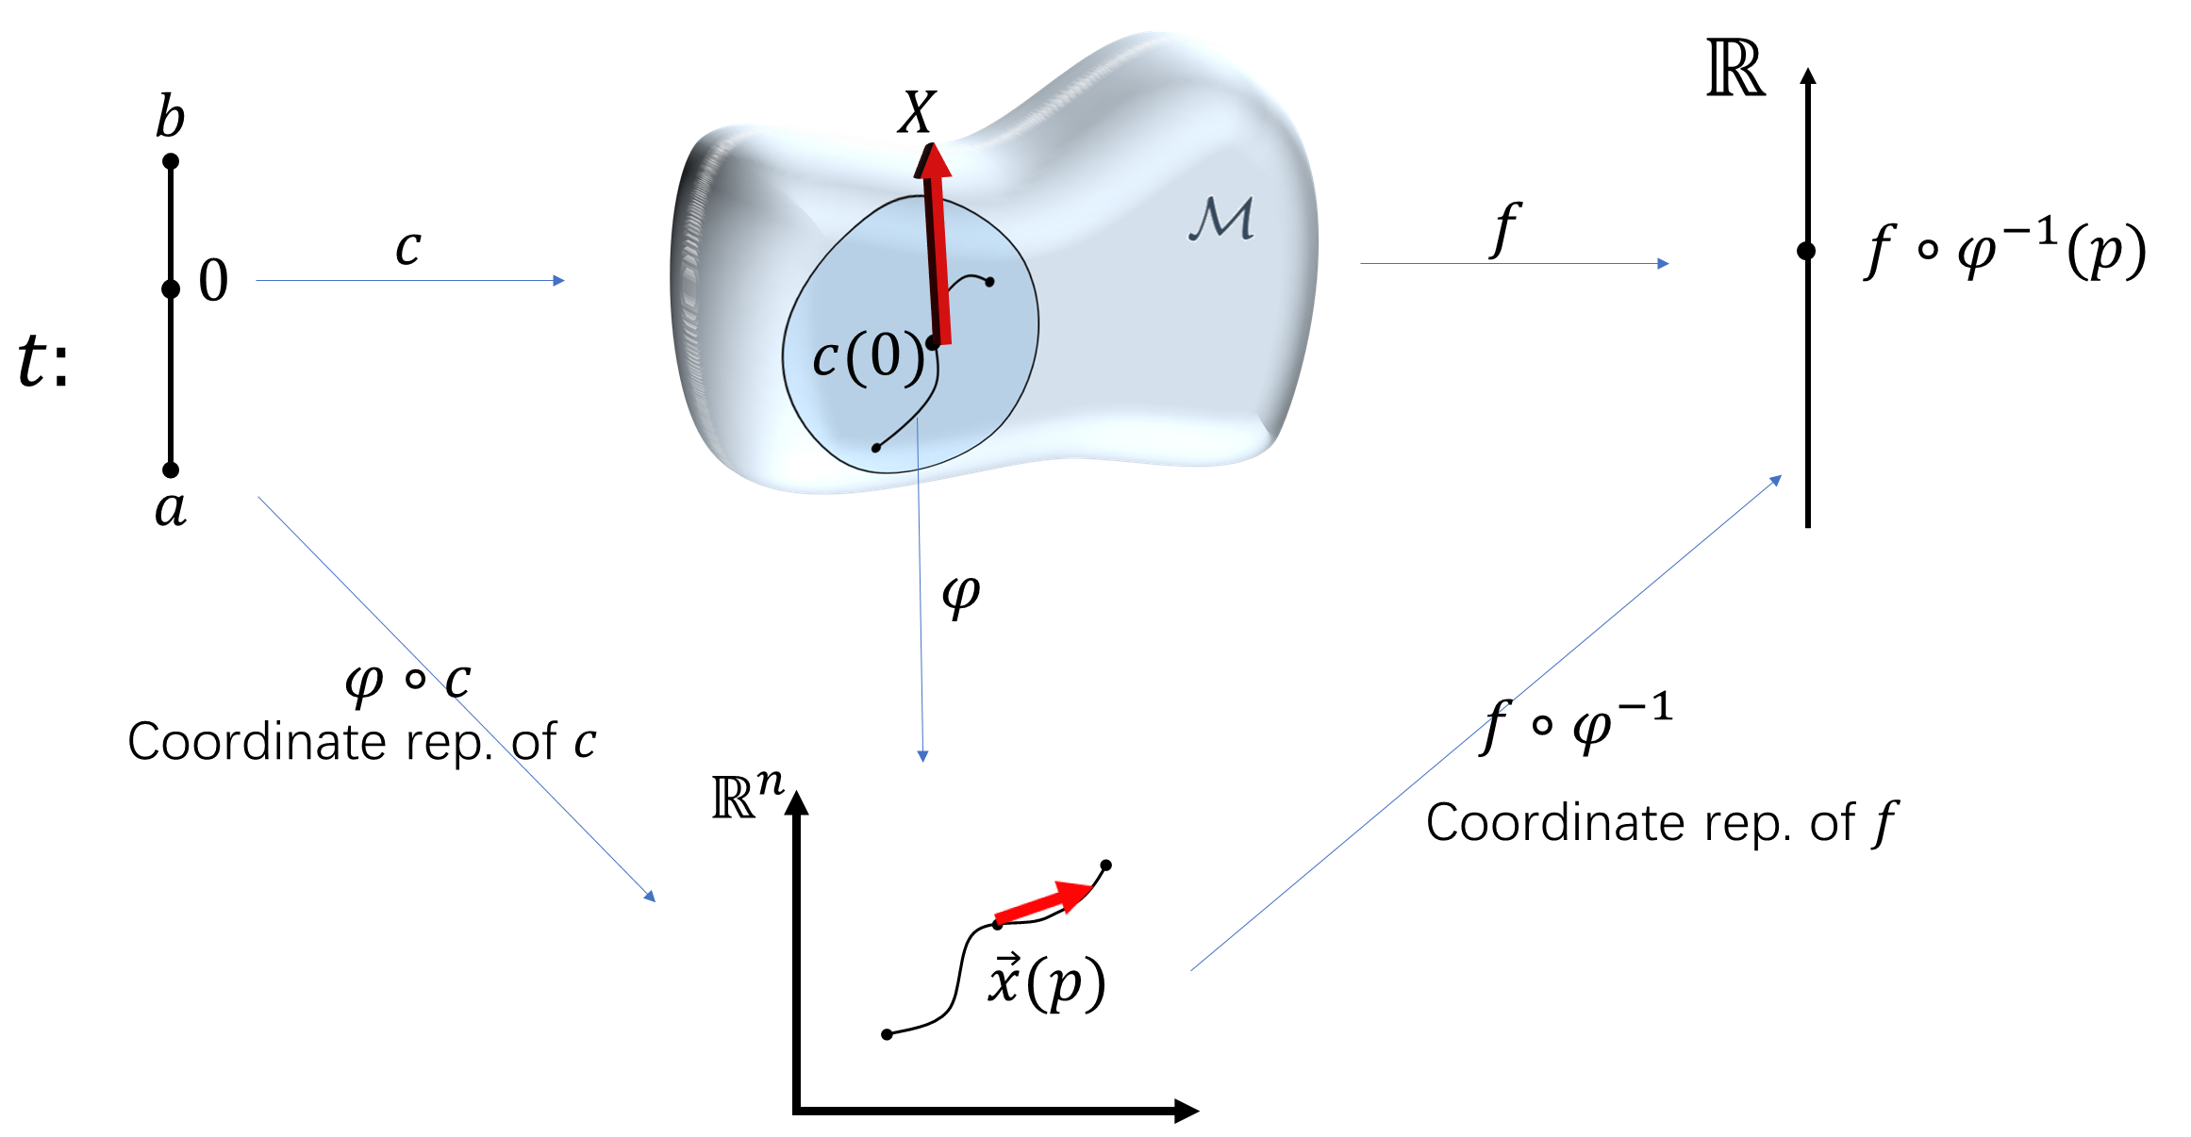

Slide 15
